Slide 1
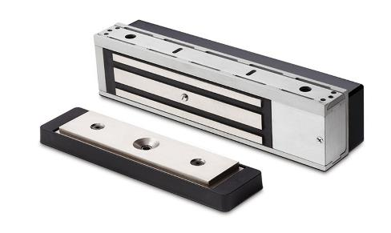
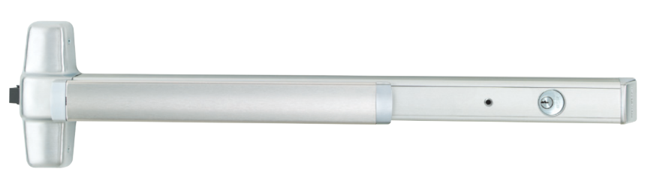
Delayed Egress Locks Q&A
PUSH UNTIL ALARM SOUNDS
DOOR CAN BE OPENED IN 15 SECONDS
Notes:
Last month, a question was left in the chat about some of the more complicated delayed egress applications, so I thought we’d do a little Q&A this month. If there are additional questions you can put them in the chat.

Slide 2
Where are delayed egress locks permitted?
PUSH UNTIL ALARM SOUNDS
DOOR CAN BE OPENED IN 15 SECONDS
Notes:
The question that most often affects specwriters is where these locks are permitted. The purpose is to deter egress for 15 seconds, or 30 seconds where approved by the AHJ, and they are not allowed in every use group.

Slide 3
International Building Code (2024)
1010.2.12 Delayed egress. Delayed egress electrical locking systems shall be permitted on doors in the means of egress serving the following occupancies in buildings that are equipped throughout with an automatic sprinkler system in accordance with Section 903.3.1.1 or an approved automatic smoke or heat detection system installed in accordance with Section 907.
1. Group B, F, I, M, R, S and U occupancies.
2. Group E classrooms with an occupant load of less than 50.
3. In courtrooms in Group A-3 and B occupancies, delayed egress electrical locking systems shall be permitted to be installed on exit or exit access doors, other than the main exit or exit access door, in buildings that are equipped through-out with an automatic sprinkler system in accordance with Section 903.3.1.1.
Notes:
This section is from the 2024 IBC…I don’t think it has changed since the 2018 edition. It states here that the building must have a sprinkler system or smoke or heat detection system. If the building does not have one of those systems, the delayed egress lock can not be installed.
Here it lists the use groups where the I-Codes permit delayed egress locks, along with 2 that were added in the 2018 edition.

Slide 4
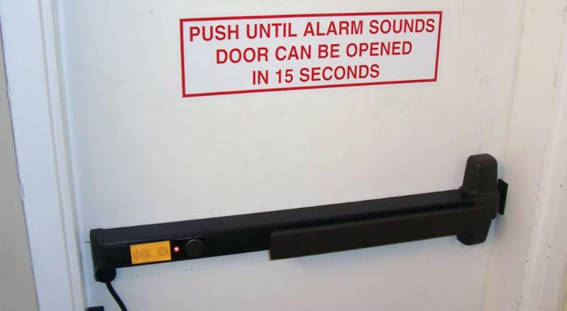
IBC
Business, Factory, Institutional, Mercantile, Residential, Storage, Utility
Group E Classrooms – calculated occupant load <50
Courtrooms with a sprinkler system – secondary exits
Notes:
These are the use groups…prior to the 2018 edition, delayed egress locks were not allowed by the I-Codes in any assembly or educational occupancies. The 2018 edition was changed to permit delayed egress locks on classroom doors in educational occupancies if the calculated occupant load is less than 50 (watch out for large classrooms like for kindergarten – a classroom of 1,000 square feet will typically have a calculated occupant load of 50). Courtrooms are often assembly occupancies, and in these areas delayed egress locks are permitted on other than the main entrance/exit but only if the building has a sprinkler system.
The changes related to classrooms and courtrooms can help with problems of elopement in schools, and access to the judge and jury areas in courthouses.

Slide 5
NFPA 101, Life Safety Code (2024)
7.2.1.6.1.1 Approved, delayed-egress electrical locking systems shall be permitted to be installed on door assemblies serving low- and ordinary-hazard contents in buildings protected throughout by an approved, supervised automatic fire detection system in accordance with Section 9.6 or an approved, supervised automatic sprinkler system in accordance with Section 9.7, and where permitted in Chapters 11 through 43, provided that all of the following criteria are met.
Notes:
NFPA 101 is less restrictive, stating that the building has to be of low or ordinary hazard contents. A fire detection system or sprinkler system is required, and the occupancy chapter has to permit delayed egress locks.

Slide 6
NFPA 101
Not permitted on the main entrance/exit doors serving assembly occupancies
Prohibited on airport jetway doors
Lodging or rooming houses can only have one door with a delayed egress lock per escape path
Residential board and care facilities are permitted to have delayed egress locks only on exterior doors
Notes:
These are the exceptions where the occupancy chapters have restrictions.

Slide 7
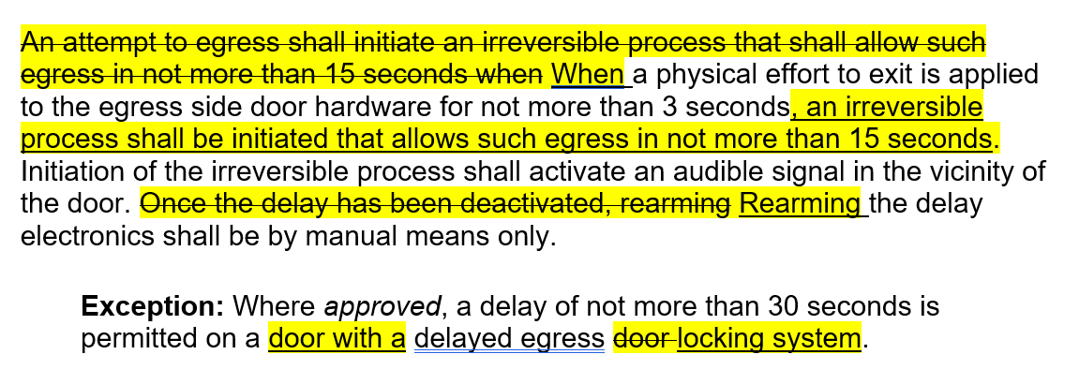
Can manual rearm be done remotely (w/camera)?
Notes:
This question just came up and I wrote a post on iDH about it. This is the revised section for the 2027 edition, as we were trying to address a misinterpretation from an AHJ who said that the alarm can not be stopped by rearming the device while the alarm is sounding. Here you can see that rearming the delay has to be by manual means but no other specifications are given.
Note: Prior to the IBC, the BOCA code allowed these doors to automatically rearm after opening, closing, and staying closed for 30 seconds.

Slide 8
Can manual rearm be done remotely?
IBC Commentary: Once the door is openable from the egress side at the end of the delay, it remains openable, allowing immediate egress until someone comes to the door and manually rearms the delay. The first user to the door may face a delay, but after that, other users would be able to exit immediately. Automatically rearming the delayed egress electrical locking system from a remote location such as a central control station or security office is not permitted.
Notes:
IMO the rearm does not have to be done with a key – an electronic credential could be used to rearm the device (an AHJ might have a different opinion). But the question that arose recently was whether someone at a security desk could turn on a camera to look at the area near the door, and then rearm the delayed egress lock remotely. The IBC Commentary says no, although the code is not clear.

Slide 9
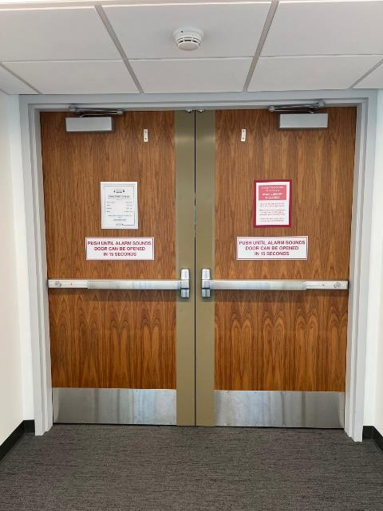
Does activation of one delayed egress lock on a pair require the other lock to be activated?
There is nothing in the model codes that states this, but an AHJ could require it.
Gang Bus Option: Up to 8 Chexit devices can be connected together using the gray (GNG) wires, allowing them to act as a single system.
Notes:
The model codes would permit two delayed egress locks to operate independently, although Chexits could be wired so that both delays are initiated at the same time using the gang bus option.

Slide 10
Can two delayed egress locks be installed in one means of egress (in series)?
IBC: The egress path from any point shall not pass through more than one delayed egress locking system
Exceptions:
Group I-1, Condition 2, Group I-2 or I-3 – not more than two with a combined delay of 30 seconds, max.
Group I-1, Condition 1 or Group I-4 occupancies – not more than two with a combined delay of 30 seconds, max. – automatic sprinkler system required
Notes:
This option could also be used when there are two delayed egress locks in a path of egress, like one leading into the stairs and one on the exit discharge at ground level. Initiating the delay timer on the upper level could start the time on the discharge door. The IBC used to say that there could be only one delay before entering an exit (like a stairwell) but now it says one delay per egress path. I just wrote a post on iDigHardware about this application.
The I-Codes do include exceptions for some institutional occupancies, where two delayed egress locks can be installed in a means of egress, with a combined delay of 30 seconds, maximum.
NFPA 101 does not restrict the number of delayed egress locks per egress path except in lodging or rooming houses (one per escape path).

Slide 11
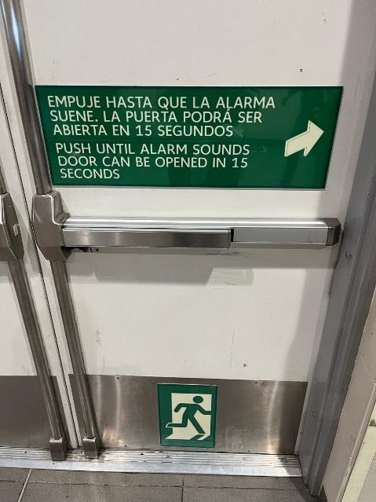
Where does the signage have to be installed?
I-Codes: Above and within 12 inches of the door exit hardware, and must comply with the visual character requirements of ICC A117.1. In Group I – institutional occupancies, the AHJ may allow signage to be omitted for certain types of treatment areas.
NFPA: Located on the egress side of the door adjacent to the release device. Must be readily visible, durable, with letters not less than 1-inch high and 1/8-inch stroke with a contrasting background.
Notes:
The signage is required to say “Push until alarm sounds. Door can be opened in 15 seconds” (or 30 seconds if approved by the AHJ. If the door is inswinging, the sign will say “Push until alarm sounds…”
The I-Codes require the signage above and within 12 inches of the releasing hardware – this may sometimes conflict with a vision panel and in that case I’ve seen the signage below the device.
The wording is the same for NFPA 101, but the sign has to be on the egress side adjacent to the release device.
The model codes do specify requirements for the size of the characters – this is important if the signage supplied with the device will not be used.
The I-Codes permit the signage to be omitted where approved (by the AHJ) in Group I occupancies, where care recipients
who because of clinical needs require restraint or containment as part of the function of the treatment area.

Slide 12

Resources
Locksmith Ledger article (also one on controlled egress)
WWYD? Rearming a delayed egress lock
Infographic
Whiteboard animation video
iDigHardware.com/ACE
Notes:
There are lots of resources available on delayed egress – the links are all on the ACE page along with these slides.

Slide 13

We take requests!
What do you want to learn about?
Want to write a guest post for iDigHardware?
Notes:
What code questions would you like to see addressed in this call?
We are looking for guest posts for iDigHardware!

