Slide 1


Lori Greene
DAHC/CDC, FDAI, FDHI
Allegion – Manager,
Codes & Resources
iDigHardware.com
Code Update
Mark A. Kuhn
AOC, FDHI, DHT, DHC, CFDAI, CDT, CSI
Allegion - Architectural
Consultant
Notes:
Reminder that we will be doing these quick code updates each month, with a brief overview of the code change or requirement, and links to additional resources.
Put questions in the chat.
Upcoming code changes can sometimes be used as clarifications or requests for AHJ approval even before adoption.

Slide 2



IBC – Group A, Assembly
303.1.3 Associated with Group E occupancies. A room or space used for assembly purposes that is associated with a Group E occupancy is not considered a separate occupancy.
303.1.4 Accessory to places of religious worship. Accessory religious educational rooms and religious auditoriums with occupant loads of less than 100 per room or space are not considered separate occupancies.
303.1.5 Special amusement areas. Special amusement areas shall comply with Section 411.
What does
this mean??
Notes:
Revisiting the question from last month about whether the auto operator requirements for assembly occupancies apply to schools. I had a call with ICC staff and they are hesitant to require auto operators on doors serving assembly spaces like libraries and cafeterias, although they agreed with auto operators on doors serving theaters and gymnasiums.
As I said last month, it all depends on how the space is classified – Group A (requires operators if the calculated occupant load is 300+) or Group E (does not require operators if the door can be manually operated as required by the codes and standards). I think we may see a clarification in the 2030 IBC.

Slide 3

On an egress door, the architect wants a mag-lock that is controlled on both sides by a card reader. When would this be permitted?
This is ok if the fire alarm unlocks the lock for egress.
This would be allowed on a memory care unit.
This is not permitted by the model codes.
Notes:
This month’s poll question is based on an actual question that we receive frequently – put your answer in the chat (if you dare!)
On an egress door, the architect wants a mag-lock that is controlled on both sides by a card reader. When would this be permitted?
This is ok if the fire alarm unlocks the lock for egress.
This would be allowed on a memory care unit.
This is not permitted by the model codes.
The answer is B – this application would be allowed on a memory care unit, or other health care unit where patients require containment for their safety or security. As with any special locking arrangement, there are criteria in the code that must be met in order to balance life safety with security.

Slide 4
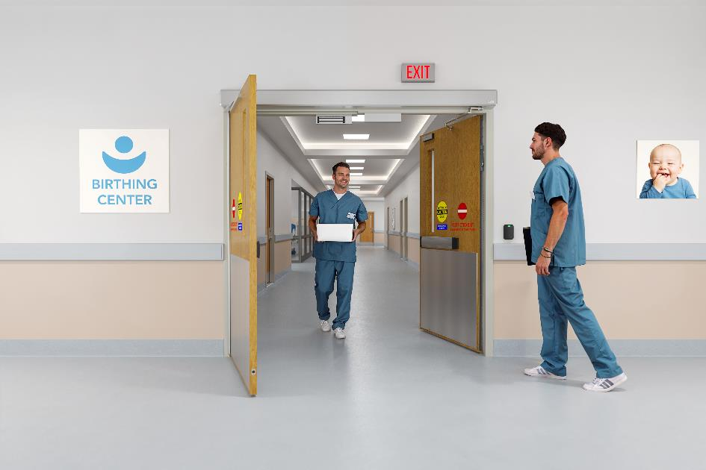
Controlled Egress in Health Care
  Behavioral health
  Memory care
  Infant and maternity
  Pediatrics
  Emergency department
  It is up to the AHJ where to allow this application in Group I – Institutional/ Health Care
Notes:
In most buildings, doors in a means of egress can NOT be locked to prevent egress, even if they unlock upon fire alarm. One exception is in health care units where patients require containment for their safety or security. This application is called controlled egress, and although the model codes don’t specifically state which types of units are allowed to have these locks, the options listed here are typical.

Slide 5
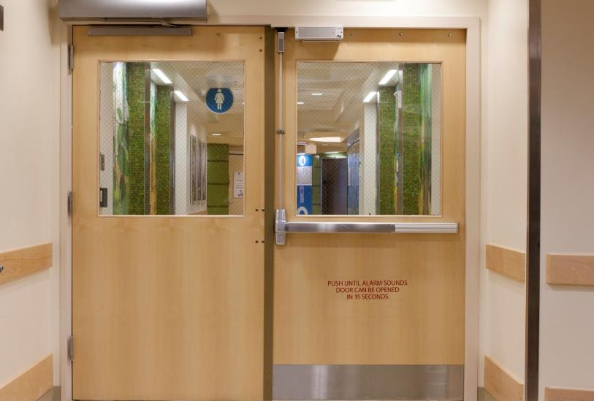
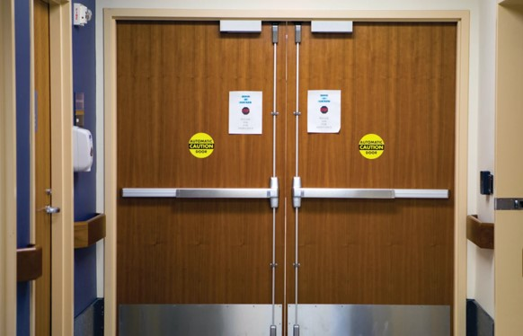
Delayed Egress vs.
Controlled Egress
Delayed Egress
Releases to allow egress 15 seconds after an attempt to exit is made
Audible alarm and signage
Used to deter theft and elopement
Releases to allow egress when evacuation is needed
No audible alarm or signage required
Used in health care units where patients require containment for their safety or security
Controlled Egress
Notes:
Delayed egress locks, which have a 15 second delay (or sometimes 30 seconds) do not work well for some types of health care units. For example, in memory care we were seeing some residents exhibiting exit-seeking behaviors and setting off the audible alarm or sometimes even being able to leave the building after 15 seconds.
Beginning with the 2009 model codes, a new application was added which is now commonly called controlled egress. With controlled egress locks, doors serving certain types of health care units can have doors that are locked indefinitely to prevent elopement.
Hopefully everyone is aware that there is an alternative available to delayed egress, depending on the type of unit a door is serving, and it is a better application for many health care facilities. Some facility managers are not yet aware of this option.

Slide 6
How controlled egress works:
ONLY ALLOWED IN CERTAIN TYPES OF HEALTH CARE UNITS
Door stays locked until egress is needed
Immediate egress is allowed:
  Upon actuation of fire alarm or sprinkler system
  Upon loss of power
  Upon remote signal
  Staff must have the ability to unlock the doors if evacuation is required
  There are some exceptions to these remote release methods
Notes:
Unlike delayed egress locks, controlled egress locks are NOT required to release after 15 seconds, and NO audible alarm or signage is required by the model codes. The doors are locked indefinitely, and there are several release methods required, which help to ensure life safety for building occupants. The model codes have slightly different requirements, so you will need to consult the adopted code for specifics, but generally, the locks must be fail safe, and immediate egress must be allowed:
Upon actuation of fire alarm or sprinkler system
Upon loss of power
Upon remote signal
Staff must have the ability to unlock the doors if evacuation is required
The I-Codes and the NFPA codes vary somewhat, so consult the adopted code for specifics.

Slide 7
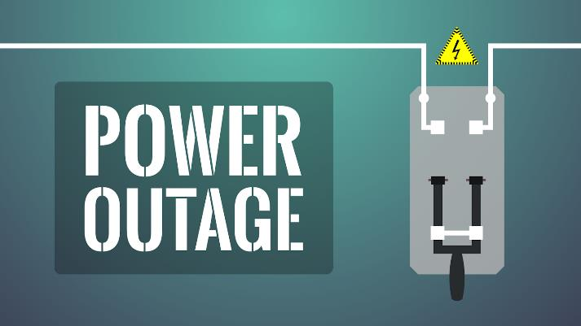
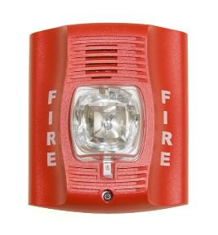


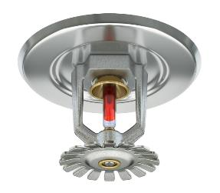
Exceptions: Psychiatric or cognitive treatment areas & units with listed child abduction systems
IBC exempts these doors from:
  Automatic release upon fire alarm / sprinkler activation
  Release upon power failure
  Remote release
  Limitation on the number of controlled egress doors before entering exit
Notes:
Certain areas are exempt from the automatic/remote release requirements and the limitation on the number of controlled egress doors in a means of egress. In the IBC the exempt areas are psychiatric and cognitive treatment areas and units with listed child abduction systems. Doors serving these areas are not required to automatically unlock to allow egress upon fire alarm/sprinkler activation, power failure, or remote release, and there can be more than one door with a controlled egress lock in the path of egress.

Slide 8
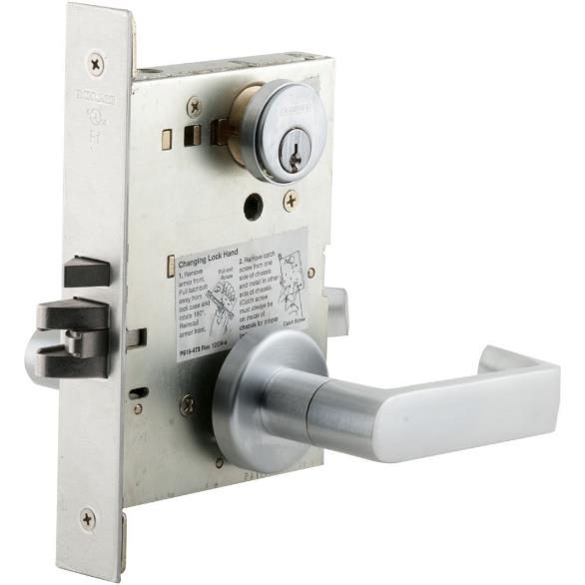
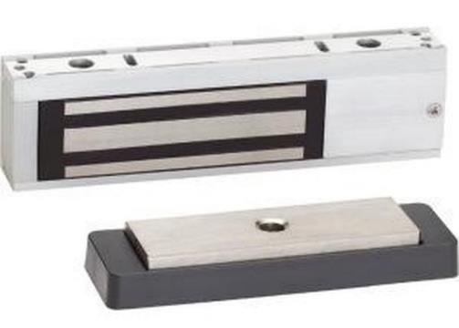
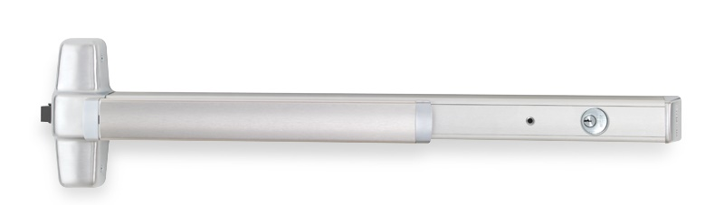
Hardware used in controlled egress systems
Controlled egress panic hardware
Electromagnetic lock
Electromechanical lock
FAIL SAFE
Notes:
Mark is going to use the rest of our time to talk about specifying hardware for this application.
For a controlled egress system, you could use panic hardware that is similar to a delayed egress device, except that it has what’s called “infinite delay” (the Chexit can function this way). That’s what’s going to keep the door locked indefinitely. Electromagnetic locks or electromechanical locks could also be used, but regardless of the type of locking hardware in the system, it must be fail safe so that it will unlock when the power is cut.
The products used in a controlled egress system are required to be listed to UL 294 – Standard for Access Control System Units; the 2024 model codes permit UL 1034 as an alternative. These listings are required by many of the code sections that address special locking arrangements, but are not required for normal locking arrangements.

Slide 9
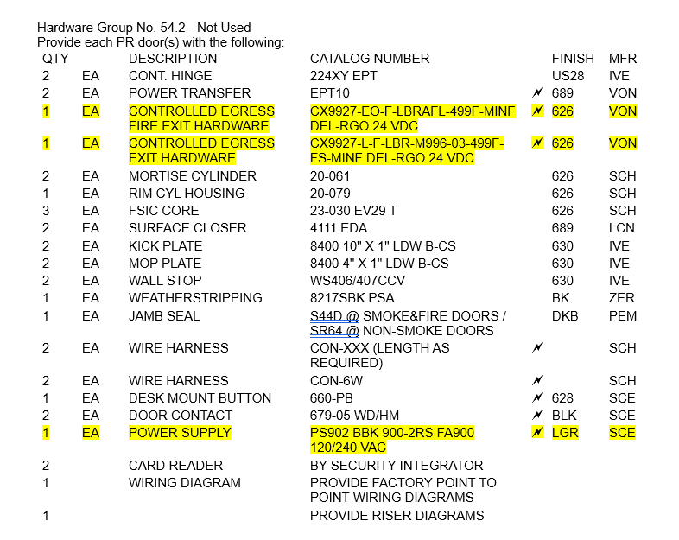
OPERATIONAL DESCRIPTION:
BOTH DOORS NORMALLY CLOSED AND SECURE.
ENTRY BY VALID CREDENTIAL OR REMOTE RELEASE.
CONTROLLED EGRESS - EGRESS BY VALID CREDENTIAL OR REMOTE RELEASE.
ACCESS BY VALID CREDENTIAL.
DOORS UNLOCK WITH LOSS OF POWER. (FAIL SAFE)
DOORS MONITORED BY ACCESS CONTROL.
Notes:
So how do we specify a controlled egress system?

Slide 10
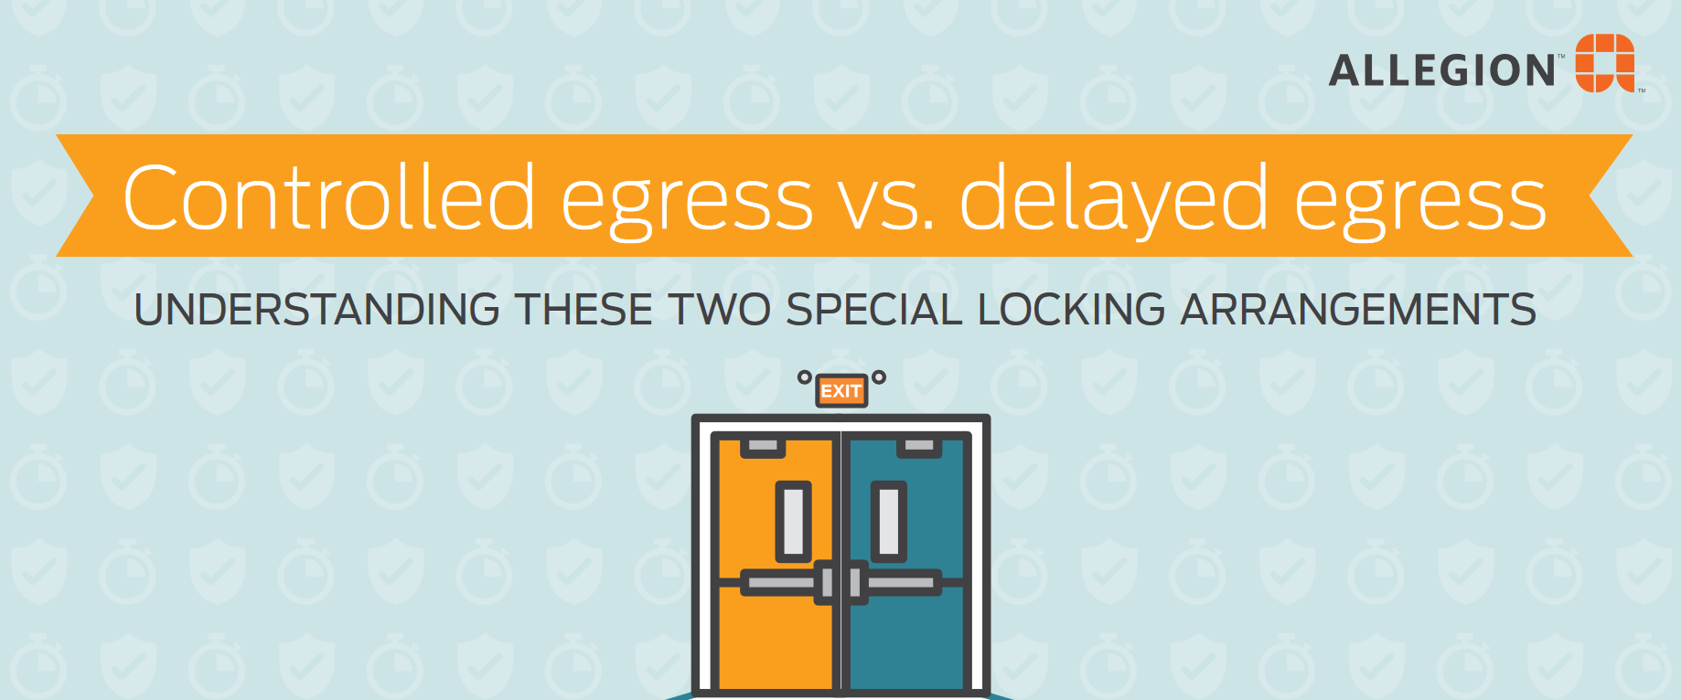

Notes:
Because there is so much confusion surrounding this application, an infographic was created that discusses controlled egress vs. delayed egress. There is a link to the infographic in the speaker notes and on the ACE page: https://idighardware.com/2022/08/delayed-egress-or-controlled-egress/.
Other resources include:
Locksmith Ledger Articles about the delayed egress and controlled egress requirements of each of the model codes
https://idighardware.com/2022/01/locksmith-ledger-model-code-comparison-controlled-egress-locking-systems/
https://idighardware.com/2021/10/locksmith-ledger-model-code-comparison-delayed-egress-locking-systems/
A whiteboard animation video comparing the two types of systems
http://idighardware.com/2016/08/controlled-egress-vs-delayed-egress-video/
A recorded webinar on the two types of systems
https://idighardware.com/webinars/#webinar_5
Links have been added to the ACE page: https://idighardware.com/ace/

Slide 11

We take requests!
What do you want to learn about?
Want to write a guest post for iDigHardware?
Notes:
What code questions would you like to see addressed in this call?
We are looking for guest posts for iDigHardware!

