Slide 1


Lori Greene
DAHC/CDC, FDAI, FDHI
Allegion – Manager,
Codes & Resources
iDigHardware.com
Code Update
Mark A. Kuhn
FDHI, AHC, EHC, DHT, DHC, CFDAI, CDT, CSI
Allegion - Architectural
Consultant
Notes:
Reminder that we will be doing these quick code updates each month, with a brief overview of the code change or requirement, and links to additional resources.
Put questions in the chat.
Upcoming code changes can sometimes be used as clarifications or requests for AHJ approval even before adoption.

Slide 2
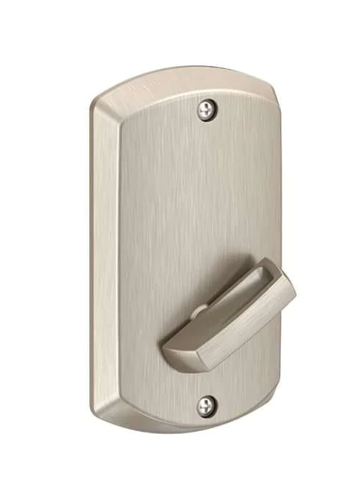
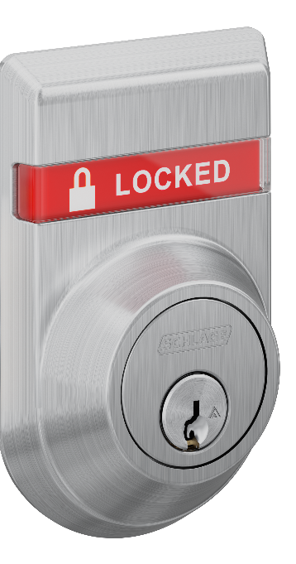
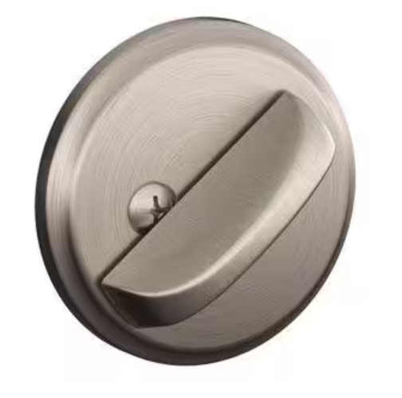
Key-Operated Locks vs. Thumbturn Deadbolts
Notes:
This update covers a section of the model codes addressing key-operated locks with a key cylinder on the egress side. These are typically double-cylinder deadbolts, and will almost always have an indicator in order to be code-compliant.
Deadbolts with a thumbturn are permitted by the model codes under certain conditions, and are not required to comply with the same requirements that apply to key-operated locks. I’m going to go through the requirements for thumbturn deadbolts quickly.
We’re talking about separate deadbolts, not a deadbolt that is part of a mortise lock or interconnected lock.

Slide 3
Thumbturn Deadbolts in a Means of Egress
The IBC section that was previously called “Bolt Locks” addresses flush bolts and surface bolts on pairs of doors – NOT deadbolts.
Notes:
It was a common misconception that the bolt locks section prohibited deadbolts. That is not true – the section addresses bolts for the inactive leaf of a pair of doors. This section has been changed to a table to help clarify that requirements.

Slide 4
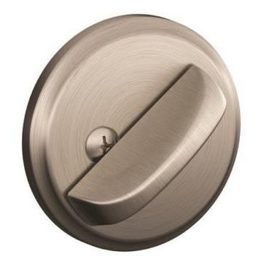
Thumbturn Deadbolts in a Means of Egress
Door does not require panic hardware
Door unlatches with one releasing motion for egress (some exceptions, including dwelling units and NFPA 101 for existing classroom doors)
No key, tool, special knowledge or effort for egress
No tight grasping, pinching, or twisting of the wrist
Releasing hardware between 34-48 inches AFF (some state limitations)
Notes:
Deadbolts with thumburns are acceptable on doors that do not require panic hardware if the door unlatches with one releasing operation – remember there is an exception in NFPA 101 for existing classroom doors.
As with other operable hardware, the lock must be operable for egress with no key, tool, special knowledge, or effort – this would require a thumbturn on the egress side rather than a key
The thumbturn must be operable with no tight grasping, pinching, or twisting of the wrist, which would typically be an elongated thumbturn that pivots from the end
The deadbolt must be mounted between 34 and 48 inches above the floor – or in compliance with the mounting height requirements of the state or local jurisdiction

Slide 5
Key-Operated Locks vs. Thumbturn Deadbolts
Notes:
Now back to key-operated locks which will almost always have an indicator.

Slide 6
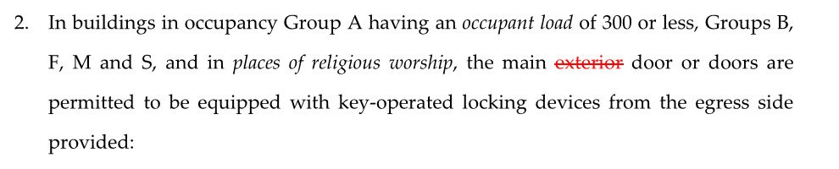
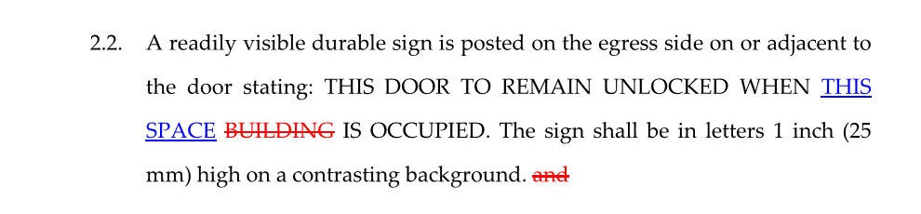
Key-Operated Locks
2015 IBC Redline Version
Notes:
In the 2015 edition of the IBC, the word “exterior” was removed from the section on key-operated locks, and the wording on the signage was changed slightly. This was not a BHMA proposal.
The sign is now required to say, THIS DOOR TO REMAIN UNLOCKED WHEN THIS SPACE IS OCCUPIED.
The result of these little changes was that people started trying to use double-cylinder deadbolts on the interior entrance doors leading to various spaces in a building, rather than the main entrance doors to the building.
The reason the use of double-cylinder deadbolts was limited to the main entrance to the building was that the building couldn’t be occupied or the business open with those doors locked. Note that these locks are not allowed on all occupancy types – they are limited to assembly occupancies with an occupant load of 300 people or less, business, factory, mercantile, and storage occupancies, and places of religious worship.

Slide 7
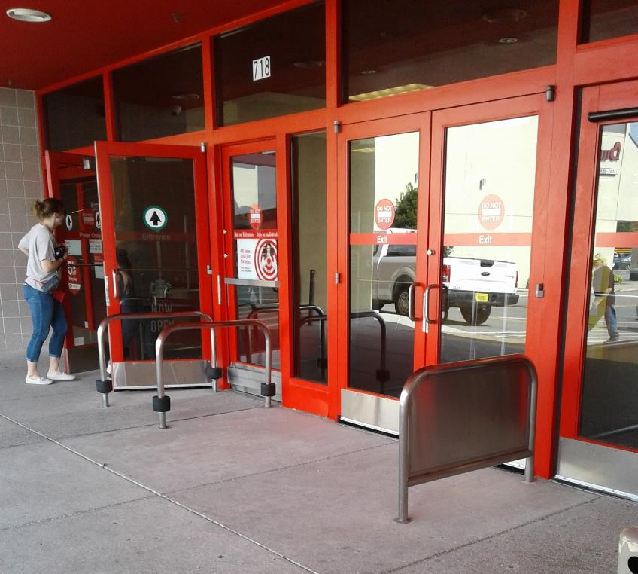

Notes:
Originally, this section of the codes applied to the main EXTERIOR door or doors – like the mercantile entrance on the left.
Then a code change proposal was made with the intent to allow the same application on retail stores in malls, which are not always exterior doors.

Slide 8
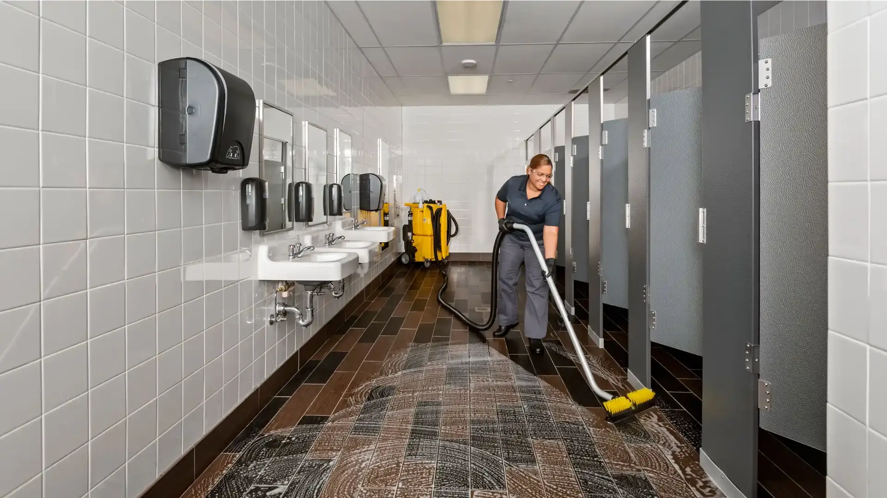
Notes:
But with the new language, people have asked about using double-cylinder deadbolts on multi-stall restrooms, for example, because they considered the door to the restroom as the main entrance to that space.
That wasn’t the intent of the model codes – those doors need to allow free egress. Key-operated locks are not permitted here, and thumbturn deadbolts need to be classroom function.
Talk briefly about the change for multistall restrooms.
2902.3.6 Door Locking
Where a toilet facility is provided for the use of multiple occupants, the egress door for the room shall not be lockable from the inside of the room. This section does not apply to family or assisted-use toilet facilities. Exception: The egress door of a multiple occupant toilet room shall be permitted to be lockable from inside the room where all the following criteria are met:
The egress door shall be lockable from the inside of the room only by authorized personnel by the use of a key or other approved means.
The egress door shall be readily openable from the toilet room in accordance with Section 1010.2.
The egress door shall be capable of being unlocked from outside the room with a key or other approved means.

Slide 9

Key-Operated Locks – 2024 IBC
Limited to certain use groups
  Group A (assembly) with an occupant load of 300 or less – alternative to panic hardware
  Groups B (business), F (factory), M (mercantile), and S (storage)
  Places of religious worship
When the following criteria are met…
Notes:
In buildings in occupancy Group A having an occupant load of 300 or less, Groups B, F, M and S, and in places of religious worship, the main door or doors are permitted to be equipped with key-operated locking devices from the egress side provided that:
3.1. The doors are the main exterior doors to the building, or the doors are the main doors to the tenant space.
3.2. The locking device is readily distinguishable as locked.
3.3. A readily visible durable sign is posted on the egress side on or adjacent to the door stating: THIS DOOR TO REMAIN UNLOCKED WHEN THIS SPACE IS OCCUPIED. The sign shall be in letters 1 inch (25 mm) high on a contrasting background.
3.4. The use of the key-operated locking device is revocable by the building official for due cause.

Slide 10
Key-Operated Locks – 2024 IBC
3.1. The doors are the main exterior doors to the building, or the doors are the main doors to the tenant space.
Continued…
Notes:
In buildings in occupancy Group A having an occupant load of 300 or less, Groups B, F, M and S, and in places of religious worship, the main door or doors are permitted to be equipped with key-operated locking devices from the egress side provided that:
3.1. The doors are the main exterior doors to the building, or the doors are the main doors to the tenant space.
3.2. The locking device is readily distinguishable as locked.
3.3. A readily visible durable sign is posted on the egress side on or adjacent to the door stating: THIS DOOR TO REMAIN UNLOCKED WHEN THIS SPACE IS OCCUPIED. The sign shall be in letters 1 inch (25 mm) high on a contrasting background.
3.4. The use of the key-operated locking device is revocable by the building official for due cause.

Slide 11
Key-Operated Locks – 2024 IBC
Lock is readily distinguishable as locked.
Signage
  THIS DOOR TO REMAIN UNLOCKED WHEN THIS SPACE IS OCCUPIED.
  1-inch letters on a contrasting background
The AHJ may revoke permission.
Notes:
In buildings in occupancy Group A having an occupant load of 300 or less, Groups B, F, M and S, and in places of religious worship, the main door or doors are permitted to be equipped with key-operated locking devices from the egress side provided that:
3.1. The doors are the main exterior doors to the building, or the doors are the main doors to the tenant space.
3.2. The locking device is readily distinguishable as locked.
3.3. A readily visible durable sign is posted on the egress side on or adjacent to the door stating: THIS DOOR TO REMAIN UNLOCKED WHEN THIS SPACE IS OCCUPIED. The sign shall be in letters 1 inch (25 mm) high on a contrasting background.
3.4. The use of the key-operated locking device is revocable by the building official for due cause.

Slide 12
Key-Operated Locks – NFPA 2021/2024
Exterior door assemblies and interior door assemblies to an individual tenant space or to a single tenant space shall be permitted to have key-operated locks from the egress side, provided that all of the following criteria are met:
Notes:
The use of key-operated locks is limited by NFPA 101 to exterior doors and interior doors to a single tenant space. The NFPA change happened in 2021 instead of 2024.

Slide 13
Key-Operated Locks – NFPA 2021/2024
Allowed by occupancy chapter
Unlocked when building is occupied
Lock readily distinguishable as locked
Signage
Key immediately available to any occupant when locked
Notes:
This is on BHMA’s list to try to fix in the 2024 IBC, but it was modified in the 2021 edition of NFPA 101.
The use of key-operated locks is limited by NFPA 101 to exterior doors and interior doors to a tenant space.
The locks must also be allowed by the occupancy chapter – they are acceptable for some occupancy classifications but not all.
The door must be unlocked when the building is occupied, the lock must be readily distinguishable as locked – like a deadbolt with an indicator.
The signage that I mentioned before is required, and the key must be immediately available to any building occupant when the door is locked.
This helps to ensure that the door is only locked when employees are present – because the general public would not have access to the key.

Slide 14
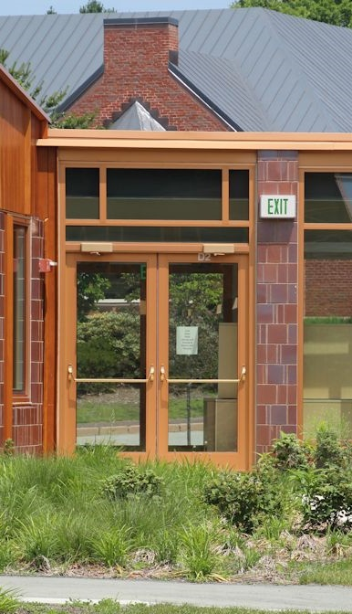
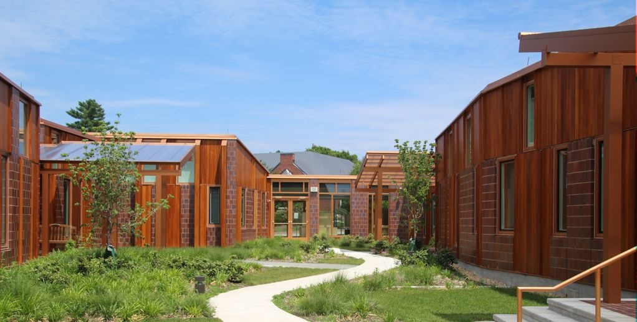
Egress from Exterior Spaces
Notes:
Related code section (next month) addressing doors serving exterior spaces – same type of lock.

Slide 15
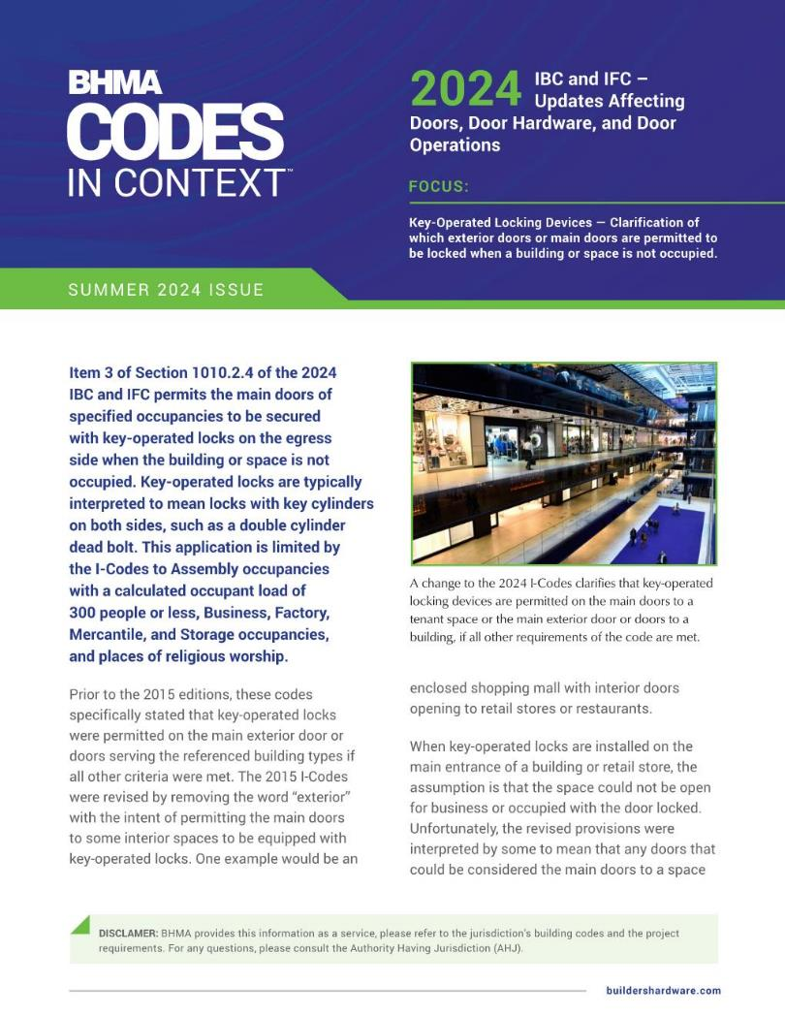
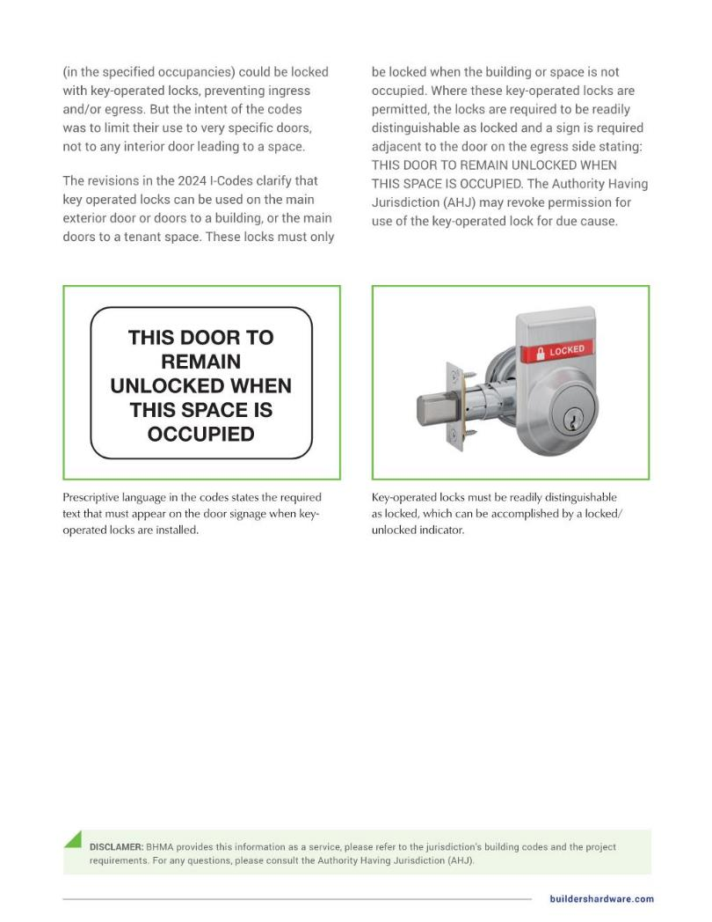
Notes:
This slide deck and a recent Decoded article have been uploaded to the ACE page on iDigHardware:
https://idighardware.com/ace/
There is also a BHMA Codes in Context document about this change related to key-operated locks.

Slide 16

We take requests!
What do you want to learn about?
Want to write a guest post for iDigHardware?
Notes:
We are looking for guest posts

