Slide 1

When all of the egress paths for a school courtyard pass through the interior of the building, which of the following statements is true?
Free egress from the courtyard through the school is required at all times.
At least one door from the courtyard has to be unlocked 24/7.
The model codes allow an electrified lock on the courtyard side, if it unlocks upon fire alarm.
The 2021 and 2024 IBC allow the doors to be locked on the courtyard side if certain criteria are met.
Notes:
Poll Question – put your answer in the chat (if you dare!)
When all of the egress paths for a school courtyard pass through the interior of the building, which of the following statements is true?
Free egress from the courtyard through the school is required at all times.
At least one door from the courtyard has to be unlocked 24/7.
The model codes allow an electrified lock on the courtyard side, if it unlocks upon fire alarm.
The 2021 and 2024 IBC allow the doors to be locked on the courtyard side if certain criteria are met.

Slide 2
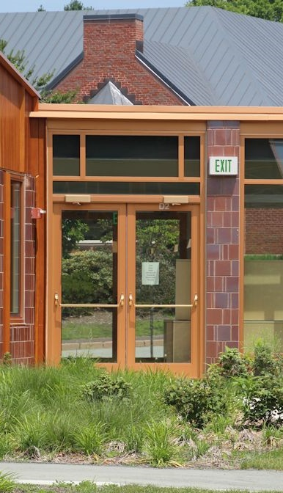
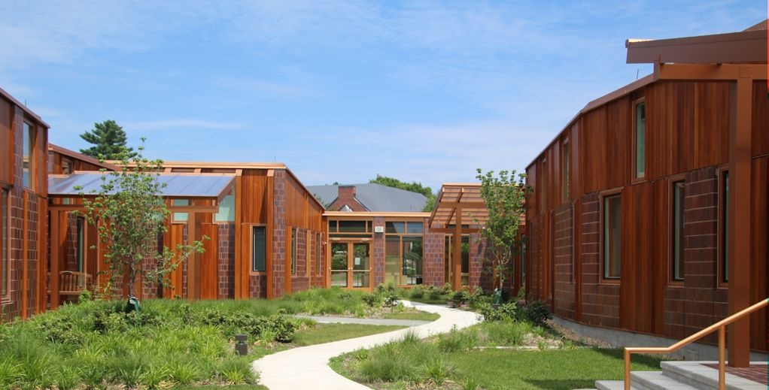
Egress from Exterior Spaces
Notes:
The last time we were on this call we talked about the requirements for key-operated deadbolts, and we mentioned that on the next call we would talk about a related set of requirements, which addresses a problem that we didn’t previously have a good code-compliant solution for.
When you have an exterior space with an egress path that passes through the interior of the building – like a courtyard or roof terrace - there was no code-compliant way to lock the doors to prevent unauthorized access to the building.
The photos here are of a school courtyard, and the exit door that leads into the school. It would be really easy for someone to climb over the roof of the school and gain access because the doors have panic hardware to allow free egress through the school. At the end of this courtyard there is a pair of doors with panic hardware on the courtyard side, swinging into the school for egress from the courtyard. This isn’t ideal from a security perspective.
You might have heard us talk about this topic before, but questions keep coming up because more states have now adopted the 2021 editions of the I-Codes and some states have even adopted the 2024 editions.

Slide 3
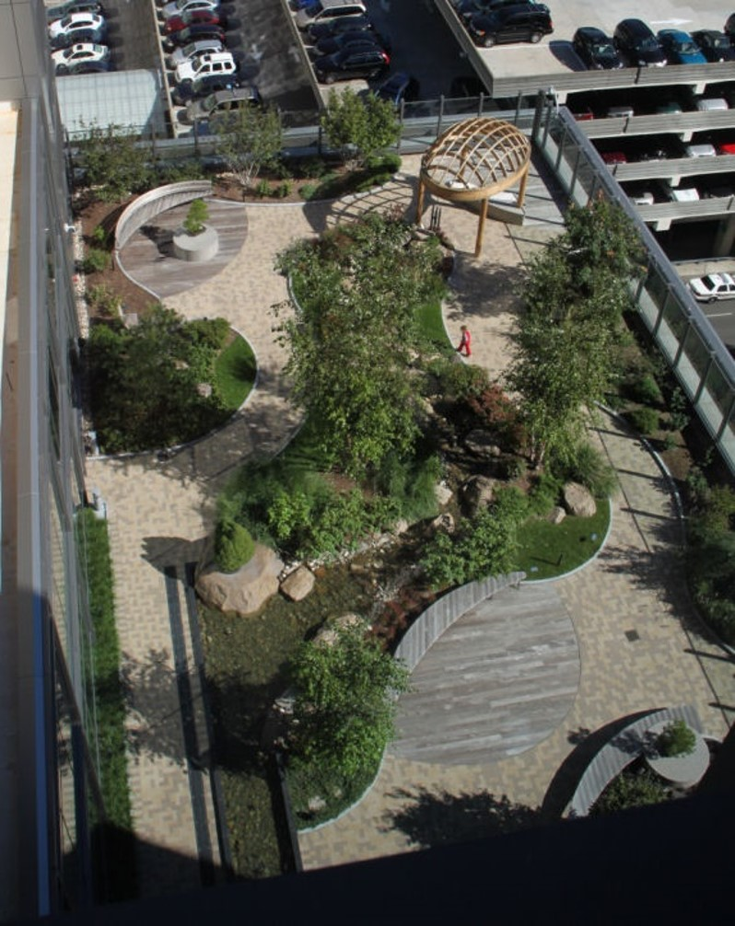
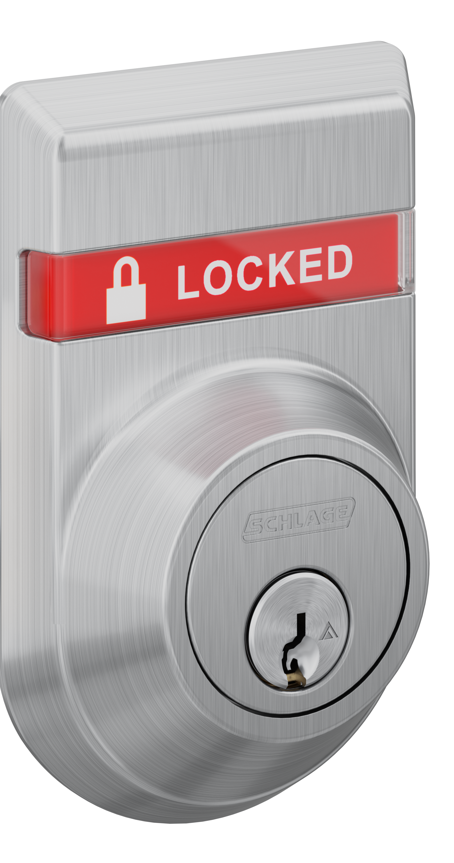
Egress from Exterior Spaces
2021 and 2024 IBC
Exterior spaces with egress route through interior of building
Applies to exterior spaces that are not egress courts
Max occupant load 300 people
Approved locking device is allowed – readily distinguishable as locked
Notes:
The 2021 IBC added a section that addresses doors serving a means of egress for an exterior space, where the egress path passes through the interior of the building.
The new section doesn’t apply to egress courts, which are exterior areas that provide access to a public way for one or more exits.
It is intended to apply to courtyards, balconies, or occupied roofs like the roof garden shown in the photo here.
If the exterior space has an occupant load of 300 people or less, the door to the interior of the building can be locked if certain criteria are met.
Similar to the key-operated lock section of the model codes, which allows double-cylinder deadbolts to be used under certain circumstances, the lock on this door has to be readily distinguishable as locked. An indicator lock is a good application here.

Slide 4
Egress from Exterior Spaces
At least one weatherproof telephone or two-way communication system with instructional signage
Signage - THIS DOOR TO REMAIN UNLOCKED WHEN THE OUTDOOR AREA IS OCCUPIED
Clear window or glazed opening, at least 5 square feet in area at each exit access door
Notes:
In addition, a weatherproof phone or two-way communication system is required adjacent to at least one exit access door, with signage describing the use of the system
Again, like the other doors with key-operated locks, signage is required – this time stating THIS DOOR TO REMAIN UNLOCKED WHEN THE OUTDOOR AREA IS OCCUPIED.
And – there has to be a clear window, sidelight, or vision light at least 5 square feet in area at each of the exit access doors.
I think this is a really helpful change, to establish safe guidelines for these openings rather than having each AHJ decide what to allow.
With that said, this is a change that would not apply until the 2021 or 2024 edition of the IBC is adopted in a particular jurisdiction.
Using this application prior to adoption of the 2021 IBC would require a code modification, but at least there’s a set of guidelines to use when requesting the modification.

Slide 5
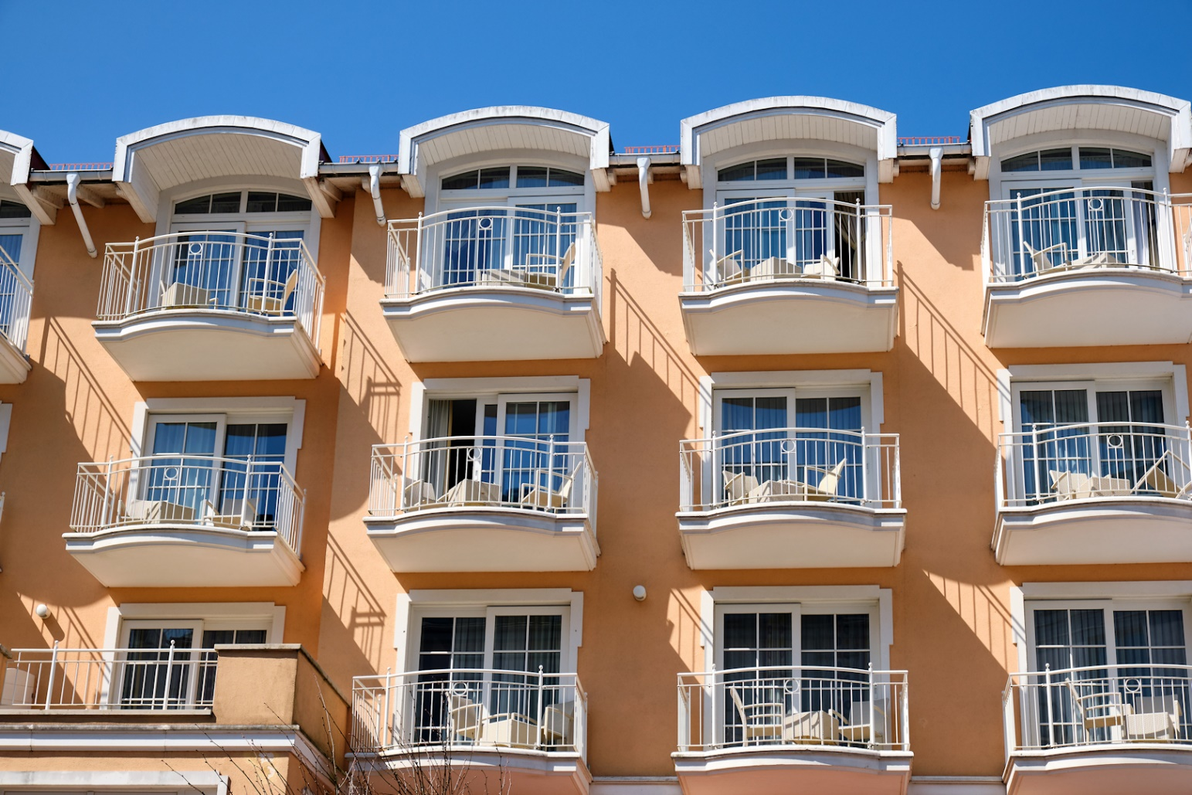
Egress from Exterior Spaces
Balconies, decks, or exterior spaces may be locked on the outside when serving:
Individual dwelling/sleeping units
Private office space – exterior space 250 square feet, maximum
Telephone, etc. not required
Notes:
The same section of the IBC addresses doors serving individual balconies for dwelling units or sleeping units, and balconies for private office space where the exterior area is 250 square feet or less.
These doors can be locked or lockable from the exterior, and the telephone, vision panel, indicator, etc., are not required by the code.

Slide 6
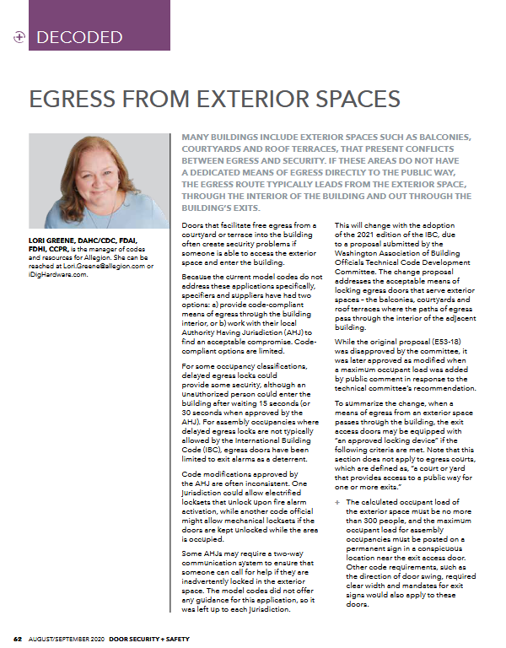
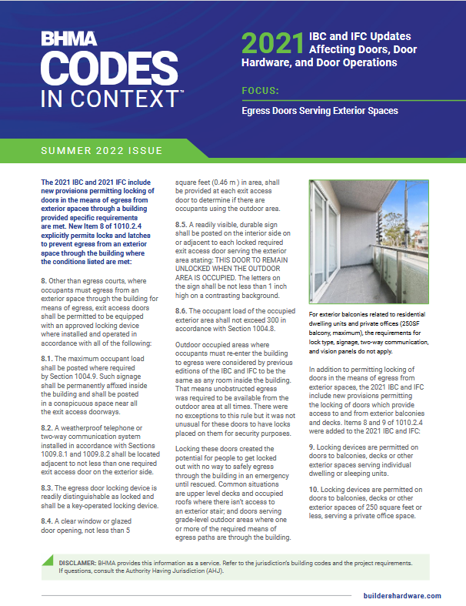
Notes:
This slide deck and a recent Decoded article have been uploaded to the ACE page on iDigHardware:
https://idighardware.com/ace/
There is also a BHMA Codes in Context document about this change related to key-operated locks.

Slide 7

We take requests!
What do you want to learn about?
Want to write a guest post for iDigHardware?
Notes:
What code questions would you like to see addressed in this call?
We are looking for guest posts for iDigHardware!

