Slide 1
Lori Greene
DAHC/CDC, FDAI, FDHI
Allegion – Manager,
Codes & Resources
iDigHardware.com
Code Update
Mark A. Kuhn
FDHI, AHC, EHC, DHT, DHC, CFDAI, CDT, CSI
Allegion - Architectural
Consultant
Notes:
Reminder that we will be doing these quick code updates each month, with a brief overview of the code change or requirement, and links to additional resources.
Put questions in the chat.
Upcoming code changes can sometimes be used as clarifications or requests for AHJ approval even before adoption.

Slide 2
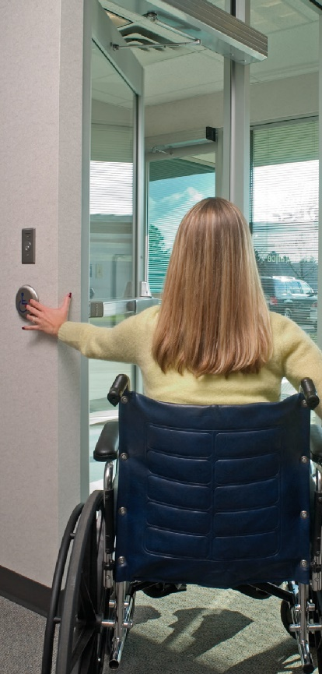
Accessible Public Entrances
2021 IBC: 1105.1.1 Automatic doors. In facilities with the occupancies and building occupant loads indicated in Table 1105.1.1, public entrances that are required to be accessible shall have one door be either a full power-operated door or a low-energy power-operated door. Where the public entrance includes a vestibule, at least one door into and one door out of the vestibule shall meet the requirements of this section.
Notes:
Until 2021, there wasn’t a requirement in the model codes or accessibility standards for automatic operators in any specific locations.
Auto operators are usually installed for convenience, or when a door can not meet the requirements for a manual door – if it’s too hard to open, or if there isn’t enough maneuvering clearance.
The 2021 IBC requires public entrances for some buildings to have at least one automatic door – either a power-operated pedestrian door or a door with a low-energy automatic operator, or a set of automatic doors if there is a vestibule.
The table here on the screen shows the applicable use groups and the associated occupant loads, but in case you’re not familiar with each of the use groups I have them broken out for you…

Slide 3
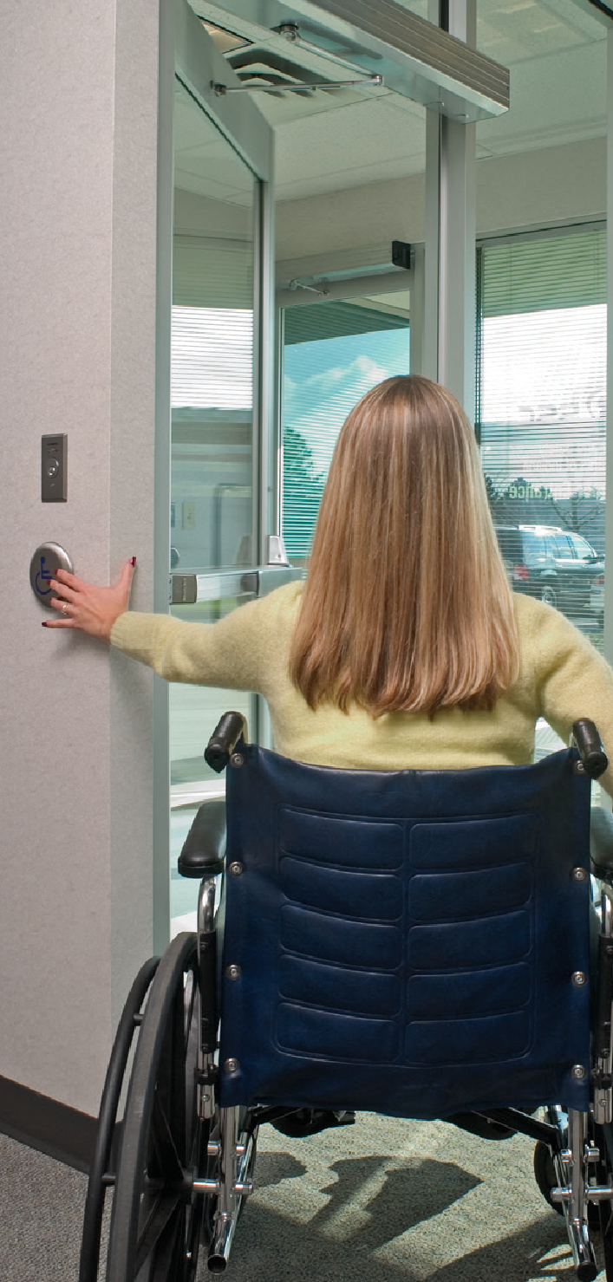
Accessible Public Entrances
A-1 – Assembly - viewing of performing arts/movies
A-2 – Assembly - food/drink consumption
A-3 – Assembly - worship, recreation, amusement
A-4 – Assembly - viewing of indoor sporting events
B – Business - office, professional, or service
M – Mercantile - display and sale of merchandise
R-1 – Residential - transient sleeping units
>300
>500
Notes:
Use Group A covers Assembly occupancies, and the subgroups are described here on the screen, but basically the requirement would apply to all assembly occupancies with an occupant load of more than 300 people – except Group A-5.
Group A-5 covers assembly occupancies for viewing outdoor activities, like stadiums and grandstands.
The other use groups shown here require a public entrance with an automatic door when the occupant load is more than 500 people.
Those use groups are B – Business, M – Mercantile, and R-1 – Residential which includes hotels.

Slide 4
What is considered a public entrance?
In the 2021 edition of the IBC, a public entrance is defined as “An entrance that is not a service entrance or a restricted entrance.” The requirements for these entrances are included in Section 1105 – Accessible Entrances.
IBC Section 1105 requires at least 60 percent of all public entrances to be accessible. In addition, this section requires the following types of entrances to be accessible:
Notes:
Not all entrances in a building are considered public entrances, and not all public entrances are required to be accessible.

Slide 5
IBC Commentary on Accessibility
“The fundamental philosophy of the code on the subject of accessibility is that everything is required to be accessible. This is reflected in the basic applicability requirement (see Section 1103.1). The code’s scoping requirements then address the conditions under which accessibility is not required in terms of exceptions to this general mandate. In the early 1990s, building codes tended to describe where accessibility was required in each occupancy, and any circumstance not specifically identified was excluded. The more recent codes represent a fundamental change in approach. Now one must think of accessibility in terms of ‘if it is not specifically exempted, it must be accessible.’ “

Slide 6
Which other entrances are required to be accessible?
Parking structures with pedestrian access from the garage to the building
Tunnels and elevated walkways with pedestrian access
Restricted entrances to a building or facility
Entrances for inmates or detainees at judicial, detention, correctional
Service entrances if it is the only entrance to the building or tenant space
Tenant spaces must have at least one entrance to each tenant space
Dwelling units and sleeping units that are accessible, Type A, or Type B
Notes:
Parking Structures – Where direct pedestrian access is provided from a parking garage to a building or facility, the entrances must be accessible.
Tunnels and Elevated Walkways – Where direct pedestrian access is provided from a pedestrian tunnel or elevated walkway to a building or facility, at least one entrance from each tunnel or walkway must be accessible.
Restricted Entrances – Where restricted entrances are provided to a building or facility, at least one restricted entrance must be accessible.
Entrances for Inmates or Detainees – At judicial facilities, detention facilities, and correctional facilities, where entrances are used only by inmates or detainees and security personnel, at least one such entrances must be accessible.
Service Entrances – When a service entrance is the only entrance to a building or tenant space, that entrance must be accessible. When a service entrance is not the only entrance to a tenant space, the service entrance is not required to be accessible.
Tenant Spaces – At least one accessible entrance must be provided to each tenant space, except for self-storage facilities that are not required to be accessible.
Dwelling Units and Sleeping Units – Each dwelling unit and sleeping unit in a facility must have at least one accessible entrance, except that an accessible entrance is not required for units that are not required to be Accessible units, Type A units, or Type B units.
If an area is not required to be accessible, an accessible entrance is not typically required. This means that areas that are exempt from the accessibility requirements are usually also exempt from the requirements for an accessible entrance. Refer to the applicable building code or accessibility standard to learn more about these exceptions.

Slide 7
Does this change require automatic operators to be added to accessible public entrances in existing buildings?
This change applies if:
The project is required to comply with the 2021 IBC, and
The entrance is a public entrance that is required to be accessible, and
The use group is one of the types listed above, AND
The calculated occupant load is greater than 300 or greater than 500, depending on the use group.
Notes:
This change is not likely to be applied retroactively, unless they are being renovated or there is a local code modification that applies to existing buildings.

Slide 8
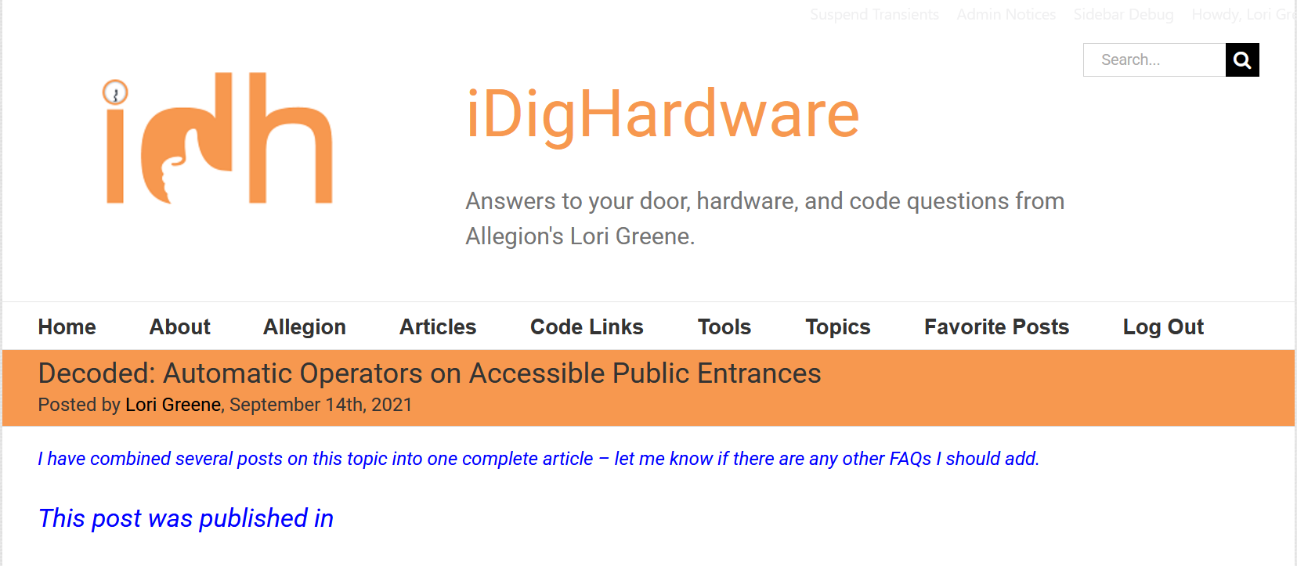
Notes:
This slide deck and several supporting articles have been uploaded to the ACE page on iDigHardware:
https://idighardware.com/ace/
https://idighardware.com/2021/09/decoded-automatic-operators-on-accessible-public-entrances/
https://idighardware.com/2024/04/decoded-automatic-operators-in-mixed-use-facilities/

Slide 9
We take requests!
What do you want to learn about?

