Slide 1
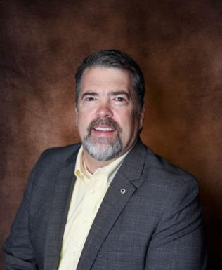
Lori Greene
DAHC/CDC, FDAI, FDHI
Allegion – Manager,
Codes & Resources
iDigHardware.com
Code Update
Mark A. Kuhn
FDHI, AHC, EHC, DHT, DHC, CFDAI, CDT, CSI
Allegion - Architectural
Consultant

Slide 2
Code Development
Builders Hardware Manufacturing Association (BHMA)
Standards
Certified Product Directory (CPD)
Codes, Government, Industry Affairs Committee (CGIA)
ICC Codes & Standards – I-Codes – IBC/IFC, A117.1
NFPA Codes & Standards – NFPA 101, 80
Some State/City Codes – California, Florida, NYC, Canada
Changes and Clarifications
School security
Fire doors
Egress requirements
Accessibility
Special locking arrangements vs. normal locking arrangements

Slide 3
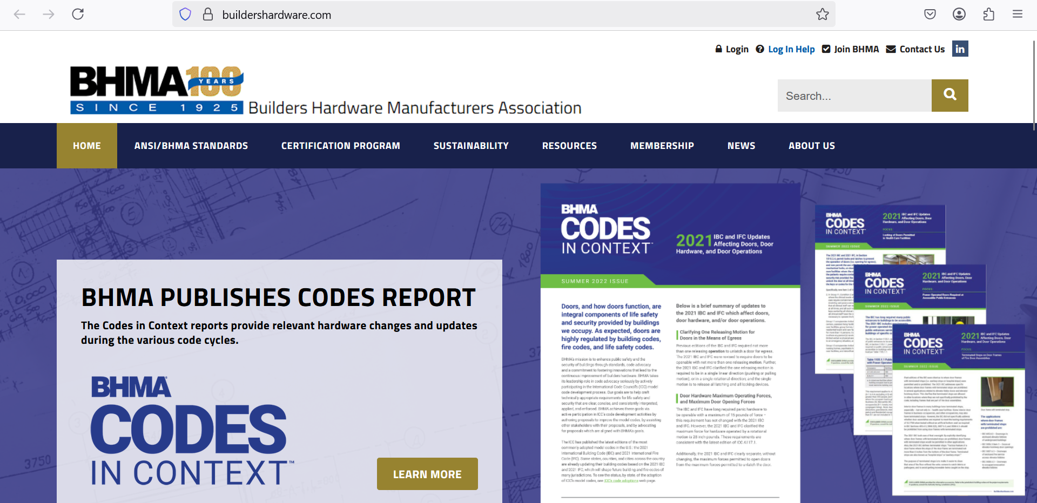

Slide 5
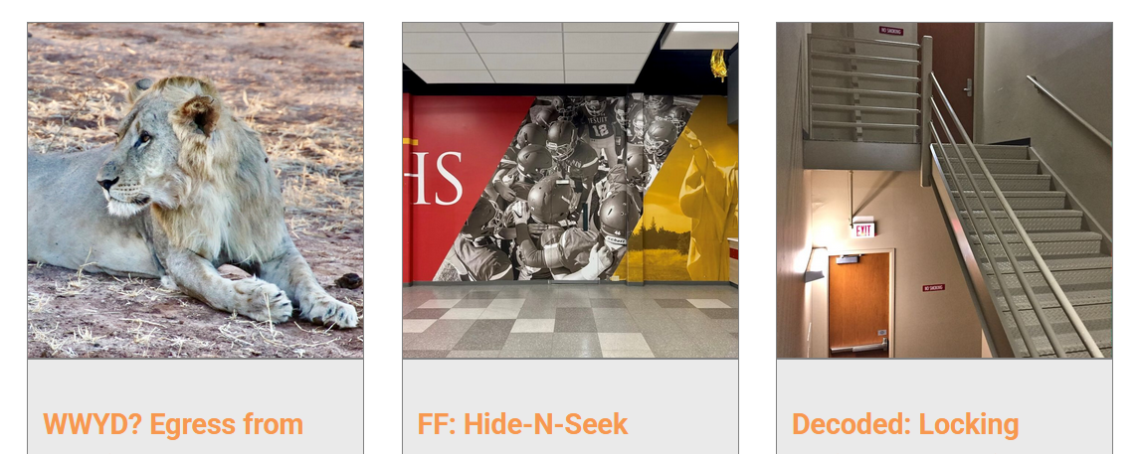

Slide 6
We take requests!
What do you want to learn about?
Lori Greene
Mark Kuhn

