Slide 1
Lori Greene
DAHC/CDC, FDAI, FDHI
Allegion – Manager,
Codes & Resources
iDigHardware.com
Code Update
Mark A. Kuhn
FDHI, AHC, EHC, DHT, DHC, CFDAI, CDT, CSI
Allegion - Architectural
Consultant
Notes:
Reminder that we will be doing these quick code updates each month, with a brief overview of the code change or requirement, and links to additional resources.
Put questions in the chat.
Upcoming code changes can sometimes be used as clarifications or requests for AHJ approval even before adoption.

Slide 2
Type your answer in the chat, if you dare!
According to the 2024 IBC, which listing(s) would be required for QEL panic hardware installed on the aluminum storefront door serving as the main entrance of a new high school?
UL 294 ~ UL 1034 ~ UL 10C ~ UL 305 ~ All of these ~ None of these

Slide 3
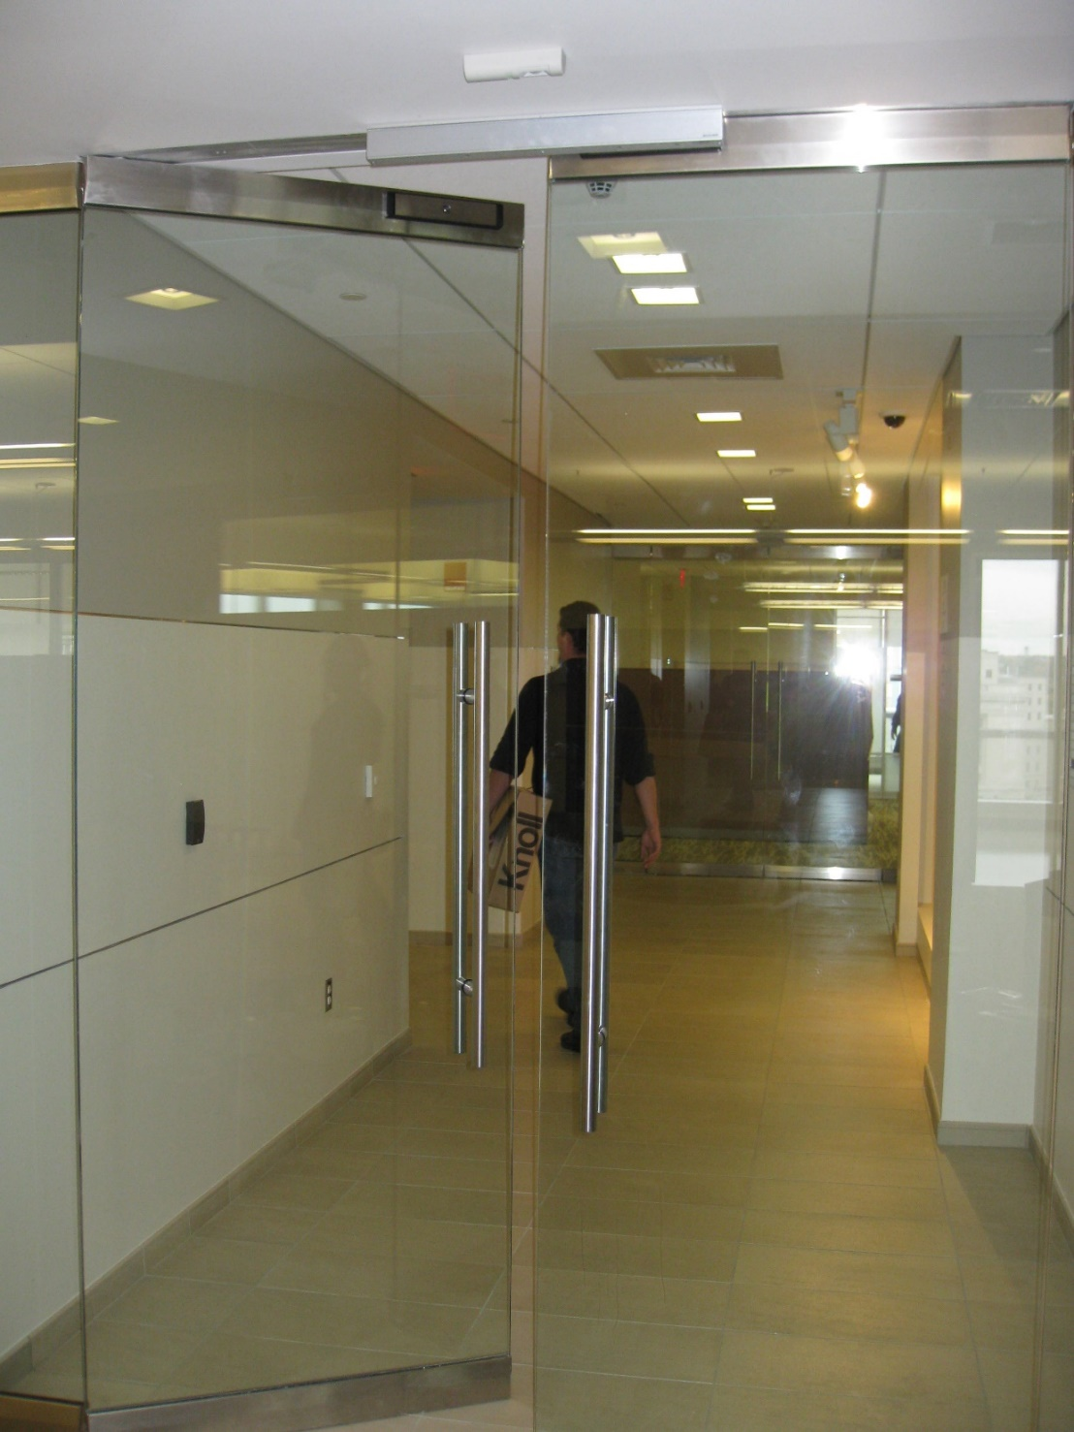
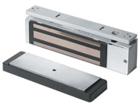
Special Locking Arrangements
Sensor Release
Door Hardware Release
Delayed Egress
Controlled Egress in Health Care
Stairwell Reentry
Elevator Lobby Egress
Interlocks
Monitored Egress
Code Update
Notes:
The code requirements that apply to electrified hardware are very frequently misunderstood and misapplied. This led to problems in the field, resulting in project delays, additional costs, and a perpetuation of the misunderstandings.
The model codes include sections that are specific to various special locking arrangements. These are typically electrified hardware applications that might impact egress, like delayed egress or mag-locks.
Beginning with the 2021 I-Codes there is a section called monitored or recorded egress…I would not consider this application a special locking arrangement, which is why it’s highlighted on this list. This section applies to electrified hardware that is monitoring egress or attendance – sometimes there will be a credential reader on the egress side but it would usually be there just to shunt an alarm – egress is not limited by the electrified hardware.

Slide 4
Normal Locking Arrangements
Unlatch with one releasing motion for egress (some exceptions)
No key, tool, special knowledge or effort for egress
No tight grasping, pinching, or twisting of the wrist
Releasing hardware between 34-48 inches AFF (some exceptions)
Code Update
Notes:
The most common application for electrified hardware is not a special locking arrangement – these systems could be called normal locking arrangements. The access control system limits ingress or access, but the electrified hardware does not affect egress at all. These doors have to comply with the same code requirements as mechanical door hardware.
The door has to unlatch with one releasing motion to allow free egress – there are a couple of exceptions this this requirement.
A building occupant must not require a key, tool, special knowledge or effort for egress.
The operable hardware can’t require tight grasping, pinching, or twisting if the wrist to operate.
And the releasing hardware must be mounted between 34 and 48 inches above the floor – again, there are some exceptions to this requirement.
There was no section with the special locking arrangements that addressed the most common type of access control system. Unfortunately, it’s really common for an AHJ or someone else to try to apply a section from special locking arrangements to an access control system that allows free egress, so we added language to the 2021 IBC commentary to help explain the intent, and the 2024 IBC includes an important change. In the 2024 edition of NFPA 101, there is information in Appendix A.

Slide 5
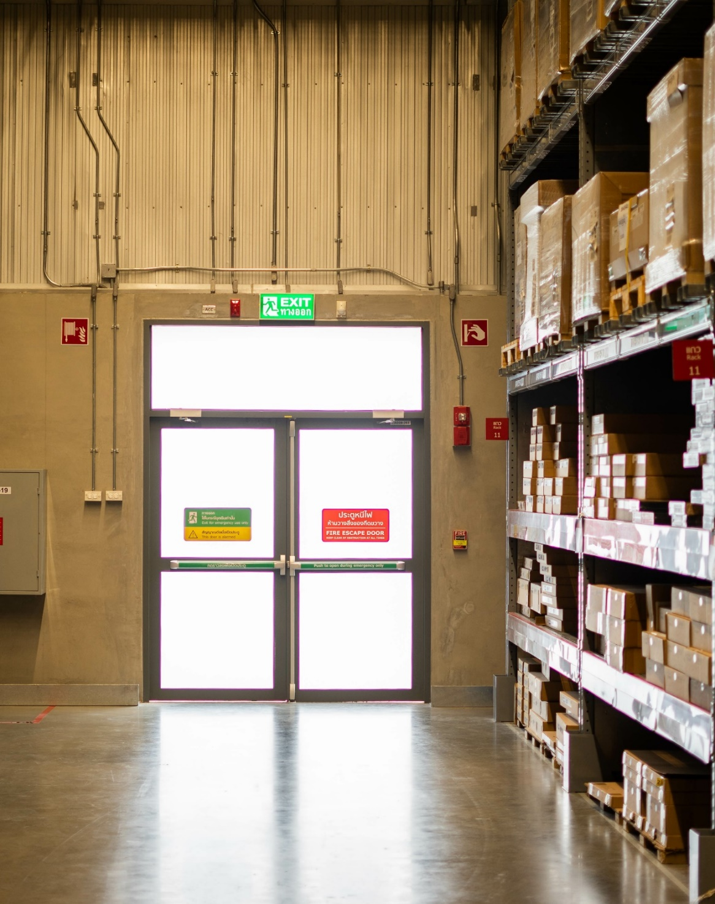
Monitored or Recorded Egress – 2021 I-Codes
1010.2.10 Monitored or recorded egress. Where electrical systems that monitor or record egress activity are incorporated, the locking system shall comply with Section 1010.2.11, 1010.2.12, 1010.2.13, 1010.2.14 or 1010.2.15 or shall be readily openable from the egress side without the use of a key or special knowledge or effort.
Code Update
Notes:
This is the section on monitored or recorded egress from the 2021 I-Codes. It requires doors with these systems to either comply with one of the special locking arrangements sections OR requires the doors to be readily openable from the egress side without the use of a key or special knowledge or effort.

Slide 6
Clarification in the 2024 IBC:
2024 IBC
Monitored or recorded egress, and access control systems. Where electrical systems that monitor or record egress activity are incorporated, or where the door has an access control system, the locking system on the egress side of the door shall comply with Section 1010.2.11, 1010.2.12, 1010.2.13, 1010.2.14 or 1010.2.15 or shall be readily openable from the egress side without the use of a key or special knowledge or effort.
Code Update
Notes:
Access control systems have been added to this section. This clarifies that when a door with electrified hardware allows free egress, it does not have to comply with the sections addressing special locking arrangements, as long as it is readily openable from the egress side without a key or special knowledge or effort. Now there is finally a code section to point to with regard to access control doors that allow free egress.

Slide 7
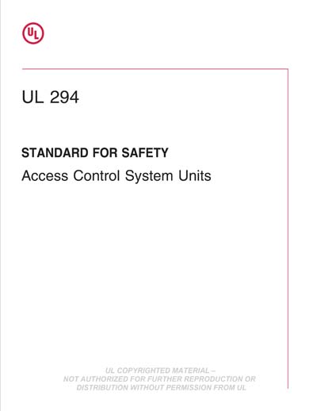
UL 294 – Standard for Access Control System Units
IS NOT required by code for all access control systems
IS required by code for:
Delayed Egress Locks
Controlled Egress Locks
Sensor Release
Door-Hardware Release
Elevator Lobby Locks
Stairwell Reentry (NFPA 101)
Code Update
Notes:
An important result of having the section related to access control doors with free egress is the clarification regarding UL 294 listings. The model codes require the UL 294 listing for electrified hardware in some types of special locking arrangements. The listing is not required for ALL electrified hardware. This has been a major source of confusion with AHJs and others.

Slide 8
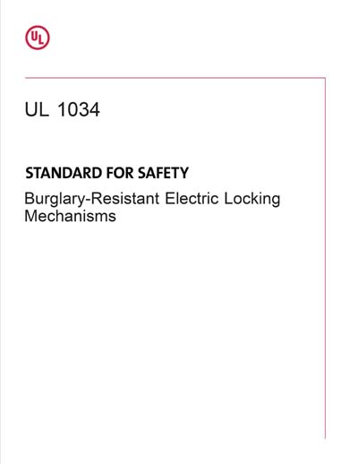
UL 294 – Standard for Access Control System Units UL 1034 – Standard for Burglary-Resistant Electric Locking Mechanisms
The electromechanical or electromagnetic locking device shall be listed in accordance with either UL 294 or UL 1034.
2024 IBC
Code Update
Notes:
Some electrified hardware is listed to UL 1034 instead of (or in addition to) UL 294. Where listings are required by the model codes – typically for special locking arrangements - the 2024 editions allow the products in these systems to be listed to EITHER UL 294 or UL 1034. The model codes also clarify that the listings are required for the electromechanical or electromagnetic locking devices, not for every single component of the system. This was unclear previously.
The addition of UL 1034 as an alternative will not technically go into effect until the 2024 code is adopted in a project’s jurisdiction. The project specification must accurately reflect the current requirements in that location.

Slide 9
https://idighardware.com/2025/02/decoded-listings-for-electrified-hardware/
https://idighardware.com/ACE/
Notes:
More info about this change can be found in the linked blog post or on the ACE page. The article on the screen is a new Decoded article about listings.
There is a page on the topics menu of iDigHardware dedicated to special locking arrangements.
On the Articles page of iDigHardware, there are Decoded articles about almost every code requirement related to door openings.

Slide 10
Type your answer in the chat, if you dare!
According to the 2024 IBC, which listing(s) would be required for QEL panic hardware installed on the aluminum storefront door serving as the main entrance of a new high school?
UL 294 ~ UL 1034 ~ UL 10C ~ UL 305 ~ All of these ~ None of these

Slide 11
We take requests!
What do you want to learn about?

