Slide 1
Lori Greene
DAHC/CDC, FDAI, FDHI
Allegion – Manager,
Codes & Resources
iDigHardware.com
Code Update
Mark A. Kuhn
FDHI, AHC, EHC, DHT, DHC, CFDAI, CDT, CSI
Allegion - Architectural
Consultant
Notes:
Reminder that we will be doing these quick code updates each month, with a very brief overview of the code change or requirement, and links to additional resources.
Upcoming code changes can be used as clarifications or requests for AHJ approval even before adoption.

Slide 2
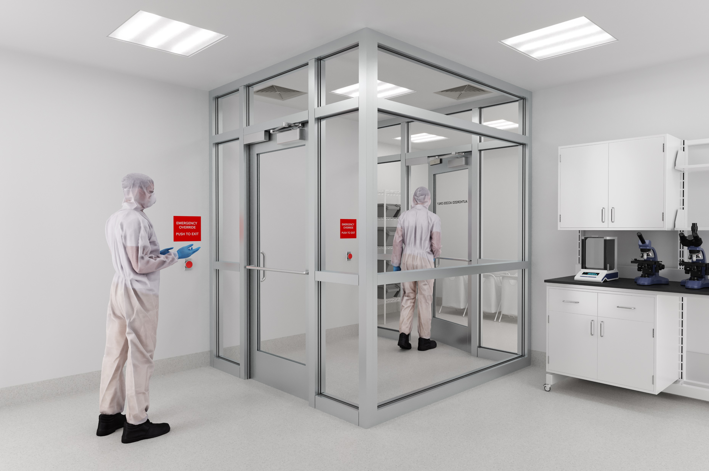
Interlocks
Set of 2 or more doors
When one door is open, the other door(s) can not be opened
Electromagnetic locks
Fail safe electromechanical locksets/electric strikes (less common)
1 vs. 100 – Code Update
Notes:
An interlock is a type of system where when one door is open, the other door can’t be opened. They are used for security or to limit air transmission, and common applications are data centers, money counting rooms in casinos, clean rooms, and laboratories. An interlock could impact egress because if the outer door is propped open, the occupants of the room may not be able to exit through the inner door.
Electromagnetic locks and door position switches are typically used to control the interlock function, but fail safe electromechanical locks or fail safe electric strikes (with institutional function locks) could be used.
With a safety interlock, the doors are typically unlocked until someone opens one door. With security locks, the doors are typically locked, and when one door is opened, the access control reader on the other door will not unlock the second door. These should not be confused with sallyports or mantraps. https://idighardware.com/2025/01/qq-interlock-types/
The model codes don’t currently address interlocks, so each interlock has to be approved by the AHJ unless there is a state or local code modification.

Slide 3
Interlocks – 2027 I-Codes
Permitted in the means of egress for security, environmental control, or clinical needs in:
Groups F, H-3, H-4, H-5, I-1, I-2, and S where the calculated occupant load of the space is less than 50
Groups B and M with an occupant load of 10 or less
1 vs. 100 – Code Update
Notes:
A new section has been approved for the 2027 I-Codes that will address interlocks (AKA control vestibules), and a definition for control vestibule will be added. Technically, this section will not apply until a particular jurisdiction adopts the 2027 code, but the change can be used to design/specify interlocks. The text of the new code section should be submitted to the AHJ with the request for approval of the interlock.
There are limitations to the use groups and occupant loads where this application is permitted.
2027 IBC Approved Change:
CONTROL VESTIBULE. A space with doors in series that are interlocked such that when one door is open other doors are restricted from opening.
1010.2.15 Control Vestibule. Control vestibules shall be permitted in the means of egress for security, environmental control, or clinical
needs in:
1. Groups F, H-3, H-4, H-5, I-1, I-2, and S where the occupant load of the room or space served by the control vestibule is less than
50.
2. Groups B and M where the occupant load of the room or space served by the control vestibule is 10 or less.
Continued on next slide…

Slide 4
Interlocks – 2027 I-Codes
Building must be equipped throughout with an automatic sprinkler system, or
An approved automatic smoke detection system must be installed in the room or space served by the control vestibule.
The egress path from any point shall not pass through more than one control vestibule.
1 vs. 100 – Code Update
Notes:
A sprinkler system or smoke detection system is required, and the path of egress must not pass through more than one interlock/control vestibule.
2027 IBC Approved Change:
1010.2.15.1 Protection. Control vestibules shall be permitted where the building complies with either of the following:
1. The building is equipped throughout with an automatic sprinkler system in accordance with Section 903.3.1.1.
2. An approved automatic smoke detection system in accordance with Section 907 is installed in the room or space served by the
control vestibule.
1010.2.15.2 Egress path. The egress path from any point shall not pass through more than one control vestibule.
Continued on next slide…

Slide 5
Interlocks – 2027 I-Codes
Override switch on egress side of each door (refer to code for details, including signage)
Unlock upon activation of sprinkler system/smoke detection system
Unlock upon loss of power
Unlock upon activation of emergency alarm system for hazardous materials (when present)
Self-closing, outswinging doors
UL listed locks – UL 294 OR UL 1034
1 vs. 100 – Code Update
Notes:
This slide details the safety overrides that will be required. Note that the model codes now allow the UL 1034 listing as an alternative to UL 294 for special locking arrangements. There are specifics on the override switch - including required signage – in the code text.
A change has been submitted for the 2027 edition of NFPA 101 but has not yet been approved.
2027 IBC Approved Change:
1010.2.15.3 Interlocking door operation. Where doors in the means of egress are configured as a control vestibule, the control vestibule
door interlocking system shall provide for egress. The control vestibule shall comply with all of the following:
1. An approved override switch shall be provided on the egress side of each door of the control vestibule which unlocks the
interlocked electric lock of that door.
1.1. Each override switch shall be located within 48 inches (1219 mm) of the door and 40 inches minimum to 48 inches
maximum (1016 mm to 1219 mm) above the floor.
1.2. Signage shall be provided with instructions on the use of the interlock override switch.
1.3. When operated, the override switch shall result in direct interruption of power to the interlocked electric lock — independent
of other electronics — and the interlocked electric lock shall remain unlocked for not less than 30 seconds.
Exception: Where the control vestibule is designed to impede occupant egress for security reasons, the override switches for
the door interlocks shall be permitted to be moved to approved alternate locations.
2. Upon activation of the automatic sprinkler system or automatic smoke detection system the interlock function of the doors of the
control vestibule shall deactivate.
3. Upon loss of power to the interlock function of the doors, the interlock function of the door locking system of the control vestibule
shall deactivate.
4. Where a control vestibule serves a room or space equipped with an emergency alarm system for hazardous materials, the
interlock function of the doors shall deactivate when such emergency alarm system is activated.
5. The doors of the control vestibule shall be self-closing.
6. The doors of the control vestibule shall swing in the direction of egress travel.
Exception: Power-operated doors in accordance with Section 1010.3.2.
7. The electro-mechanical or electromagnetic locking devices shall be listed in accordance with either UL 294 or UL 1034.

Slide 6
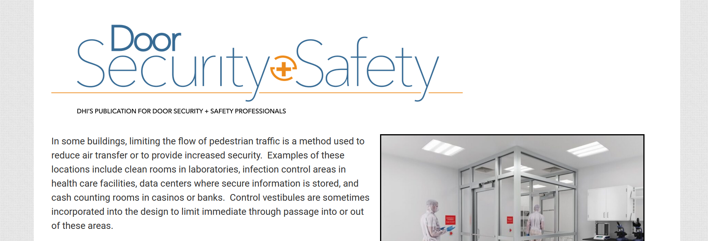
https://idighardware.com/2024/11/decoded-control-vestibules-in-a-means-of-egress/
https://idighardware.com/ACE/
Notes:
More info about this change can be found in the linked blog post or on the ACE page.
On the Articles page of iDigHardware, there are Decoded articles about almost every code requirement related to door openings.

