Slide 1
Lori Greene
DAHC/CDC, FDAI, FDHI
Allegion – Manager,
Codes & Resources
iDigHardware.com
Code Update
Mark A. Kuhn
FDHI, AHC, EHC, DHT, DHC, CFDAI, CDT, CSI
Allegion - Architectural
Consultant
Notes:
Introductions on the next couple of slides

Slide 2
Lori Greene
DAHC/CDC, FDAI, CCPR
Manager, Codes & Resources
2012
became manager,
codes and resources
2009
created iDigHardware.com
1994
began representing the Allegion brands
1986
joined the industry
Notes:
Less than 1 minute introduction

Slide 3
Mark Kuhn
FDHI, AHC, EHC, DHT, DHC, CFDAI, CDT
Architectural Consultant
2021
starting helping Lori ☺
2016
began representing the Allegion brands
1984
joined the industry
Notes:
Less than 1 minute introduction

Slide 4
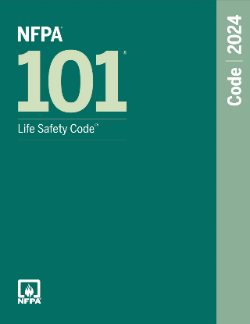
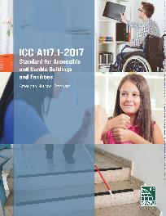
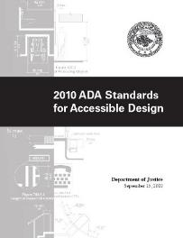
Notes:
BHMA CGIA’s work (and our work)
Changes vs. clarifications
State codes

Slide 5
https://idighardware.com/ace
Notes:
We will share a new topic on this call each month.
21 topics on ACE page + this month
slide decks, speaker notes, links to extra resources
If you want us to cover a topic, check the ACE page first

Slide 6
Notes:
When you have a code question - check iDH first (Google search works well)
Click the orange ball to find your ACE

Slide 7
Digital Code Reference Guide
ACE Training to Replace COR140
Updated External Training
Notes:
What’s coming next year

Slide 8
SCHOOL SECURITY CHANGES
Notes:
Over to Mark

Slide 9
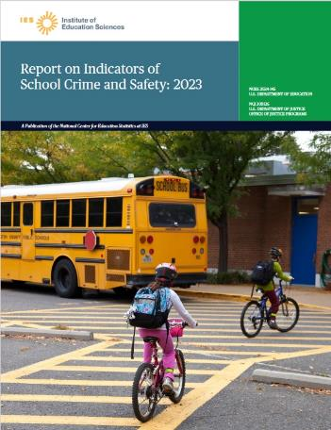
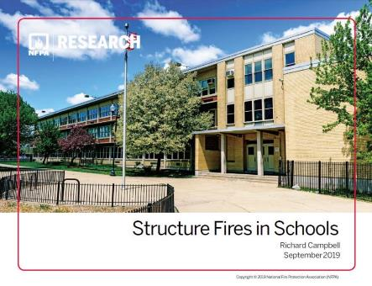
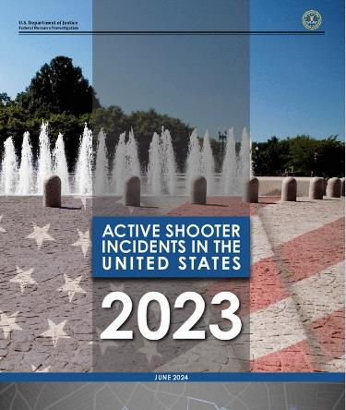
Statistics on School Safety
NFPA: 4,800 fires in educational facilities per year, on average (2010-2020)
Code Update
Notes:
Quick overview of stats to remind people why active shooter events are not the only consideration
People think fires don’t occur in schools and that’s the reason the code should allow classroom barricade devices, but according to NFPA there are an average of 4,800 fires in educational facilities per year. We don’t see high numbers of fatalities because of the strong code requirements and enforcement.

Slide 10
Statistics on School Safety
NFPA: 4,800 fires in educational facilities per year, on average (2010-2020)
FBI: <4 active shooter events in educational facilities per year, average (2010-2023)
Code Update
Notes:
In comparison, FBI reports indicate that each year since 2010 there have been an average of less than 4 active shooter events in educational facilities. We need to help schools prepare for these events, but they shouldn’t focus only on active shooter events and overlook other hazards.

Slide 11
Statistics on School Safety
NFPA: 4,800 fires in educational facilities per year, on average (2010-2020)
FBI: <4 active shooter events in educational facilities per year, average (2010-2023)
NCES: 568,100 non-fatal victimizations at school for students aged 12-18 (2022)
Code Update
Notes:
One other consideration is the prevalence of non-fatal victimizations, which includes assault and sexual assault. Current codes require locked doors in schools to be openable from the outside by an authorized person with a key, credential, or other approved means.
Sources:
NFPA: https://www.nfpa.org/education-and-research/research/nfpa-research/fire-statistical-reports/structure-fires-in-schools
FBI: https://www.fbi.gov/how-we-can-help-you/active-shooter-safety-resources
NCES: https://nces.ed.gov/programs/coe/crime-and-safety

Slide 12
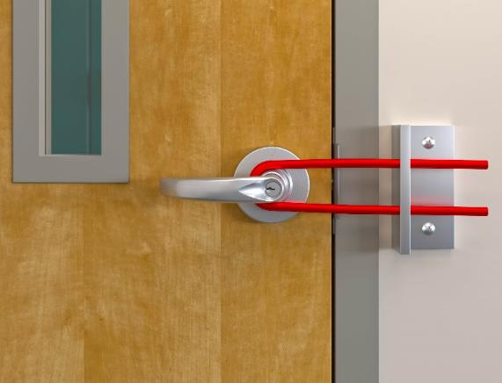
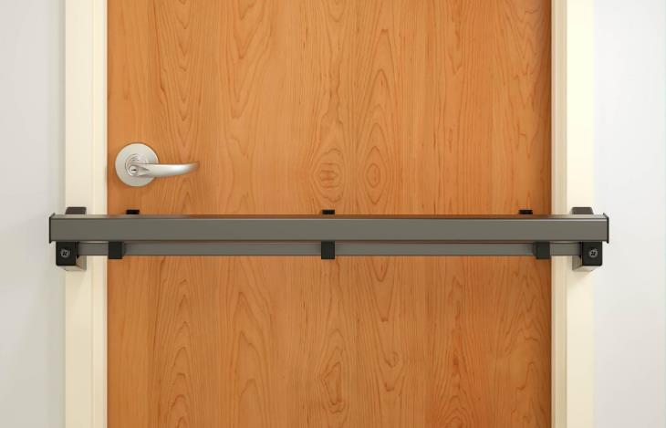
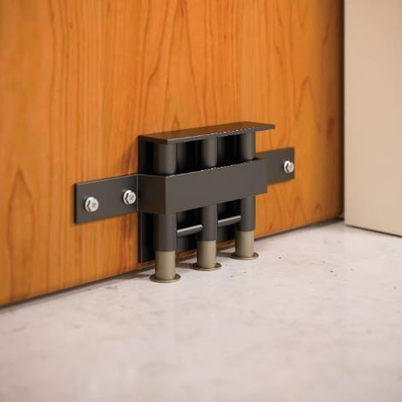
Classroom Barricade Devices
Code Update
Notes:
Of course, these are some of the types of devices that some schools were considering, but hopefully we will be seeing less barricade devices going forward.

Slide 13
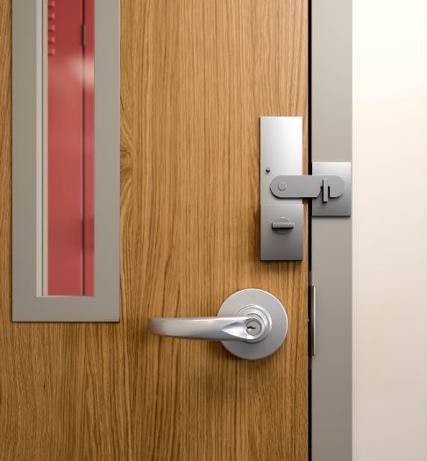
NFPA 101 TIA 1436
Modified the 2018 edition of NFPA 101 – carried forward to 2021/2024 editions
Two non-simultaneous releasing motions are allowed for K-12 classroom doors in existing schools
All other requirements of 101 must be met
Applies to jurisdictions that have adopted the 2018 or subsequent edition of NFPA 101
Intent is to allow a separate deadbolt
Code Update
Notes:
NFPA codes have been modified to allow a second releasing motion for egress on classroom doors in existing schools – this was proposed by a school district so they could add deadbolts, but we’ve been told that the fire marshal in that state will not allow the second releasing motion. The I-Codes do not allow 2 releasing motions for classroom doors.

Slide 14
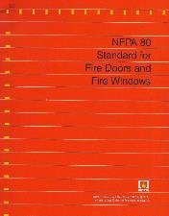
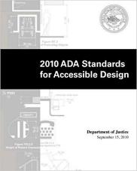
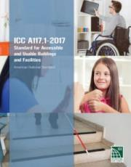
Combined Code Requirements
Door must unlatch with one releasing motion*
No key, tool, special knowledge or effort for egress
No tight grasping, pinching, or twisting of the wrist
Releasing hardware 34-48 inches AFF (or as required by state or local codes/standards)
Authorized access from the outside (added 2018)
Panic hardware required when door is serving 50+ occupants
Hardware on fire doors listed to UL 10C
NFPA 80 limits alterations to fire doors
NFPA 101 – lockable without opening door
State and local codes may vary
*2 non-simultaneous releasing motions for existing classroom doors are now allowed in some jurisdictions.
Notes:
There are multiple codes and standards that must be met.

Slide 15
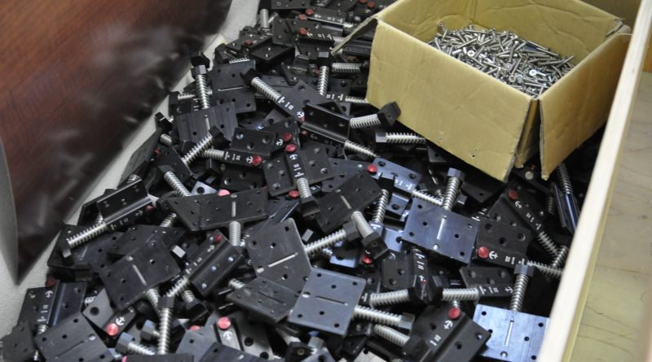
A California college was required to remove $200,000 worth of barricade devices because they were not code-compliant.
Photo: Victor Tence, The Guardsman
Code Update
Notes:
In addition to the potential liability of installing something that isn’t code-compliant, there’s a possibility that the devices will have to be removed.
A college in California installed more than $200,000 worth of barricade devices that did not comply with the state codes, and they were all ordered removed by the fire marshal.

Slide 16
2018/2021/2024 IBC:
1010.2.7 Locking arrangements in educational occupancies. In Group E occupancies, Group B educational occupancies and Group I-4 occupancies, egress doors from classrooms, offices and other occupied rooms with locking arrangements designed to keep intruders from entering the room shall comply with all of the following conditions:
1. The door shall be capable of being unlocked from outside the room with a key or other approved means.
2. The door shall be openable from within the room in accordance with Section 1010.2.
3. Modifications shall not be made to listed panic hardware, fire door hardware or door closers.
4. Modifications to fire door assemblies shall be in accordance with NFPA 80.
Remote locking or unlocking of doors from an approved location shall be permitted in addition to the unlocking operation in Item 1.
Notes:
There is a change coming in the 2027 IBC (NFPA codes still in progress) that will affect classroom doors. In the 2018 model codes, a section was added with regard to locking doors in schools. Doors were PERMITTED to be locked as long as they still complied with the existing egress requirements (#2), and the added requirement for authorized access (#1). This section was included with minimal changes in the 2021 and 2024 editions.

Slide 17
2027 IBC:
1010.2.7.1 Egress doors in educational occupancies.
Egress doors from classrooms, offices, and other occupied rooms shall be provided with locking arrangements designed to keep intruders from entering the room and shall comply with all of the following:
1. The doors shall be capable of being locked from inside the room.​
2. The doors shall be capable of being unlocked from outside the room with a key or other approved means.
3. The doors shall be openable from within the room in accordance with Section 1010.2.
4. Modifications shall not be made to listed panic hardware, fire door hardware or door closers.
5. Modifications to fire door assemblies shall be in accordance with NFPA 80.
Code Update
Notes:
In the 2027 edition, rather than PERMITTING doors in schools to be locked, the IBC will REQUIRE doors in schools to be lockable. This will apply to egress doors serving classrooms, offices, and other occupied rooms. The doors must be lockable from inside the room, and the other requirements still apply (free egress + authorized access). Side note: Many schools are struggling with elopement, and beginning with the 2018 I-Codes, delayed egress is an option for classrooms with a calculated occupant load of less than 50 people.

Slide 18
2027 IBC:
​1010.2.7.2 Exterior entry doors. Exterior doors ​which provide entry into the building shall be provided with locking arrangements designed to keep intruders ​from entering the building, and shall comply with all of the following:​
1. The doors shall be lockable from the egress side of the door. ​
2. A minimum of one door on each building face shall be capable of being unlocked from outside the ​building with a key or other approved means.​
3. Each egress door shall be openable from within the building in accordance with Section 1010.2
Code Update
Notes:
There is a Part 2 of the 2027 change that applies to exterior doors in schools – these must also be lockable from the egress side (no classroom function lever trim) and must continue to comply with the egress requirements. The IBC will also require at least one door on each face of the building to be able to be unlocked from the outside for emergency access.
These changes are not required to be made retroactively, but they reflect best practices that should be applied from today going forward.

Slide 19
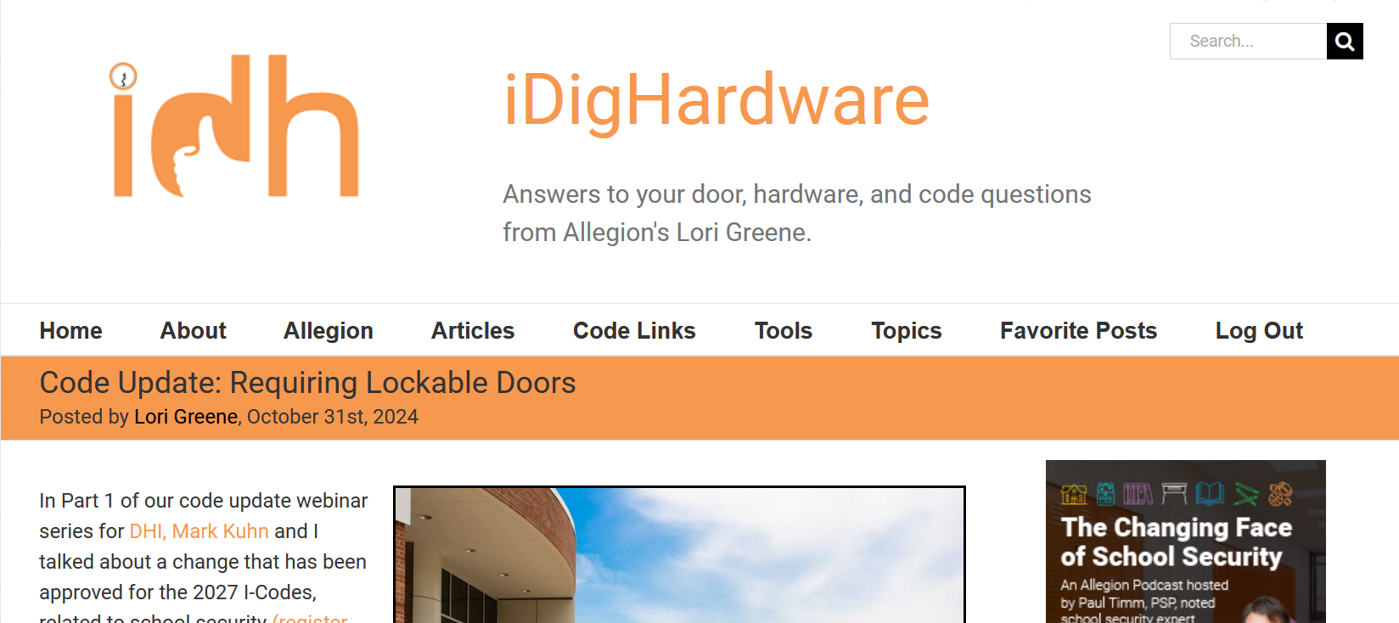
https://idighardware.com/2024/10/code-update-requiring-lockable-doors/
https://idighardware.com/ACE/
Notes:
More info about this change can be found in the linked blog post or on the ACE page.

