Slide 1
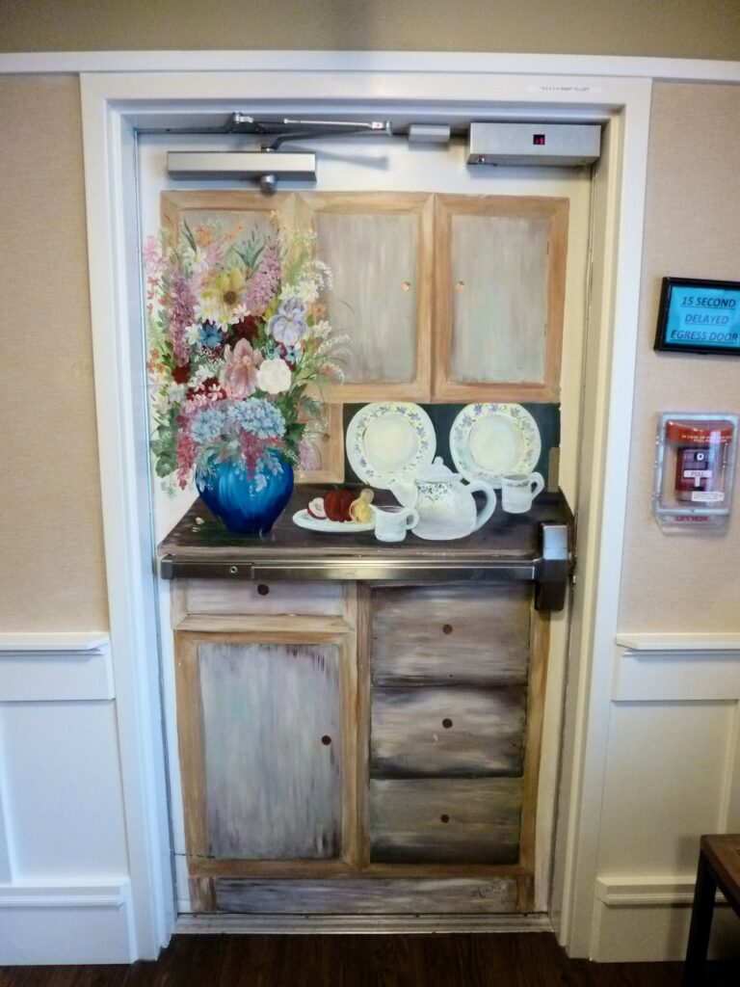
Question:
The door in a photo is an egress door in a memory care facility. Is it code-compliant?
Yes
No
It’s up to the AHJ.
It depends on which edition of the code has been adopted.
Notes:
Here is a quiz question to get this discussion rolling…

Slide 2
Question:
The door in a photo is an egress door in a memory care facility. Is it code-compliant?
Yes
No
It’s up to the AHJ.
It depends on which edition of the code has been adopted.
Notes:
One of the golden rules of egress doors is that they must be distinguishable as doors – they can not be concealed by curtains, mirrors, or murals.
BUT…a change was made to the 2015 edition of NFPA 101 that allows doors in certain types of health care units to be disguised, to deter exit seeking and elopement. This topic is being covered at the request of one of the RSOs – if there is a code question you would like addressed in a monthly update, let Lori know.

Slide 3
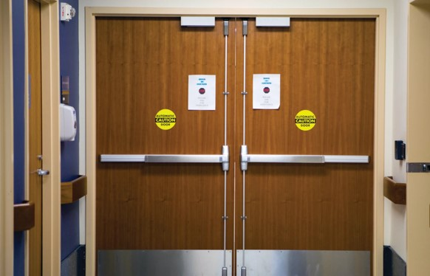
Controlled Egress
ONLY ALLOWED IN HEALTH CARE UNITS WHERE PATIENTS REQUIRE CONTAINMENT FOR SAFETY OR SECURITY
Door stays locked until egress is needed
Immediate egress is allowed:
Upon actuation of fire alarm or sprinkler system
Upon loss of power
Upon remote signal
Staff must have the ability to unlock the doors if evacuation is required
There are some exceptions to these remote release methods
Notes:
A previous update covered controlled egress locks in health care facilities…refer back to that update if necessary.
Controlled egress locks are allowed to restrict egress if the requirements listed in the code are met, and they are typically allowed in memory care units, maternity and nursery areas, and other locations where patients require containment for their safety or security. This application is only allowed in health care – not in other types of facilities.
As of the 2015 edition of NFPA 101, if a door in a health care facility is allowed to have a controlled egress lock, the door can be disguised with a mural based on certain criteria stated in the code.

Slide 4
NFPA 101, beginning with the 2015 edition:
18.2.2.2.7* Doors permitted to be locked in accordance with 18.2.2.2.5.1 shall be permitted to have murals on the egress doors to disguise the doors, provided all of the following are met:
1. Staff can readily unlock the doors at all times in accordance with 18.2.2.2.6. 2.* The door-releasing hardware, where provided, is readily accessible for staff use. 3.* Door leaves, windows, and door hardware, other than door-releasing hardware, are permitted to be covered by the murals. 4. The murals do not impair the operation of the doors. 5. The location and operation of doors disguised with murals are identified in the fire safety plan and are included in staff training. 6. Any modification to a fire door complies with NFPA 80.
Notes:
This section is found in Chapter 18 for new health care facilities.
The mural can not cover the door-releasing hardware or impair the operation of the door, and the location and operation of the disguised doors must be identified in the fire safety plan an included in staff training.
In 2021, a clarification was added – if the door is a fire door, the modification must comply with NFPA 80. This means that if a decorative film is applied to the door, it must be listed for that purpose or allowed by the door manufacturer and listing lab as a field modification. Note that painting a fire door is not considered a field modification, so painting a mural on a fire door would not require approval from the door manufacturer or listing lab.

Slide 5
NFPA 101, existing health care:
19.2.2.2.7* Doors permitted to be locked in accordance with 18.9.2.2.5.1 shall be permitted to have murals on the egress doors to disguise the doors, provided all of the following are met:
1. Staff can readily unlock the doors at all times in accordance with 18.2.2.2.6. 2.* The door-releasing hardware, where provided, is readily accessible for staff use. 3.* Door leaves, windows, and door hardware, other than door-releasing hardware, are permitted to be covered by the murals. 4. The murals do not impair the operation of the doors. 5. The affected smoke compartments are protected throughout by an approved, supervised automatic sprinkler system in accordance with 19.3.5.7.
6. The location and operation of doors disguised with murals are identified in the fire safety plan and are included in staff training. 7. Any modification to a fire door complies with NFPA 80.
Notes:
A similar section is found in the existing health care chapter of NFPA 101 and includes an added requirement that the smoke compartment where the door is located must be protected throughout by an automatic sprinkler system.

Slide 6
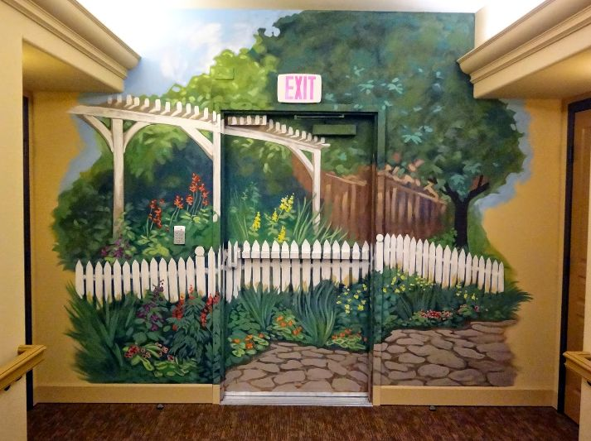
BUT…
Not included in NFPA 101-2012 – adopted by CMS/Joint Commission
Not specifically addressed in the IBC or IFC
Requires AHJ approval
Murals on the access/ingress side are not prohibited
Notes:
BUT!
This change was first incorporated in the 2015 edition of NFPA 101. CMS and the Joint Commission are still enforcing the 2012 edition of NFPA 101, which did not reference murals on egress doors. The International Building Code and International Fire Code do not specifically address murals on egress doors either. This means that if the adopted code in a particular jurisdiction is something other than NFPA 101-2015 or a subsequent edition of NFPA 101, a mural on a controlled egress door would require AHJ approval.
If the mural is on the access or ingress side of the door, this is not typically a code issue, although the NFPA 80 requirements would apply if it is a fire door assembly.

Slide 7
iDH Tip: Topics Pages
Notes:
A few new links have recently been added to the topics menu – these are sections of iDigHardware or pages (instead of blog posts) that cover a particular topic. If there is a subject that you think should be added to the topics menu, let Lori know.

