Slide 1
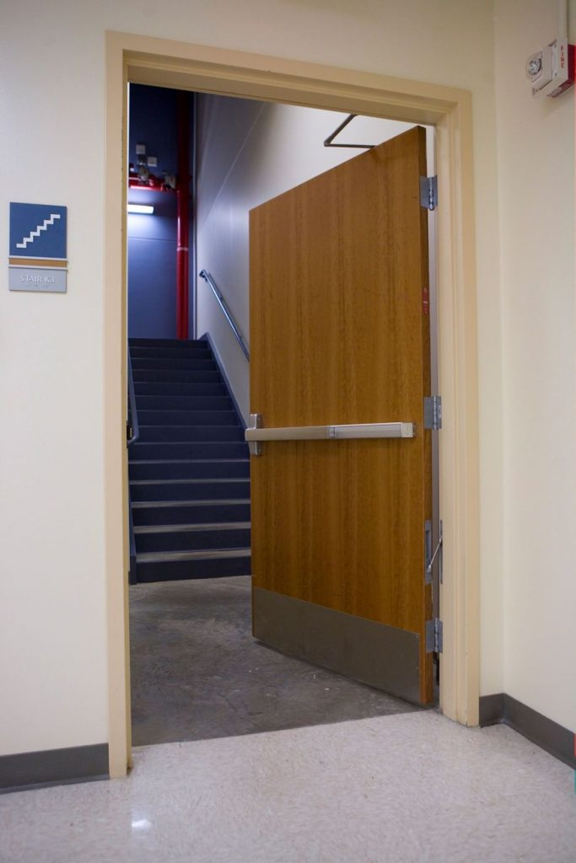
Question:
In a high-rise apartment building with 26 apartments per floor, are the stair doors required by code to have fire exit hardware (panic hardware)?
Yes
No
It’s up to the AHJ.
It depends on which edition of the code has been adopted.
Notes:
Here is a quiz question to get this discussion rolling…

Slide 2
Question:
In a high-rise apartment building with 26 apartments per floor, are the stair doors required by code to have fire exit hardware (panic hardware)?
Yes
No
It’s up to the AHJ.
It depends on which edition of the code has been adopted.
Notes:
Although panic hardware may be preferred for durability, reliability, security, and/or ease of use, the model codes do not require panic hardware for residential occupancies, regardless of the occupant load. There is an exception for assembly spaces contained within residential occupancies.

Slide 3
Locksmith Ledger
Five Code Considerations for Multifamily Residential Buildings
Fire door assemblies for unit entries
Releasing motions for egress
Electrified hardware for access control
Panic hardware and fire exit hardware
Fair Housing Act
Notes:
A recent article published in Locksmith Ledger addresses five code considerations for multifamily residential buildings. This information can be helpful in other types of buildings as well. In the interest of time, I will share one tip from each topic – refer to the article for more info.

Slide 4
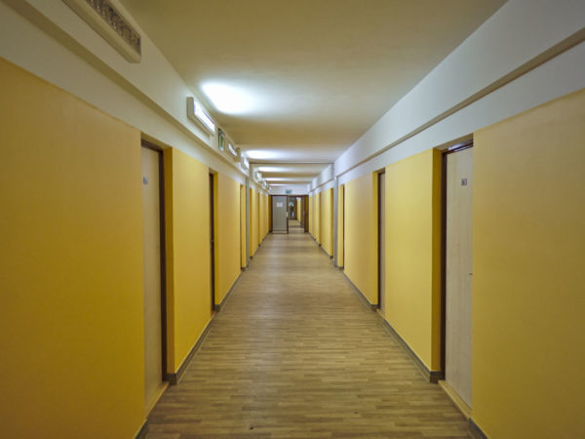
Fire Door Assemblies for Unit Entries
Interior dwelling unit entry doors – typically 20-minute fire doors
This post explains how to find the required rating in the code: https://idighardware.com/2022/11/qq-dwelling-unit-entry-door-fire-rating/
Notes:
How to determine the required rating of a fire door assembly is a very frequently-asked question. In some cases, the rating of the fire door assembly is ¾ of the rating of the wall, but this is not true in every case.
For apartments and other residential occupancies, the fire door on the unit entry plays a very important role in helping to prevent the spread of smoke and flames should a fire occur within a dwelling unit or sleeping unit. The rated partitions and doors help to keep the means of egress (corridors and stairs) usable for evacuation.

Slide 5
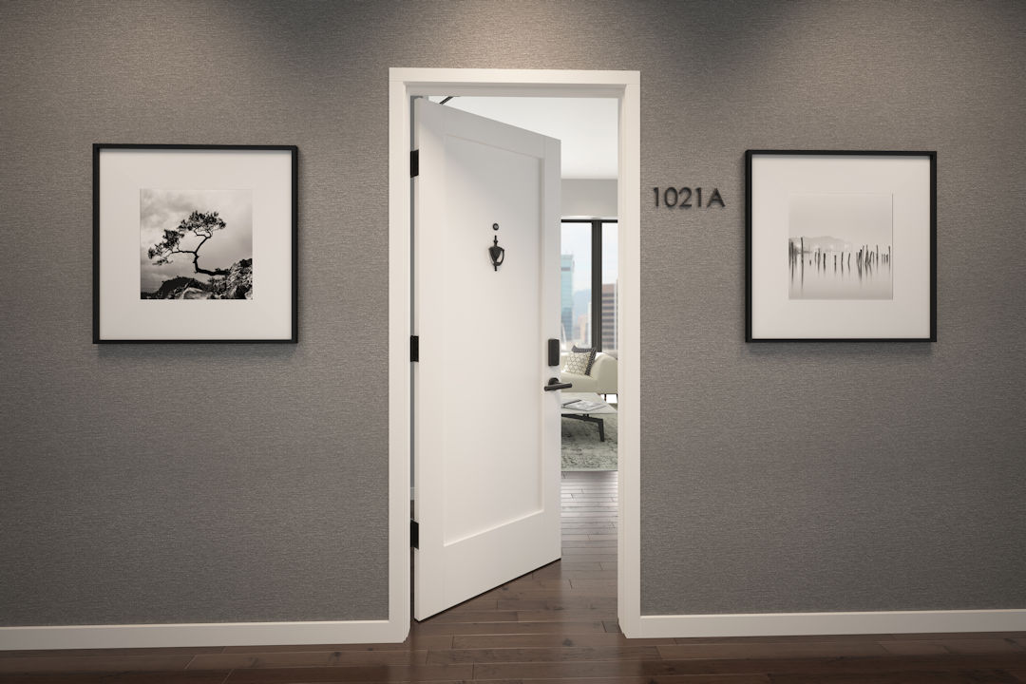
Releasing Motions for Egress
Most egress doors are required to unlatch with one releasing motion
Entrance doors to dwelling units and sleeping units are an exception
Notes:
The model codes require most doors in a means of egress to unlatch with one releasing motion. Entrance doors to dwelling units and sleeping units are one exception to that rule. Both the I-Codes and the NFPA codes allow these doors to have a nightlatch, deadbolt, or security chain in addition to the latching hardware, as long as a key is not needed for egress. The I-Codes limit this second security device to units with a calculated occupant load of 10 people or less (units of 2000 square feet or less).
As always, state and local codes may include additional limitations.

Slide 6
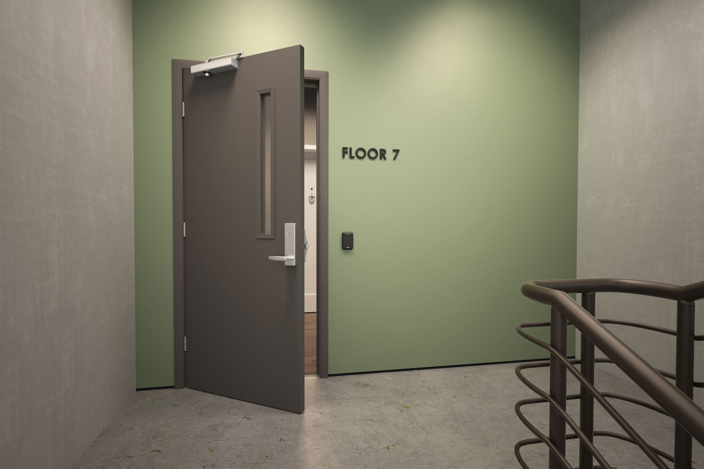
Electrified Hardware for Access Control
Access control and special locking arrangements are becoming more common in multifamily buildings
Stairwell reentry
Electromagnetic locks
Delayed egress (parking garages are a common application)
Elevator lobby egress doors
Notes:
As with other buildings types, access control and electrified hardware are becoming more and more common in residential buildings. Often these applications are considered “normal locking arrangements”, where egress is not dependent on the status of the electrified hardware. But some applications are “special locking arrangements”, and the model codes include detailed requirements for these systems.
Visit iDigHardware.com/sla for in-depth information on special locking arrangements.

Slide 7
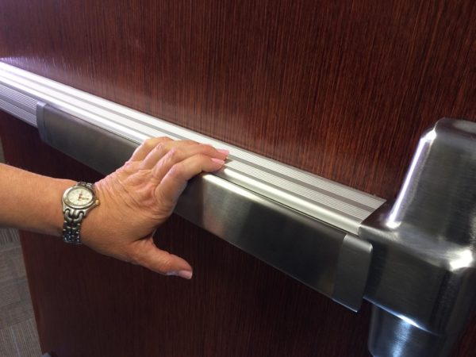
Panic Hardware and Fire Exit Hardware
Is not required by code for residential occupancies
IS required by code if the residential building contains assembly space
May also be required for electrical rooms depending on the voltage/amperage of the equipment
Notes:
Although the stairwell doors in the quiz question did not require panic hardware because the doors were only serving floors with apartments, a residential building could include an assembly space like a café, function room, or large lobby area. If the occupant load of the assembly space is 50 people or more (I-Codes) or 100 people or more (NFPA codes), panic hardware is required for the egress doors serving these spaces if the door is equipped with a lock or latch.
Some electrical rooms and refrigeration rooms also require panic hardware, depending on the type of equipment in the room.

Slide 8
Fair Housing Act
Applies to most multifamily buildings
Helps to ensure accessibility for all
Notes:
The federal Fair Housing Act was first adopted in 1968 and was amended in 1988. This law requires all covered multifamily dwellings ready for first occupancy after March 13, 1991 to be accessible and usable by people with disabilities. Covered multifamily dwellings include dwelling units in buildings containing four or more units if the building has an elevator, or all ground floor units if the building does not have an elevator.
There is detailed information about the Fair Housing Act requirements in this Decoded article: https://idighardware.com/2014/08/decoded-fair-housing-act/.

Slide 9
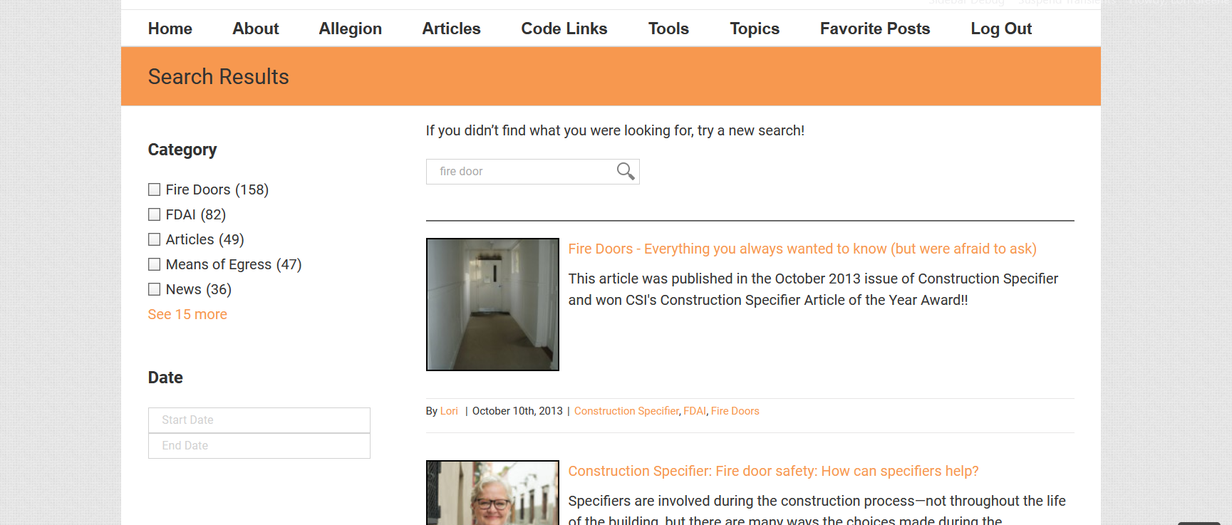
iDH Tip: Finding What You’re Looking For
Notes:
There are currently well over 3,000 posts on iDigHardware, so it can be difficult to find what you’re looking for. The site has two different search options – one is in the upper right-hand corner of the header. If that search box is used, once the results come up there are options for filtering the results, entering a date range, or conducting the search again using a different search engine.
If you are looking for an in-depth article on a particular topic, those are on the Articles page (click Articles in the menu bar). Once on the articles page, you can hit Ctrl^F and then type in what you’re trying to find.
On the Tools menu there are links to the videos page and other resources.
The Topics menu has links for popular topics like fire doors, school security and safety, and special locking arrangements.

Slide 10
iDH Tip: Finding What You’re Looking For
Go to Google
Put “iDigHardware” in quotes along with what you are searching for
Notes:
If you are looking for a particular post, or multiple posts on a particular topic, the easiest way is to go to Google. Type “iDigHardware” in quotes, along with the topic you are looking for, and Google will look for results within the iDigHardware site. In this example, I searched for the code reference guide and limited the search to iDigHardware, and the guide is the first result.

Slide 11
iDH Tip: Finding What You’re Looking For
You can also do this with Google Images (images.google.com)
Notes:
This works for images too…go to images.google.com, put “iDigHardware” in quotes and then whatever you’re looking for. Here I searched for infographics posted on the site, to find the one on delayed egress vs. controlled egress.
If you have a question or an idea for an iDH tip, let me (Lori) know!

