Slide 1
Notes:
This year I will be working on a health care code presentation and some supporting materials, as well as sharing a link to a post from iDigHardware in the ASHE newsletter each month. There are quite a few code requirements and exceptions that are specific to health care facilities. The first article for the newsletter is a Decoded article called FAQs on Fire Door Requirements for Health Care Facilities.
This ACE update gives the short answers to each of the FAQs in that article…for more information there are links in the article to detailed posts. If you don’t have time to cover all of the FAQs in your RSO meeting, you can choose a few and send people to the article for the rest. The article is here: https://idighardware.com/2022/02/decoded-faqs-on-fire-door-requirements-for-health-care-facilities/, or you can find it on the Articles page of iDigHardware.

Slide 2
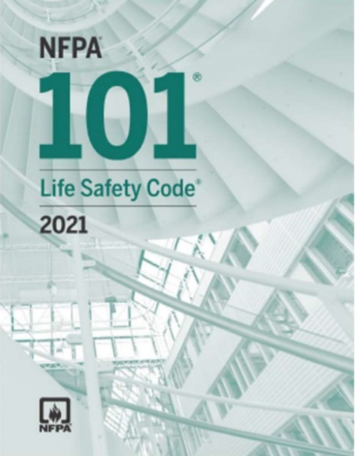
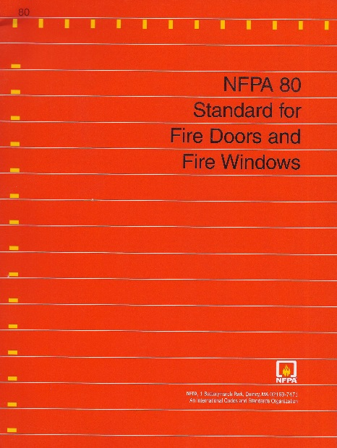
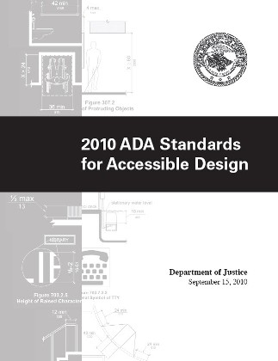
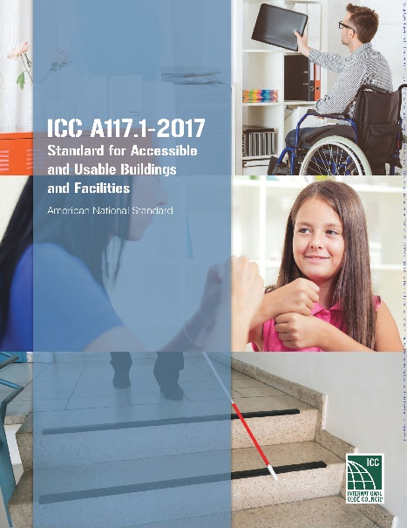
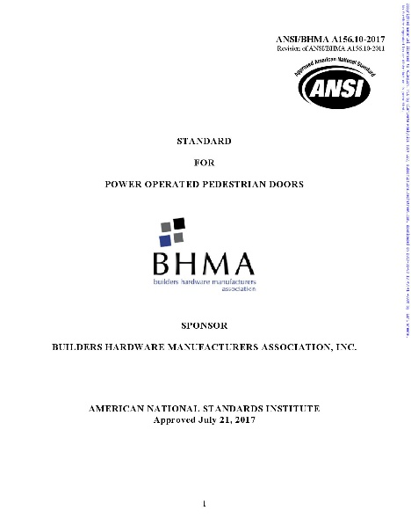
Which code(s) or standard(s) must be followed?
NFPA 101-2012 adopted/enforced by CMS and Joint Commission
Other codes like NFPA 70 and NFPA 72
Referenced standards like NFPA 80 and BHMA standards
Accessibility standards
Adopted building codes and fire codes, possibly with state or local modifications
Notes:
For many facilities there may be more than one Authority Having Jurisdiction (AHJ), and often these AHJs may be enforcing different codes and referenced standards. For this reason, it’s important to have an understanding of the requirements of various publications.
CMS (Centers for Medicare and Medicaid Services) has adopted NFPA 101-2012, and this is enforced by the accrediting organizations like the Joint Commission. Many hospital facility managers will focus only on NFPA 101-2012 because of the Joint Commission accreditation, but in most locations, this is not the only code that applies.
There are specialized codes like NFPA 70 – National Electrical Code and NFPA 72 – National Fire Alarm and Signaling Code that apply in most jurisdictions.
Referenced standards like NFPA 80 and the BHMA standards, as well as the accessibility standards – ICC A117.1 and the ADA Standards for accessible design also apply in most jurisdictions.
State and local code officials will typically enforce the adopted codes like the IBC and IFC, often with state or local modifications.

Slide 3
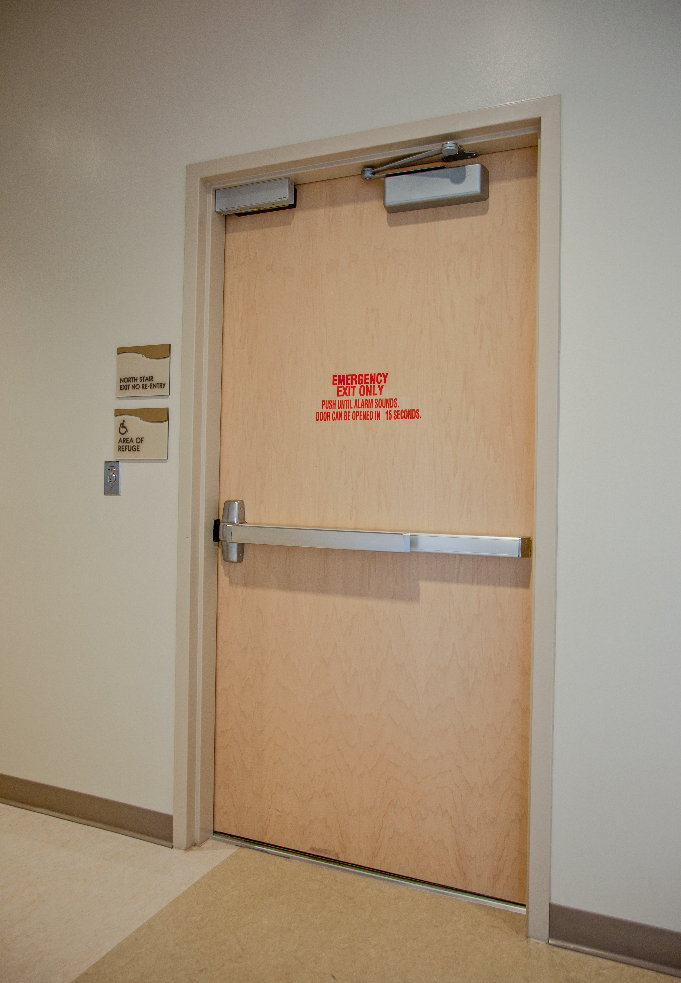
Are all components of a fire door assembly required to be listed and/or labeled?
Yes, unless there is an exception in NFPA 80.
For example, protection plates mounted within the bottom 16 inches of door height are not required by NFPA 80 to be listed/labeled.
Listing/labeling requirements DO apply to mag-locks, deadbolts
Notes:
The intent of the codes and standards is for each component that is part of a fire door assembly to be listed for that purpose, unless specifically exempted by the standard. For example, a protection plate installed in the bottom 16 inches of door height is not required by NFPA 80 to be listed or labeled. The standard also addresses certain “items of a generic nature” that are not required to be labeled but must comply with the specifications of NFPA 80.
NFPA 80 allows listed components of a swinging fire door assembly to be from different manufacturers and/or different listing laboratories, except where restricted by individual published listings. Depending on which code has been adopted, components of a swinging fire door assembly may be listed to NFPA 252, UL 10B, or UL 10C. However, the IBC requires components to be listed using a positive pressure test – either the UL 10C standard or the NFPA 252 standard with the test conducted using the positive pressure method.
Some people think that deadbolts and mag-locks, which are not considered positive-latching hardware, do not require a listing, but there are no exemptions in the codes and standards for these products.

Slide 4
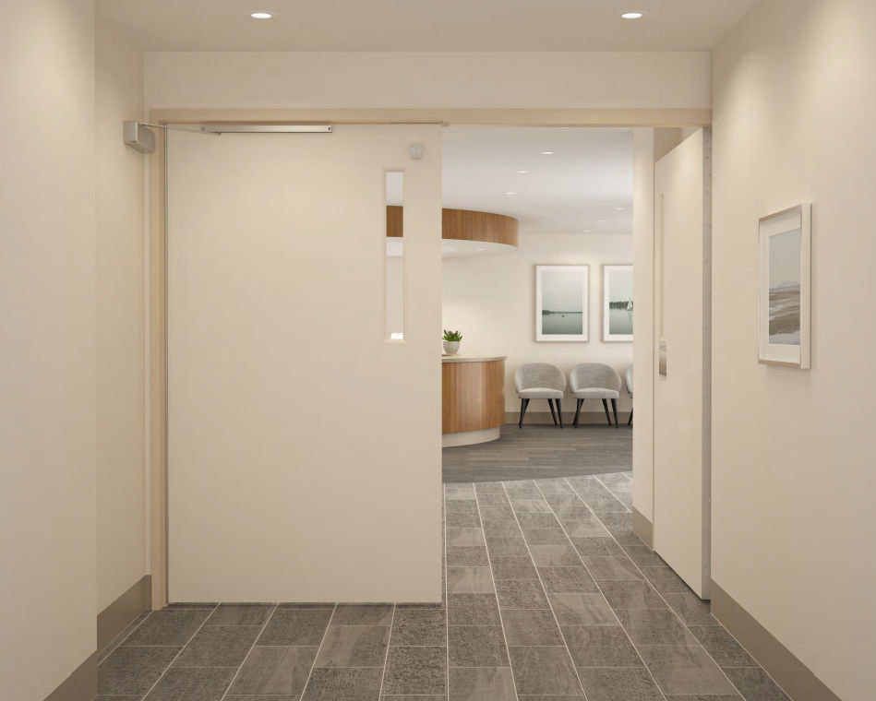
Are cross-corridor doors in health care facilities required to have positive-latching hardware?
For double-egress pairs in smoke barriers in health care facilities – the IBC does not require doors to be fire rated or to have positive-latching hardware.
NFPA 101 has similar language but does not specifically call out double-egress pairs.
This has been clarified over the past several editions of the model codes, but I believe it has been the intent of the codes for many years.
Notes:
Some cross-corridor doors in health care facilities are required to be fire doors, and these doors must meet the requirements of NFPA 80 – including an active latchbolt to ensure positive latching. However, the most common cross-corridor doors in health care facilities – double egress pairs in smoke barriers – are exempt from these requirements. Much of the confusion about this application has been caused by the numerous changes that have been made in the model codes, to try to clarify the intent. Currently, both the I-Codes and the NFPA codes include exceptions specific to pairs of doors in smoke barriers, which state that the doors are not required to be fire doors or to have positive-latching devices. There are other requirements in these sections that do apply, such as restrictions on clearances and glazing, so it’s important to refer to the applicable section for prescriptive criteria.
The next 2 slides include the applicable sections from the IBC and NFPA 101, for reference.

Slide 5
IBC - 2021
Notes:
For reference: Exception 1 in this section of the IBC addresses double-egress pairs in health care facilities.

Slide 6
NFPA 101 - 2012
Notes:
For reference: In NFPA 101, there are sections in both Chapter 18 (new health care) and 19 (existing health care) that address doors in smoke barriers. These sections do not specifically call out double egress pairs, however, that is the typical configuration for pairs in a smoke barrier.

Slide 7
Can existing fire door assemblies be modified in the field for new hardware?
Job site preparations
Recent editions of NFPA 80 do not limit size of round holes if allowed by the manufacturer’s listings.
Field modifications
Permission must be requested in advance from listing labs, via the door or frame manufacturer.
Notes:
The short answer is yes – fire doors can be modified in the field, but there are some limitations depending on the work that is needed. NFPA 80 includes requirements for two types of alterations: job-site preparations and field modifications. Job-site preparations are limited to round holes for surface-mounted hardware, function holes for mortise locks, and holes for labeled viewers. Past editions of NFPA 80 limited round holes for job-site preparations (with the exception of cylinder holes) to 1-inch diameter. In the 2016 edition of the standard, the limit on the hole diameter was removed, and larger round holes are permitted for surface-applied hardware installed in accordance with the door and hardware manufacturers’ listings. Undercutting of wood and composite doors (where permitted by their listings) and installation of protection plates are also addressed as job-site preparations.
For alterations that are not considered job-site preparations, NFPA 80 includes requirements for field modifications. Field modifications must be approved before the work is begun, and approval must be requested from the listing laboratory, via the door or frame manufacturer. If a field modification is not approved by the lab, it’s possible that the work could be done in a shop that is authorized to perform the alteration, or that the door or frame could be relabeled in the field after completion of the work. Unused holes left when hardware is changed in the field must be filled using the methods prescribed in NFPA 80 or as permitted by the manufacturers’ listings.

Slide 8
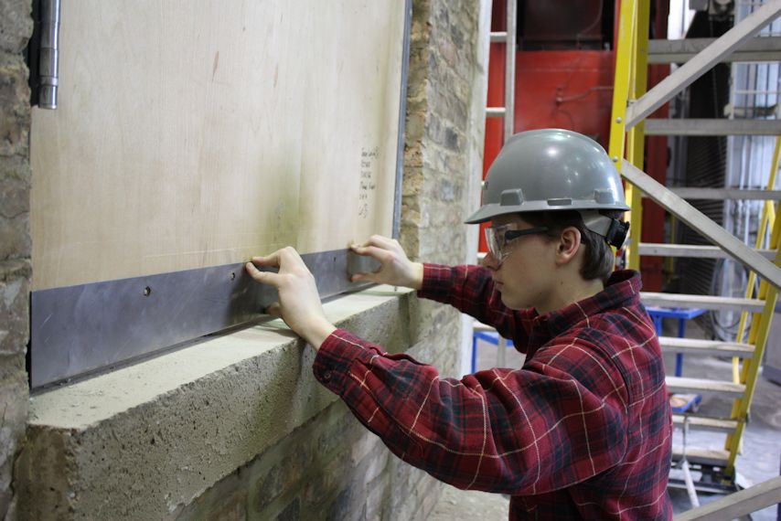
If the clearance on an existing fire door is greater than what is allowed by NFPA 80, how can this be addressed?
Gasketing and door bottoms available
Must be listed for use on fire doors with excess clearance
Check limitations on door material, rating, and amount of clearance
Notes:
On existing fire door assemblies, one of the most common deficiencies found is clearance that is greater than what is allowed by NFPA 80. Since the 2016 edition, NFPA 80 has allowed clearance at the head, jambs, and meeting stiles of 1/8-inch +/- 1/16-inch for 20-minute doors (including wood doors) in hollow-metal frames; hollow metal doors listed for up to 3 hours are subject to the same limitations. Wood doors rated for more than 20 minutes are limited to clearances at the head, jambs, and meeting stiles of 1/8-inch, maximum. Clearance under the bottom of a fire door may be a maximum of 3/4-inch (or 3/8-inch, maximum, if the bottom of the door is more than 38 inches above the floor).
When clearances exceed the maximums stated in the standard, it may be possible to add gasketing, edge guards, door sweeps, or other materials to bring the door into compliance. However, the products used to address this problem must be specifically listed for use on fire doors with excess clearance. Standard gasketing and door bottoms will not solve the problem, even if they are listed to UL 10C or NFPA 252. Products designed to address non-compliant clearances will typically include limitations on the door material, fire rating, and maximum clearance, so it is important to refer to the manufacturer’s information to determine whether the product will bring the fire door assembly back into compliance.

Slide 9
If an existing pair of fire doors has vertical rod fire exit hardware, can the bottom rods and latches be removed, and an auxiliary fire pin installed?
Is the LBR retrofit allowed by the manufacturer’s listings?
Openings installed before the late 90’s may be especially problematic.
Notes:
Because vertical rod style fire exit hardware can be problematic in health care facilities, many facility managers have inquired about modifying existing pairs to remove the bottom rods and latches.
The answer to whether or not an existing pair can be retrofitted is not found in the codes and standards, as it is dependent on the listings of the fire doors and the fire exit hardware. If the doors and hardware have been installed in the last 20 years or so, it is likely that the manufacturers’ listings would allow an auxiliary fire pin to be added and the bottom rods and latches removed. However, older fire doors or fire exit hardware may not have been tested or listed with the “less bottom rod” (LBR) application. For a definitive answer, information about the existing doors and hardware must be provided to the manufacturers, to see if their listings for products manufactured at that time will permit the field modification.

Slide 10
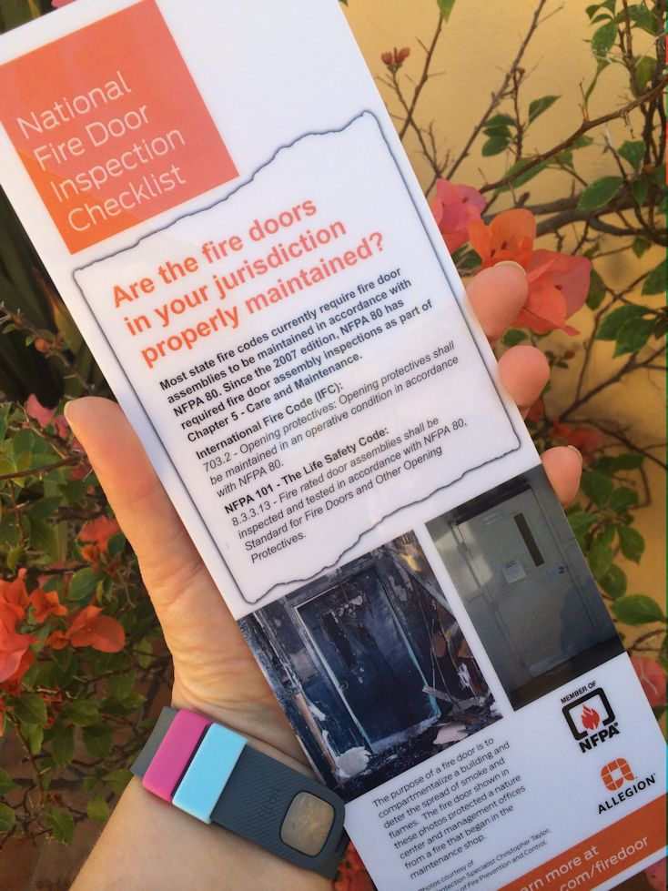
Are fire door assemblies in health care facilities required to be inspected annually?
YES! This has been confirmed by CMS and the Joint Commission.
Don’t forget about our laminated fire door inspection card.
This is an older version of the card, but you get the idea.
Notes:
In the last 15 years, prescriptive requirements for fire door assembly inspections have been added to the model codes and to NFPA 80. Currently, NFPA 80 requires fire door assemblies to be inspected after installation, after maintenance work, and annually, although the edition of NFPA 80 referenced by NFPA 101-2012 only requires annual inspections.
The Centers for Medicare and Medicaid Services (CMS) and their accrediting organizations such as the Joint Commission, adopted the 2012 edition of the Life Safety Code in July of 2016. NFPA 101-2012 references the 2010 edition of NFPA 80, which requires fire door assemblies in all occupancy classifications – including health care facilities – to be inspected annually. In 2017, CMS issued a memorandum confirming that fire door assembly inspections were required for all accredited health care facilities and establishing a deadline for compliance of January 1, 2018. These requirements continue to be enforced today, for any health care facility that receives funding from CMS.
We have a laminated card on fire door inspection that has been really helpful to our customers. You can see it here: https://idighardware.com/firedoor/, and it is available to order from the same place you order catalogs and the code reference guide.

Slide 11
Notes:
The iDigHardware tip for this month…
The Flying Locksmiths asked me to create a code class for their locksmiths, so I created a Crash Course in Codes with locksmiths and installers in mind. Since I posted the recording, several AHJs have emailed me to say that it was a great refresher for code officials as well, so feel free to use it as you see fit. I have not yet registered it for AIA CEUs, since we don’t offer CEUs for recorded presentations, but I could ask Antoinette to register it if anyone wants to present it in person for architects.
The link to the recording is available on the iDigHardware Webinars page (on the Tools menu), along with 6 other recordings. There is also a page of resources that go along with the topics covered in the presentation, to allow attendees to learn more about a specific topic. That page is https://idighardware.com/crashcourse/.

