Slide 1
Opening Force
Interior manually-operated, non-fire-rated doors: 5 pounds
Other manually-operated doors: 30 pounds to set the door in motion, 15 pounds to move door to the fully-open position
Notes:
In the 2021 IBC, the requirements for maximum opening force for doors have not changed, but they have been separated from the requirements for operable force – the force to operate the hardware.
To open a manually-operated, non-fire-rated swinging door, the IBC limits the opening force to 5 pounds.
For other manually-operated doors, the IBC allows a maximum of 30 pounds to set the door in motion, and 15 pounds to move the door to the fully-open position – this includes fire doors and exterior doors. Some jurisdictions have local modifications that affect these requirements.
For the manual operation of automatic doors, the IBC allows 50 pounds to set the door in motion and 15 pounds to open the door fully, BUT the code also requires low energy operators to comply with A156.19 – this standard limits doors with low-energy operators to 30 pounds to set the door in motion and 15 pounds to open the door fully.
Prior editions of the IBC include a limit of 15 pounds to release the latch, but in the 2021 edition the operable force is addressed separately.

Slide 2
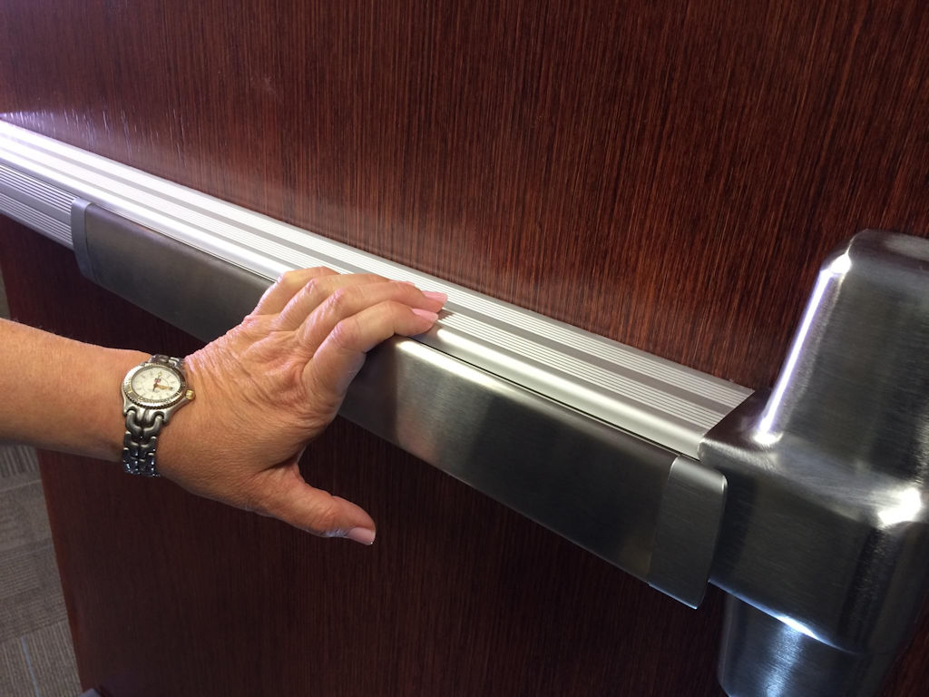
Operable Force
Pushing or pulling motion: 15 pounds, maximum
Rotational motion: 28 inch-pounds, maximum
Consistent with ICC A117.1
ADA: 5 pounds, maximum
Notes:
The operable force in the IBC is now consistent with ICC A117.1, which is the accessibility standard referenced by the IBC.
The maximum force to operate hardware with a pushing or pulling motion, like panic hardware, is 15 pounds.
For hardware that is operated by a rotational motion – like a lever handle, the limit is 28 inch-pounds.
This creates a conflict with the ADA standards, which limit the force for operable parts – including door hardware – to 5 pounds.

Slide 3
AX Devices
What does this mean for the AX devices, which are certified to operate with 5 pounds of force or less?
Notes:
The AX was designed to meet the 5-pound limitation of the ADA standards.
The change to the ADA standards that mandates 5 pounds maximum for the operation of hardware was made (accidentally) as an editorial change, without going through the normal code development process.
At that time (2010), ICC A117.1 did not include limitations on operable force for hardware – those were added in the 2017 edition.
Most states use some form of ICC A117.1 as their accessibility standard, although technically the ADA applies to all states because it is a federal law.
I’m not sure when or how this conflict will be resolved, but in the meantime, it’s something to watch out for – especially in states like California where the ADA standards are used for accessibility instead of ICC A117.1.
In these states the AX should be specified in order to meet the 5-pound limit – there has been at least one project in California where the “standard” panic hardware had to be removed and AX devices installed.
Because the ADA is a federal law, there is always the possibility that in a state that uses ICC A117.1 as their accessibility standard, panic hardware meeting this standard could be installed (15 pounds of force, maximum), and someone could later enforce the ADA standards and the hardware would not be compliant.
At some point I’m guessing that the ADA standards will be revised to match ICC A117.1 – 15 pounds of pushing/pulling motion and 28 inch-pounds of rotational motion, but we will have to wait and see.

Slide 4
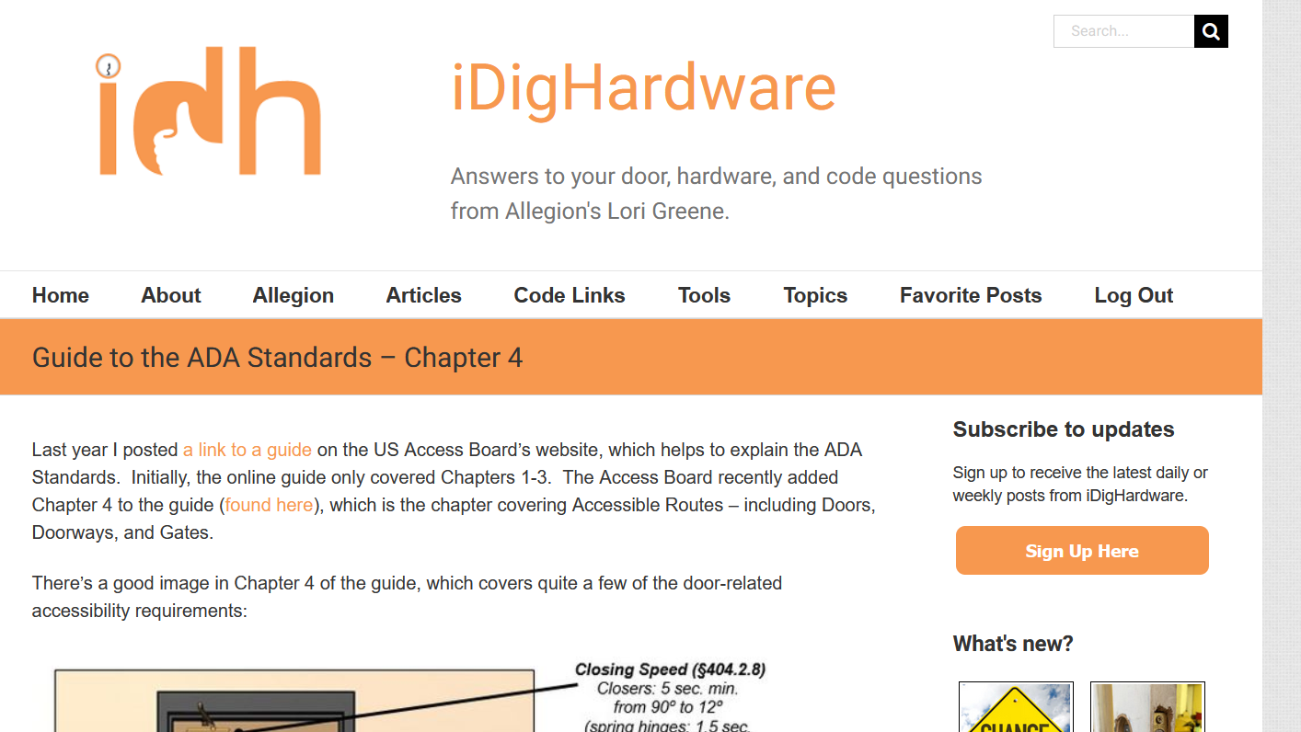
Notes:
iDH Tip – Online ADA Guide
Quite a few years ago I posted about an online guide to the ADA standards, that was created by the US Access Board, but there are still a lot of people who are not aware of it.
There is a link to the guide at the bottom of the right sidebar on iDigHardware, just above the Techstreet link.
The post in this screenshot covers some of the door-related issues addressed by the guide, which includes information and images to help explain the requirements of the standards.
Many of your accessibility-related questions can be answered by referring to the online guide. In addition, there is a commentary version of ICC A117.1 which is available to download from our Techstreet account (there is also a commentary edition of the IBC available there).
The ADA standards can be downloaded from ADA.gov.
Here is a link to the post on the screen: https://idighardware.com/2015/08/guide-to-the-ada-standards-chapter-4/

