Slide 1
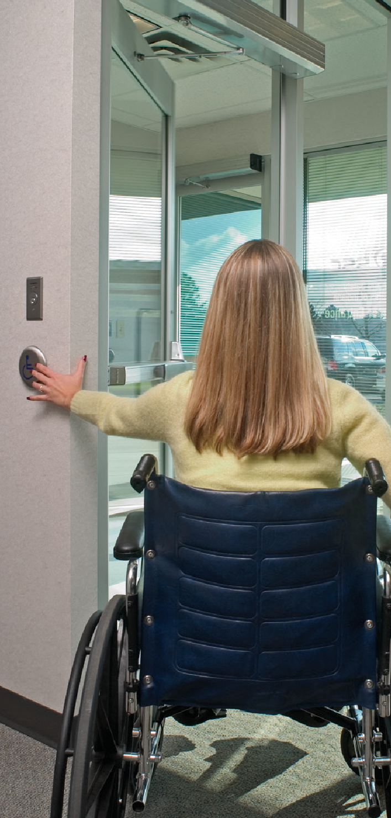
Public Entrances
2021 IBC: 1105.1.1 Automatic doors. In facilities with the occupancies and building occupant loads indicated in Table 1105.1.1, public entrances that are required to be accessible shall have one door be either a full power-operated door or a low-energy power-operated door. Where the public entrance includes a vestibule, at least one door into and one door out of the vestibule shall meet the requirements of this section.
Notes:
Until now, there wasn’t a requirement in the model codes or accessibility standards for automatic operators in any specific locations.
Auto operators are usually installed for convenience, or when a door can not meet the requirements for a manual door – if it’s too hard to open, or if there isn’t enough maneuvering clearance.
The 2021 IBC will now require public entrances for some buildings to have at least one automatic door – either a power-operated pedestrian door or a door with a low-energy automatic operator.
The table here on the screen shows the applicable use groups and the associated occupant loads, but in case you’re not familiar with each of the use groups I have them broken out for you…

Slide 2
Public Entrances
A-1 – Assembly - viewing of performing arts/movies
A-2 – Assembly - food/drink consumption
A-3 – Assembly - worship, recreation, amusement
A-4 – Assembly - viewing of indoor sporting events
B – Business - office, professional, or service
M – Mercantile - display and sale of merchandise
R-1 – Residential - transient sleeping units
>300
>500
Notes:
Use Group A covers Assembly occupancies, and the subgroups are described here on the screen, but basically the requirement would apply to all assembly occupancies with an occupant load of more than 300 people – except Group A-5.
Group A-5 covers assembly occupancies for viewing outdoor activities, like stadiums and grandstands.
The other use groups shown here require a public entrance with an automatic door when the occupant load is more than 500 people.
Those use groups are B – Business, M – Mercantile, and R-1 – Residential which includes hotels.

Slide 3
Public Entrances
ICC A117.1
404.3.1 Public entrances Where an automatic door or gate is required at a building or facility public entrance, it shall be a full powered automatic or a low-energy automatic door or gate.
404.3.2 Vestibules Where an entrance includes a vestibule, at least one exterior door or gate and one interior door or gate in the vestibule shall have the same type of automatic door or gate opener.
Notes:
I kind of expected that a change was coming, because the 2017 edition of ICC A117.1 had a new section that required the vestibule door to also have an automatic operator when the public entrance is required to have an automatic operator.
At that time, the model codes didn’t require automatic operators for public entrances, but A117.1 was ahead of the curve.
So we will start to see some openings at public entrances requiring auto operators on both the exterior and the vestibule doors.

Slide 4
Notes:
iDH Tip
All Allegion employees can download the codes and standards that we frequently use, from our Techstreet subscription. This includes the I-Codes – International Building Code, International Fire Code, ICC A117.1 – Accessible and Usable Buildings and Facilities, and many others. The IBC Commentary is extremely helpful because it explains the intent of the codes – the 2021 edition of the Commentary will be available soon. For NFPA, we have access to NFPA 101, 80, 72, and others, but NFPA has recently changed their policy and is not distributing the new editions as PDFs. So, for example, the 2021 edition of NFPA 101 is not available through Techstreet and must be purchased separately or accessed via NFPA’s subscription service (we don’t have company-wide access to this). Our Techstreet subscription also gives us access to all of the BHMA standards.
If you do not have a Techstreet login, email lori.greene@allegion.com. If you have forgotten your password, Lori can re-set it. The link to access our subscription is NOT techstreet.com – it is subscriptions.techstreet.com. There is a link at the bottom of the right sidebar on iDigHardware.

