Slide 1
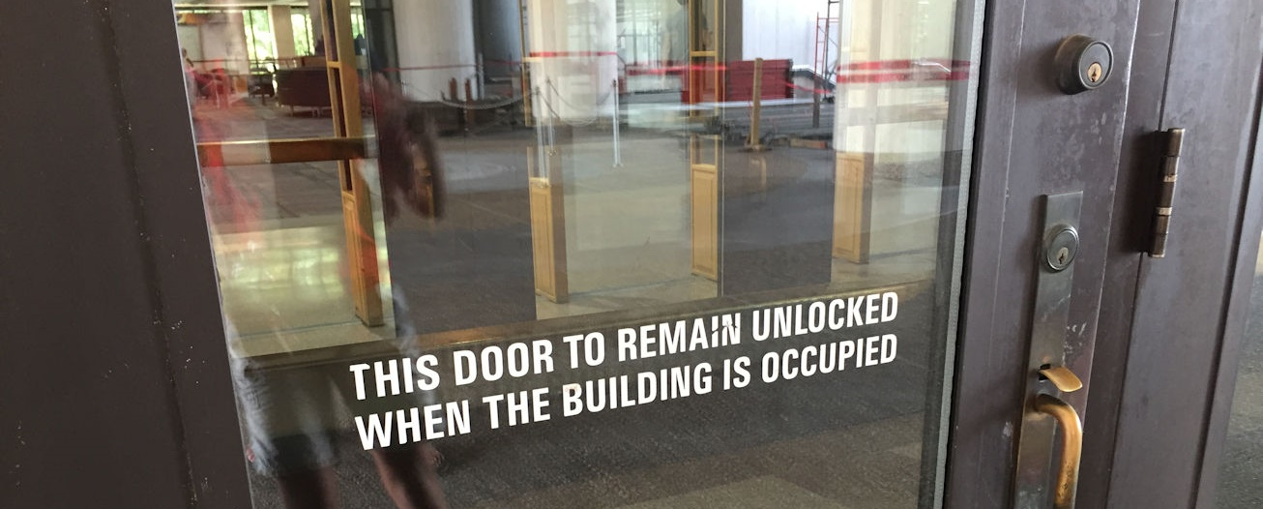
Key-Operated Locks
Notes:
The sections on key-operated locks in both the IBC and NFPA 101 address doors with double-cylinder deadbolts – which have a key cylinder on both the exterior and the interior.
We have all seen signage like this, stating that the door must remain unlocked when the building is occupied – this is one of the requirements of the key-operated lock section.
The door in this photo is not compliant with the rest of that section…

Slide 2
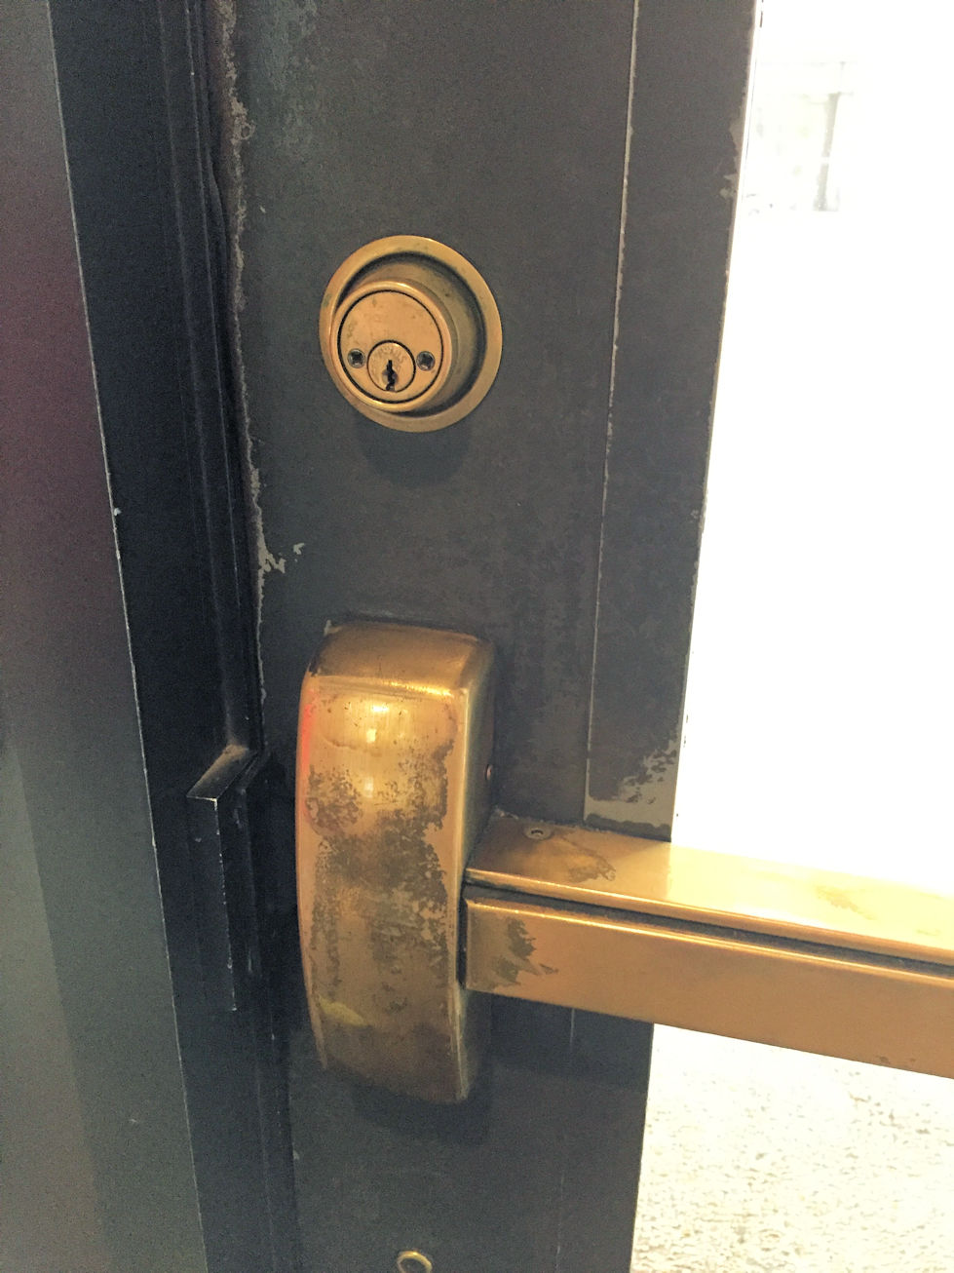
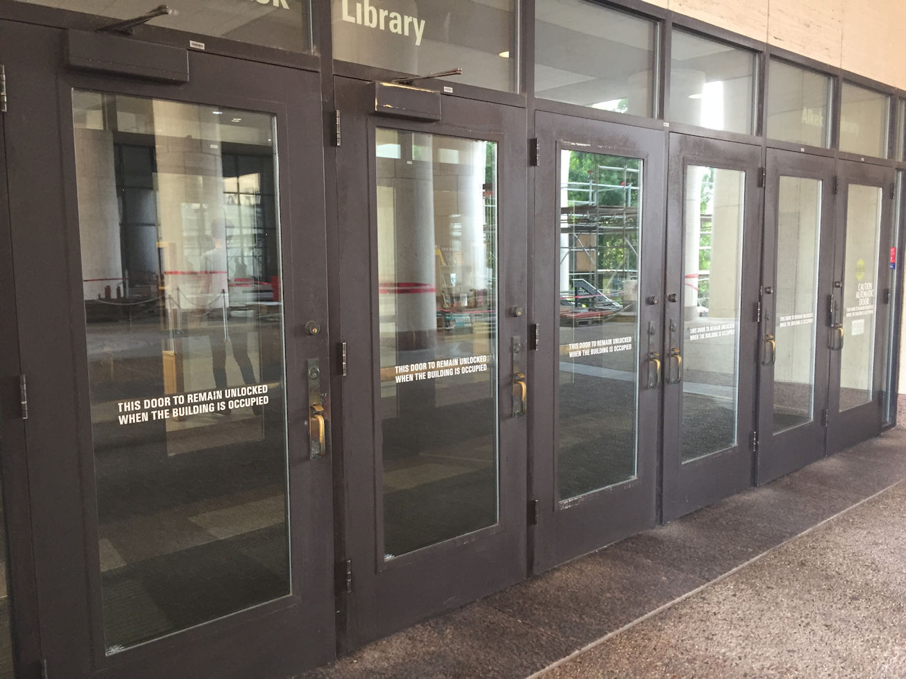
Notes:
Because each of the doors in this bank of doors has the required signage, but the double-cylinder deadbolt has been installed in addition to panic hardware.
The intent of this section is that when a double-cylinder deadbolt is installed on the main entrance and exit door or doors, it is installed instead of the panic hardware, not in addition to it.
The lock is also required to be a type that is readily distinguishable as locked – like a deadbolt with an indicator.

Slide 3
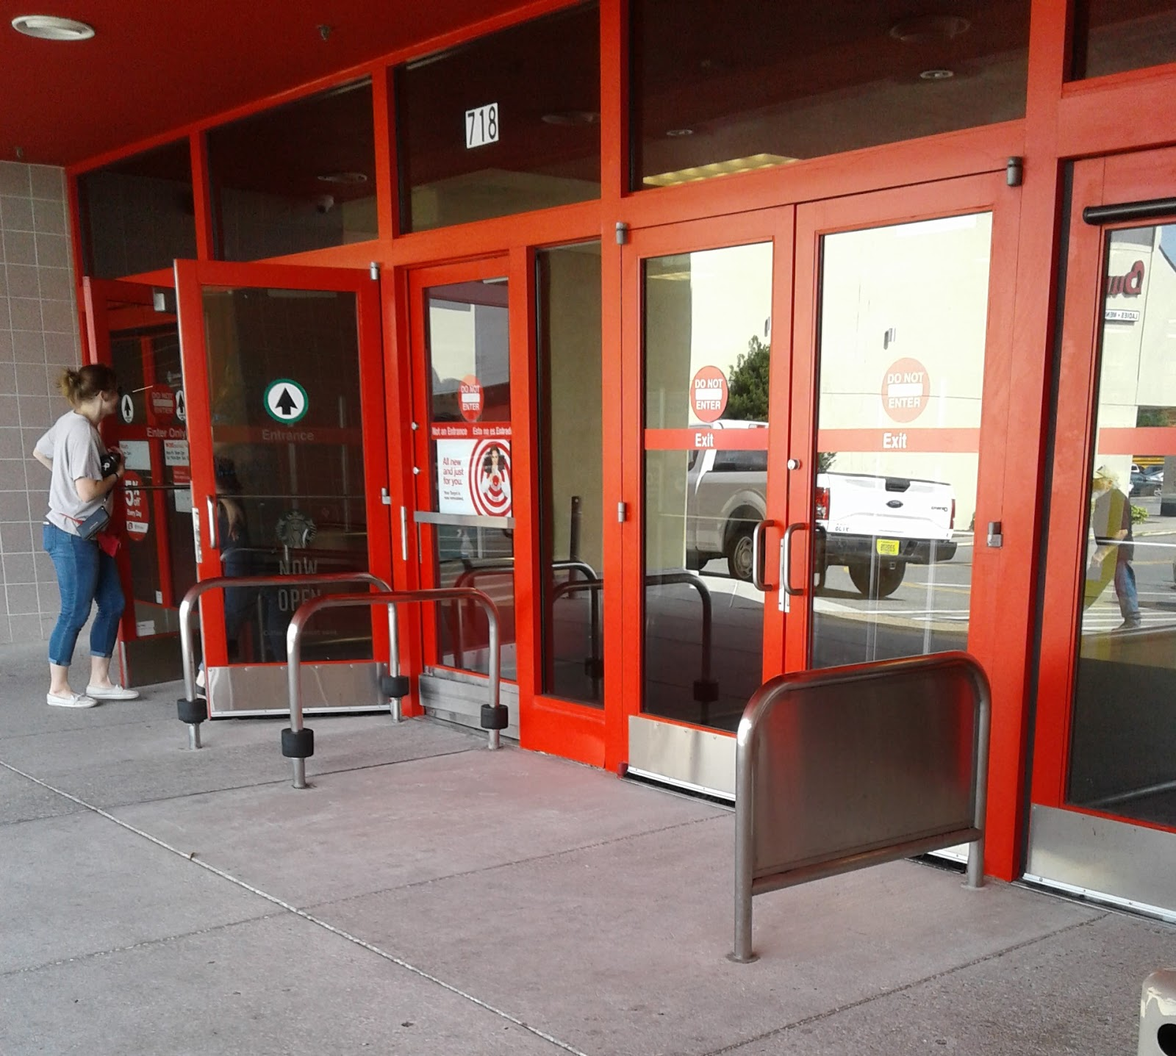
Notes:
Originally, this section of the codes applied to the main EXTERIOR door or doors – like the mercantile entrance on the left.
Then a code change proposal was made with the intent to allow the same application on retail stores in malls, which are not always exterior doors.

Slide 4
Key-Operated Locks
2015 IBC Redline Version
Notes:
In the 2015 edition of the IBC, the word “exterior” was removed from this section, and the wording on the signage was changed slightly.
The sign is now required to say, THIS DOOR TO REMAIN UNLOCKED WHEN THIS SPACE IS OCCUPIED.
The result of these little changes was that people started trying to use double-cylinder deadbolts on the interior entrance doors leading to various spaces in a building, rather than the main entrance doors to the building.
The reason the use of double-cylinder deadbolts was limited to the main entrance to the building was that the building couldn’t be occupied or the business open with those doors locked. Note that these locks are not allowed on all occupancy types – they are limited to assembly occupancies with an occupant load of 300 people or less, business, factory, mercantile, and storage occupancies, and places of religious worship.
But with the new language, people have asked about using double-cylinder deadbolts on multi-stall restrooms, for example, because they considered the door to the restroom as the main entrance to that space.
That wasn’t the intent of the model codes – those doors need to allow free egress.
The text on the screen is from the redline version of the IBC – if you haven’t seen this publication before, it shows all of the changes from the previous edition so it makes it easier to see what’s new.

Slide 5
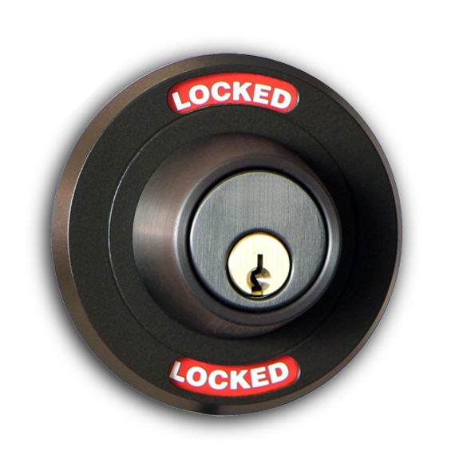
Key-Operated Locks
NFPA 101-2021: Exterior door assemblies and interior door assemblies to an individual tenant space or to a single tenant space shall be permitted to have key-operated locks from the egress side, provided that all of the following criteria are met:
Allowed by occupancy chapter
Unlocked when building is occupied
Lock readily distinguishable as locked
Signage
Key immediately available to any occupant when locked
Photo: Architectural Openings Division 08
Notes:
This is on BHMA’s list to try to fix in the 2024 IBC, but it was modified in the 2021 edition of NFPA 101.
The use of key-operated locks is limited by NFPA 101 to exterior doors and interior doors to a tenant space.
The locks must also be allowed by the occupancy chapter – they are acceptable for some occupancy classifications but not all.
The door must be unlocked when the building is occupied, the lock must be readily distinguishable as locked – like a deadbolt with an indicator.
The signage that I mentioned before is required, and the key must be immediately available to any building occupant when the door is locked.
This helps to ensure that the door is only locked when employees are present – because the general public would not have access to the key.
Keep in mind that this section applies to locks with a key cylinder on the egress side – not to deadbolts with a thumbturn on the egress side.

Slide 6
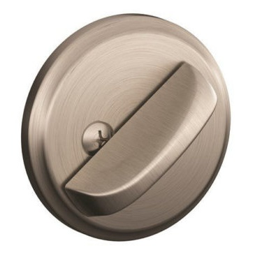
Thumbturn Deadbolts in a Means of Egress
The IBC section called “Bolt Locks” addresses flush bolts and surface bolts on pairs of doors – NOT deadbolts.
Thumbturn deadbolts are OK if:
Door unlatches with one releasing motion for egress (some exceptions)
No key, tool, special knowledge or effort for egress
No tight grasping, pinching, or twisting of the wrist
Releasing hardware between 34-48 inches AFF (some exceptions)
Door does not require panic hardware
Notes:
Just to finish the subject of deadbolts – some people think deadbolts are not allowed in means of egress, because of a section in the IBC called Bolt Locks.
This section does not address deadbolts – it covers manual flush bolts and surface bolts on the inactive leaf of a pair of doors.
Deadbolts with thumburns are acceptable on doors that do not require panic hardware if the door unlatches with one releasing operation – remember there is an exception in NFPA 101 for existing classroom doors.
As with other operable hardware, the lock must be operable for egress with no key, tool, special knowledge, or effort – this would require a thumbturn on the egress side rather than a key
The thumbturn must be operable with no tight grasping, pinching, or twisting of the wrist, which would typically be an elongated thumbturn that pivots from the end
The deadbolt must be mounted between 34 and 48 inches above the floor – or in compliance with the mounting height requirements of the state or local jurisdiction

Slide 7
iDigHardware
.com/webinars
Notes:
On the Webinars page of iDigHardware (iDigHardware.com/webinars), there are 6 webinar recordings including Lori’s most recent webinar on the changes to the 2021 model codes. These webinars are registered with AIA – contact Antoinette Valdez if you need help finding the presentations.
Additional webinars will be added (probably not until 2022) on other electrified hardware applications like stairwell reentry and electromagnetic locks. These presentations, along with Webinar 5, are probably too detailed for architects but can be used with integrators and others who need to understand the detailed code requirements for these systems.
You can also access the webinars page via the Tools menu.

