Slide 1
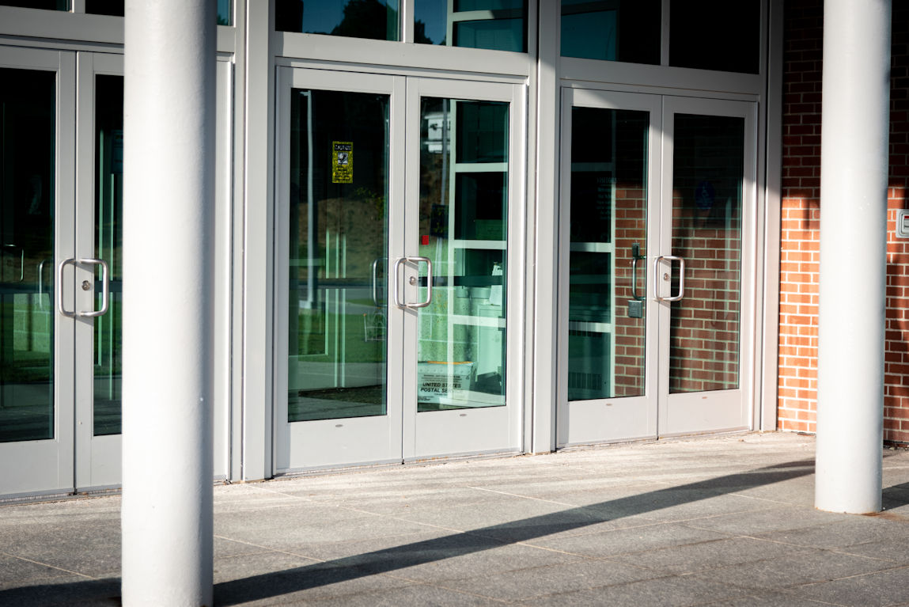
Question:
Which of the following doors would NOT be required to have a flush and smooth surface measured 10 inches up from the floor?
Classroom door
Patient room door
Stairwell fire door
Exterior door with low-energy operator
Notes:
Here is a quiz question to get this discussion rolling…

Slide 2
Question:
Which of the following doors would NOT be required to have a flush and smooth surface measured 10 inches up from the floor?
Classroom door
Patient room door
Stairwell fire door
Exterior door with low-energy operator
Notes:
The flush, smooth surface is required for manually-operated doors but automatic doors are addressed in a separate section of the standards. The automatic door section does not have a similar requirement because a building occupant would not have to push on an automatic door to open it or to keep it open, so the risk of catching a crutch, cane, walker, or wheelchair footpad along the bottom of the door is minimal.

Slide 3
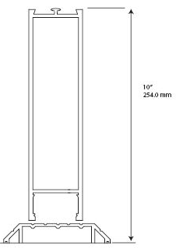
2010 ADA Standards (A117.1 similar)
404.2.10 Door and Gate Surfaces. Swinging door and gate surfaces within 10 inches (255 mm) of the finish floor or ground measured vertically shall have a smooth surface on the push side extending the full width of the door or gate. Parts creating horizontal or vertical joints in these surfaces shall be within 1/16 inch (1.6 mm) of the same plane as the other. Cavities created by added kick plates shall be capped.
10 inches
minimum
Notes:
The requirements of the ADA standards and ICC A117.1 are similar. This is not a new requirement – it has been in A117.1 for over 20 years - the height used to be 12 inches. It was added to the ADA standards in the 2010 edition.
The 10-inch-high flush, smooth surface is measured up from the floor or ground, on the push side of the door (manual doors only).
In addition to the minimum bottom rail height, no hardware can protrude off the door in this area (push side).
The 10-inch flush, smooth surface must extend the full width of the door.
If there are horizontal or vertical joints – if a kick plate is installed, for example – the difference between the planes must be no more than 1/16-inch.
If a door has a narrow bottom rail and a kick plate is added to extend the height of the bottom rail, the area at the top of the kick plate must be capped (between the glass and the plate).

Slide 4
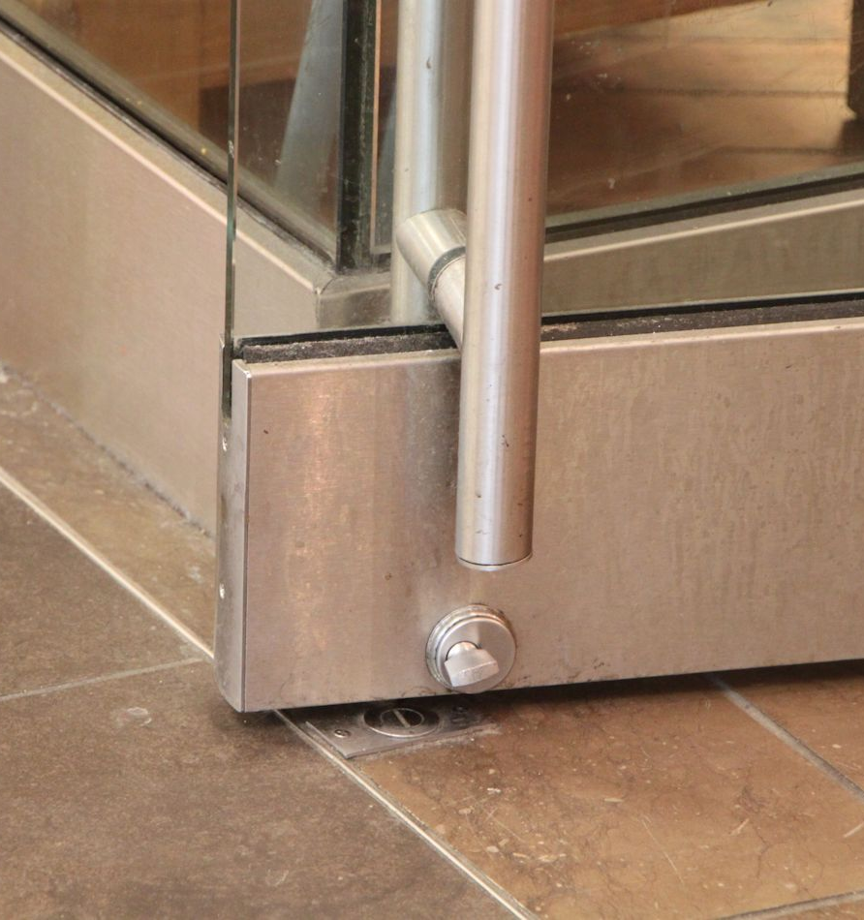
No Protruding Hardware
Notes:
Surface vertical rods, kick down stops, full height pulls (push side) and bottom rail deadbolts conflict with this requirement. Surface-mounted automatic door bottoms are also a problem.
*I’ll be interested to see if anyone notices that the first photo has both the bottom latches/strikes, and the prep for the pin. ☺

Slide 5
ADA Exceptions (A117.1 similar)
Sliding doors shall not be required to comply with 404.2.10.
Tempered glass doors without stiles and having a bottom rail or shoe with the top leading edge tapered at 60 degrees minimum from the horizontal shall not be required to meet the 10 inch (255 mm) bottom smooth surface height requirement.
Doors and gates that do not extend to within 10 inches (255 mm) of the finish floor or ground shall not be required to comply with 404.2.10.
Existing doors and gates without smooth surfaces within 10 inches (255 mm) of the finish floor or ground shall not be required to provide smooth surfaces complying with 404.2.10 provided that if added kick plates are installed, cavities created by such kick plates are capped.
Notes:
The 10-inch requirement does not apply to:
Sliding doors
Glass doors without stiles, where the top of the bottom rail is sloped back toward the glass (60 degrees minimum from horizontal) – these doors are exempt from the 10-inch bottom rail height but can not have protruding hardware in that area
Doors and gates that don’t extend to within 10 inches of the floor – for example, toilet stall doors
Existing doors – kick plates may be used to extend the height of the bottom rail but must be capped
There are very few exceptions for doors that are not required to meet the accessibility standards, so doors must generally comply with this requirement and the other requirements of the standards unless they are specifically exempt.

Slide 6
Notes:
The ADA Guide, a website of the US Access Board, includes information explaining the ADA requirements.
Here is a direct link to the section of the Guide that addresses this topic:
https://www.access-board.gov/ada/guides/chapter-4-entrances-doors-and-gates/#door-and-gate-surfaces

Slide 7
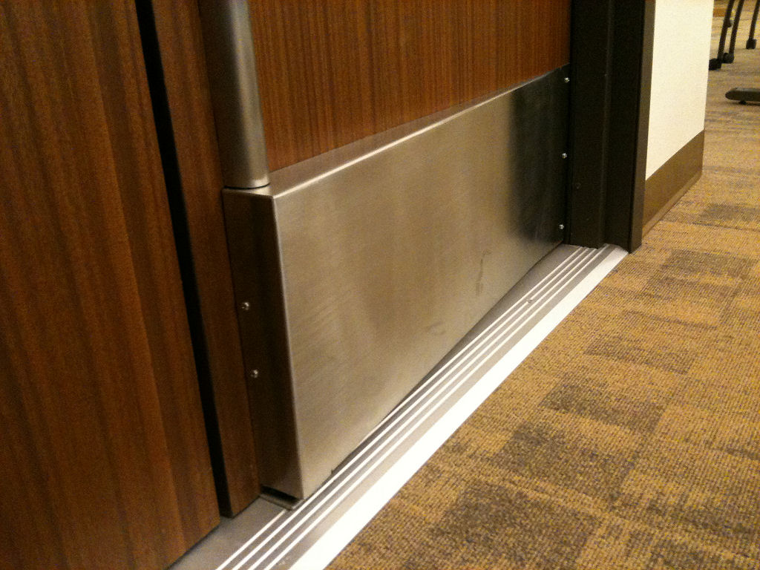
ICC A117.1 Commentary
Notes:
The ICC A117.1 Commentary also includes explanatory information, including a line stating that a sloped plate over a vertical rod and latch “could possibly resolve some issues.” This is left up to the AHJ so surface vertical rods with bottom rods and latches should be avoided.
https://idighardware.com/2011/01/extended-latch-guards/

Slide 8
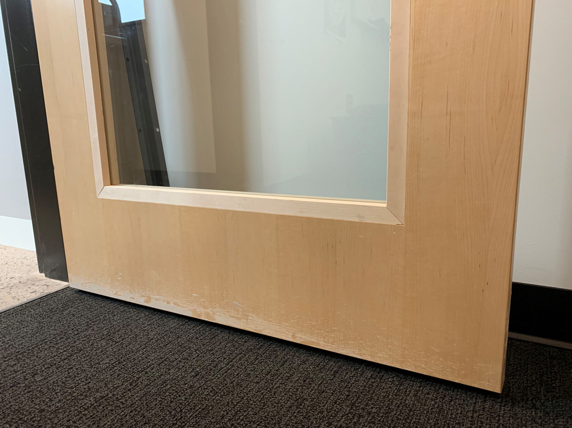
BEFORE
AFTER
Notes:
Joe Cross sent these photos from a school district, where the bottom rail on the new doors was not quite high enough. The end user noticed the problem, and the molding was changed in the field to a flush design increase the bottom rail height.
We should be watching for this on projects to help our architects avoid this problem.
https://idighardware.com/2021/11/ff-flush-bottom-rail/

Slide 9
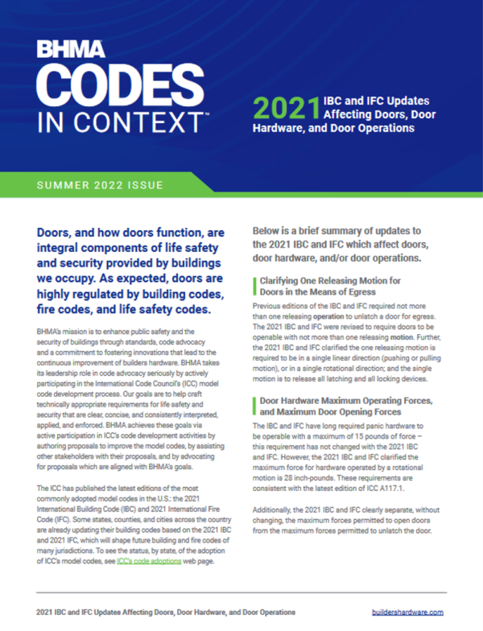
Notes:
iDH Tip:
BHMA has some new resources on codes. The Codes in Context report shows the changes to a particular code or standard, and there are focus documents that go into more detail about a particular change. BHMA has also published a matrix showing door-related IBC changes from one edition to the next – from 2012 to 2024.
https://idighardware.com/2022/11/new-resource-bhma-codes-in-context/
https://idighardware.com/2022/11/bhma-ibc-changes-2012-to-2024/
If there are any specific code issues that we want to cover in these monthly updates, let Lori know!

