Slide 1
Decoded 2 – Fire Door Assemblies
Learning Objectives
Become familiar with the standard for fire door assemblies – NFPA 80, and the sections which apply to swinging doors with builders hardware.
Understand various fire ratings, when and where those assemblies would be used, and the purpose of fire doors.
Learn basic rules for fire doors which ensure that fire doors will be closed and latched if there is a fire, with minimal smoke infiltration.
Review the requirements for annual inspection of fire doors, including inspection criteria and procedures.

Slide 2

Decoded 2 – Fire Door Assemblies
Audio Dial-In - US & Canada: 866-430-4132
Audio Dial-In - International: 404-665-9207
Audio Code: 781-453-5306
Mute your phone (*6 to mute, #6 to unmute).
This webinar is being recorded.

Slide 3
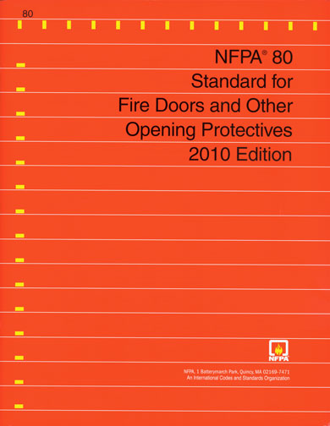
Session 2 – Fire Doors
NFPA 80 – format and organization
Purpose of fire doors
Fire ratings and testing
Basic fire door requirements
Fire Door Assembly Inspection

Slide 4
NFPA 80
NFPA 80 details the requirements for fire doors.
NFPA 80 does not state where fire doors are required.
Referenced by the IBC, NFPA 101, and other codes.
Recent Editions: 1999, 2007, 2010, 2013
COR140 exam uses the 2007 edition

Slide 5
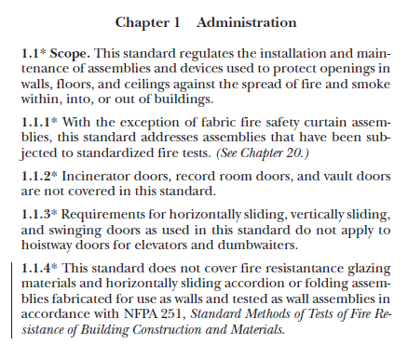
NFPA 80
?
Does anyone know what the * or the | indicate?
Type in the chat box.

Slide 6
NFPA 80
* = More information in Annex A – Explanatory Material
| = Revised in the last code change cycle.

Slide 7
NFPA 80
P06
Chapter 1 – Administration
Chapter 2 – Referenced Publications
Chapter 3 – Definitions
Chapter 4 – General Requirements
Chapter 5 – Care and Maintenance
Chapter 6 – Swinging Doors with Builders Hardware
Chapter 7 – Swinging Doors with Fire Door Hardware
Chapters 8-20 – Other Types of Doors, Glass Block, Dampers, Curtains
Annexes

Slide 8

Swinging Doors with Builders Hardware

Slide 9
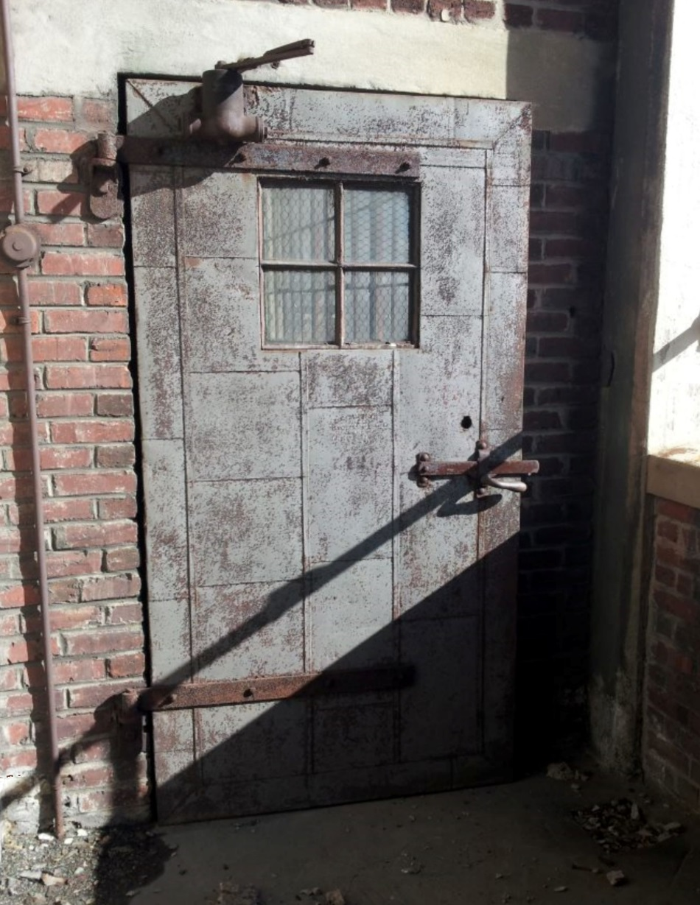
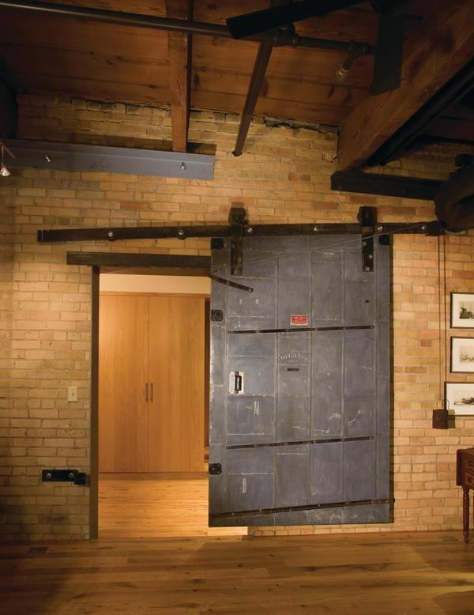
Swinging and Sliding Doors with Fire Door Hardware

Slide 10
Fire Door Ratings
Class A—Openings in fire walls and in walls that divide a single building into fire areas
Class B—Openings in enclosures of vertical communications through buildings and in 2-hour rated partitions providing horizontal fire separations
Class C —Openings in walls or partitions between rooms and corridors having a fire resistance rating of 1 hour or less
Class D—Openings in exterior walls subject to severe fire exposure from outside the building
Class E—Openings in exterior walls subject to moderate or light fire exposure from outside the building

Slide 11
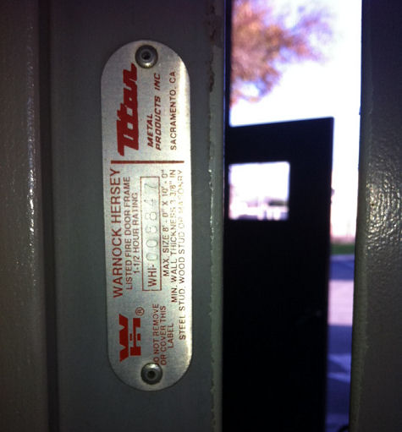
Fire Door Ratings
Most Common
    A – 3 hours
    B – 90 minutes or 60 minutes
    C – 45 minutes
    20 minutes

Slide 12

Question
What is the purpose of a fire door?
Type in the chat box.

Slide 13
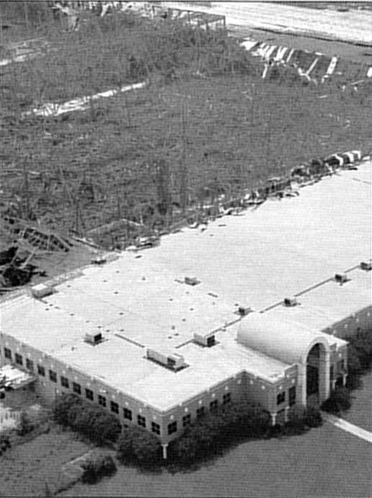
History has shown us the importance of operational fire and egress doors.
A warehouse fire in 1996 left only the part of the building protected by fire doors intact.
Source: NFPA Journal

Slide 14
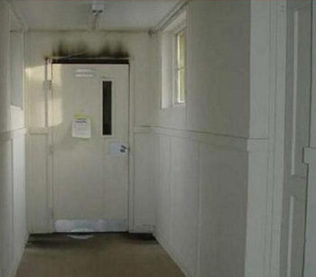
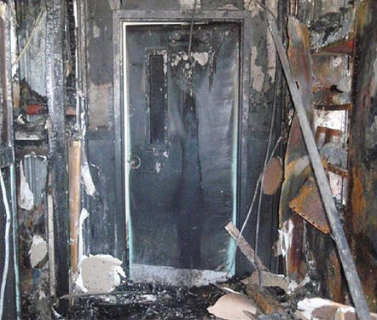
The Robert Moses Nature Center was protected by this fire door.
Photos: Paul Martin

Slide 15
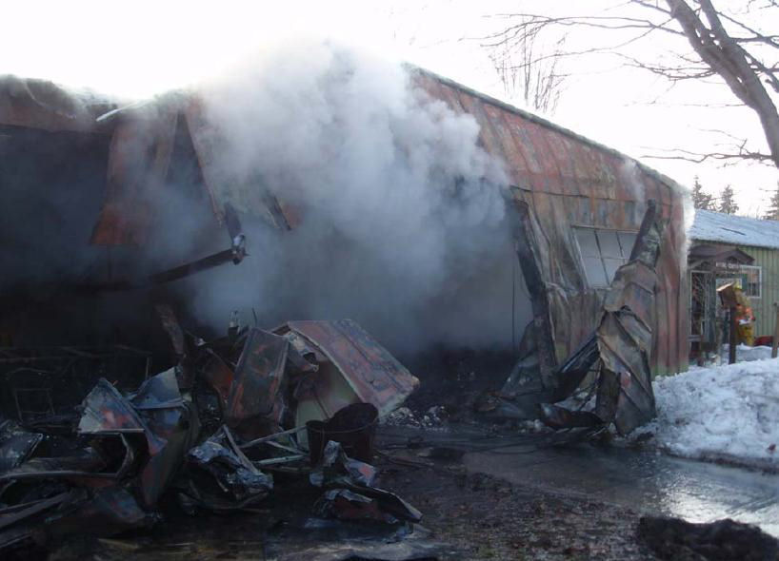
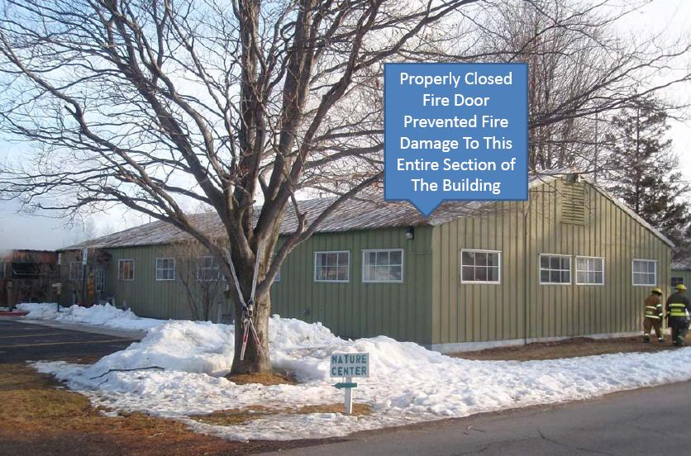

Slide 16
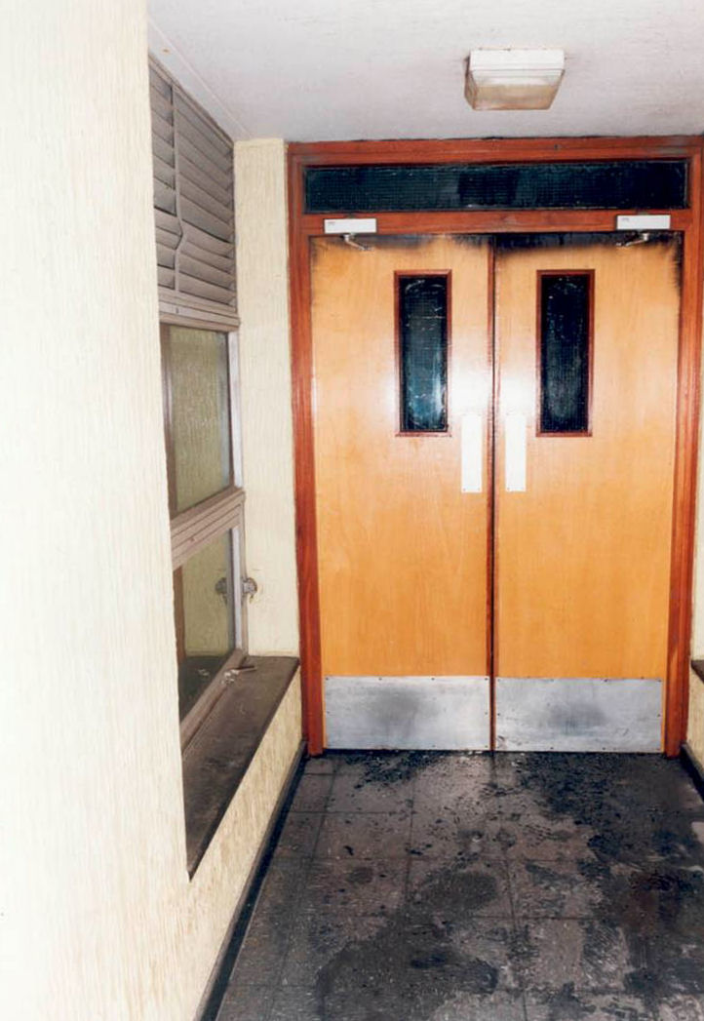
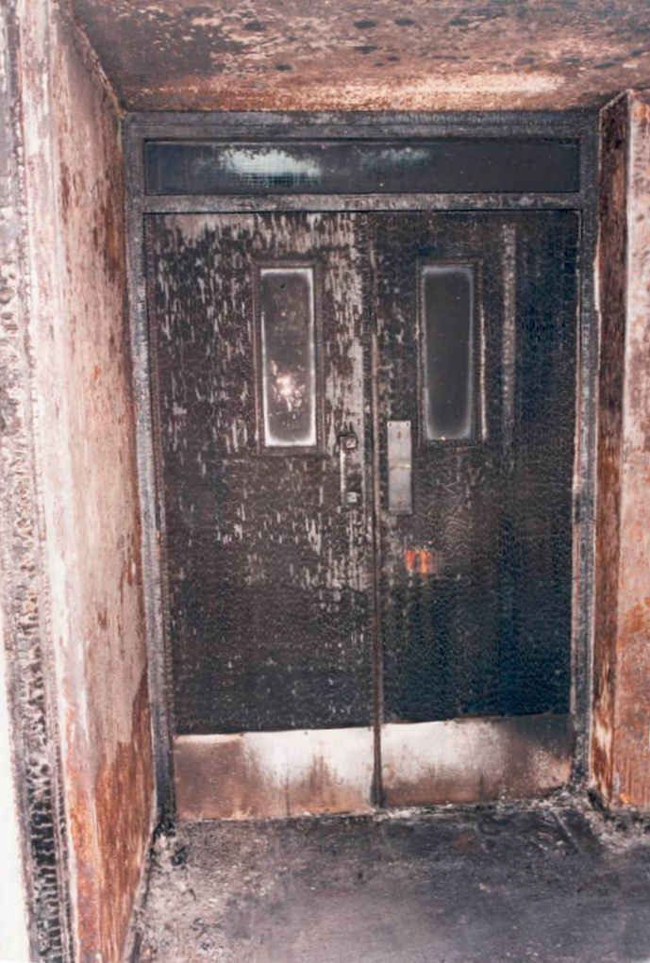

Slide 17
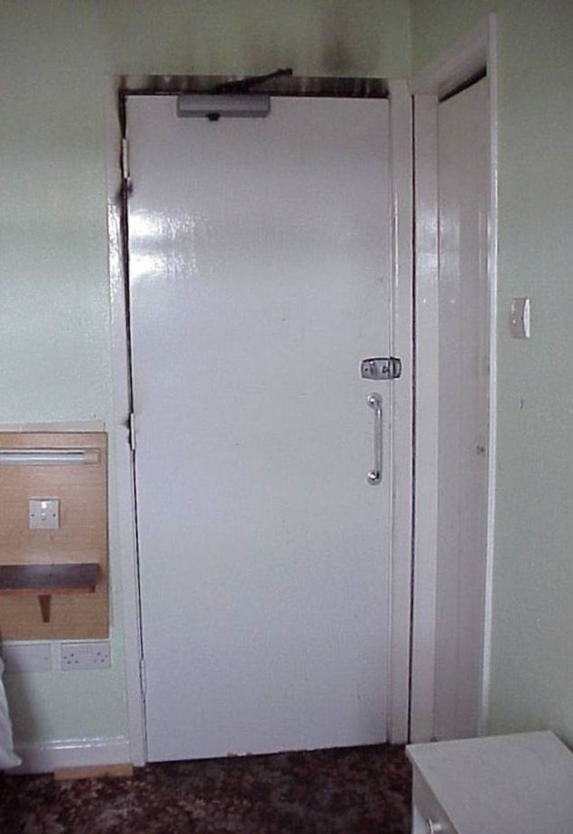
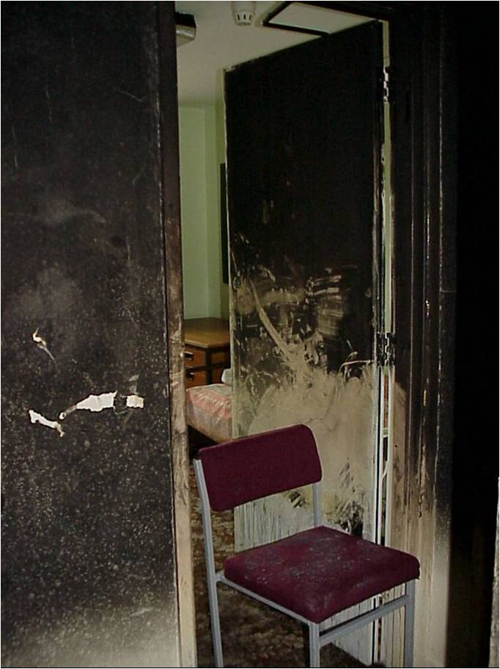

Slide 18
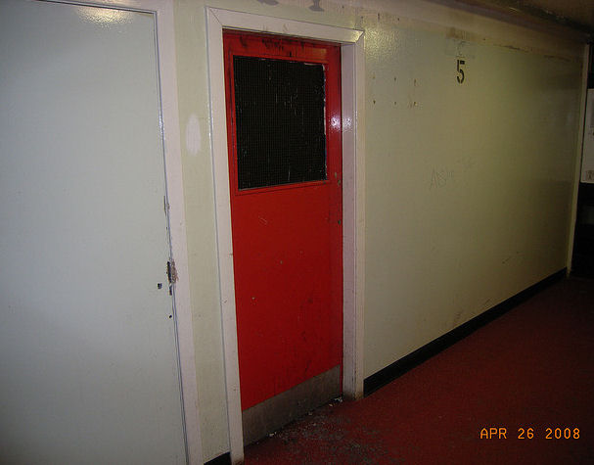
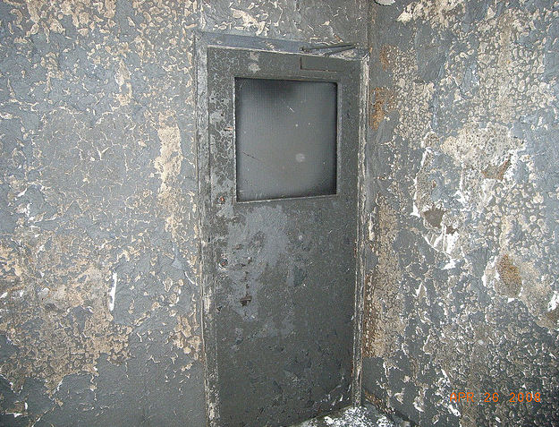

Slide 19
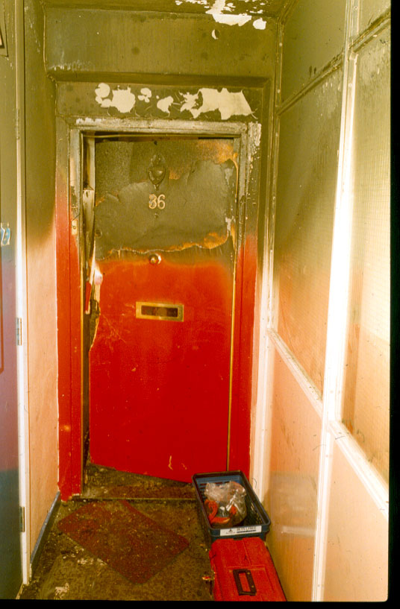
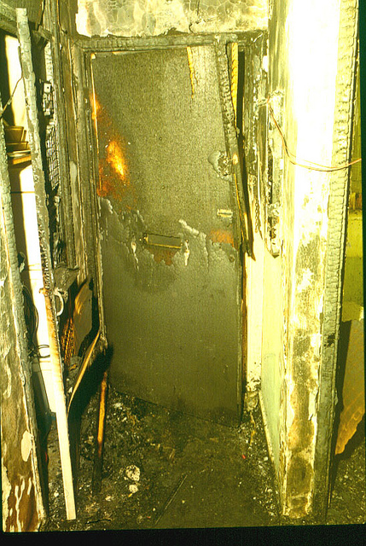

Slide 20
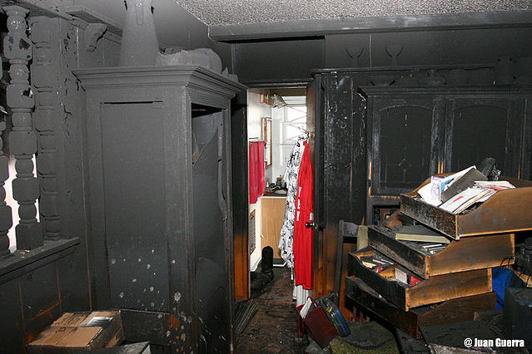

Slide 21
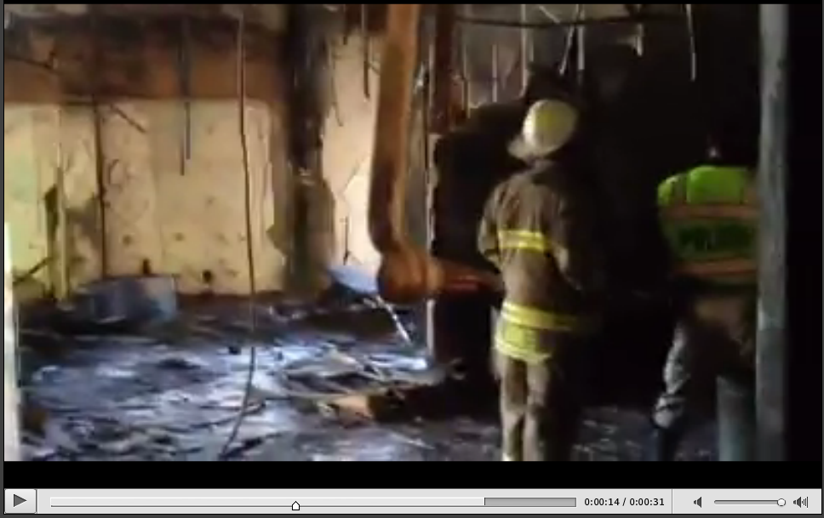
Notes:
Watch this video on class page later.

Slide 22

Fire doors must be closed and latched at the time of a fire.
thumb

Slide 23
Self-Closing or
Automatic-Closing
Self-Closing = standard door closer without a hold-open mechanism
Automatic-Closing = door closer with electric or battery-operated hold-open mechanism actuated by the fire protection system or a smoke detector
Power (automatic) operators on fire-rated doors must be deactivated upon fire alarm.

Slide 24
Question
Can you think of any locations where a fire door is not required to be self-closing?
Type in the chat box.

Slide 25
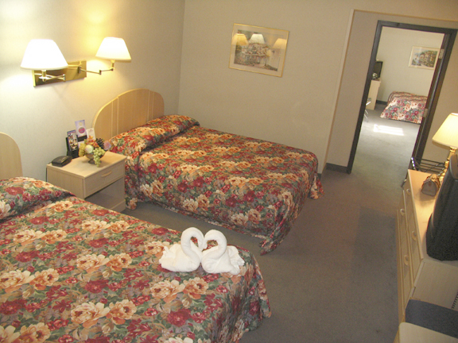
Exception
Fire doors in common walls between R-1 sleeping units
AKA communicating doors between hotel rooms

Slide 26
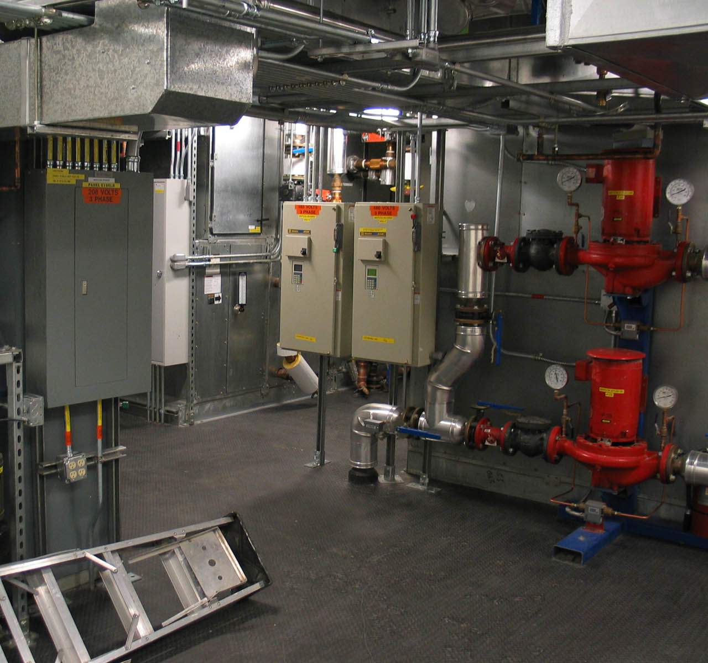
Exception
Inactive leaf of rated pair to unoccupied room
  Boiler room
  Electric room
  Mechanical room

Slide 27
Acceptable Ways to Hold Open a Fire Door
Non-detectored electronic hold-open unit released by fire alarm.
Electronic hold-open unit with on-board detector.

Slide 28
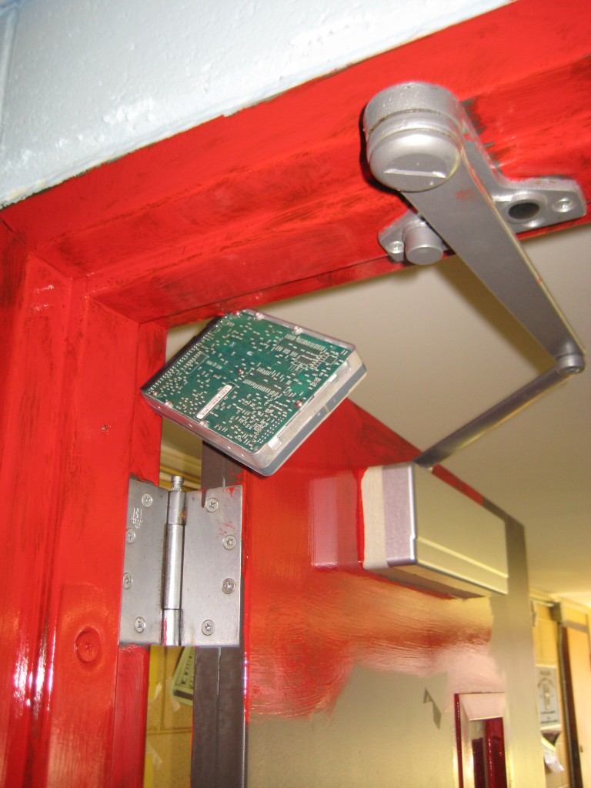
Not OK

Slide 29
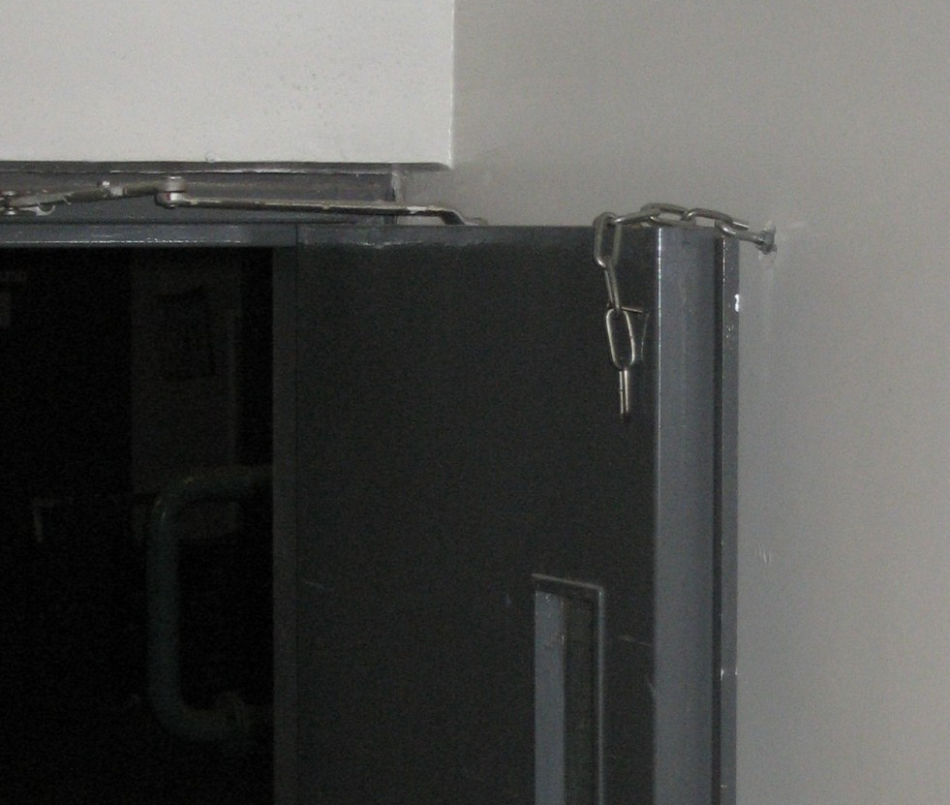
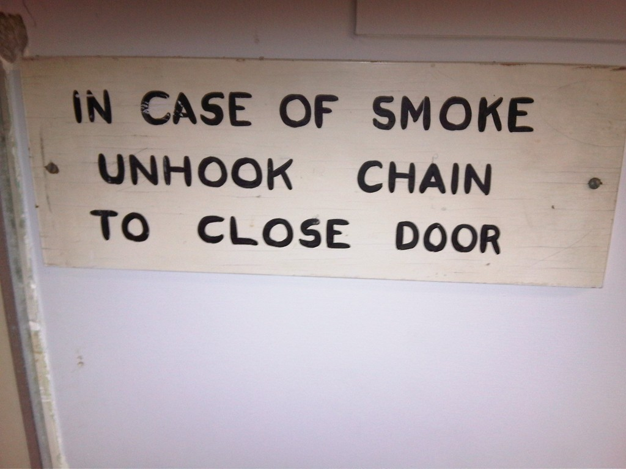
Not OK

Slide 30
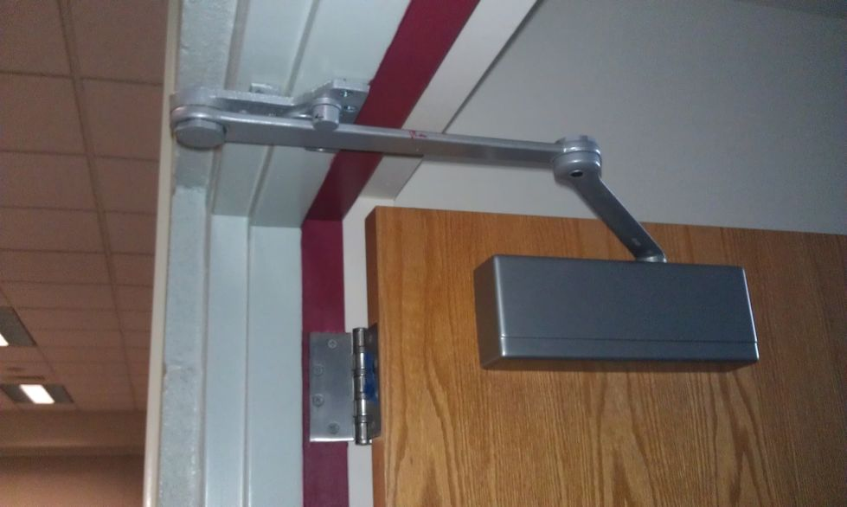
Not OK

Slide 31
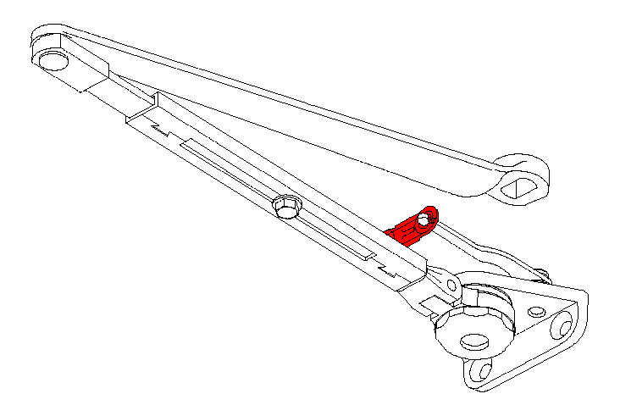
Fusible Link Arms

Slide 32
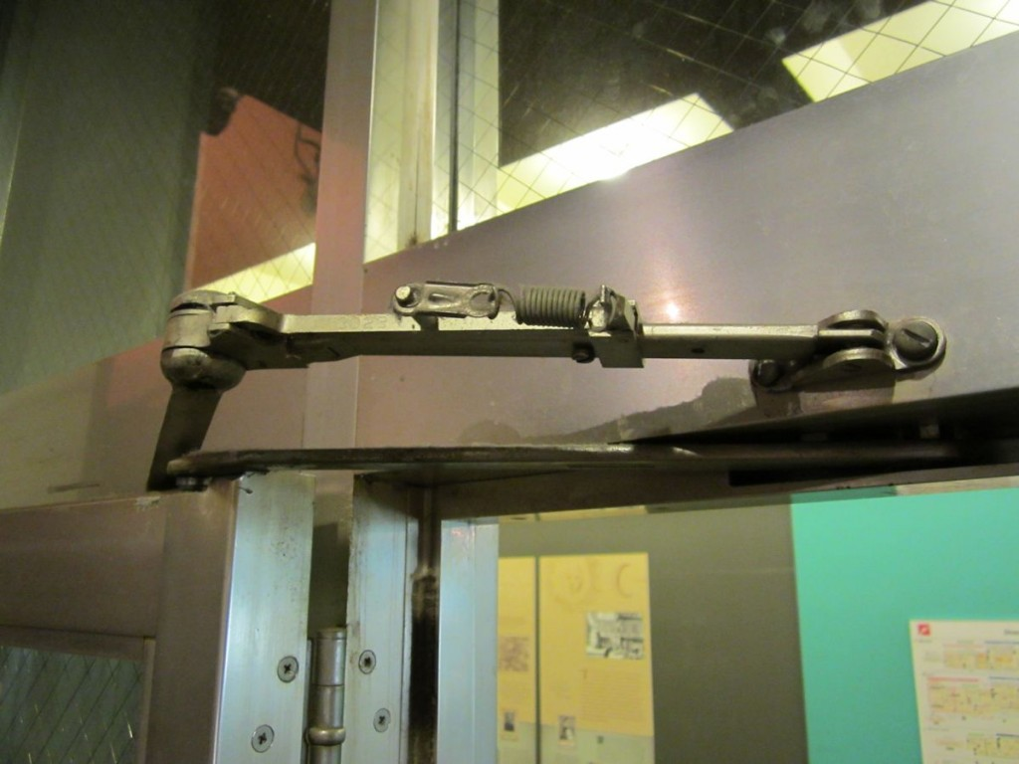
Fusible Link Arm
Current codes require smoke-actuated hold-opens for almost all fire door locations.

Slide 33
Acceptable Ways to Hold Open a Fire Door
wall or floor magnet with closer

Slide 34
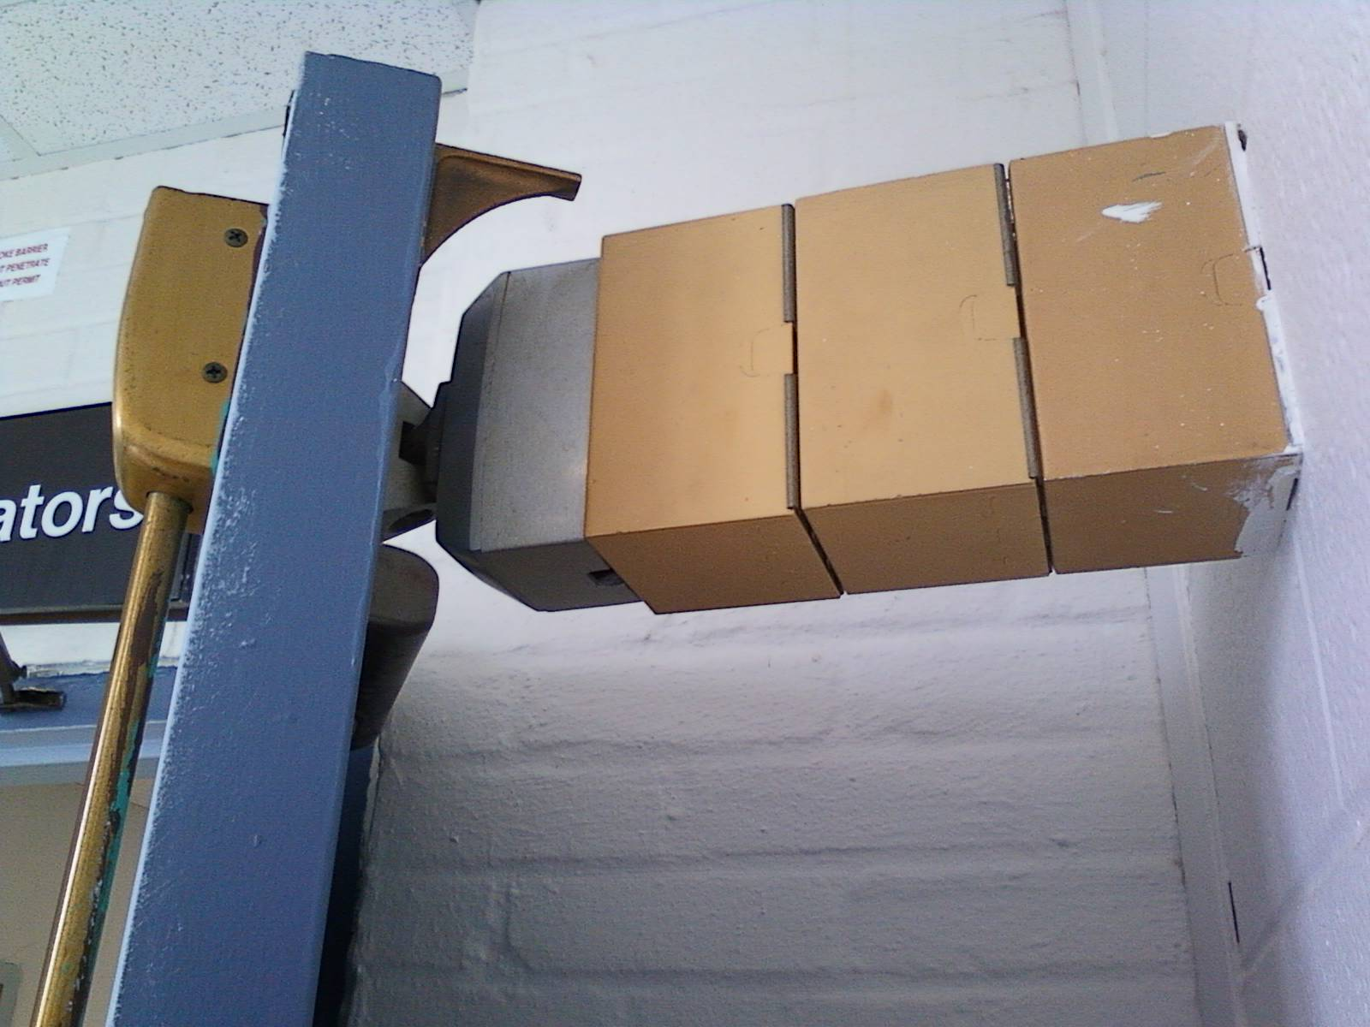
Not OK

Slide 35
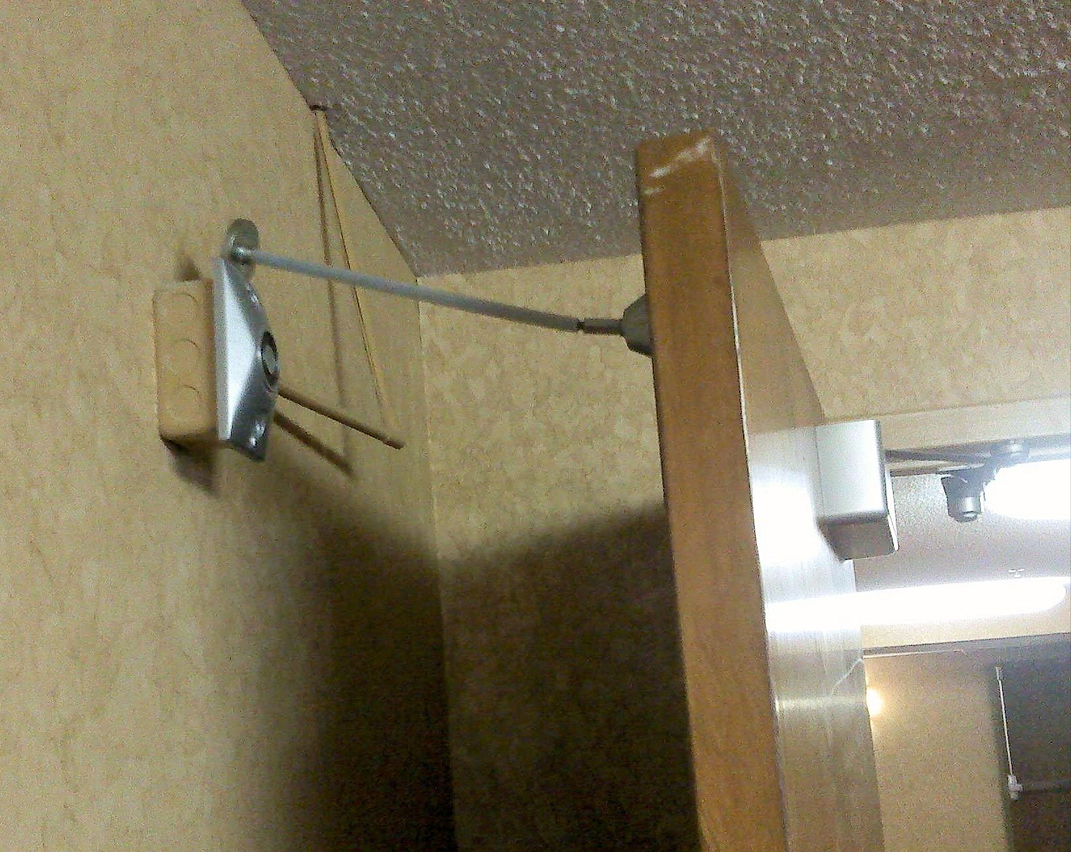
Not OK

Slide 36
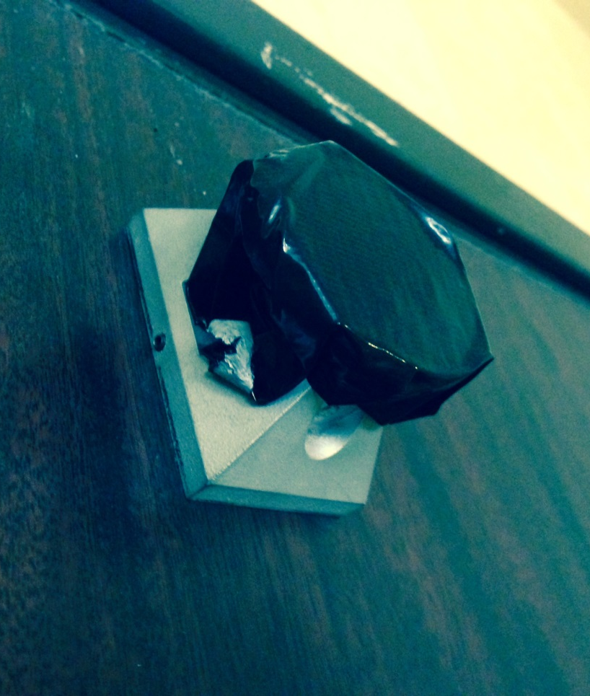
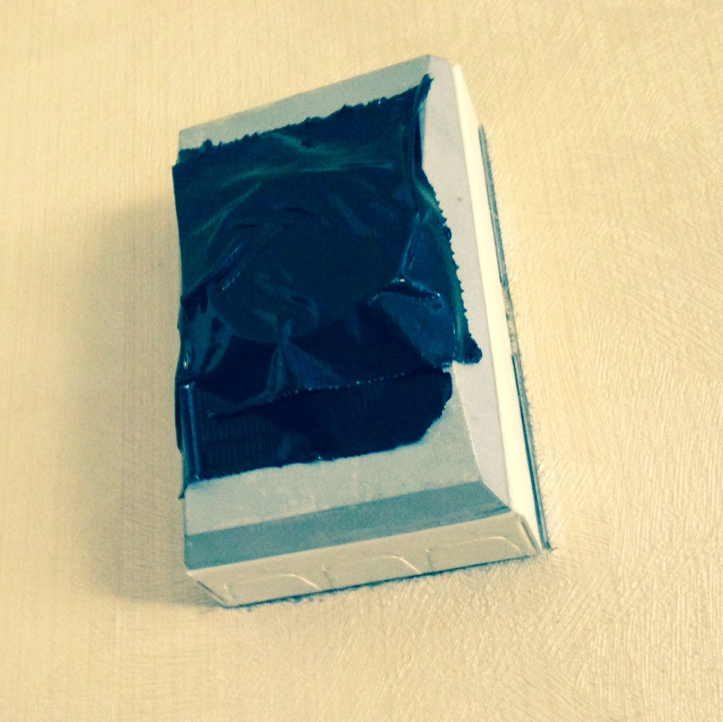
Is this OK?
Type in the chat box.

Slide 37
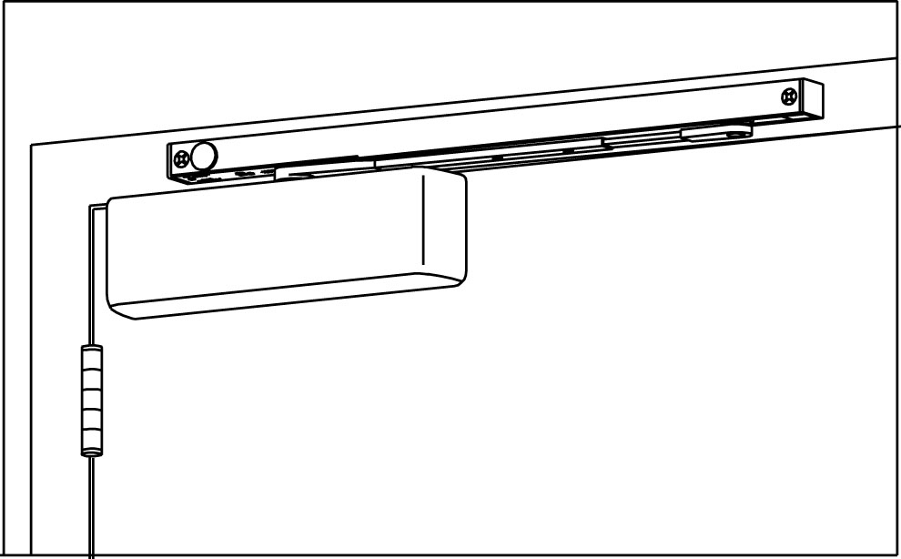
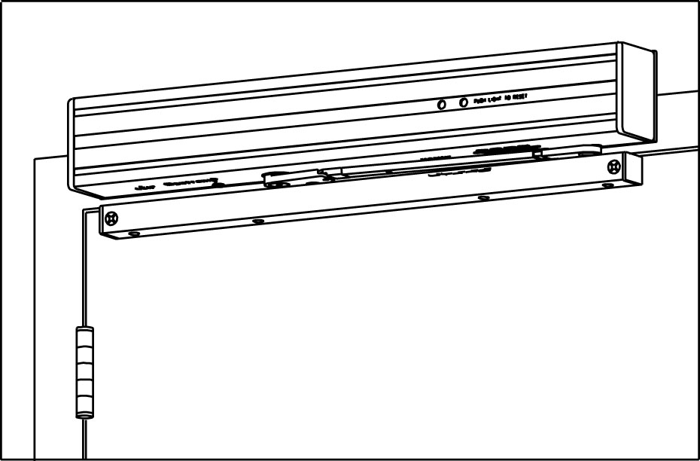
Acceptable Ways to Hold Open a Fire Door
electro-magnetic hold-open closer

Slide 38
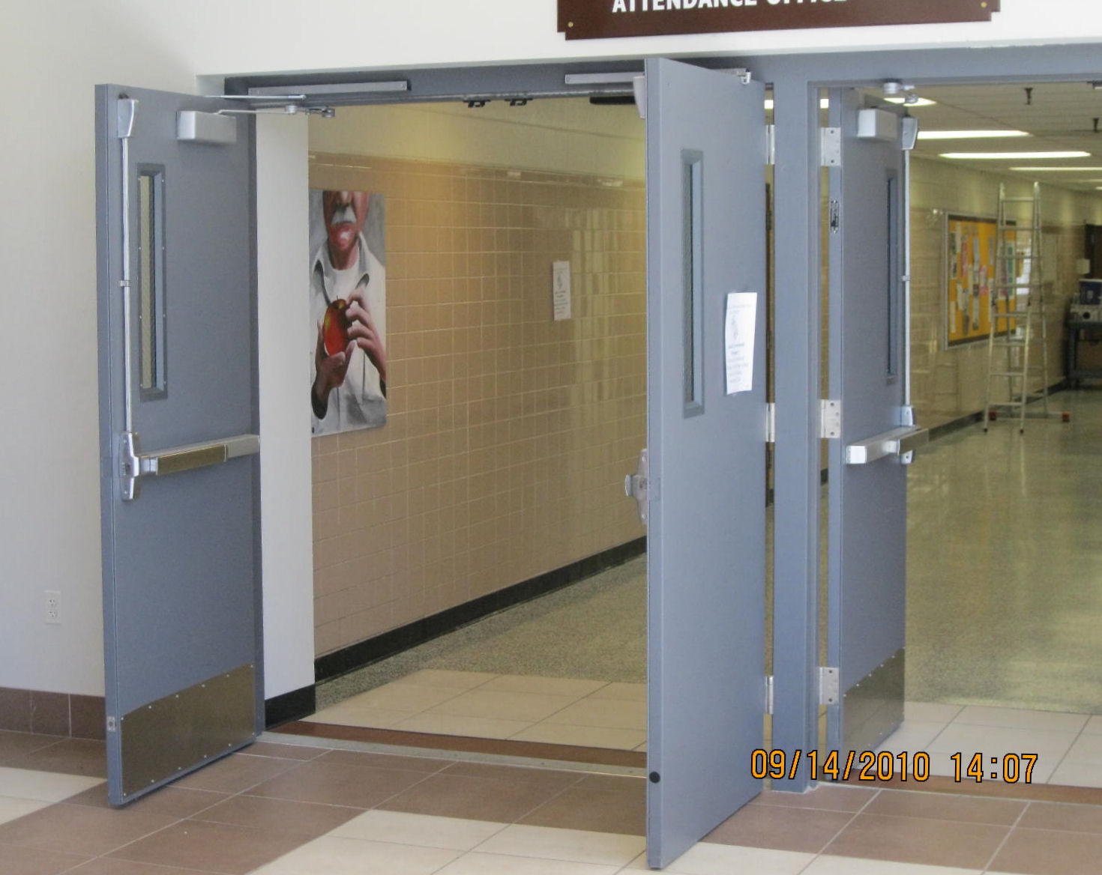
Anyone know what products were used here?
?

Slide 39
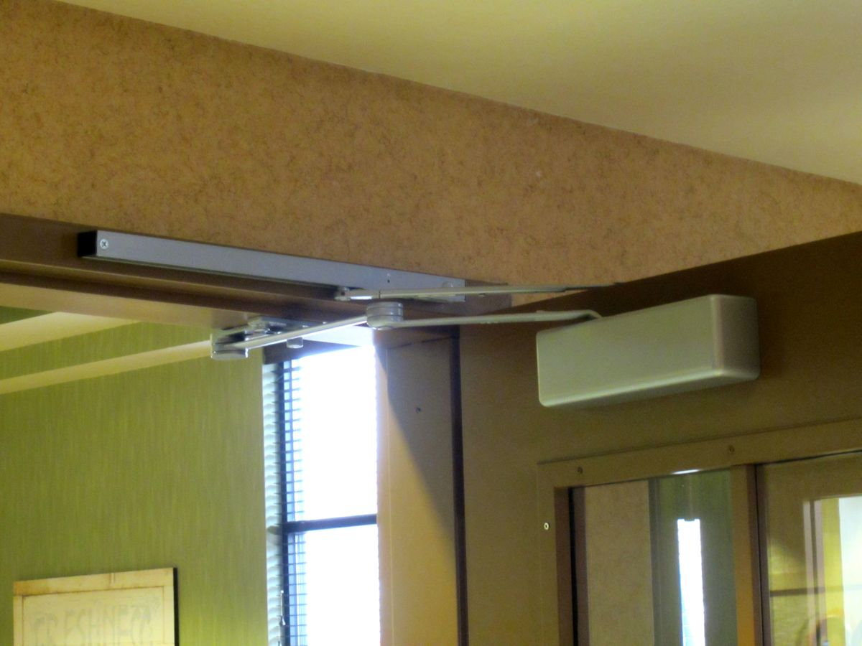
Anyone know what products were used here?

Slide 40
4111-Cush x 4040-SEH

Slide 41
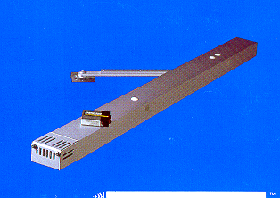
Acceptable Ways to Hold Open a Fire Door
battery-operated detectored holder with closer
GJ Sensaguard 280

Slide 42
Stair Enclosures
“The release by means of smoke detection of one door in a stair enclosure results in closing all doors serving that stair.”

Slide 43
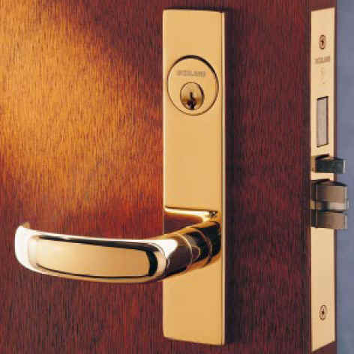
Self Latching
Positive Latching
Must have an active latch bolt

Slide 44
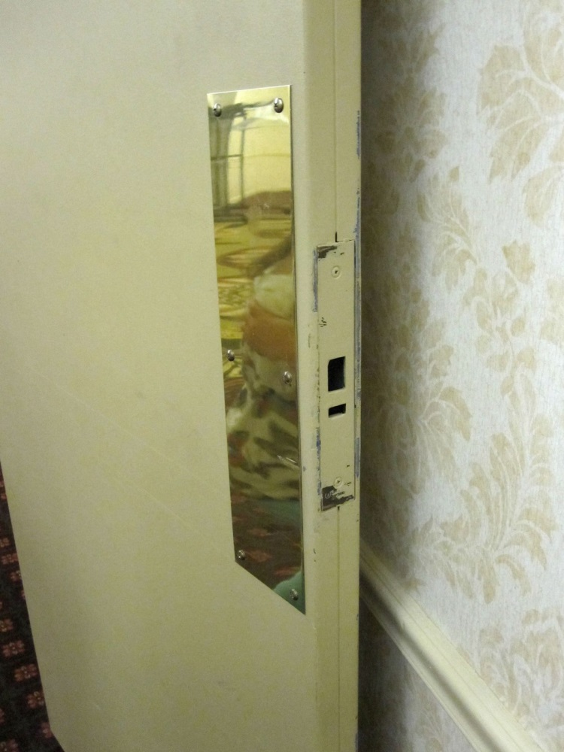
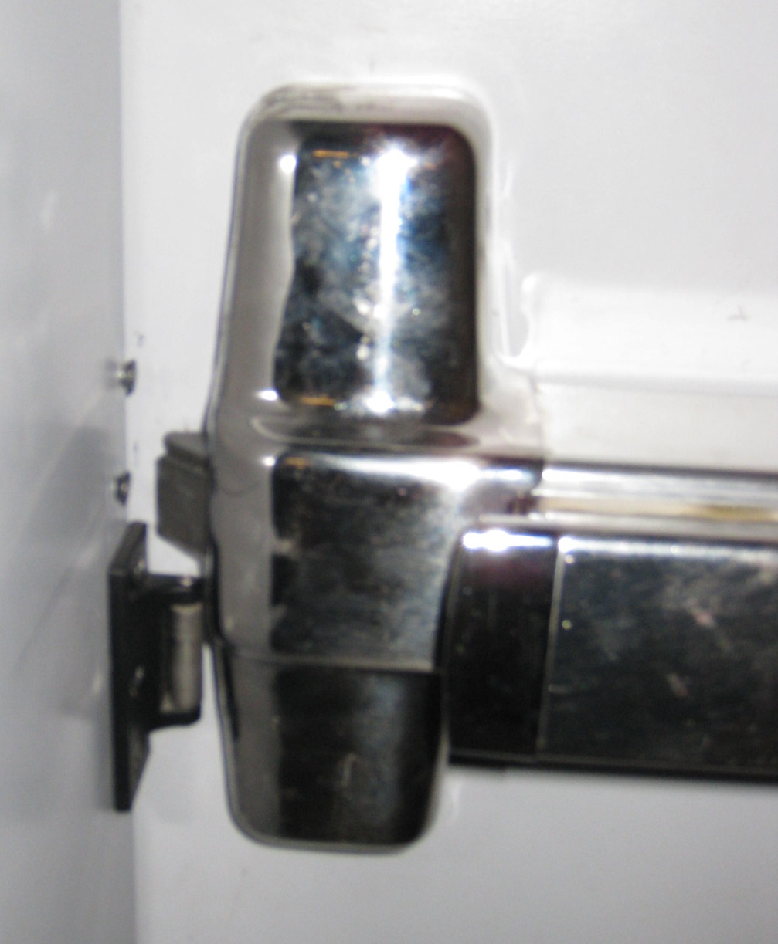
Not OK

Slide 45
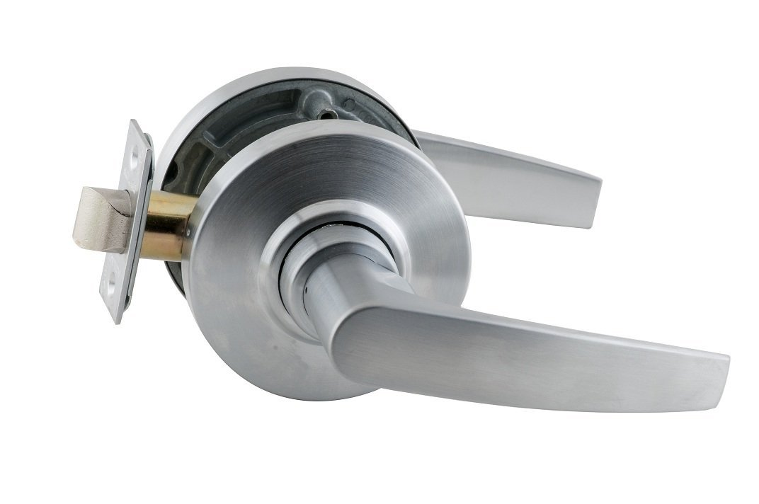
Latch Throw
NFPA 80 – 2007:
6.4.4.6 Throw.
6.4.4.6.1 The throw of single-point latch bolts shall not be
less than the minimum shown on the fire door label.
6.4.4.6.2 The minimum throw shall be as specified in the
manufacturer’s installation instructions.
In previous editions, a minimum latch throw was spelled out in NFPA 80.

Slide 46
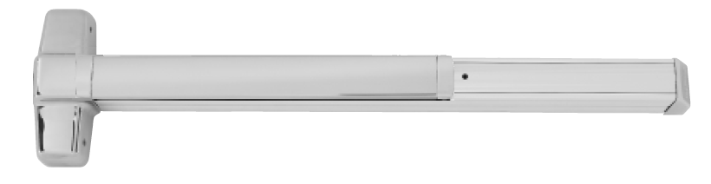
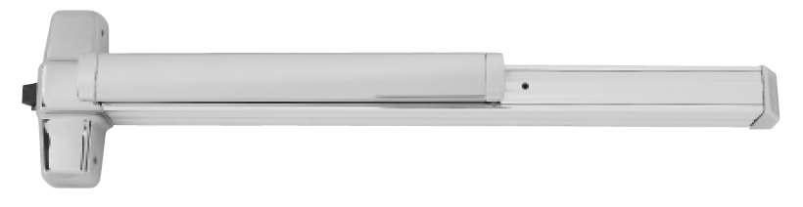
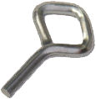
Self Latching
Positive Latching
No Mechanical Dogging

Slide 47
Self Latching
Positive Latching
No Mechanical Dogging
Latch may be held back electrically (EL/QEL) and release on fire alarm.

Slide 48
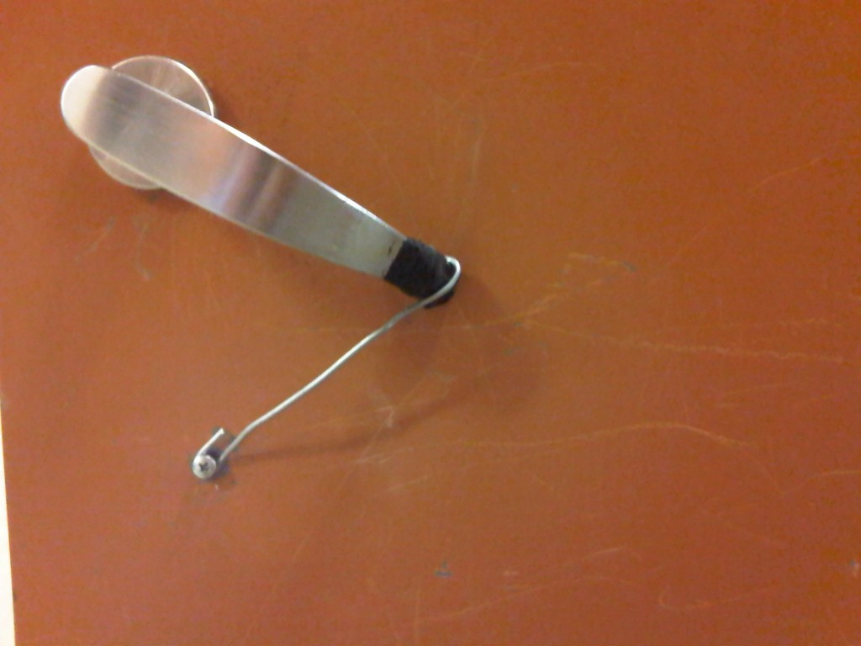
Not OK

Slide 49
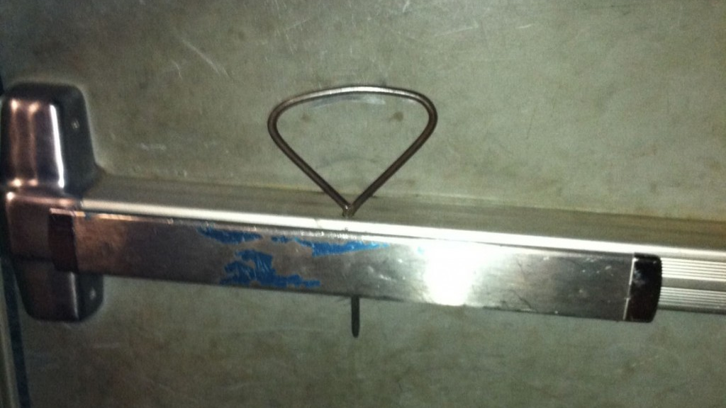
Not OK

Slide 50
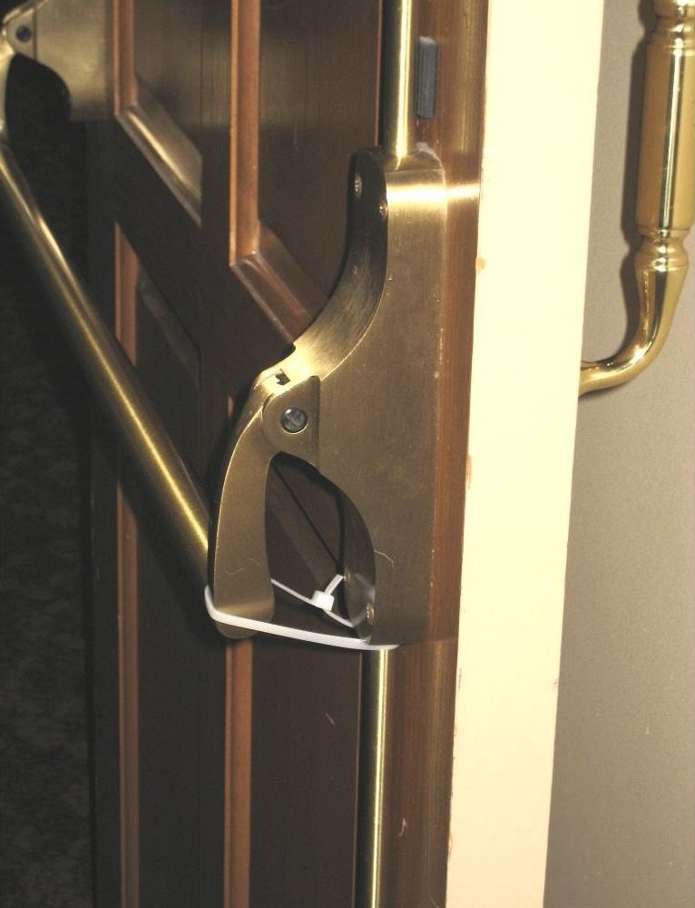
Not OK

Slide 51
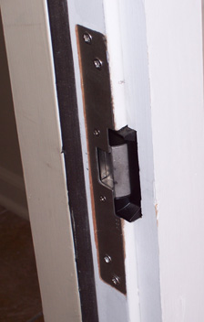
Self Latching
Positive Latching
Electric Strikes – must be Fail Secure
  Fail Secure – When power fails, keeper is secure
  Fail Safe – When power fails, keeper is free

Slide 52
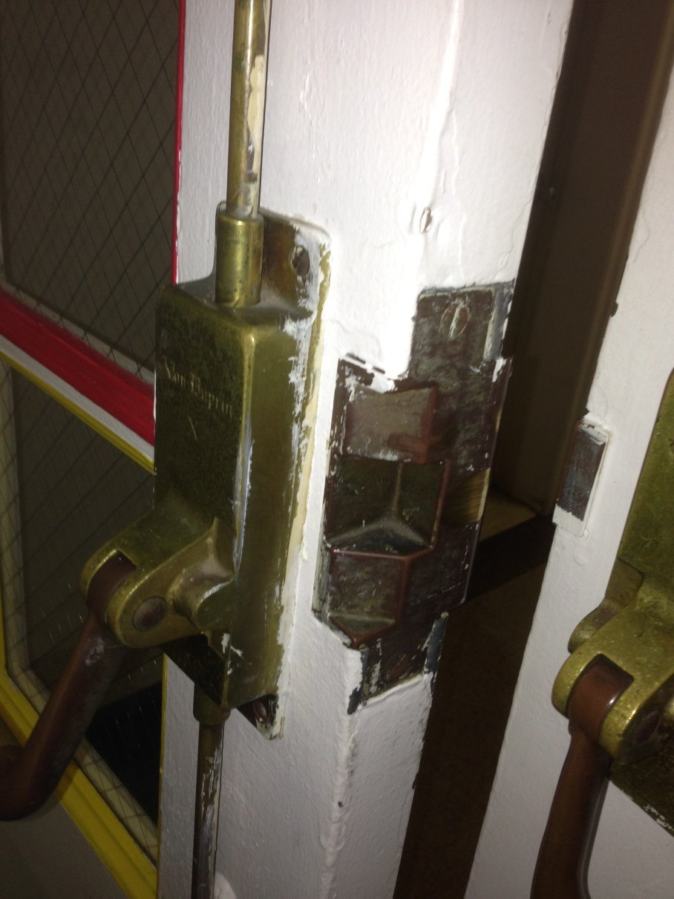
Open Back Strikes
NFPA 80 – 2007:
6.4.4.10* Open back strikes shall be permitted to be used in lieu of conventional strikes only where specifically provided
for in the published listings.

Slide 53
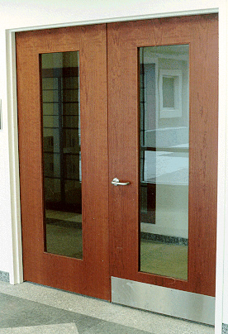
Self Latching
Positive Latching
Automatic Flush Bolts
  No “Dummy” Trim on Egress Side
  Coordinator Required

Slide 54


Flush Bolts
automatic
manual

Slide 55
Door Coordinators
Pairs of doors
Used with automatic flush bolts and astragals
Coordinates closing of doors so the correct door closes first
Bar type and gravity type
  Bar type installs under frame head
  Gravity type installs on frame face

Slide 56
Door Coordinators

Slide 57


Slide 58
Door Coordinator
inactive active

Slide 59
Door Coordinator
inactive active

Slide 60
Door Coordinator
inactive active

Slide 61
Door Coordinators

Slide 62
Door Coordinator
inactive active

Slide 63
Door Coordinator
inactive active

Slide 64
Door Coordinator
inactive active

Slide 65
Door Coordinator
inactive active

Slide 66
Door Coordinator
inactive active

Slide 67

Uncoordinated

Slide 68
Astragals
NFPA 80 – 2007:
6.4.7* Astragals.
6.4.7.1 Doors swinging in pairs, where located within a means of egress, shall not be equipped with astragals that inhibit the free use of either leaf.
6.4.7.2* Pairs of doors that require astragals shall have at least one attached in place to project approximately 3⁄4 in. (19 mm) or as otherwise indicated in the individual published listings.
Previous editions of NFPA 80 required astragals for doors rated more than 90 minutes.

Slide 69

What’s wrong here? Type in the chat box.

Slide 70
The overlapping astragal on this pair will prevent one door from being opened.

Slide 71
Fire Test Methods

Slide 72



Early Stage
2/3
-0.1 0.0 0.1
1/3
-0.1 0.0 0.1

Slide 73
Advanced Stage
2/
-0.1 0.0 0.1
1/3
-0.1 0.0 0.1

Slide 74
In Real Life
The level of thermal discontinuity can be clearly seen here.
The neutral pressure plane would be just above that level.
Notes:
7

Slide 75
Fire Test Methods
P74
UL 10B – Neutral/Negative Pressure
  Neutral pressure plane at top of the tested assembly
UL 10C – Positive Pressure
  Neutral pressure plane at 40” above the floor
NFPA 252 - Flexible - May be conducted using positive pressure (at 40” above the floor), or neutral pressure (@ top of door)
Category A Doors – intumescent is part of door (if required)
Category B Doors – intumescent is field-applied (if required)

Slide 76
Fire Test Methods
IBC 2009:
715.4.1 Side-hinged or pivoted swinging doors. Fire door assemblies with side-hinged and pivoted swinging doors shall be tested in accordance with NFPA 252 or UL 10C.
After 5 minutes into the NFPA 252 test, the neutral pressure level in the furnace shall be established at 40 inches (1016 mm) or less above the sill.
NFPA 101 2009 allows either method of fire testing.

Slide 77

Gasketing
Some fire doors must be tested in accordance with UL1784 for air infiltration
The maximum air leakage rate of the door assembly shall be 3.0 ft³/min/ft² of door opening...
Gasketing is required to limit air infiltration to this maximum.
Gasketing must be listed for use on fire doors.
A bottom seal is not required for fire doors in most locations.

Slide 78

Other Fire Door Basics…
Job-Site Preparations

Slide 79
Acceptable Job Site Preparations
Function holes for mortise locks
Holes for labeled viewers
¾” undercutting on wood and composite doors
Surface-applied hardware
  Drilling round holes up to 1” maximum diameter
  Fasteners
  Cylinders (may be larger than 1” diameter)

Slide 80

When material is removed, holes must be filled with steel fasteners, or the same material as the door or frame.

Slide 81

When material is removed, holes must be filled with steel fasteners, or the same material as the door or frame.

Slide 82

Glazing

Slide 83
Glazing
Glass in all doors must now be impact-resistant – no exception for fire doors.

Slide 84

IBC - Limiting Sizes of Wired Glass Panels

Slide 85

Clearance
Bottom of Door
  3/4” max under the door
  3/8” max if bottom of door is more than 38” a.f.f.
Jambs, Head, and Meeting Stiles
  Hollow Metal Doors – 1/8” +/- 1/16”
  Wood Doors – 1/8”

Slide 86


Slide 87

Panic hardware for fire doors is Fire Exit Hardware
Label: “Fire door to be equipped with fire exit hardware.”
No mechanical dogging
Less bottom rod applications
  “Fire pins” are used to fix door panels in the closed position.
  Hardware is not required to be operable after fire

Slide 88

What’s wrong here? Type in the chat box.

Slide 89


Slide 90

Protection Plates
16” maximum above the bottom of the door
Or UL listed
Or installed “under label service”

Slide 91

Hinges for Fire Doors
Steel base material
Ball bearing
Proper size, weight, and quantity
2 hinges for 60” in height, 1 additional hinge for each additional 30” (or portion)
Spring hinges are limited to 3070 doors or as tested

Slide 92
Hinge Fasteners
NFPA 80 – 2007:
6.4.3.2.3 Mortise hinges shall be secured to wood and
plastic-covered composite doors or wood core doors with
No. 12 × 11⁄4 in. (31.75 mm) flat, threaded-to-the-head, steel wood screws. Pilot holes shall be drilled that are 5⁄32 in. (4 mm) in diameter.
6.4.3.2.4 Surface hinges shall be attached with steel throughbolts.
6.4.3.4 Shimming. When required to meet the clearances
stated in 6.3.1.7, the shimming of hinges using steel shims
shall be permitted.

Slide 93


Not OK

Slide 94
Signage
NFPA 80 – 2007:
4.1.4 Signage. Informational signs shall be permitted to be installed on the surfaces of fire doors in accordance with 4.1.4.1 through 4.1.4.4 or in accordance with the manufacturer’s published listing.
4.1.4.1 The total area of all attached signs shall not exceed 5 percent of the area of the face of the fire door to which they are attached.

Slide 95

What’s wrong with this sign? Type in the chat box.

Slide 96
Screws are not allowed for signage on a fire door.

Slide 97
Signage
NFPA 80 – 2007:
4.1.4.2 Means of Attachment.
4.1.4.2.1 Signs shall be attached to fire doors by use of an adhesive.
4.1.4.2.2 Mechanical attachments such as screws or nails shall not be permitted.
4.1.4.3 Signs shall not be installed on glazing material in fire doors.
4.1.4.4 Signs shall not be installed on the surface of fire doors so as to impair or otherwise interfere with the proper operation of the fire door.

Slide 98
Fire Door Assembly Inspection
New to NFPA 80 in 2007
Responsibility of building owner/property manager
Documents the condition of the fire door assemblies

Slide 99
NFPA 80 Chapter 5
Visual inspection – both sides of door
Functional testing of fire door assemblies
    Ensure door leaves will be closed and latched under fire conditions
Performed by individuals with knowledge and understanding of the operating components of the type of door being subject to testing
Inspection includes operational test of automatic-closing doors
11 inspection criteria in 2007 edition, 13 in 2013 edition
Deficiencies must be repaired “without delay.”

Slide 100
Question
In a typical commercial or institutional building, where would you find a fire door?
Type in the chat box.

Slide 101
FDAI Criteria
Label visible and legible
No open holes or breaks in door or frame
Glazing, lite kits, glazing beads securely fastened
Door, frame, hinges, hardware, threshold, secure, aligned, in working order, no damage
No missing or broken parts
Clearances within acceptable limits
Closer functional, door closes completely
Coordinator (if installed) works properly
Latching hardware operates and secures door in closed position
No auxiliary items that inhibit proper operation
No field modifications outside of what is allowed by NFPA 80
Perimeter and meeting stile gasket present if required
Signage meets requirements of NFPA 80

Slide 102
Session 2 – Fire Doors
NFPA 80 – format and organization
    * asterisk, | vertical line, Chapter 6
Purpose of fire doors
    compartmentalization to protect egress
Fire ratings and testing
    neutral vs. positive pressure
Basic fire door requirements
    closing, latching, hinges, plates, glass, gasketing, clearances, job-site preparation
Fire Door Assembly Inspection

Slide 103
Homework
Watch the video analysis of 30 Dowling Circle fire.
Apartment building
Doors equipped with spring hinges
Carpet and door sweep prevented doors from closing
1 Firefighter fatality

Slide 104


