Slide 1
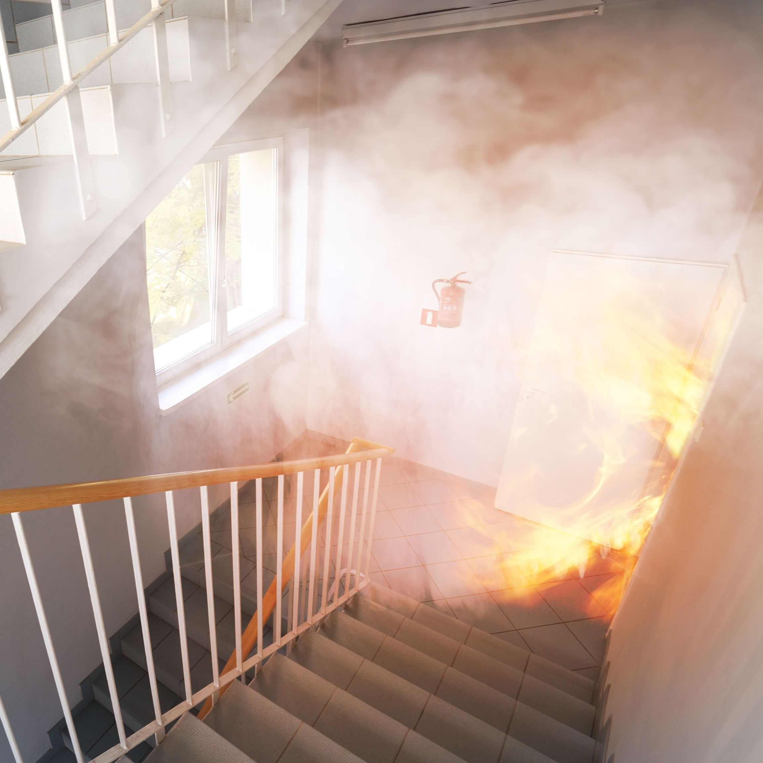
Stairwell Reentry
Allows building occupants to leave the stairwell and reenter the building through locked stairwell doors if the stair becomes compromised during a fire.
After leaving the stairwell, building occupants can find another exit or wait for assistance.
Notes:
The stairwell reentry requirements are intended to allow building occupants to leave a stairwell if it becomes compromised by smoke during a fire evacuation.
Once building occupants leave the stairwell, they can seek another exit or wait for rescue.
The model codes do not specifically state that there must be a path of egress (no locked doors) between one stairwell and the other but having this path of egress will allow building occupants to use the other stairwell for egress.

Slide 2
Cook County Administration Building Fire, Chicago
October 17, 2003
Supply room fire on 12th floor
Firefighters opened a stairwell door to fight the fire
Stairwell filled with smoke
People evacuating could not continue down, and could not reenter the building through locked stairwell doors
6 fatalities
Notes:
The stairwell reentry requirements have been in the codes for decades, but there were many existing buildings that were not compliant until a fire occurred in 2003 at the Cook County Administration Building in Chicago.
The stairwell that building occupants were using for evacuation became blocked by firefighters and equipment, and then filled with smoke. When people tried to leave the stairwell, locked doors prevented reentry into the building. At least one stair door had been blocked open with a wood wedge, which allowed some people to escape.
13 people were found in the stairwell – 7 were revived, 6 died. This fire led to much wider enforcement of the stairwell reentry requirements.

Slide 3
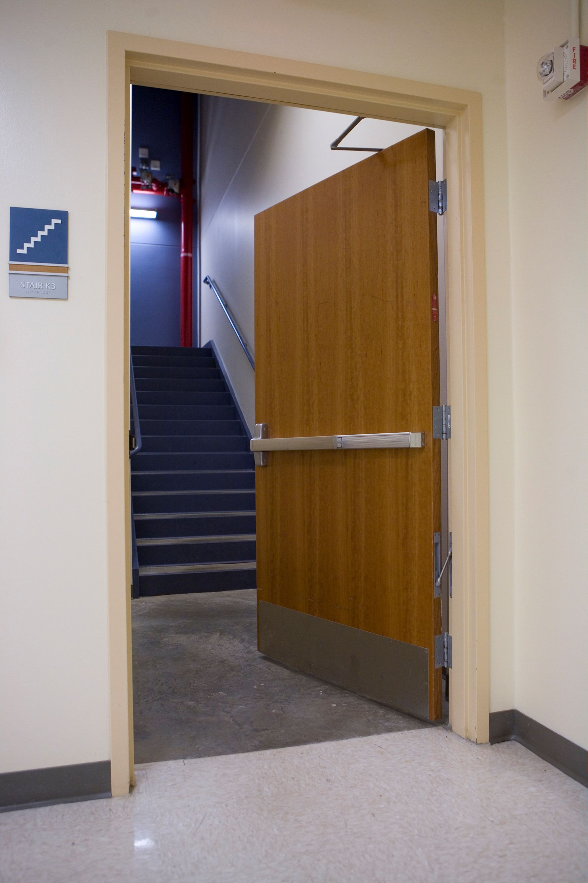
International Building Code (IBC)
The I-Codes (IBC/IFC) are more restrictive than NFPA 101, and most states have adopted 1 or both of the I-Codes.
Per the I-Codes, all stair doors must allow reentry – regardless of the number of floors
Option 1: Passage set or non-locking trim for fire exit hardware
Option 2: Electrified stair side lever unlocks upon a signal from fire command center or other location typically at the main entrance
Note: UL 294 listing is not required by the I-Codes
Notes:
The model codes vary when it comes to stairwell reentry – the IBC and IFC (AKA the I-Codes) are more stringent than NFPA 101. Since most states have adopted one or both of the I-Codes, these requirements apply in most jurisdictions.
The IBC and IFC require doors leading to the stairwell at all levels to allow for reentry. This may be accomplished with non-locking hardware, or with electrified hardware. Electrified hardware on the stair side of the door must be unlocked without unlatching via a switch at the fire command center or the main entrance of the building.
In high-rise buildings, the I-Codes require a two-way communication system in the stairwell when electrified locks are used to secure stair doors.
The I-Codes include exceptions for some buildings where a single exit is allowed. There is no need to allow building occupants to leave a stairwell if there is no other stairwell to use.
UL 294 is the Standard for Access Control System Units. Although this listing is required for some types of electrical locking systems, it is not required by the IBC for stairwell reentry hardware.

Slide 4
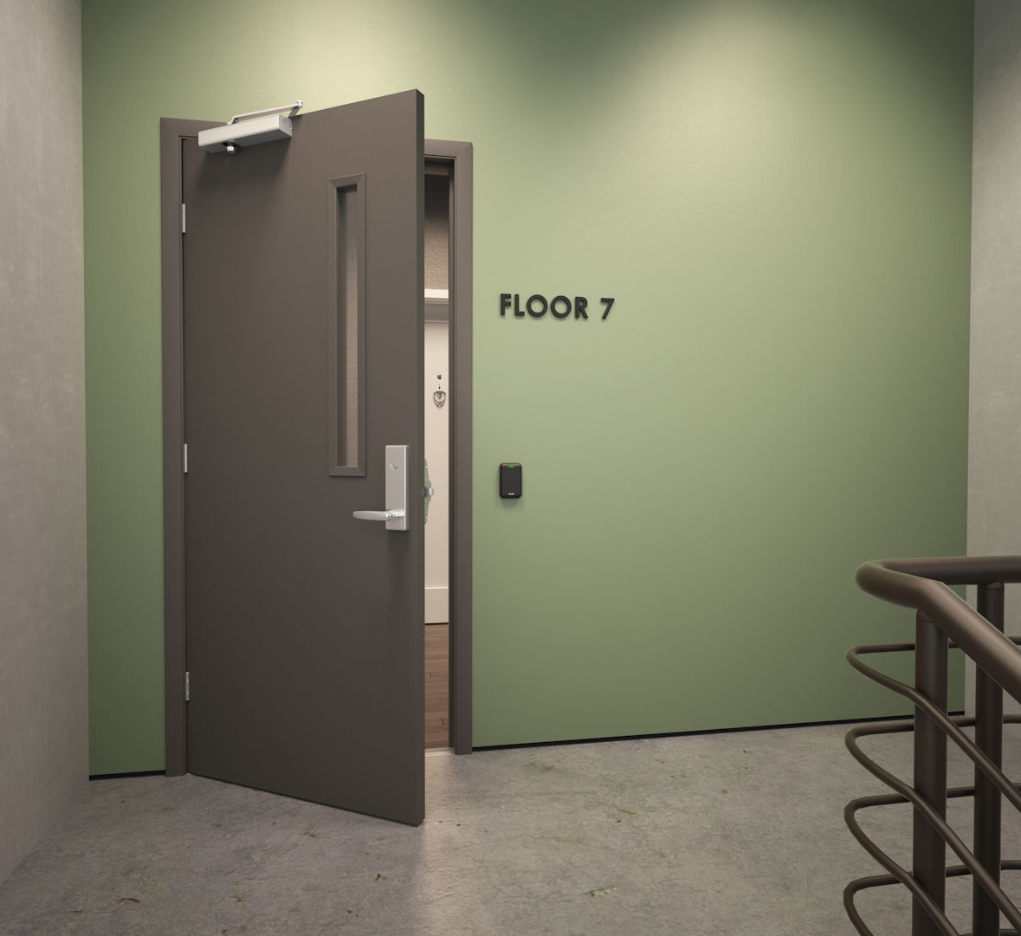
NFPA 101 – Life Safety Code
Less restrictive than the I-Codes
Stairs serving 4 stories or less can be locked mechanically on the stair side.
“Selected reentry” allows some doors to be locked mechanically with other doors allowing reentry.
Some occupancy chapters are exempt from the stairwell reentry requirements.
For stair doors that must facilitate reentry:
Option 1: Passage sets or non-locking trim for fire exit hardware
Option 2: Electrified stair side lever unlocks upon fire alarm activation
Note: The 2021 edition of NFPA 101 requires electrified hardware used for stairwell reentry to be listed to UL 294.
Notes:
The NFPA 101 requirements are less restrictive than the I-Codes, and in most jurisdictions the I-Code requirements must be followed. NFPA 101 allows mechanical locks on the stair side of the door if the stair serves 4 stories or less (the I-Codes do not allow this).
NFPA 101 allows selected reentry, where some doors allow reentry and others do not. Some of the occupancy chapters in NFPA 101 are exempt from the reentry requirements. The I-Codes do not include stairwell reentry nor exempt certain use groups from the requirements.
In locations where NFPA 101 is the adopted code and the stairwell reentry requirements of the Life Safety Code apply, stairwell doors required to provide reentry can either have passage sets / non-locking lever trim, or electrified hardware that unlocks on the stair side upon activation of the fire alarm system.
Beginning with the 2021 edition, NFPA 101 does require the UL 294 listing on electrified hardware used for stairwell doors.

Slide 5
2024 IBC Changes
2021 edition and prior:
Rely on manual activation of a switch by firefighters
Do not require hardware on stair doors to be fail safe
2024 edition will require:
Unlock upon fire alarm activation (where provided)
Unlock upon power failure
Unlock via switch at the fire command center/other location
Notes:
A key difference between the I-Codes and NFPA 101 is that the I-Codes rely on firefighters to activate a switch to unlock the doors, and NFPA 101 requires the doors to unlock automatically upon fire alarm activation. None of these model codes specifically state that the locks are required to be fail safe, although that is what the hardware industry typically uses for this application.
In the 2024 edition of the IBC and IFC, this will change. The 2024 edition will require these doors to unlock upon activation of the fire alarm, upon power failure, and upon activation of the switch at the fire command center or other location.

Slide 6
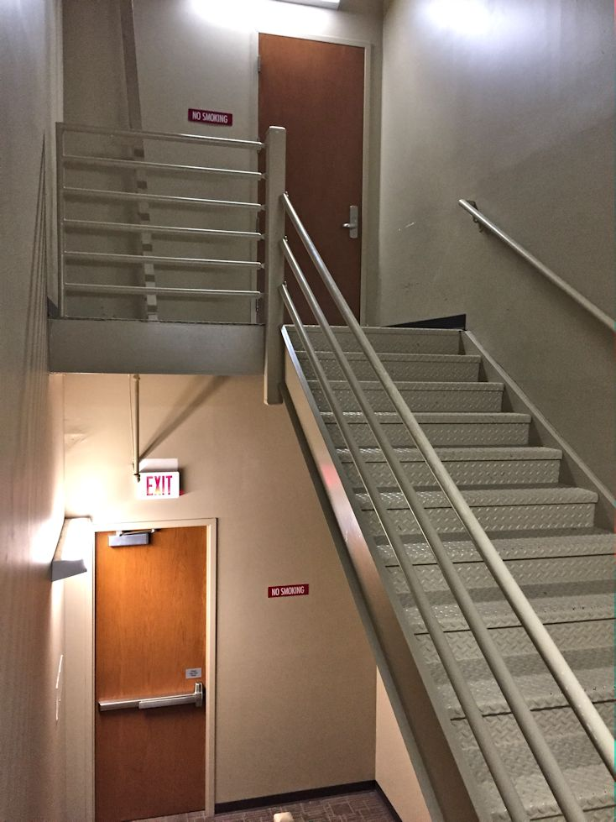
Which hardware?
Stair side lever must unlock without unlatching – positive latch required for fire doors.
Options:
Fail safe electromechanical locks
Fail safe trim for fire exit hardware
Electromagnetic locks + passage sets (and required release devices for mag-locks)
Note: Fail safe electric strikes can not be used because they are not listed for use on fire door assemblies and are not positive latching.
Note: The stair discharge door is not required by the model codes to allow reentry.
Notes:
When the electrified hardware is unlocked, stair doors must remain latched because they are typically fire doors. Fail safe electromechanical locks or fail safe trim for fire exit hardware are most commonly used. Electromagnetic locks along with passage sets (for latching) are another possibility, but the release devices required by code must be installed to ensure that the mag-lock is code-compliant for egress.
Fail safe electric strikes can not be used on fire rated stair doors because they are not listed for this purpose and are not considered positive-latching hardware.
Stair discharge doors are not required by the model codes to have electrified hardware or to facility reentry.

Slide 7
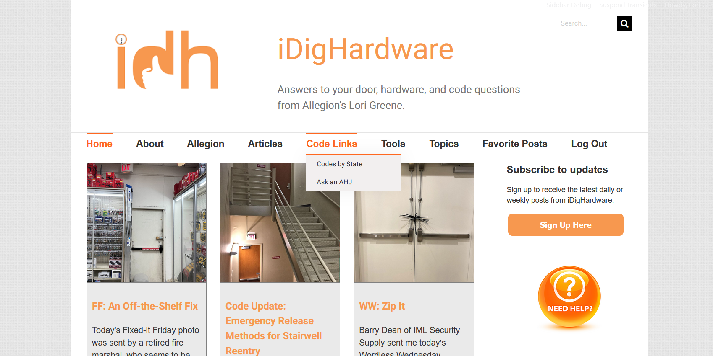
Notes:
The iDigHardware tip for this month…
On the Code Links menu of iDigHardware there are two options:
Codes by State includes links to the ICC, NFPA, and UpCodes, to help you find out which codes have been adopted in a specific jurisdiction. Remember that state/local codes may differ from the model codes.
Ask an AHJ takes you to a discussion forum for code officials (The Building Code Forum), where you can ask questions and hear from AHJs.

