Slide 1
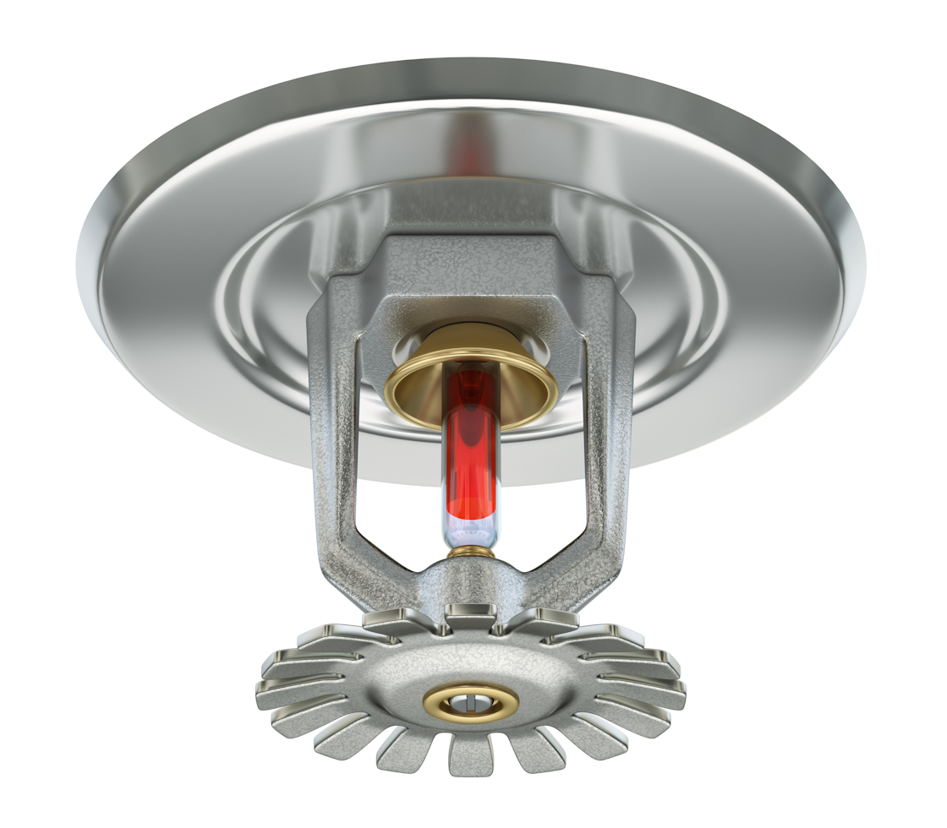
Extraneous Labels on Fire Door Assemblies
NFPA 101: Existing life safety features obvious to the public, if not required by the Code, shall be either maintained or removed.
Annex A: Where a door that is not required to be fire protection-rated is equipped with a fire protection listing label, it is not the intent of 4.6.12.3 to require such door to be self- or automatic-closing due merely to the presence of the label.
Notes:
There are not a whole lot of changes to the sections addressing fire door assemblies, but this is an important one.
There is a paragraph in NFPA 101 that requires life safety features that are obvious to the public to be maintained, or removed if they are not required.
The intent is for this requirement to apply to a life safety feature like a sprinkler system, for example.
If I was in a building that was on fire, and I saw sprinkler heads in the ceiling, I might make the decision to shelter in place based on the presence of the sprinkler system.
But if the sprinkler system was not functional, I’d be making my decision based on inaccurate information.
So the line in the code requires the sprinkler system to be maintained, or removed if not required by code.
The intent was not for this requirement to apply to fire door assemblies, and an annex note was added to try to clarify that.
But sometimes fire doors are installed where they are not required, and some AHJs considered the labels on fire door assemblies something that would be obvious to the public.
In some cases, the AHJs wanted these extraneous labels removed or required the assemblies to meet all of the NFPA 80 requirements for fire doors, even when fire doors were not required in those locations.

Slide 2
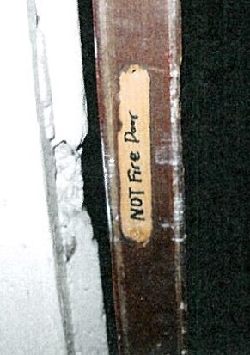
BEFORE
AFTER
Notes:
These photos show a door with a fire door label – the AHJ noted that the fire door did not have a door closer.
When he went back to make sure the deficiency had been addressed, the photo on the right shows the facility manager’s solution.
But many facility managers do not want to remove the fire door labels, in case the doors are moved to another location in the future where the label is needed.
Dealing with the AHJs requiring labels to be removed was a huge burden – especially for our health care customers.

Slide 3
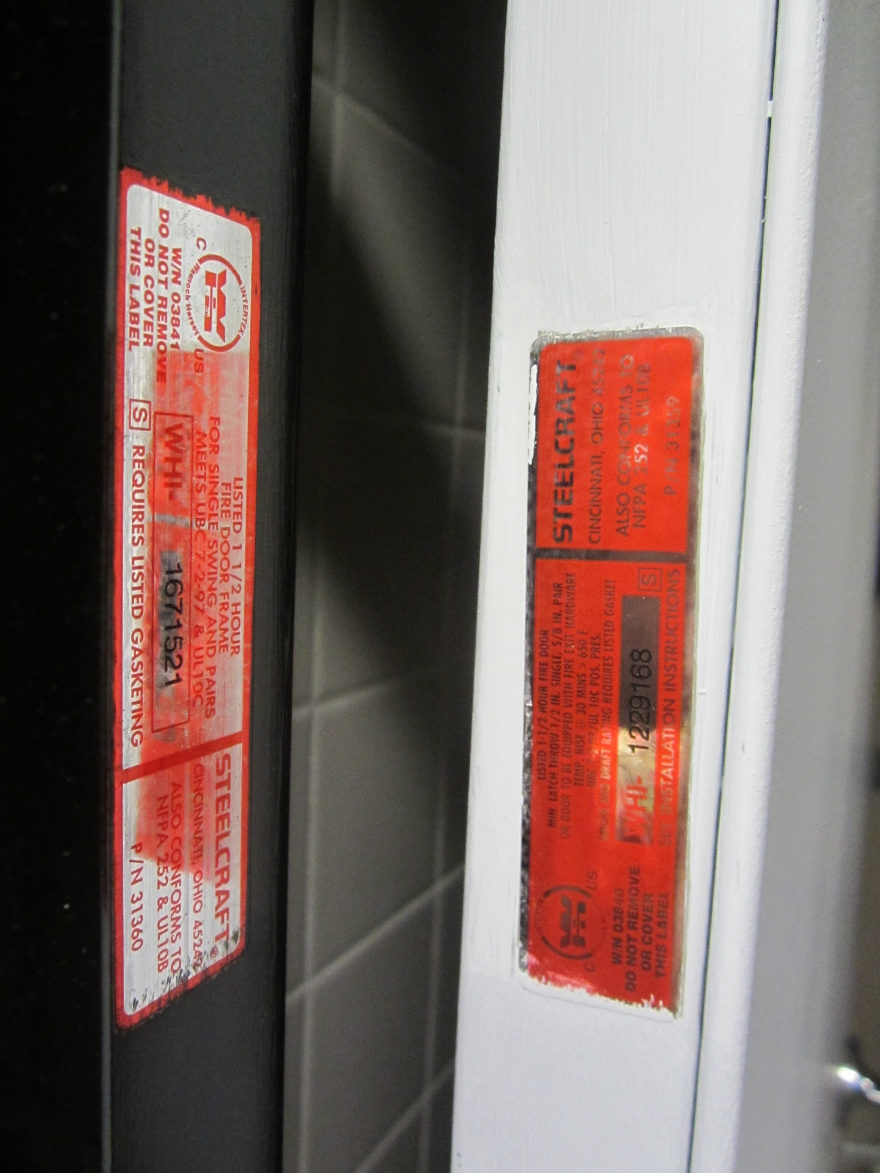
Extraneous Labels on Fire Door Assemblies
NFPA 101-2021: Where a door or door frame that is not required to be fire protection-rated is equipped with a fire protection listing label, the door and the door frame shall not be required to meet NFPA 80.
Notes:
A change has been made to the 2021 edition of NFPA 101, to clarify that if the rated fire door assembly is not required for a particular location, the label can remain and the assembly is not required to meet NFPA 80 – Standard for Fire Doors and Other Opening Protectives.

Slide 4
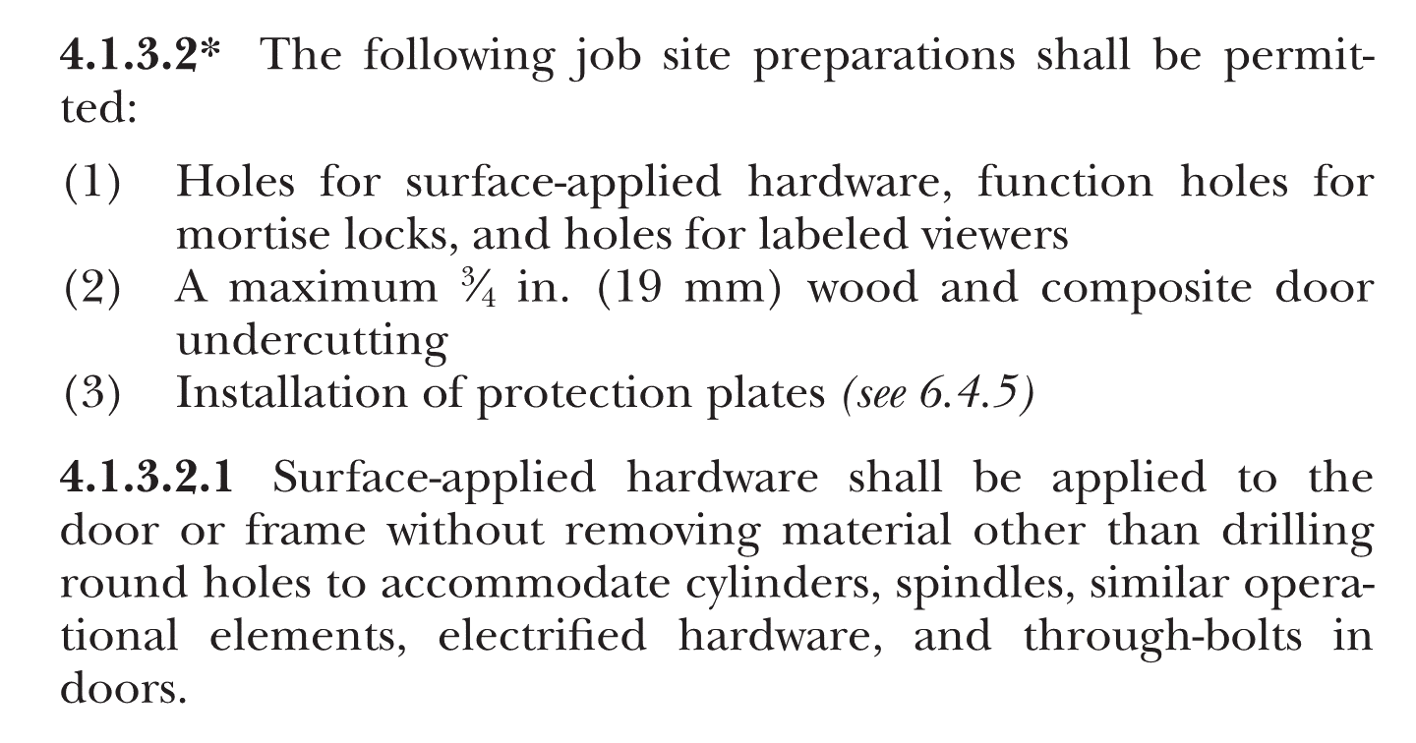
NFPA 80 2016 & 2019
Notes:
The next change is one that was made in NFPA 80 – Standard for Fire Doors and Other Opening Protectives – the change first appeared in the 2016 edition of the standard.
You may be familiar with the NFPA 80 requirements related to job-site preparations for hardware on fire doors.
The text on the screen is from NFPA 80, and allows holes for certain types of hardware, up to ¾-inch undercutting of wood and composite doors, and installation of protection plates.

Slide 5
NFPA 80 2016 & 2019
Notes:
For many years, the allowable size of holes that could be done as job-site preparations were limited to 1-inch diameter, except for cylinder holes which could be any size.
The 2016 edition of NFPA 80 added a paragraph which allows holes larger than 1 inch to be done as job-site preparations, as long as they are allowed by the manufacturers’ listings.
In talking with our compliance engineers, if a hole is shown on the installation instructions, it could be prepped in the field because the instructions are part of what is covered by our listings.
The typical interpretation of this section is that the holes do have to be round holes (not another shape).

Slide 6
NFPA 80 2016 & 2019
Notes:
Field drilling of raceways in fire doors is still a grey area, but they would be permitted by NFPA 80 when allowed by the manufacturers’ listings.
The second paragraph here states that when field-drilled raceways are not covered by the manufacturers’ listings, the raceway is treated as a field modification.
A field modification is when a change needs to be made in the field and it is not allowed by NFPA 80 as a job-site preparation. In that case, the listing lab is contacted – through the door or frame manufacturer.
Once the lab reviews the proposed field modification, they may approve the work (or not). If the work is approved as a field modification, the door or frame is not required to be relabeled in the field.

Slide 7
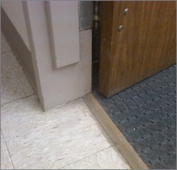
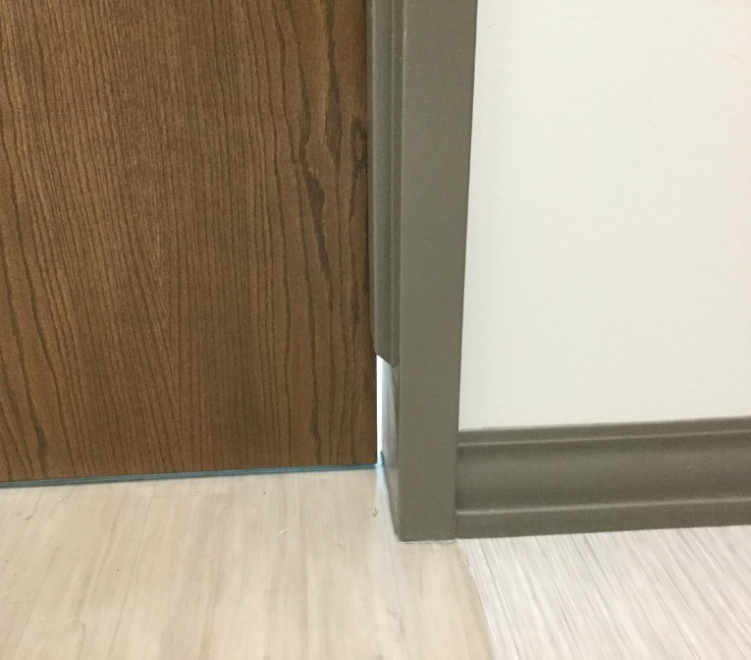
Terminated Stops
IBC-2021
Terminated stop is now defined
6 inches maximum
Prohibited where doors are required to limit air infiltration without an artificial bottom seal (limited locations)
Allowed elsewhere – including fire door assemblies
Notes:
Another change, which was made to the 2021 IBC, addresses terminated stops on fire door assemblies.
Terminated stops or hospital stops are a frame modification that ends the stop above the bottom of the frame, to eliminate the little corners where the frame meets the floor – which can be difficult to clean.
Previous editions of the IBC do not address terminated stops – they were not prohibited but there was often an assumption that they could not be used because of the gap left near the bottom of the door and the potential for smoke infiltration.
“Terminated stop” is a term that will now be defined in the IBC – including a limitation of 6 inches on the height of the missing section of stop.
The 2021 IBC defines the locations where terminated stops on fire door assemblies are NOT permitted, meaning that they ARE permitted in other locations.

Slide 8
Terminated Stops
IBC-2021
Terminated stop is now defined
6 inches maximum
Prohibited where doors are required to limit air infiltration without an artificial bottom seal (limited locations)
Allowed elsewhere – including fire door assemblies
Notes:
The reason the missing stop is not a problem in most locations is because the test for air infiltration – UL 1784 – is typically conducted with the bottom 6 inches of the door opening covered with an artificial bottom seal.
The air that passes through that area is not included in the measurement of air infiltration during the test.
There are a few locations where the assembly is required by code to meet the air infiltration limits WITHOUT the artificial bottom seal, and those are the locations where terminated stops are not allowed by the IBC.
Those are all related to elevator lobby doors – in some underground buildings, fire service access elevator lobbies, and occupant evacuation elevator lobbies, and also to some elevator hoistway doors.
Basically, if the frame with the terminated stop is not in an elevator lobby or part of the hoistway – the terminated stop complies with the IBC.
If it is near an elevator or elevator lobby, you’ll need to do a little more research.
Again, this is one of those changes that is more of a clarification…terminated stops were not prohibited before, but in the 2021 IBC the requirements are very clear and this could be used to help interpret the intent even if a jurisdiction has adopted a previous edition of the IBC.

Slide 9
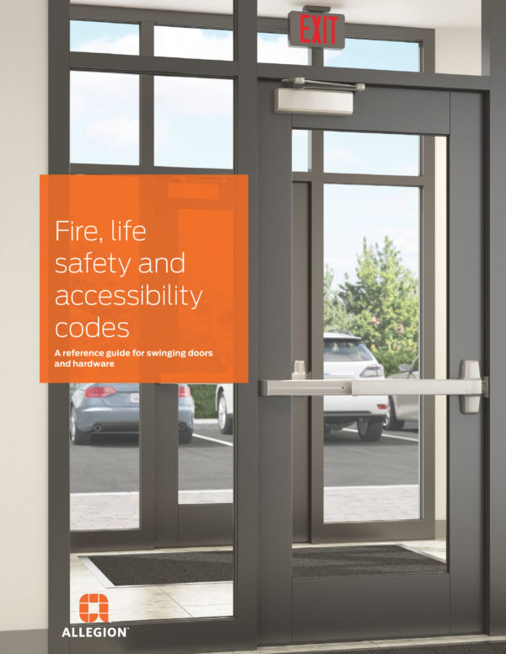
Code Reference Guide
Updated with 2021 changes
40 pages
Hard copies are not in stock yet
Can be downloaded from iDigHardware.com/guide
Notes:
And this month’s iDigHardware tip…
If you are not using the code reference guide with your customers, you should be! At one time (pre-Covid) we were giving away about 1500 of these per month – it’s very popular!
The guide has recently been updated to include the 2021 code changes…paragraph numbers for each edition of the code or standard (since 2000ish) are included so customers can find the correct section in their adopted code.
We should have hard copies in stock soon, but currently the guide can be downloaded from iDigHardware.com/guide.

