Slide 1
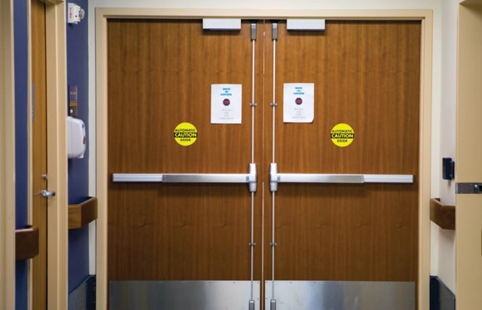
Question:
In which health care units can egress doors be equipped with electrified locks that prevent building occupants from exiting under normal operation?
Behavioral health
Memory care
Infant and maternity
All of the above
Locks must not prevent egress under normal operation
Notes:
Here is a quiz question to get this discussion rolling…

Slide 2
Question:
In which health care units can egress doors be equipped with electrified locks that prevent building occupants from exiting under normal operation?
Behavioral health
Memory care
Infant and maternity
All of the above
Locks must not prevent egress under normal operation
Notes:
In most buildings, doors in a means of egress can NOT be locked to prevent egress, even if they unlock upon fire alarm. One exception is in health care units where patients require containment for their safety or security. This application is called controlled egress, and although the model don’t specifically state which types of units are allowed to have these locks, options A, B, and C above are typical locations.

Slide 3
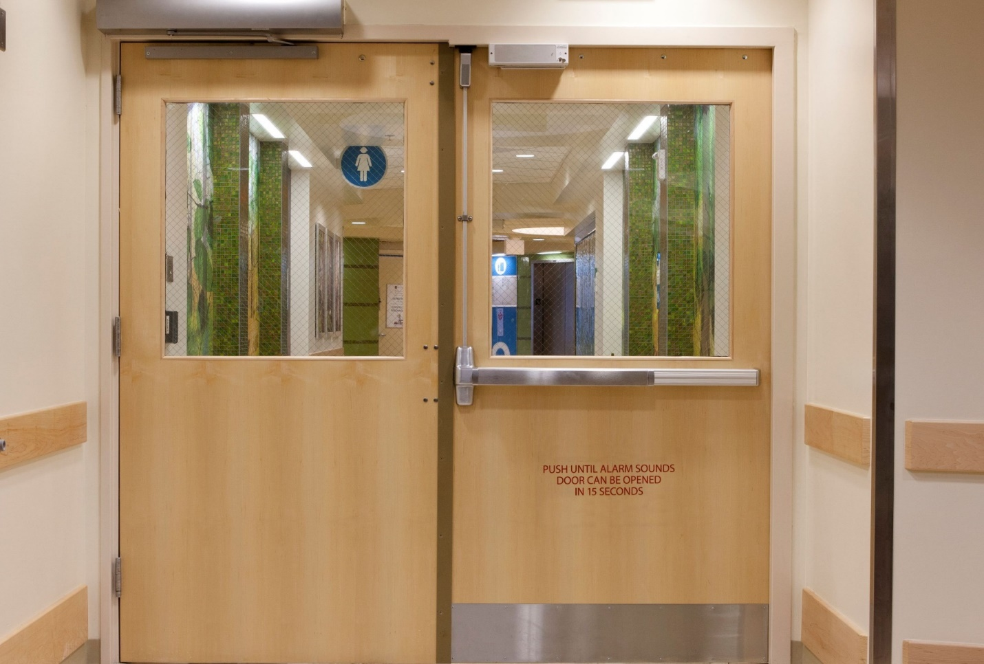
Delayed Egress vs. Controlled Egress
Delayed Egress
Releases to allow egress 15 seconds after an attempt to exit is made
Audible alarm and signage
Used to deter theft and elopement
Releases to allow egress when evacuation is needed
No audible alarm or signage required
Used in health care units where patients require containment for their safety or security
Controlled Egress
Notes:
Delayed egress locks, which have a 15 second delay (or sometimes 30 seconds) do not work well for some types of health care units. For example, in memory care we were seeing some residents exhibiting exit-seeking behaviors and setting off the audible alarm or sometimes even being able to leave the building after 15 seconds.
Beginning with the 2009 model codes, a new application was added which is now commonly called controlled egress. With controlled egress locks, doors serving certain types of health care units can have doors that are locked indefinitely to prevent elopement.
So just be aware that there is an alternative available to delayed egress, depending on the type of unit a door is serving, and it is a better application for many health care facilities. Some facility managers are not yet aware of this option.

Slide 4
How controlled egress works:
ONLY ALLOWED IN CERTAIN TYPES OF HEALTH CARE UNITS
Door stays locked until egress is needed
Immediate egress is allowed:
Upon actuation of fire alarm or sprinkler system
Upon loss of power
Upon remote signal
Staff must have the ability to unlock the doors if evacuation is required
There are some exceptions to these remote release methods
Notes:
Unlike delayed egress locks, controlled egress locks are NOT required to release after 15 seconds, and NO audible alarm or signage is required by the model codes. The doors are locked indefinitely, and there are several release methods required, which help to ensure life safety for building occupants. The model codes have slightly different requirements, so you will need to consult the adopted code for specifics, but generally, the locks must be fail safe, and immediate egress must be allowed:
Upon actuation of fire alarm or sprinkler system
Upon loss of power
Upon remote signal
Staff must have the ability to unlock the doors if evacuation is required

Slide 5
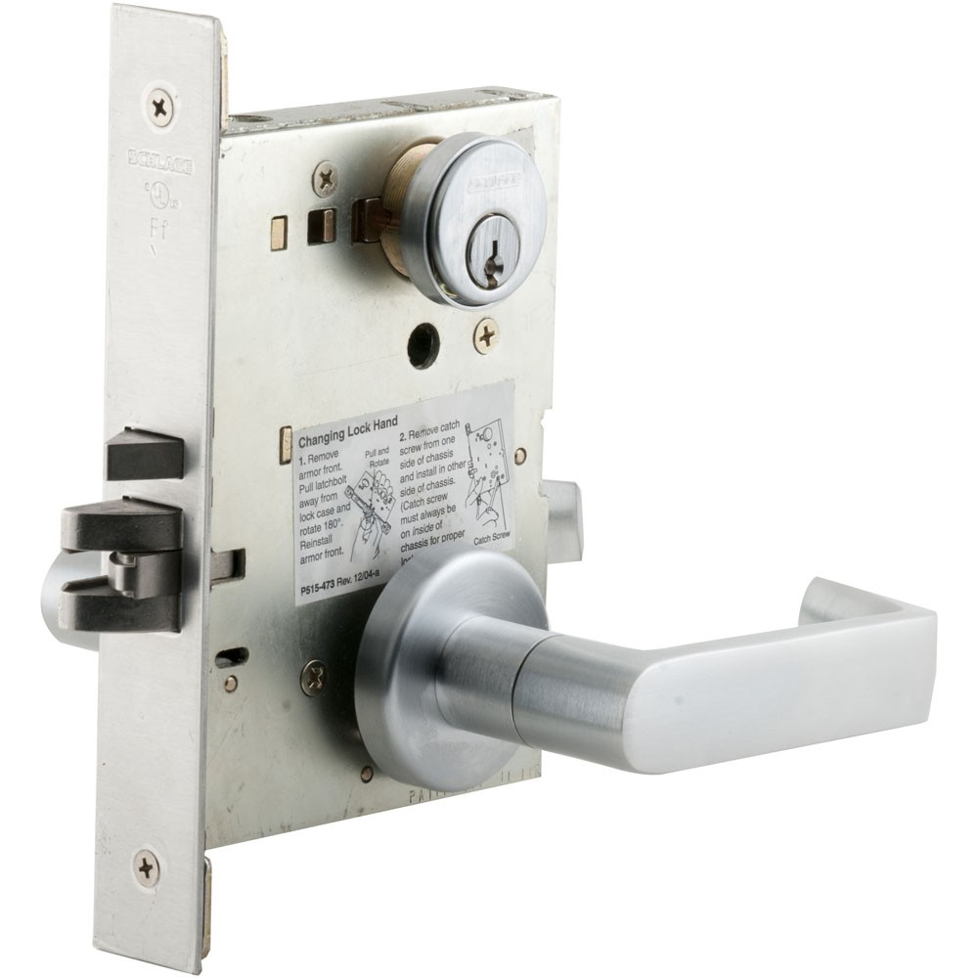
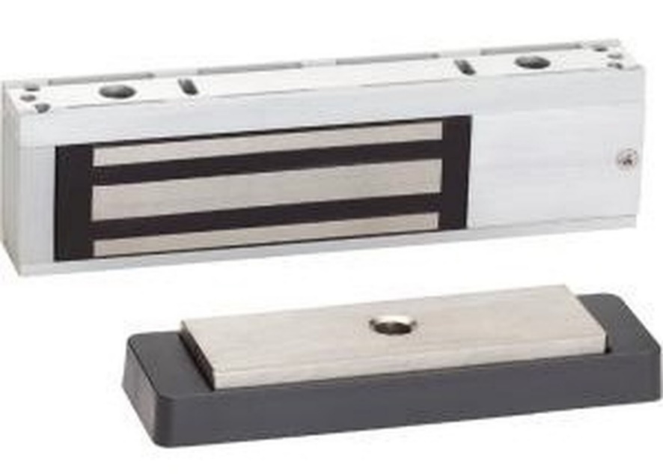
Hardware used in controlled egress systems
Controlled egress panic hardware
Electromagnetic lock
Electromechanical lock
FAIL SAFE
Notes:
For a controlled egress system, you could use panic hardware that is similar to a delayed egress device, except that it has what’s called “infinite delay” (the Chexit can function this way). That’s what’s going to keep the door locked indefinitely. Electromagnetic locks or electromechanical locks could also be used, but regardless of the type of locking hardware in the system, it must be fail safe so that it will unlock when the power is cut.
The products used in a controlled egress system are required to be listed to UL 294 – Standard for Access Control System Units. This listing is required by many of the code sections that address special locking arrangements, but the UL 294 listing is not required for normal locking arrangements.
There is a whole separate webinar on delayed egress and controlled egress if you need more detailed information.

Slide 6
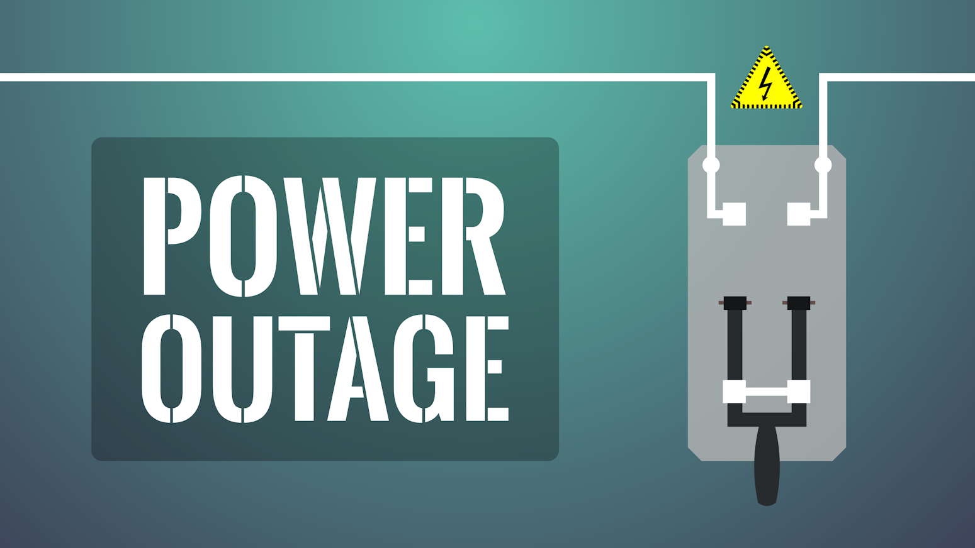
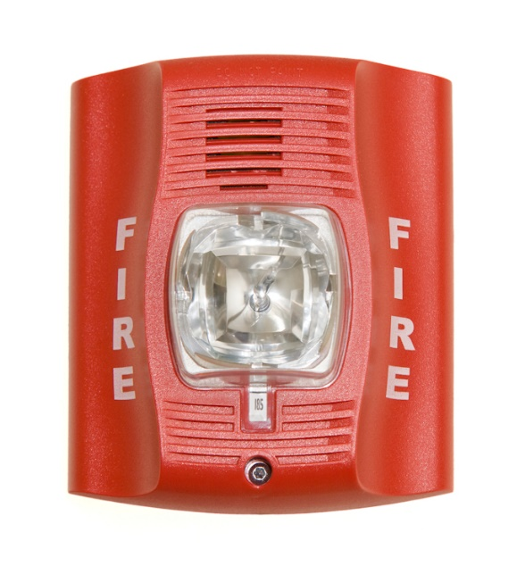
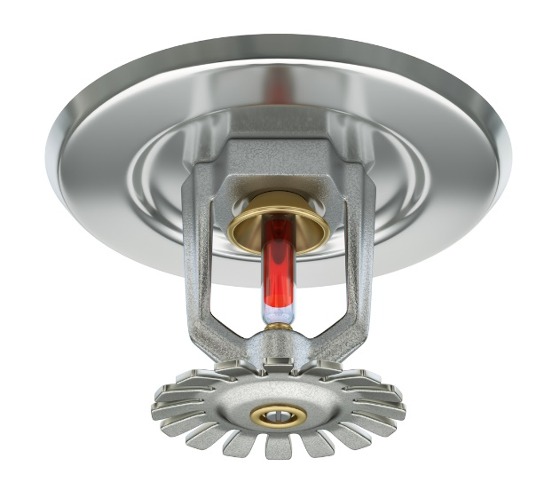
Exceptions: Psychiatric or cognitive treatment areas & units with listed child abduction systems
IBC exempts these doors from:
Automatic release upon fire alarm / sprinkler activation
Release upon power failure
Remote release
Limitation on the number of controlled egress doors before entering exit
Notes:
Remember, controlled egress locks are allowed by the model codes in health care units where patients require containment for their safety or security, like behavioral health, memory care, infant and maternity, pediatrics, and sometimes the emergency department. This is left up to the AHJ.
Certain areas are exempt from the remote release requirements and the limitation on the number of controlled egress doors in a means of egress. In the IBC the exempt areas are psychiatric and cognitive treatment areas and units with listed child abduction systems. Doors serving these areas are not required to automatically unlock to allow egress upon fire alarm/sprinkler activation, power failure, or remote release, and there can be more than one door with a controlled egress lock in the path of egress.

Slide 7
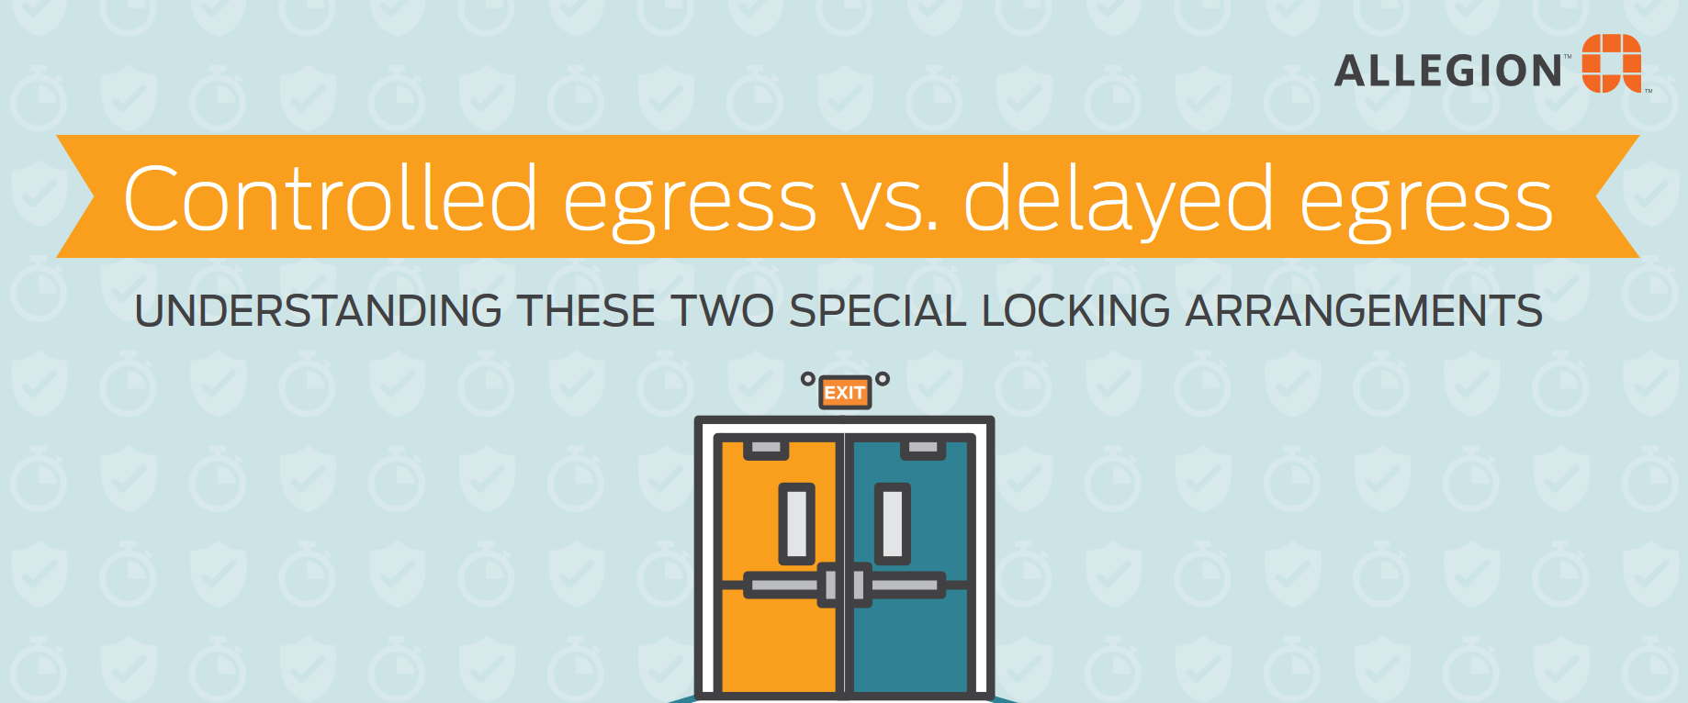
Notes:
Because there is so much confusion surrounding this application, an infographic was created that discusses controlled egress vs. delayed egress. There has been great response to this piece, and we will be creating others to address some of the special locking arrangements.
There is a link to the infographic here: https://idighardware.com/2022/08/delayed-egress-or-controlled-egress/.

