Slide 1
“Allegion” is a Registered Provider with The American Institute of Architects Continuing Education Systems (AIA/CES). Credit(s) earned on completion of this program will be reported to AIA/CES for AIA members. Certificates of Completion for both AIA members and non-AIA members are available upon request. This program is registered with AIA/CES for continuing professional education. As such, it does not include content that may be deemed or construed to be an approval or endorsement by the AIA of any material of construction or any method or manner of handling, using, distributing, or dealing in any material or product.
Questions related to specific materials, methods, and services will be addressed at the conclusion of this presentation.
Notes:
Mandatory slide. Do not remove

Slide 2
Copyright Materials
This presentation is protected by US and International Copyright laws. Reproduction, distribution, display and use of the presentation without written permission of the speaker is prohibited.
© Allegion 2014
Notes:
Mandatory slide. Do not remove

Slide 3
Program Name: Decoded 3 – Egress and Life Safety
Program Number: CDW407
Learning Units: One CEH (HSW)
Provider Number: J247
Provider Name: Allegion
Description:
Decoded 3 –Egress and Life Safety: The third class of this 4-part webinar series addresses the egress requirements of NFPA 101 – The Life Safety Code and the International Building Code. Codes impacting egress door assemblies include the means of unlatching the door to allow egress, clear opening width and opening force, luminous egress path markings, and impact-resistance requirements for glazing.
Notes:
Explain the game to the attendees.
You can split the group into teams if there are enough people. To make the game more fun, you can purchase bike horns, desk bells, or other noise makers at a dollar store. Giving each team a different type of sound device will help you recognize who rings in first.
NOTE: Choosing a box below one of the categories will take you to the question for the $ amount.
Clicking on the slide will bring in the answer. Clicking the light blue home button will bring you back to this page. Also each page has the question category and dollar value listed in the bottom right corner to help you keep track of where you are.
Some questions/answers may have more that one slide. If you do not see the light blue home button after you click in the answer, that indicates there are additional slides with information. Keep clicking through the slides until you come to the home button.
Ask for a volunteer to keep track of the score.
It would be a good idea to print this page ahead of time and take it with you or you can recreate it on a piece of flip chart paper to make it larger. Put it up in a location where the participants can see it. This will enable you to mark off boxes that the participants choose so all will know what is left.
If you leave behind handouts of this presentation , be sure to give them out AFTER the game.

Slide 4
Decoded 3 – Egress and Life Safety
Upon successful completion of the course participants should be able to:
Identify the occupancy classification or use group for a project and understand how that classification affects code requirements.
Describe basic life safety concepts including the 3 parts of a means of egress, travel distance, common path of travel, area of refuge, clear width, door swing, and dead end corridors.
Apply the means of egress requirements to door openings to select the proper locking/latching hardware.
State additional requirements for egress doors, relative to clear width, opening force, and automatic operators.

Slide 5
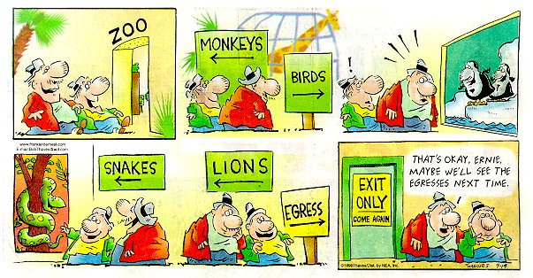
Decoded 3 – Egress and Life Safety
Audio: 866-430-4132, Code: 781-453-5306
Mute your phone (*6 to mute, #6 to unmute)
This webinar is being recorded.

Slide 6
Decoded 3 – Egress and Life Safety
Audio Dial-In - US & Canada: 866-430-4132
Audio Code: 781-453-5306
Mute your phone (*6 to mute, #6 to unmute).
This webinar is being recorded.
If you will be taking the COR140 exam, please sign up individually via DHI.org.
40 multiple-choice questions
90 minutes
open book
$450 members, $550 non-members

Slide 7
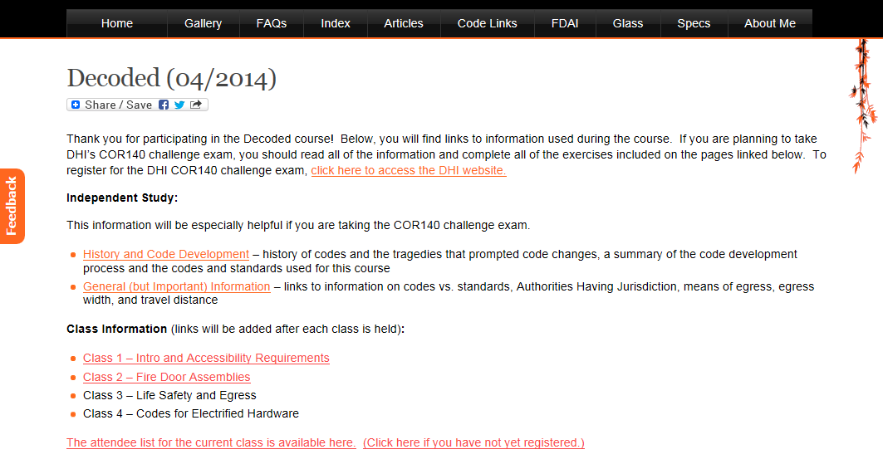

Slide 9
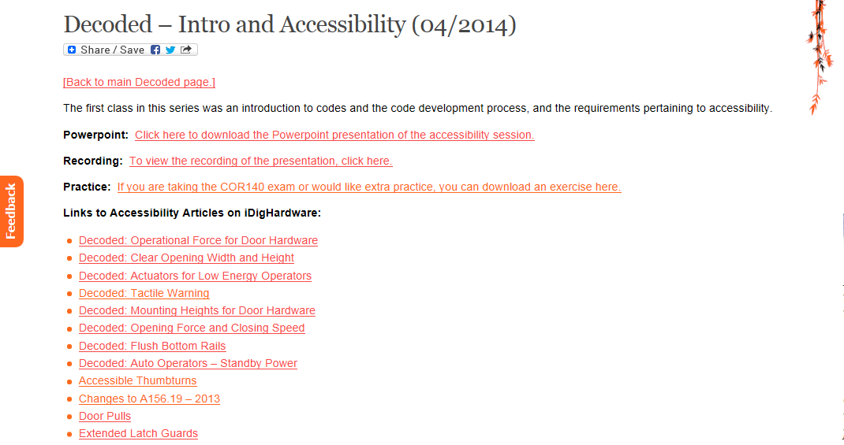

Slide 10
Session 3 – Life Safety
IBC – NFPA 101 – IFC
Occupancy Types – Use Groups
Occupied vs. Unoccupied
Opening Protectives
Means of Egress
travel distance, common path of travel, dead end corridors
clear width, projections, and door swing
opening force and auto operators
unlatching, bolts, hardware operation and height
panic hardware

Slide 11
Building Code vs. Life Safety Code or Fire Code
A building code is typically used only during design/construction. After completion, the applicable fire code is enforced.

Slide 12
P12

Slide 13
Approved

Slide 14
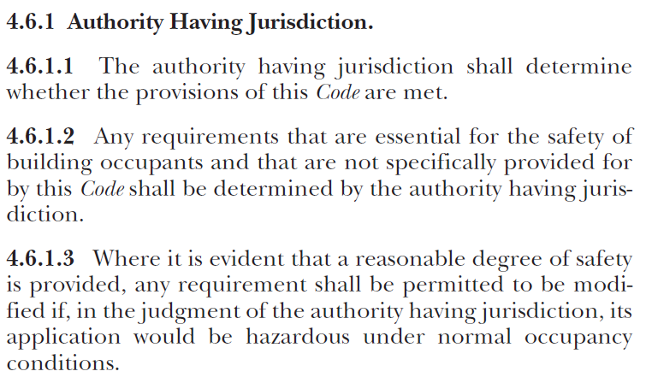
Authority Having Jurisdiction

Slide 15
Occupancy Classifications
(NFPA 101 – Chapter 6)
Use Groups
(IBC – Chapter 3)
Assembly
Educational
Day Care
Health Care
Ambulatory Health Care
Detention and Correctional
Residential
Residential Board and Care
Business
Mercantile
Industrial
Storage
Assembly
Business
Educational
Factory and Industrial
High Hazard
Institutional
Mercantile
Residential
Storage
Utility & Maintenance
Most are divided into sub-groups

Slide 16
Occupancy Classifications and Use Groups Some are a little tricky…
A college classroom building is a Business occupancy, but if a college classroom holds 50 or more, it is an Assembly occupancy.
NFPA 101’s Ambulatory Health Care occupancy is usually considered Group B (Business) for the IBC.
Child day care centers are considered Day Care occupancies per NFPA 101, but may be I (Institutional) or E (Educational) use groups per the IBC.
A training room within an office building is not considered an Assembly use group by the IBC unless it has an occupant load of 50 or more, or is over 750 sq. ft. in area.

Slide 17
Multiple Occupancies (NFPA 101)
6.1.14.2.1 Multiple Occupancy. A building or structure in which two or more classes of occupancy exist.
6.1.14.2.2 Mixed Occupancy. A multiple occupancy where the occupancies are intermingled. (follow most stringent requirements throughout)
6.1.14.2.3 Separated Occupancy. A multiple occupancy where the occupancies are separated by fire resistance–rated assemblies. (follow separate requirements for each area)

Slide 18
Hazard of Contents (NFPA 101)
6.2.2.2* Low Hazard Contents. Low hazard contents shall be classified as those of such low combustibility that no self propagating fire therein can occur.
6.2.2.3* Ordinary Hazard Contents. Ordinary hazard contents shall be classified as those that are likely to burn with moderate rapidity or to give off a considerable volume of smoke. (most buildings are ordinary hazard)
6.2.2.4* High Hazard Contents. High hazard contents shall be classified as those that are likely to burn with extreme rapidity or from which explosions are likely.

Slide 19
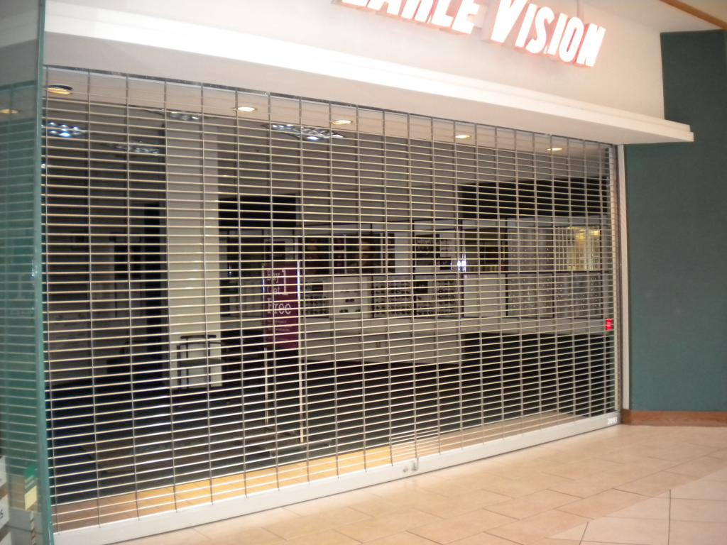
Occupied vs. Unoccupied (NFPA 101)
P19

Slide 20
Occupied vs. Unoccupied (NFPA 101)
Open for general occupancy, or
Open to the public, or
Occupied by more than 10 persons.
NFPA 101 and IFC may have differing requirements for when building is occupied vs. unoccupied.

Slide 21
Chapter 7 Means of Egress
Chapter 8 Features of Fire Protection
Chapters 12-42 Occupancy Chapters
Chapter 7 Fire and Smoke Protection Features
Chapter 10 Means of Egress

Slide 22
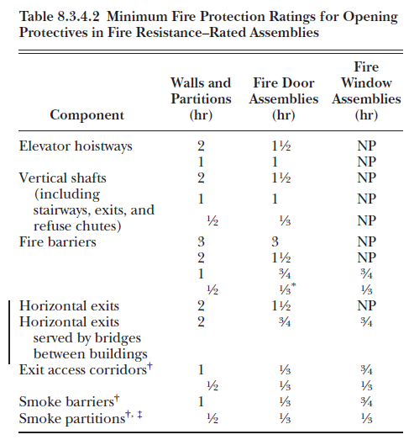
Opening Protectives (NFPA 101)

Slide 23
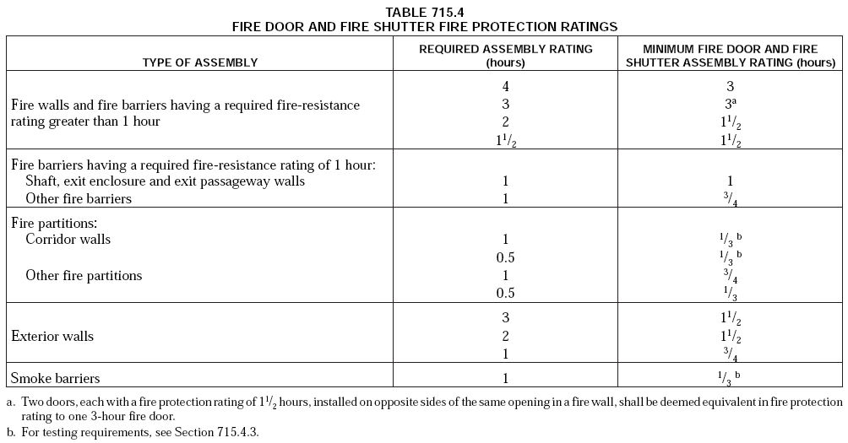
Opening Protectives – (IBC)

Slide 24
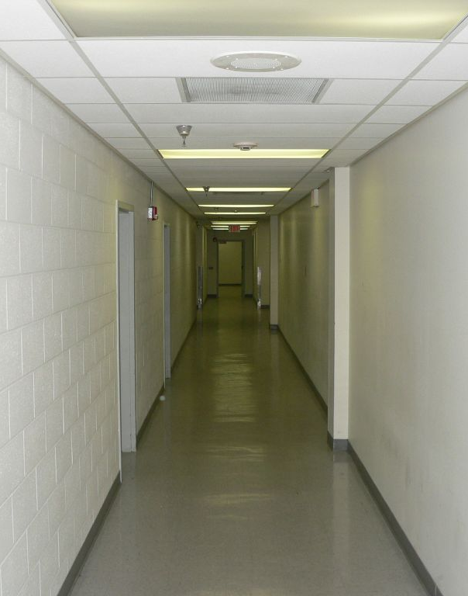
Means of Egress
A continuous and unobstructed way of travel from any point in a building or structure to a public way
Not every door is an egress door.
Not every egress door has an exit sign.

Slide 25
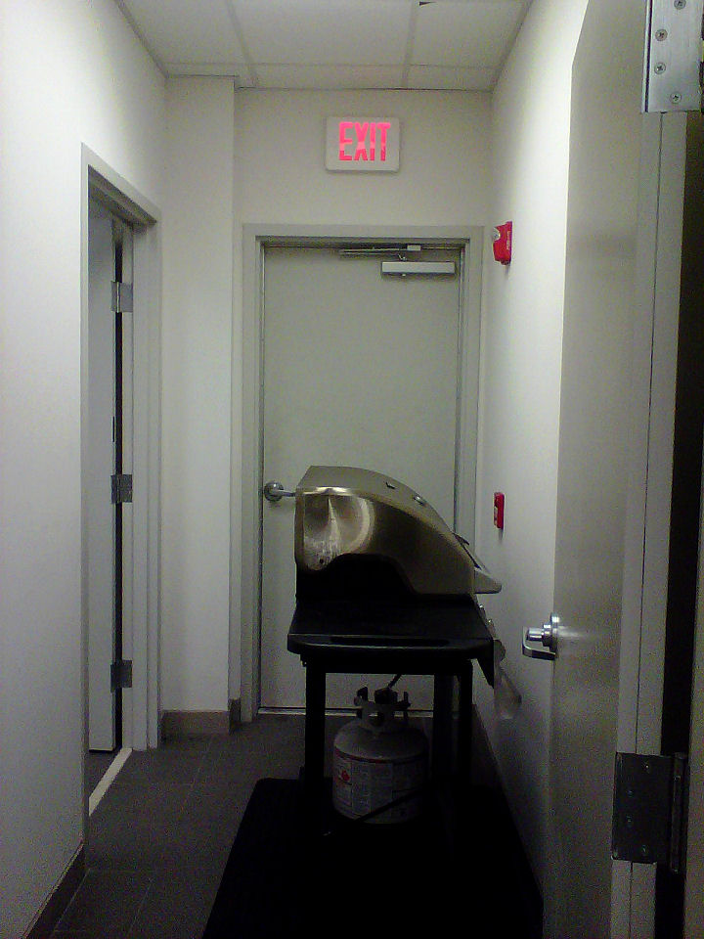

Slide 26
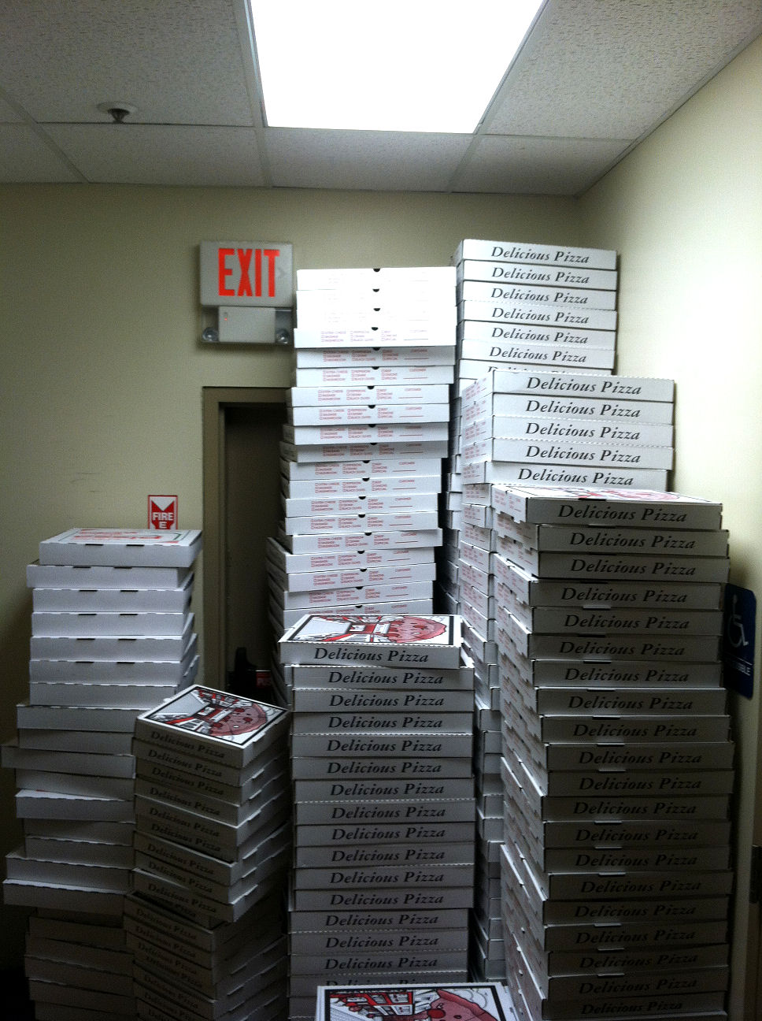

Slide 27
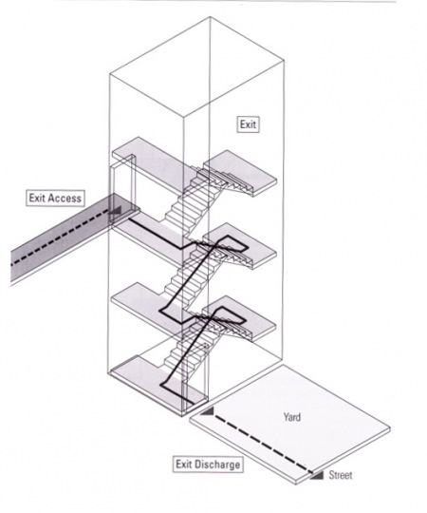
Means of Egress
Exit Access – leads from occupied portion to an exit
Exit – separated by fire-resistance-rated construction and opening protectives to provide a protected path of egress travel
Exit Discharge – between termination of an exit and a public way
Exit
Exit
Access
Exit Discharge

Slide 28
Exit Passageway

Slide 29
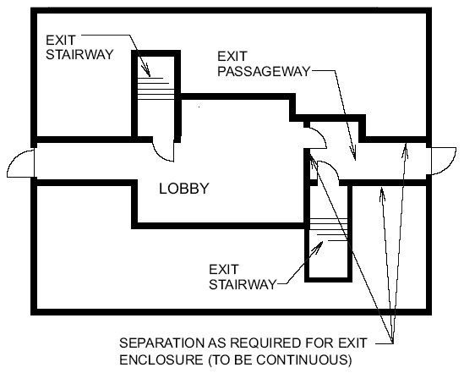
Exit Passageway

Slide 30
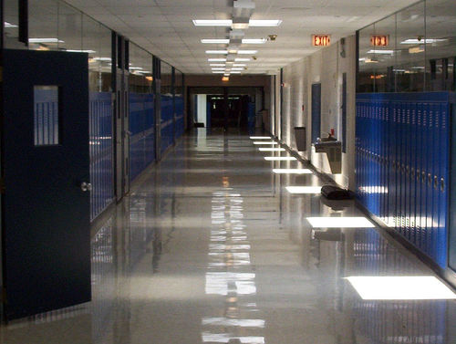
What is this?
P30

Slide 31
This is not an exit passageway. It is an exit access.

Slide 32
Means of Egress
Exit Access – leads from occupied portion to an exit
Exit – separated by fire-resistance-rated construction and opening protectives to provide a protected path of egress travel
Exit Discharge – between termination of an exit and a public way
Exit
Exit
Access
Exit Discharge

Slide 33
Exit / Exit Enclosure

Slide 34
Horizontal Exit
P34

Slide 35
Horizontal Exit

Slide 36
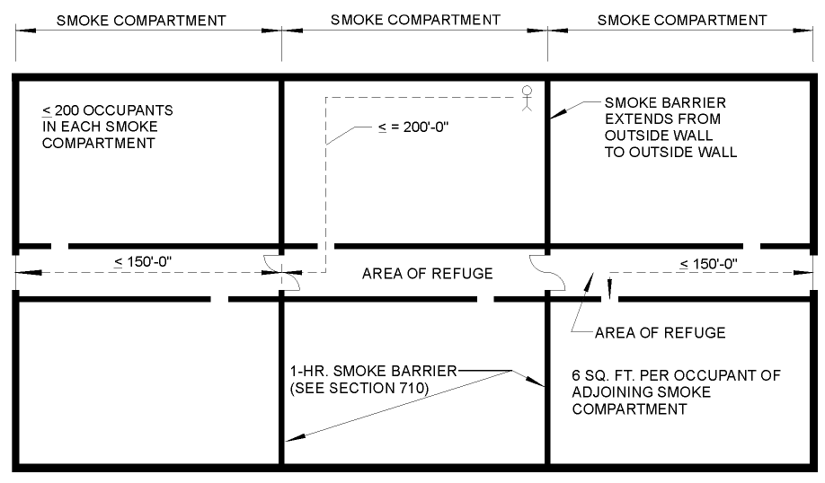
Horizontal Exit

Slide 37
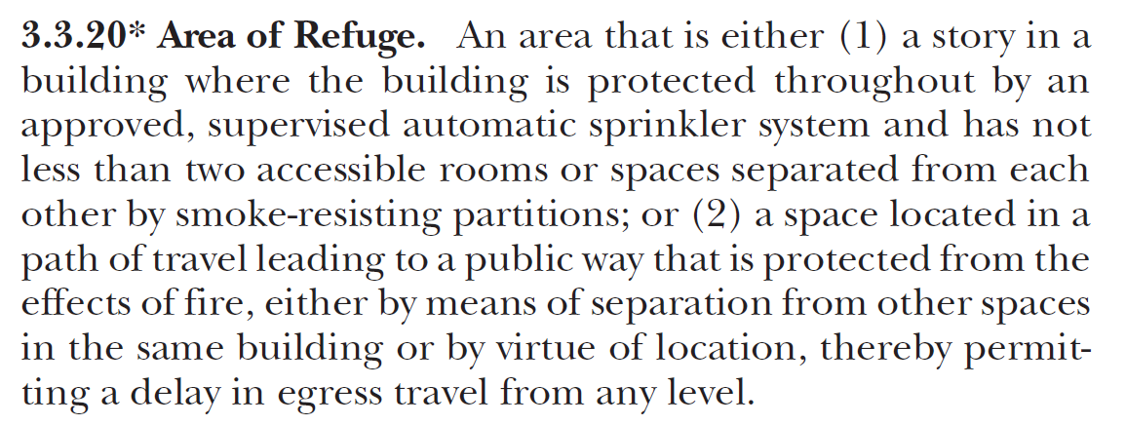
Area of Refuge
NFPA 101
IBC

Slide 38
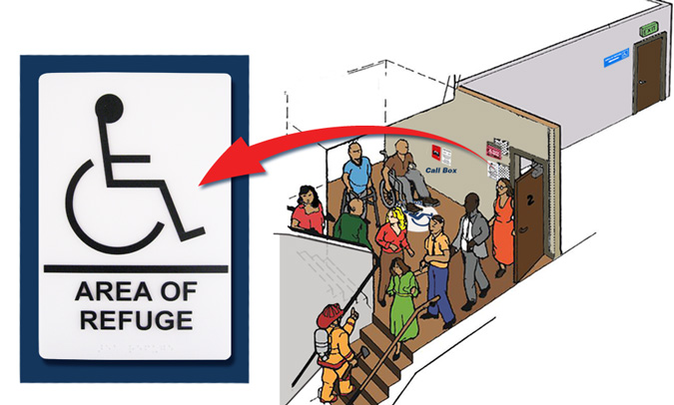
Area of Refuge

Slide 39
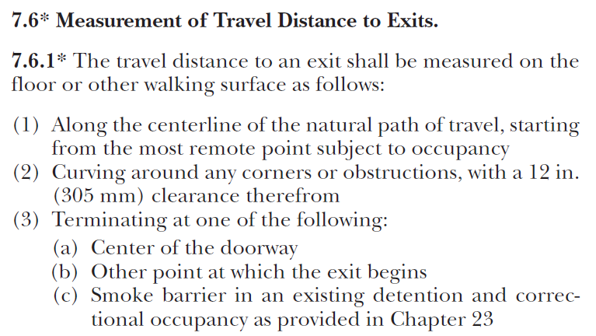
Travel Distance
Travel distance may end at the beginning of an exit, at an exit discharge, or at a horizontal exit.

Slide 40
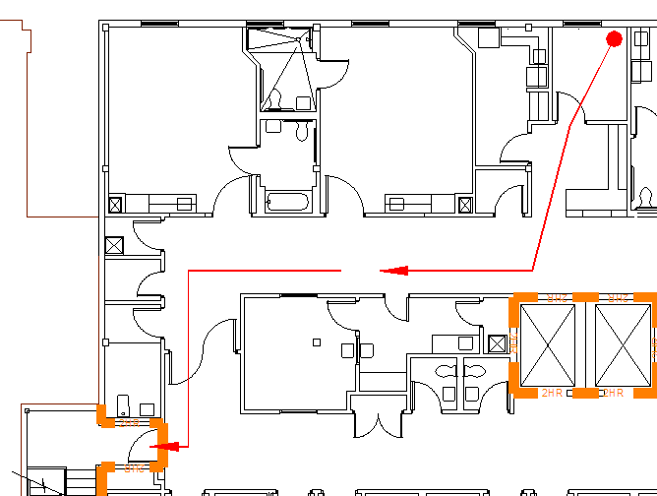
Travel Distance

Slide 41
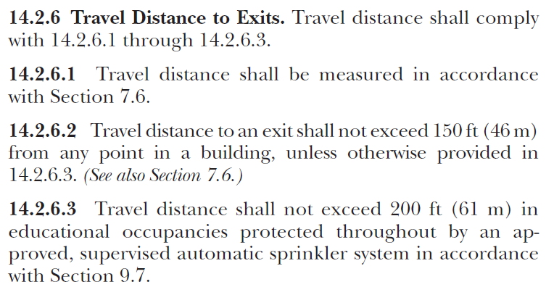
Example from New Educational Chapter

Slide 42
Common Path of Travel

Slide 43
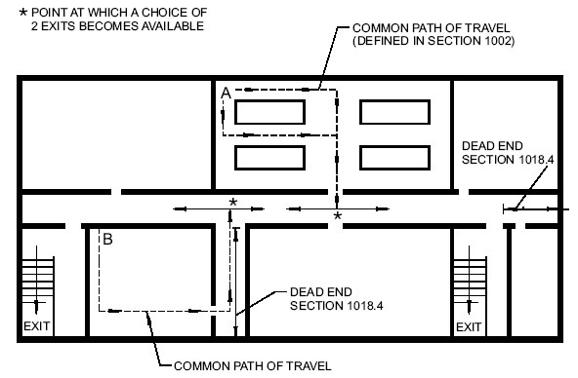
Common Path of Travel

Slide 44
Common Path of Travel Example from Existing Educational Chapter

Slide 45
Dead End Corridors
Ex:

Slide 46
Dead End Corridors
Ex:

Slide 47
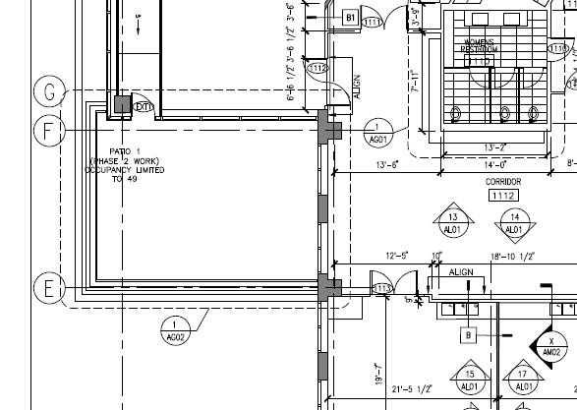
Courtyards, Terraces, and Roofs

Slide 48
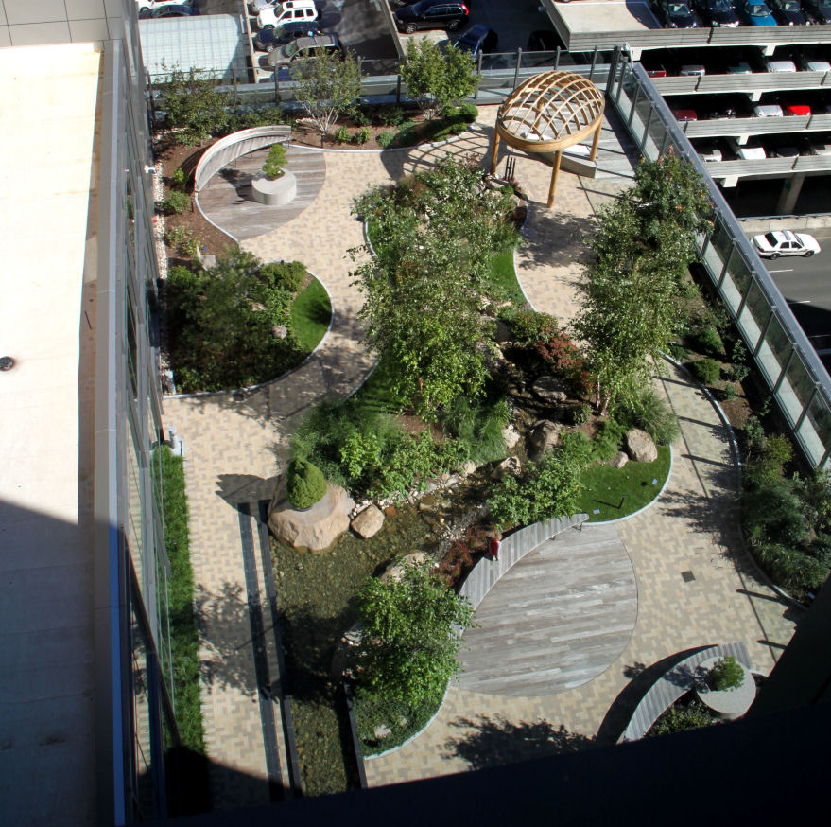
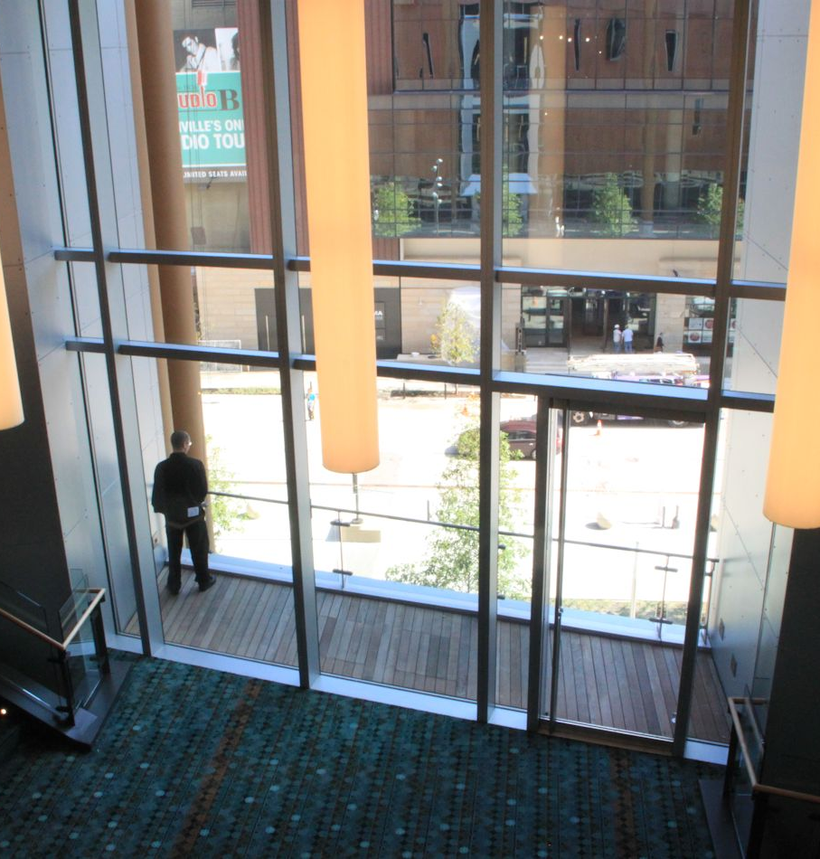
Courtyards, Terraces, and Roofs

Slide 49
Courtyards, Terraces, and Roofs

Slide 50
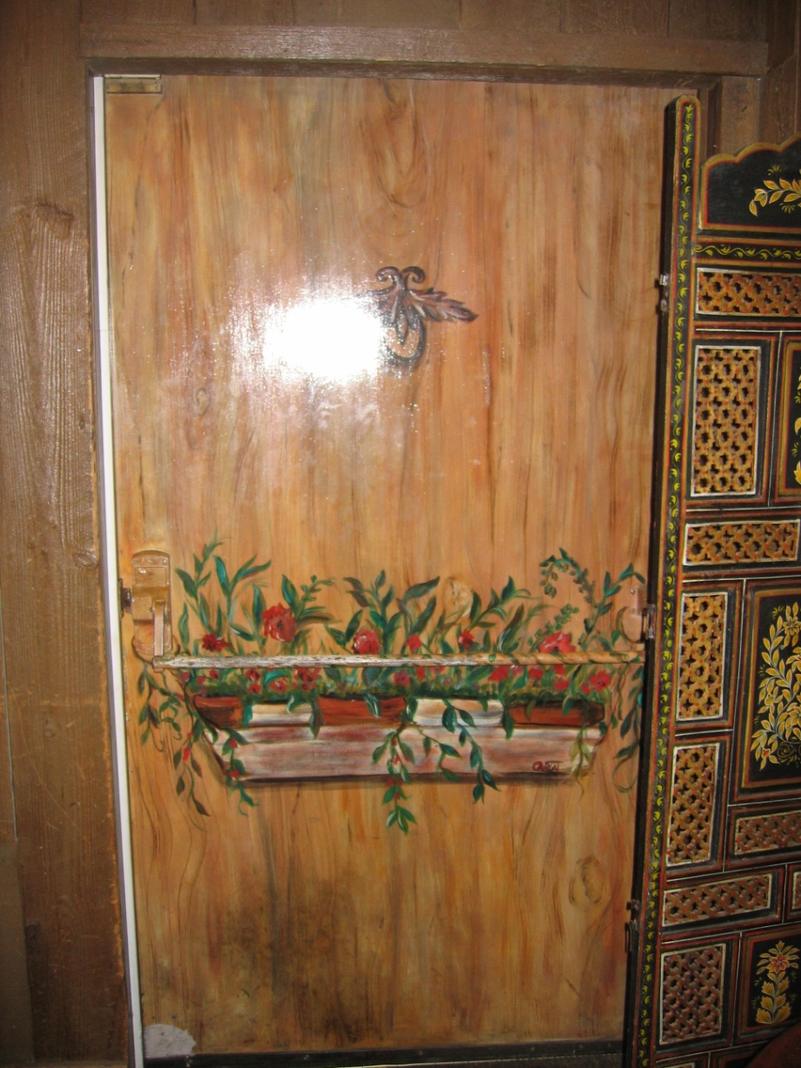
Readily Distinguishable
Means of egress doors must be visible.
No mirrors
No drapes
No decorations
No invisible doors!

Slide 51
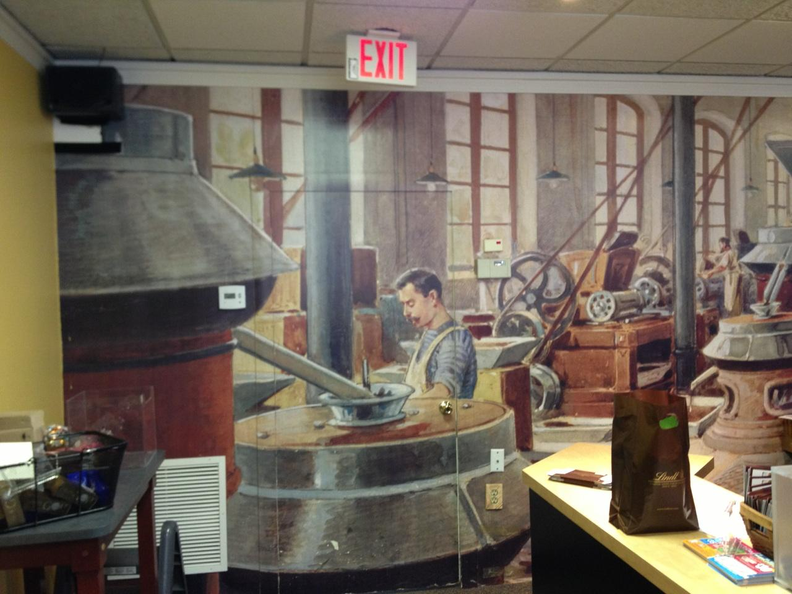

Slide 52
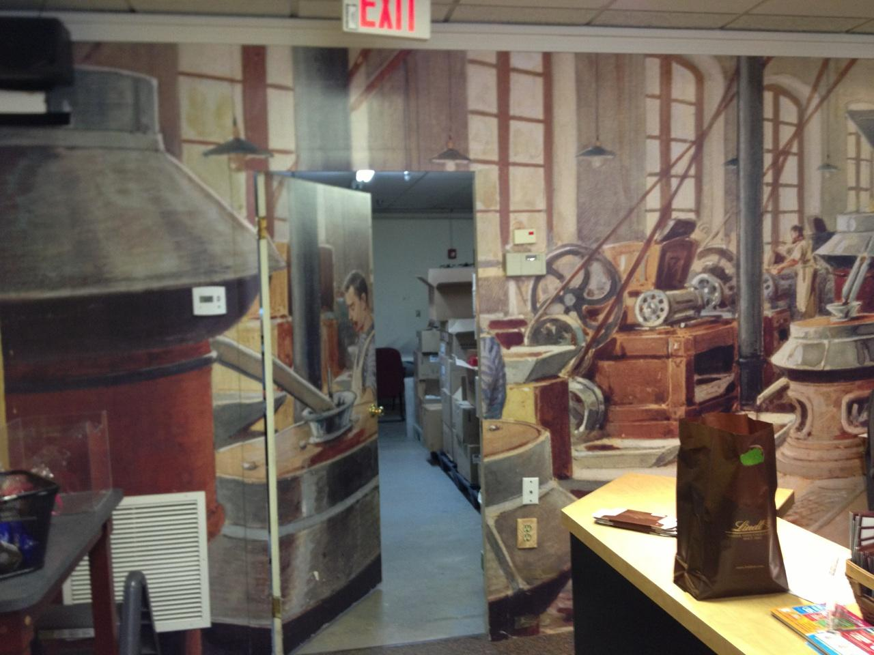

Slide 53
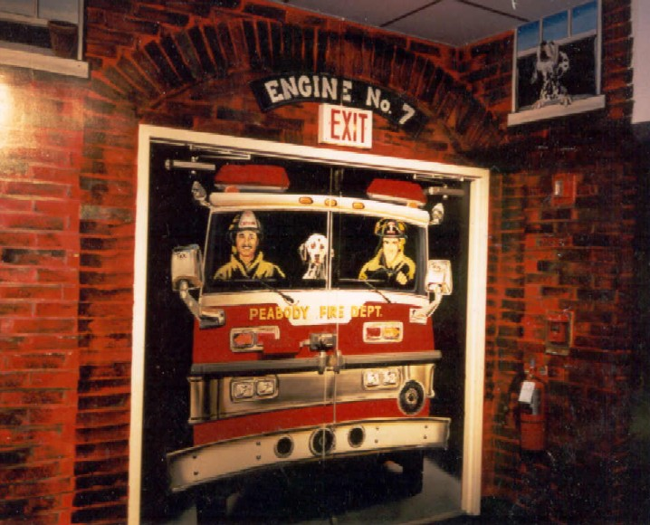

Slide 55
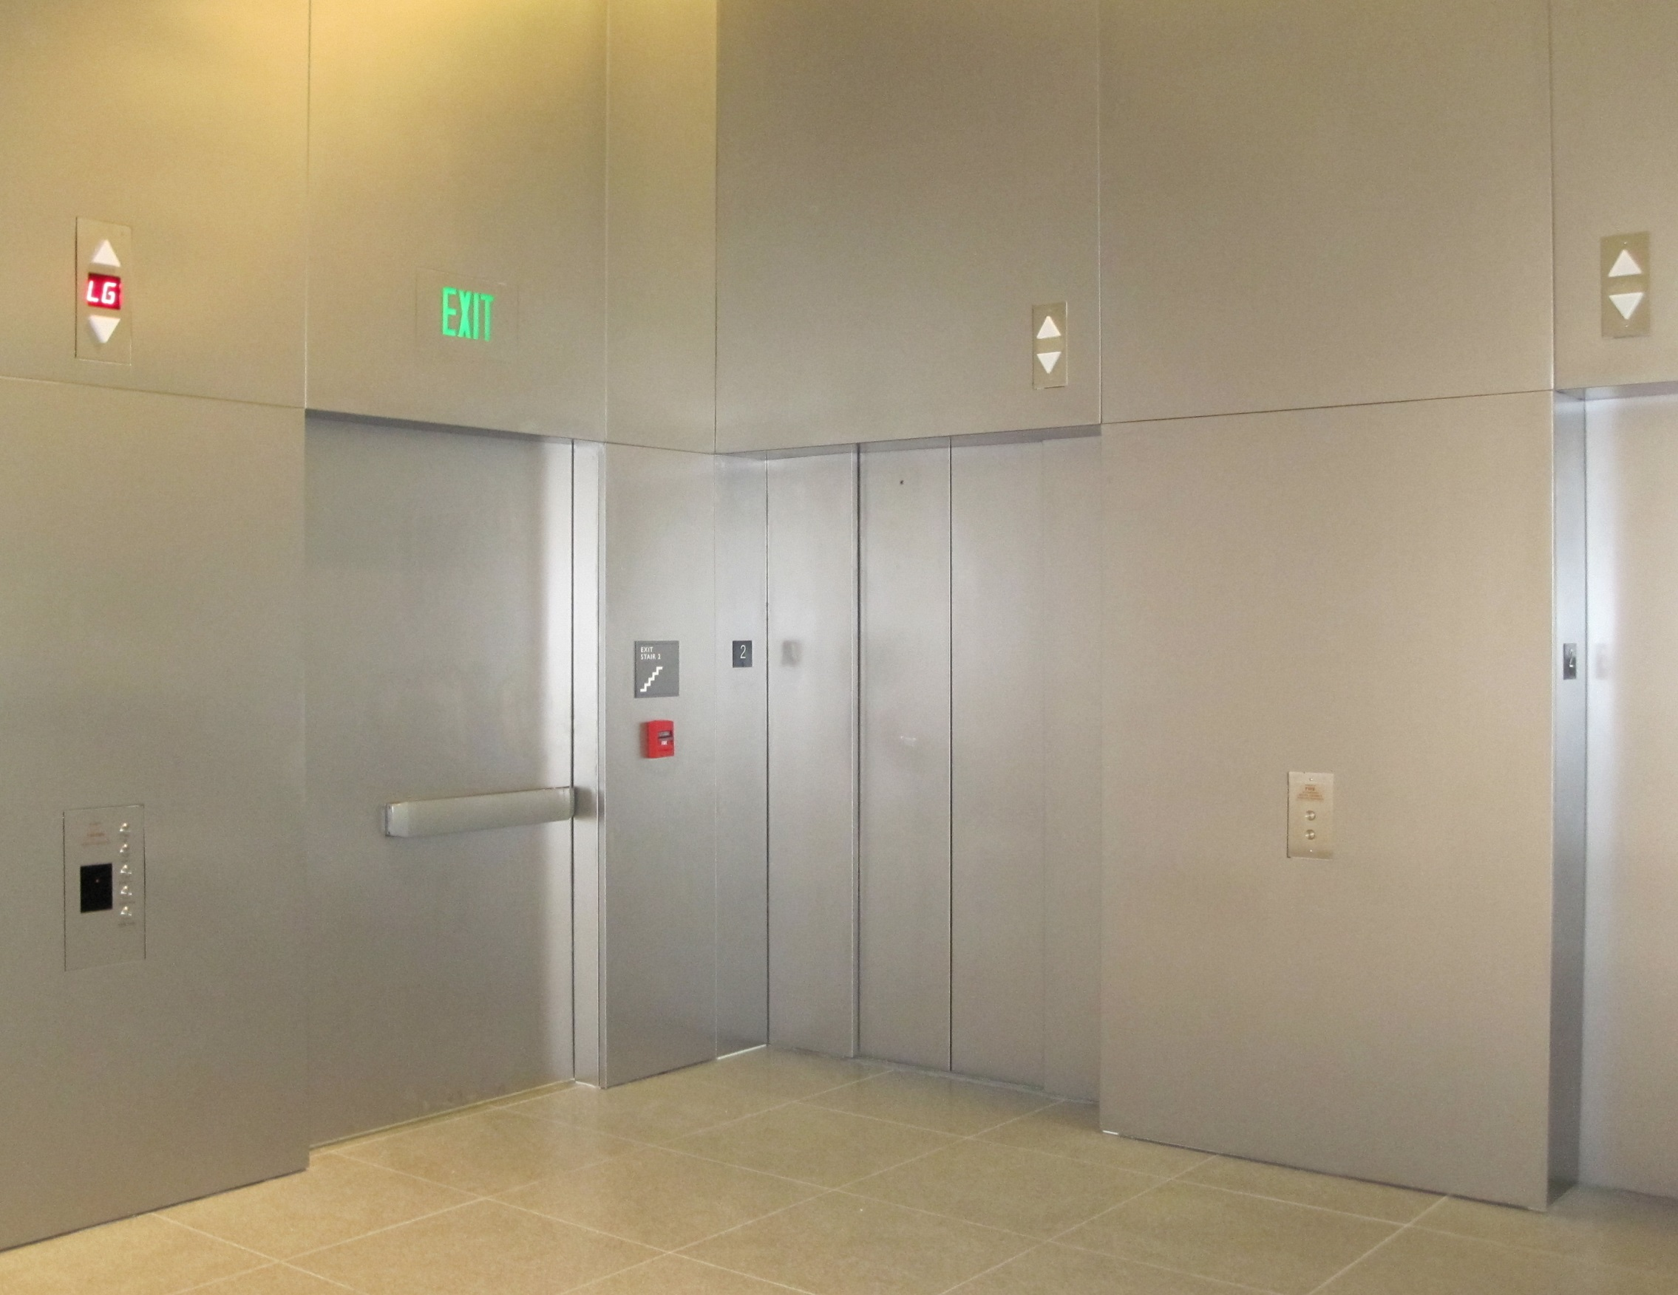
This was approved by the AHJ.

Slide 56
Also approved by the AHJ.

Slide 57
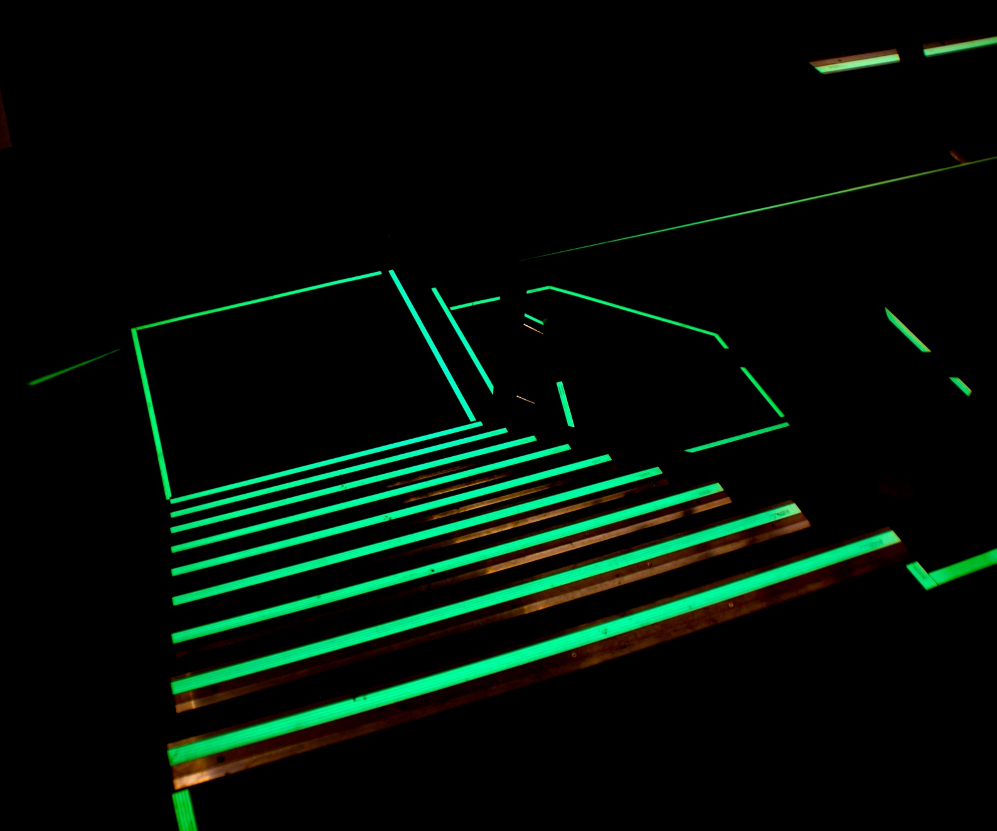
Luminous Egress Path Markings

Slide 58
Luminous Egress Path Markings
Not currently required by NFPA 101 occupancy chapters
Required by IBC in high-rise buildings in Group A – Assembly, B – Business, E – Educational, I – Institutional, M – Mercantile, and R-1 – Residential
Typically required on exit discharge doors – not on doors leading to the exit.
1” stripe around frame
Marking on or behind hardware
“Exit” in bottom 18” of door
Additional marking on stairs, walls, etc.

Slide 59
Size of Doors
32” clear width minimum
Measured with door open to 90 degrees
Between the face of the door and the stop
At least one leaf of a pair must comply
48” wide nominal max. (IBC/IFC only – not NFPA 101)
80” high nominal min.
78” to the closer arm

Slide 60
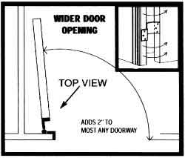
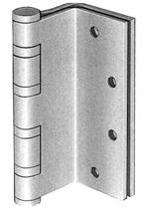
Swing Clear Hinges
May be used to gain more clearance on existing openings.

Slide 61
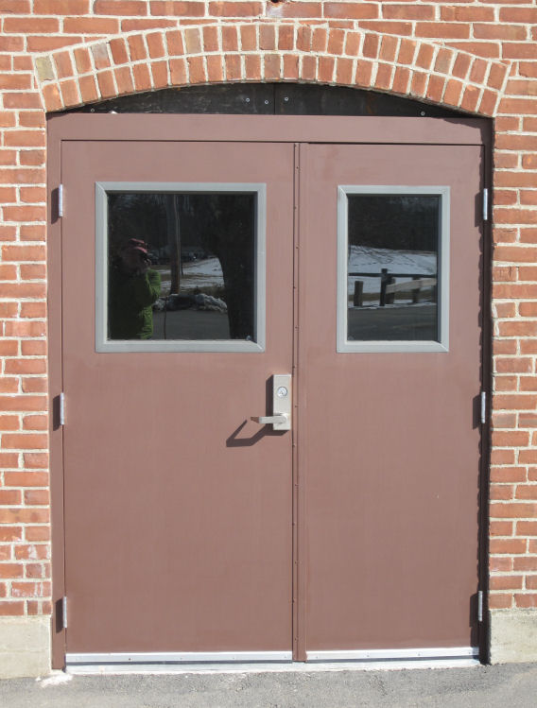

Slide 62
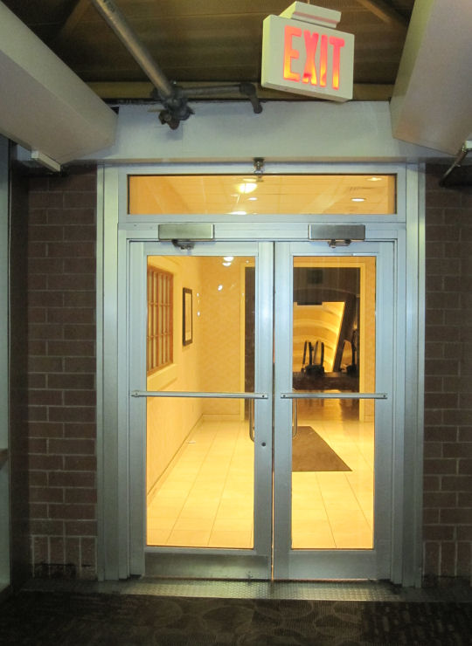

Slide 63
Projections Into Clear Width (IBC)
No projections into the required clear opening width lower than 34” above the floor.
Projections into the required clear opening width between 34” and 80” above the floor shall not exceed 4”.
4” Max.
No Proj.

Slide 64
Projections Into Clear Width (NFPA 101)
NFPA 101 limits the 4” projections to 34”-48” above the floor, hinge side only, only to address panic hardware.
4” Max.
No Proj.

Slide 65
Question
When is a door required to swing in the direction of egress?
Type in the chat box.

Slide 66
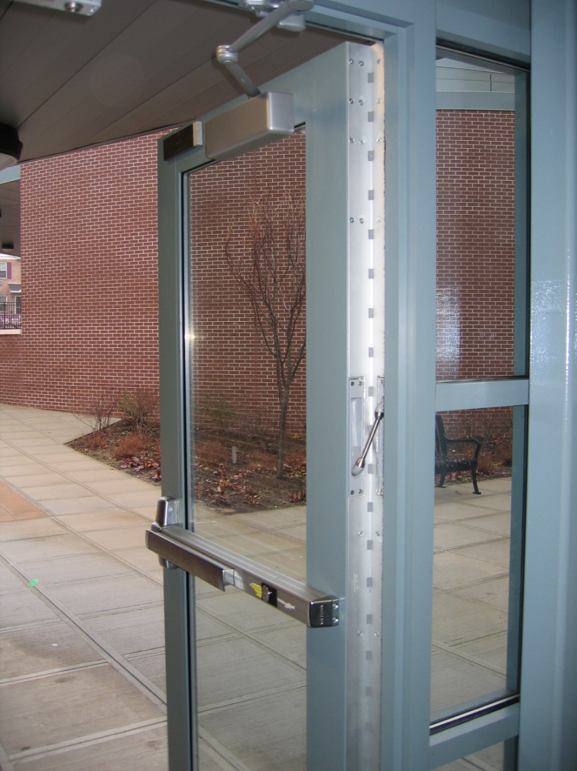
Door Swing
Egress doors shall be side-hinged swinging
Exceptions – consult codes
Swing in the direction of egress:
When serving an occupant load of 50 or more
Group H occupancy
When swinging into an exit enclosure (NFPA 101)

Slide 67
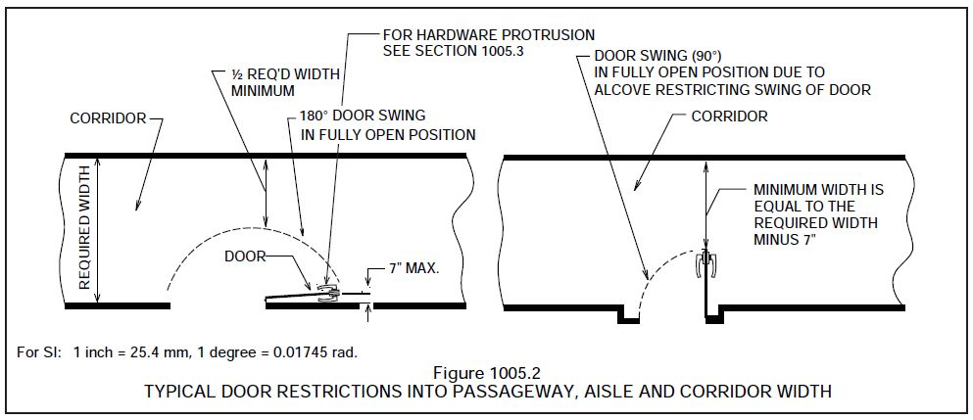
Encroachment
Required (corridor) width is calculated based on occupant load.
Measurement Point 1: Must encroach no more than ½ of the required (corridor) width at any point in door swing.

Slide 68
Encroachment
Measurement Point 2: 7” maximum encroachment on required minimum (corridor) width when door is fully open.
Be careful of cush closers and overhead stops.

Slide 69
Door Opening Force
P69
Interior swinging egress doors (non-fire-rated) – 5 lbs
Other swinging doors + sliding and folding…

Slide 70
Door Opening Force
Interior swinging egress doors (non-fire-rated) – 5 lbs
Other swinging doors + sliding and folding
15 pounds to release latch
30 pounds to set the door in motion
15 pounds to swing door to fully-open position

Slide 71
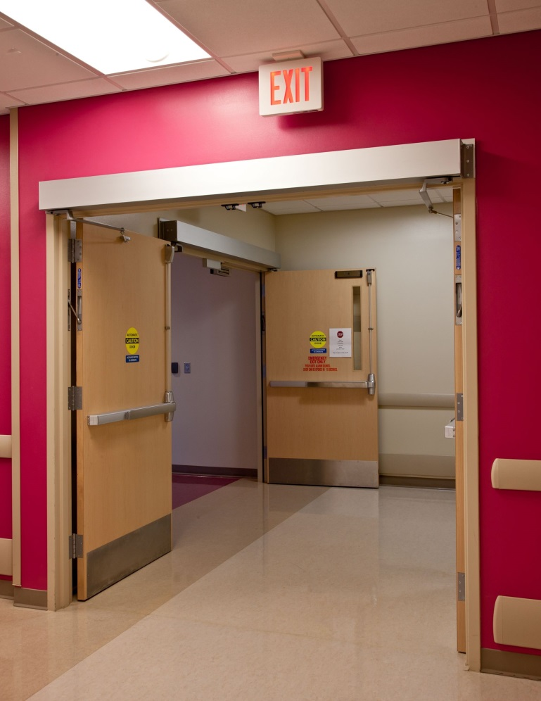
Power-Operated Doors
P71

Slide 72
Power-Operated Doors
In the event of a power failure:
15 pounds to release latch
50 pounds to set door in motion
15 pounds to open to fully-open position
Full-Power Operated - A156.10
Power-Assist and Low Energy - A156.19

Slide 73
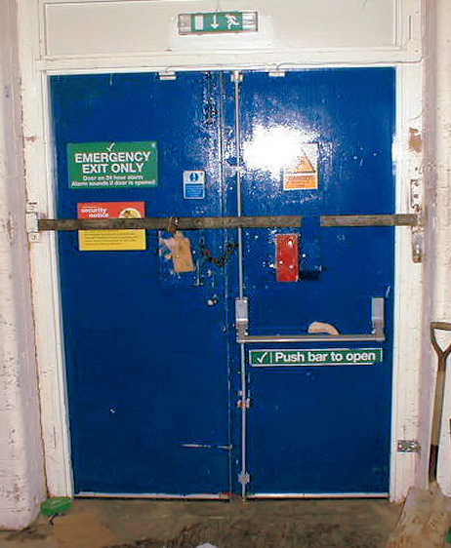
Door Operations
Readily openable
No key or special knowledge or effort
One motion to unlatch (with exceptions)

Slide 74
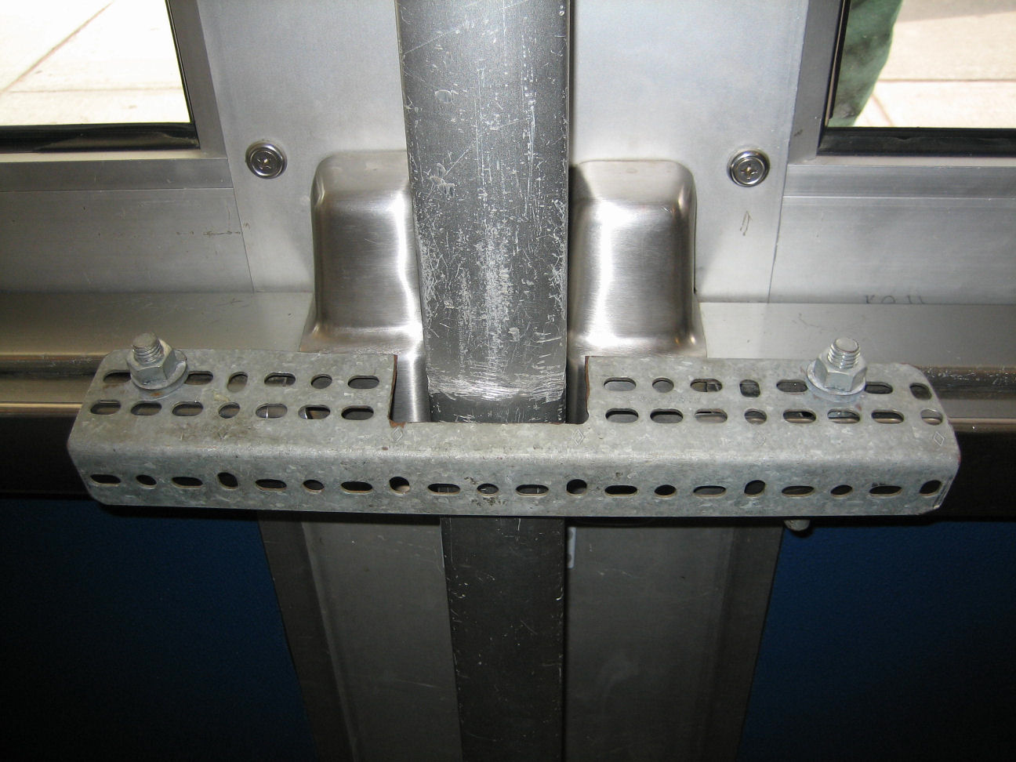

Slide 75
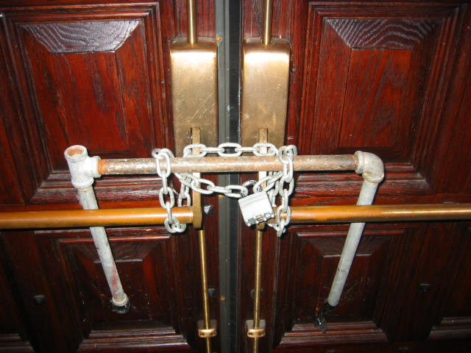

Slide 76
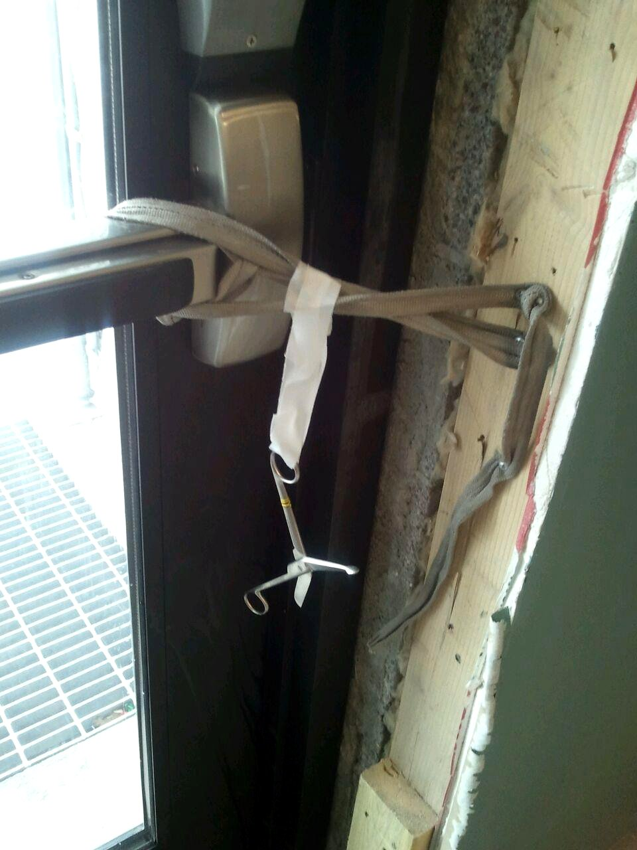

Slide 77
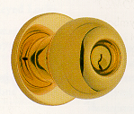
Hardware
Easy to grasp
Operable with one hand
No tight grasping
No tight pinching
No twisting of the wrist
YES!
NO!

Slide 78
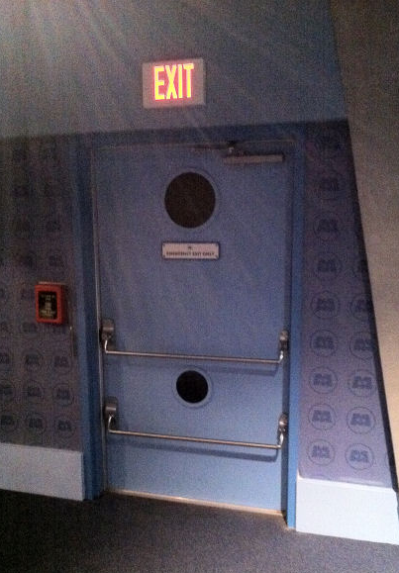
Hardware Height
Operating Devices
34” minimum AFF
48” maximum AFF
Locks used only for security purposes – any height

Slide 79
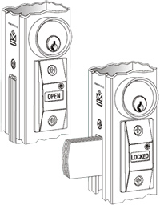
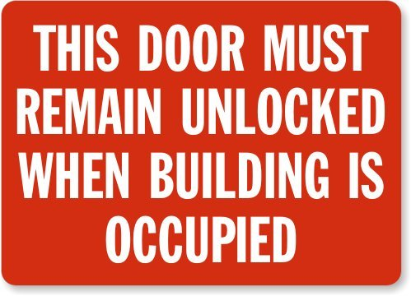
Locks & Latches
Permitted to prevent operation of doors where any of the following exists:
Places of detention or restraint
Use Group A with an occupant load of 300 or less, Groups B, F, M, and S, and in churches
Main exterior door(s)
Key-operated locking from egress side
Locking device readily distinguishable as locked
Signage on or adjacent to door
Revocable by the building official for cause

Slide 80
Locks & Latches (continued)
Permitted to prevent operation of doors where any of the following exists:
Individual dwelling or sleeping units of Group R occupancies with an occupant load of 10 or less, one additional… (may vary by local code)
Nightlatch
Deadbolt
Security chain
No key or tool needed on egress side

Slide 81
Bolt Locks (IBC)
Manual flush bolts or surface bolts not permitted
Exceptions:
Doors not required for egress in dwelling units.
Storage or equipment rooms.
Group B, F, or S occupancy with an occupant load of less than 50.
Group B, F, or S occupancy where inactive leaf is not needed to meet egress width requirements and building is fully sprinklered.
Pairs at hospital patient rooms may have constant latching bolts.
No dummy hardware on inactive leaf.

Slide 82
Unlatching
Unlatching any leaf shall not require more than 1 operation
Exception:
Places of detention or restraint
Storage or equipment rooms
Automatic flush bolts
Individual dwelling units and guestrooms of Group R occupancies

Slide 83
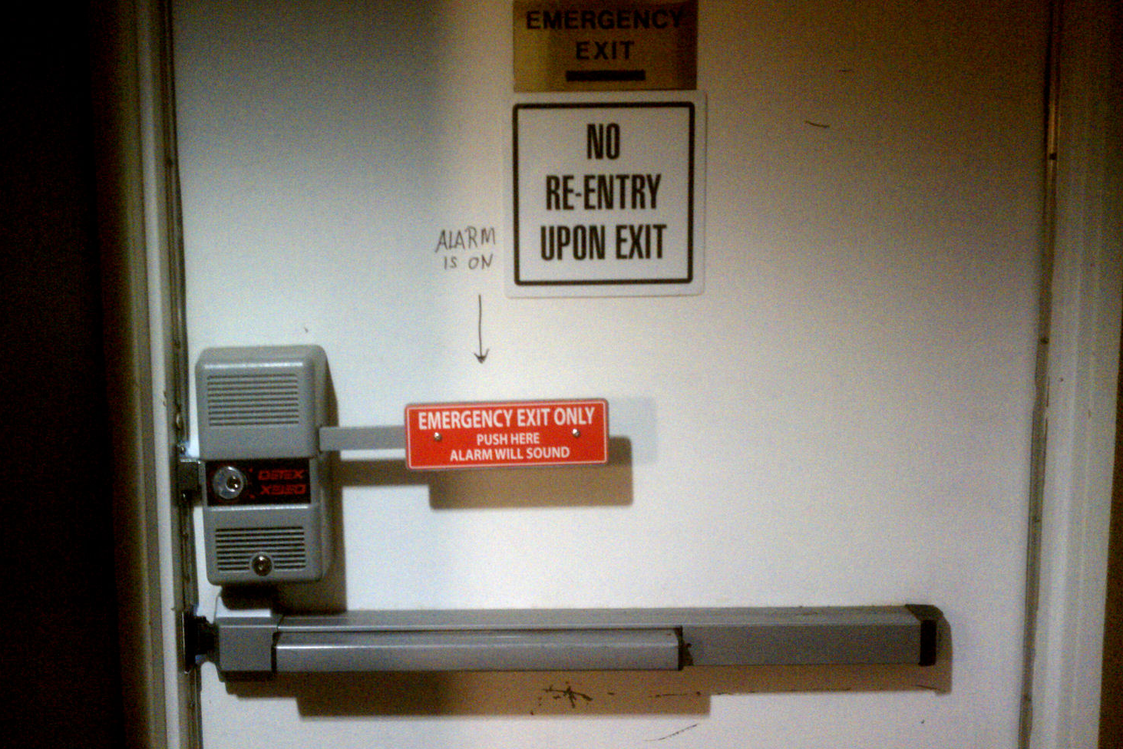

Slide 84
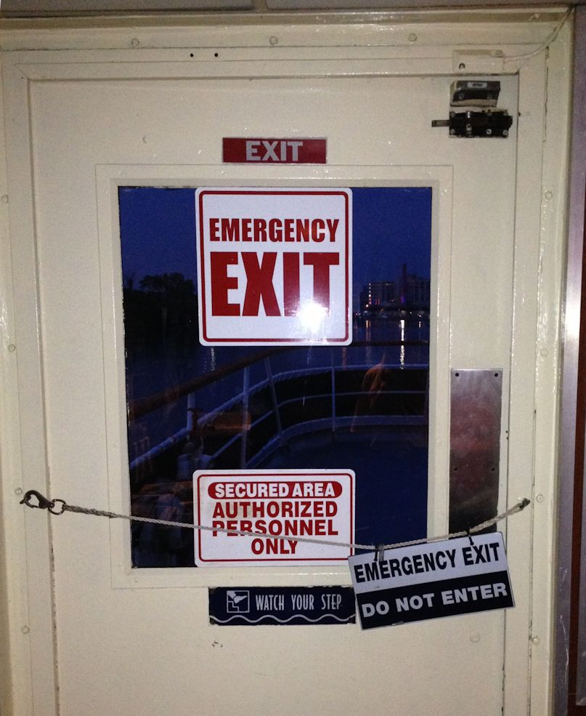

Slide 85
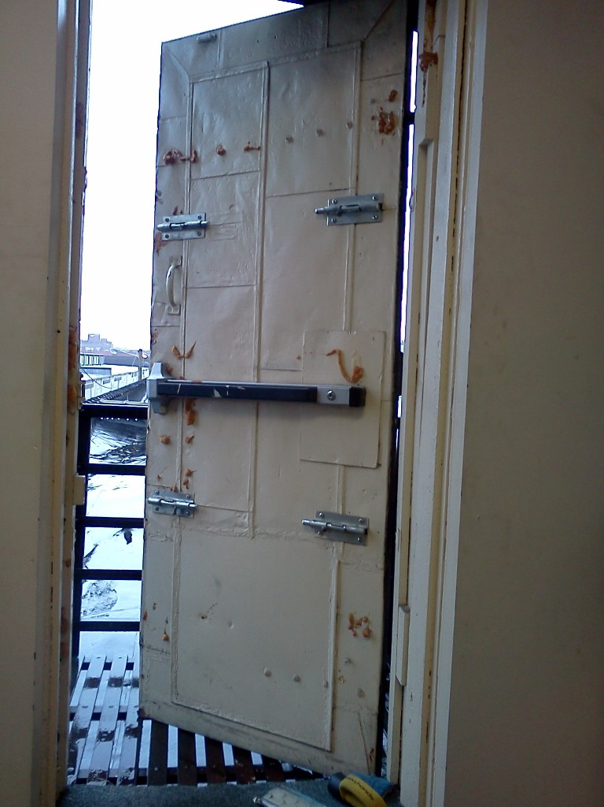
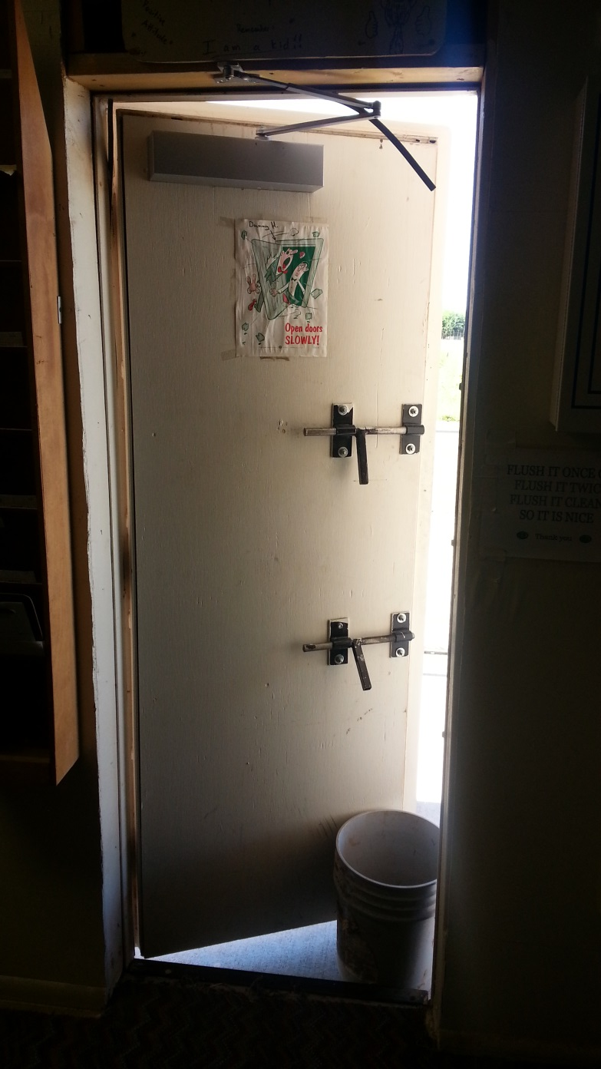

Slide 86
Panic and Fire Exit Hardware
touchpad style
crossbar style

Slide 87
Question
P87
According to NFPA 101-2009, where is panic hardware required?
Type in the chat box.

Slide 88
Panic and Fire Exit Hardware
IBC 2006, 2009, 2012
Educational and Assembly Occupancies with an occupant load of 50 or more
All High Hazard Occupancies
IBC 2000, 2003
Educational and Assembly Occupancies with an occupant load of 100 or more
Some High Hazard Occupancies
NFPA 101 (all)
Educational, Assembly, and Day Care Occupancies with an occupant load of 100 or more
Some High Hazard Occupancies

Slide 89
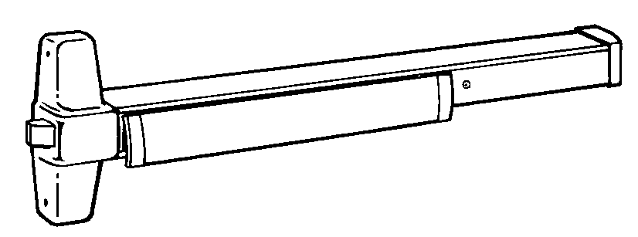
Panic and Fire Exit Hardware
Requirement for panic hardware applies to means of egress doors in these occupancy types which latch or lock.

Slide 90
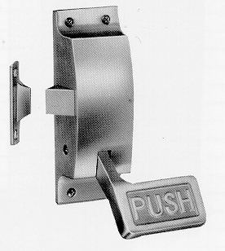
Panic and Fire Exit Hardware
Where panic hardware is required, actuating portion of device (touch-pad or cross-bar) must be at least half the width of the door.

Slide 93
Is this acceptable? Why/not? Type in the chat box.

Slide 94
Panic and Fire Exit Hardware
15 pounds of force maximum to actuate
One operation to unlatch - no other locking/latching hardware

Slide 98
Panic and Fire Exit Hardware
P98

Slide 99
Panic and Fire Exit Hardware
Panic hardware used on balanced doors must be touchpad style (not crossbar) and touchpad must not extend more than half the width of the door.

Slide 100
Panic and Fire Exit Hardware
Panic hardware used on balanced doors must be touchpad style (not crossbar) and touchpad must not extend more than half the width of the door.

Slide 101
NFPA 70 National Electric Code
Rooms housing large equipment - 600 Volts, nominal or less, 800 amperes or more (1200 amps prior to 2014)
Rooms housing conductors and equipment used on circuits of over 600 Volts, nominal.
Battery Rooms (Transformer Vaults prior to 2014)
Where the entrance has a personnel door(s), the door(s) shall open in the direction of egress and be equipped with listed panic hardware (prior to 2014: “panic bars, pressure plates, or other devices that are normally latched but open under simple pressure”)

Slide 102
Glass and Glazing
Glass in fire doors was once exempt from impact-resistant requirements.
Glass in fire doors is no longer exempt per the IBC.
Traditional wired glass is extremely hazardous.
There is A LOT more information about glass on iDigHardware (click the Glass tab)

Slide 103
Session 3 – Life Safety
IBC – NFPA 101 – IFC
Occupancy Types – Use Groups
Occupied vs. Unoccupied
Opening Protectives
Means of Egress
travel distance, common path of travel, dead end corridors
clear width, projections, and door swing
opening force and auto operators
unlatching, bolts, hardware operation and height
panic hardware

Slide 104
Thank You! This concludes the American Institute of Architects Continuing Education Systems Program

