Slide 1
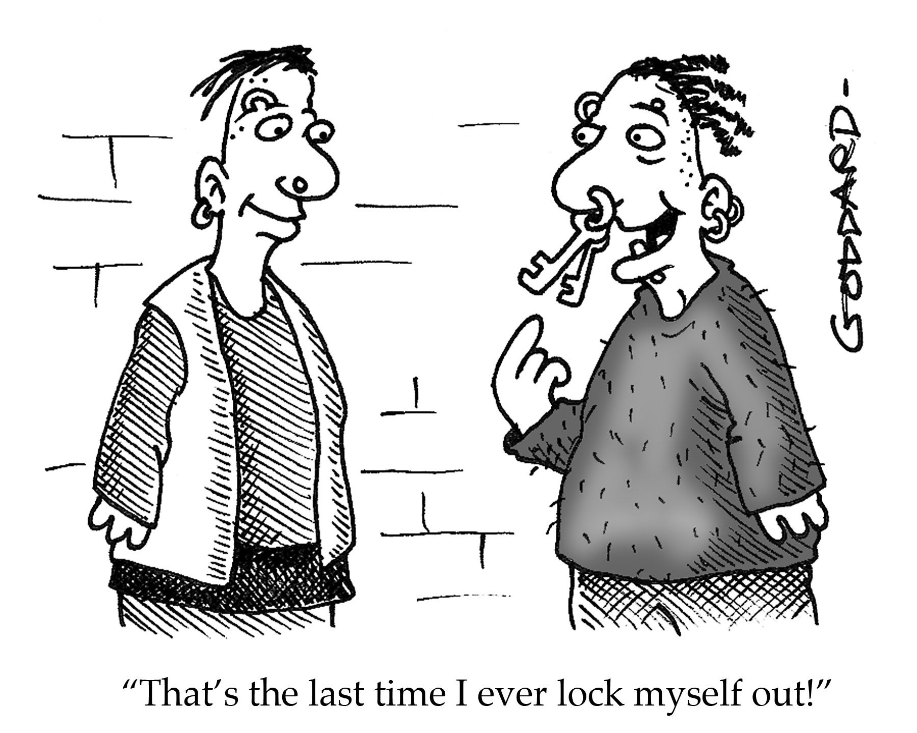
Decoded 4 – Code Requirements for Electrified Hardware
Audio Dial-In:
866-430-4132
Audio Code:
781-453-5306
Mute your phone
(*6 to mute, #6 to unmute).
This webinar is being recorded.

Slide 2
COR140 Exam - Be Prepared!

Slide 3
Session 4 – Electrified Hardware
Electric Latch Retraction
Access-Controlled Egress Doors
Electromagnetically Locked Egress Doors
Delayed Egress
Elevator Lobbies
I-2 Special Egress Locks
Stairwell Reentry

Slide 4
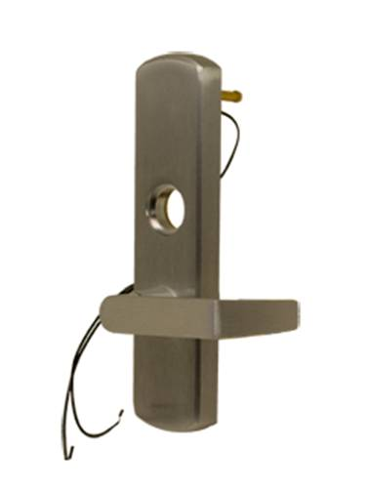
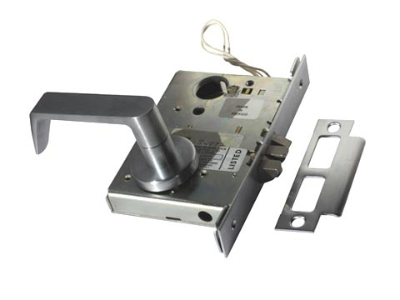
Fail Safe vs. Fail Secure Electrified Locks and Electrified Exit Device Trim
Fail Safe
When power fails, access-side lever is unlocked.
Lock is latched.
Fail Secure
When power fails, access-side lever is locked.
Lock is latched.
Both types typically allow free egress.

Slide 5
Fail Safe vs. Fail Secure Electric Strikes
Fail Safe
When power fails, keeper is free.
Latch can be pulled through keeper.
Fail Secure
When power fails, keeper is secure.
Latch is captured behind keeper.
Both types typically allow free egress.
What type of electric strikes are required when used on fire doors?

Slide 6
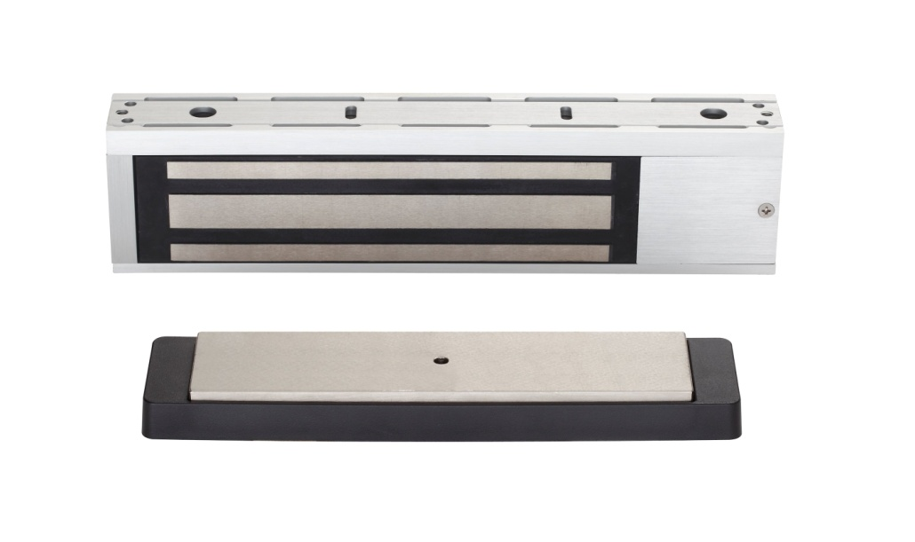
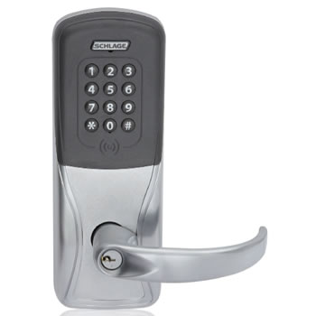
*

Slide 7
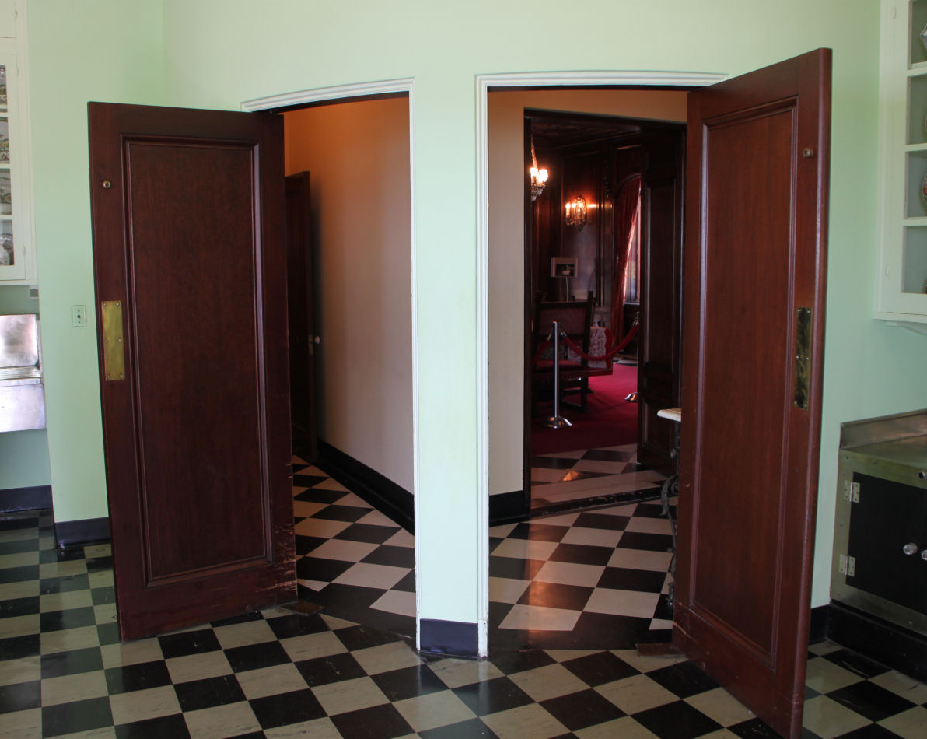
Door #101 Fine Dining
Existing kitchen
Need new doors due to 20-minute fire rating
Restaurant manager does not want doors to latch because of the noise and inconvenience
No locking required
One door will swing into kitchen, one door will swing out
Which code-compliant product should we use to provide positive latching?

Slide 8
Electric Latch Retraction (EL / QEL)
Latch can be held retracted electrically.
Must project upon fire alarm for fire rated doors so doors are latched to deter smoke and flames.
Refer to NFPA 80.
EL/QEL may also be used to release latch for automatic doors (latch may be held back indefinitely and only projected on fire alarm).

Slide 9
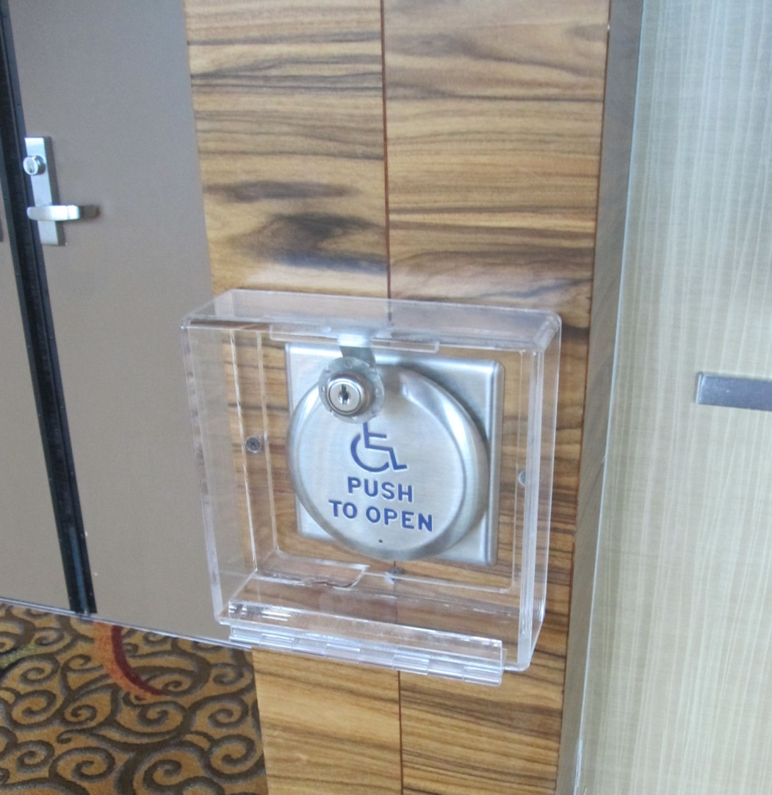
Coordinate auto operator actuators with the access control system!

Slide 10
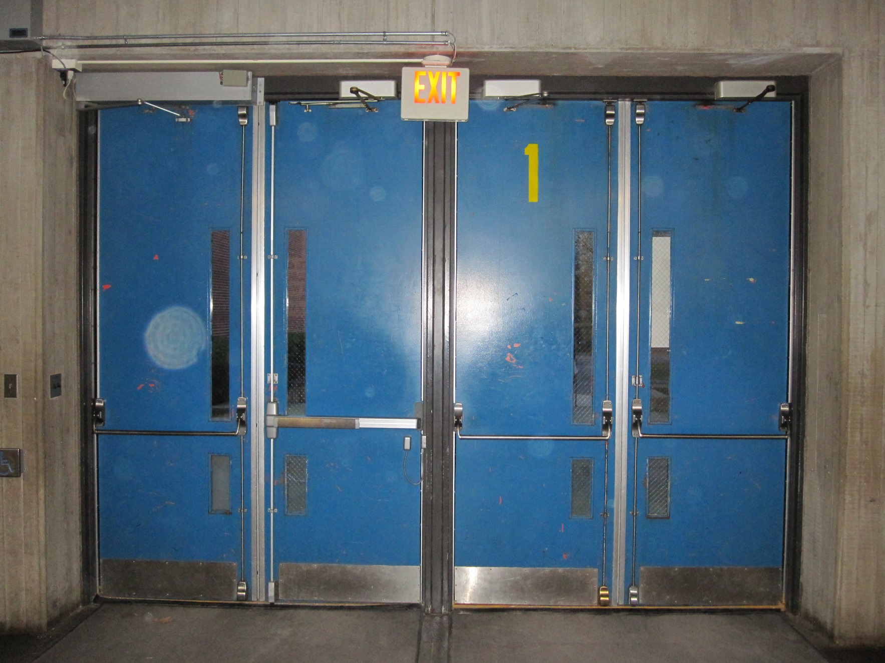
What’s wrong with this picture?

Slide 11
Electric Latch Retraction
Apply Power – Latch Retracts
Remove Power – Latch Projects
Fire alarm can initiate latching.

Slide 14
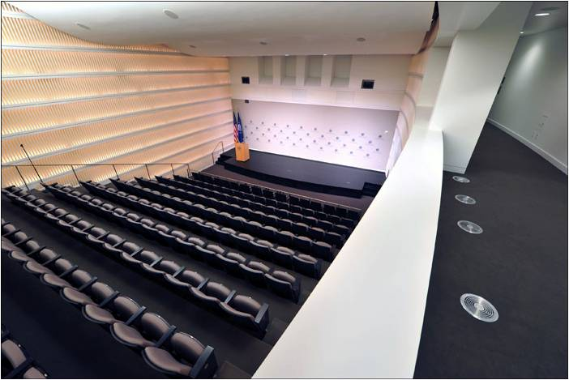

Slide 15
Door #101 Fine Dining
Existing kitchen
Need new doors
Fire Rating: 20 minutes
Restaurant manager does not want doors to latch because of the noise
One door will swing into kitchen, one door will swing out
Which code-compliant product should we use?
What other electronic components do we need to specify?

Slide 16
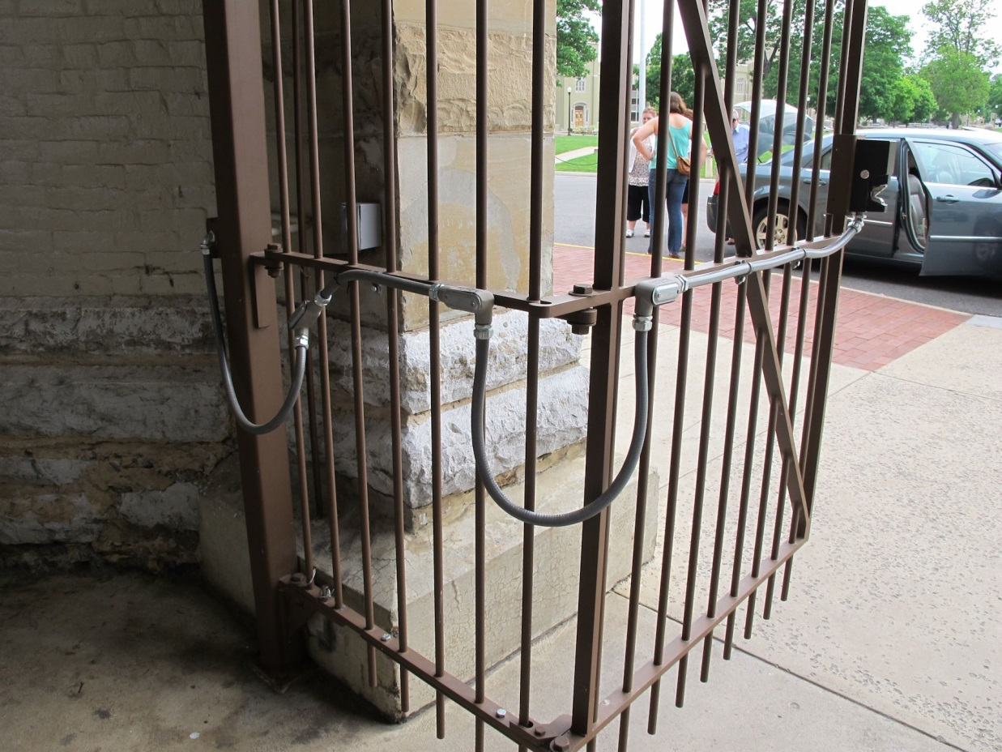
Don’t forget your conductors…

Slide 17
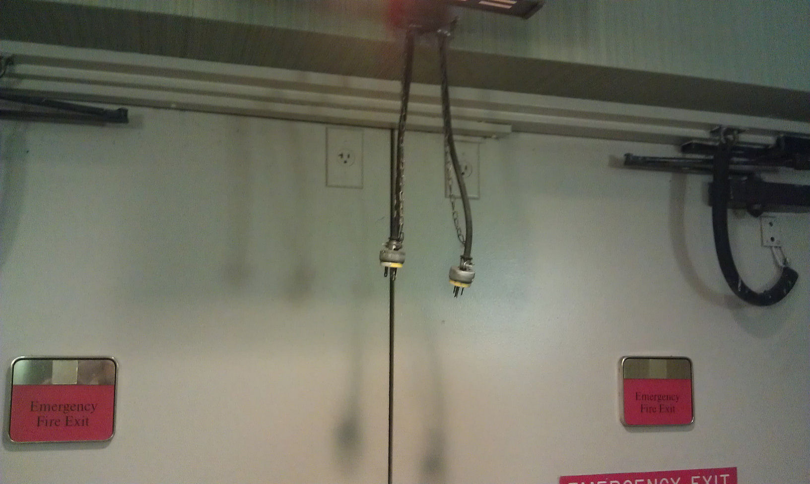
Don’t forget your conductors…

Slide 18
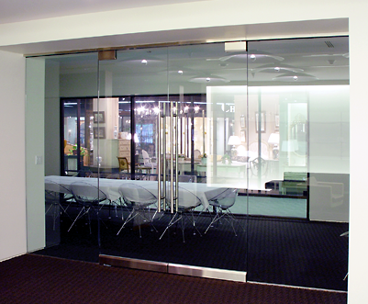
Door #102 All Glass
Existing glass door – no stiles or rails
Access control system will lock/unlock door on a time schedule
Free egress is required
Which code-compliant product should we use?

Slide 19
Door #102 All Glass
Existing glass door – no stiles or rails
Access control system will lock/unlock door on a time schedule
Free egress is required
What mag-lock mounting option is required for this door?

Slide 20
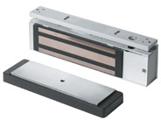
Access-Controlled Egress Doors
Used to control and monitor access.
Must also provide life safety.
Typically an electro-magnetic lock, access control device, and required release devices.
A powerbolt may also be considered an Access-Controlled Egress Door.

Slide 21
Not all doors with access control are Access-Controlled Egress Doors!
Controlled Access / Free Egress – hardware allows egress independent of access control system
Delayed Egress – 15-second delay
Stairwell Reentry – fail-safe lock
I-2 (Hospitals / Nursing Homes) – fail-safe locks
Elevator Lobbies (NFPA 101 only) – fail-safe locks
Electromagnetically Locked Egress Doors – mag-lock with door-mounted release
Access Controlled Egress Doors – mag-lock with motion sensor release

Slide 22
Access-Controlled Egress Doors
Entrance doors & tenant entrance doors (changing in 2015 edition)
IBC Groups A, B, E, I-2, M, R-1 or R-2
NFPA 101 – where allowed by occupancy chapter
A sensor unlocks the lock.
Power loss to lock unlocks the door.
Manual release device (with sign) unlocks door for 30 seconds, independent of access control system.
Actuation of fire/sprinkler system (if provided) unlocks door.

Slide 23
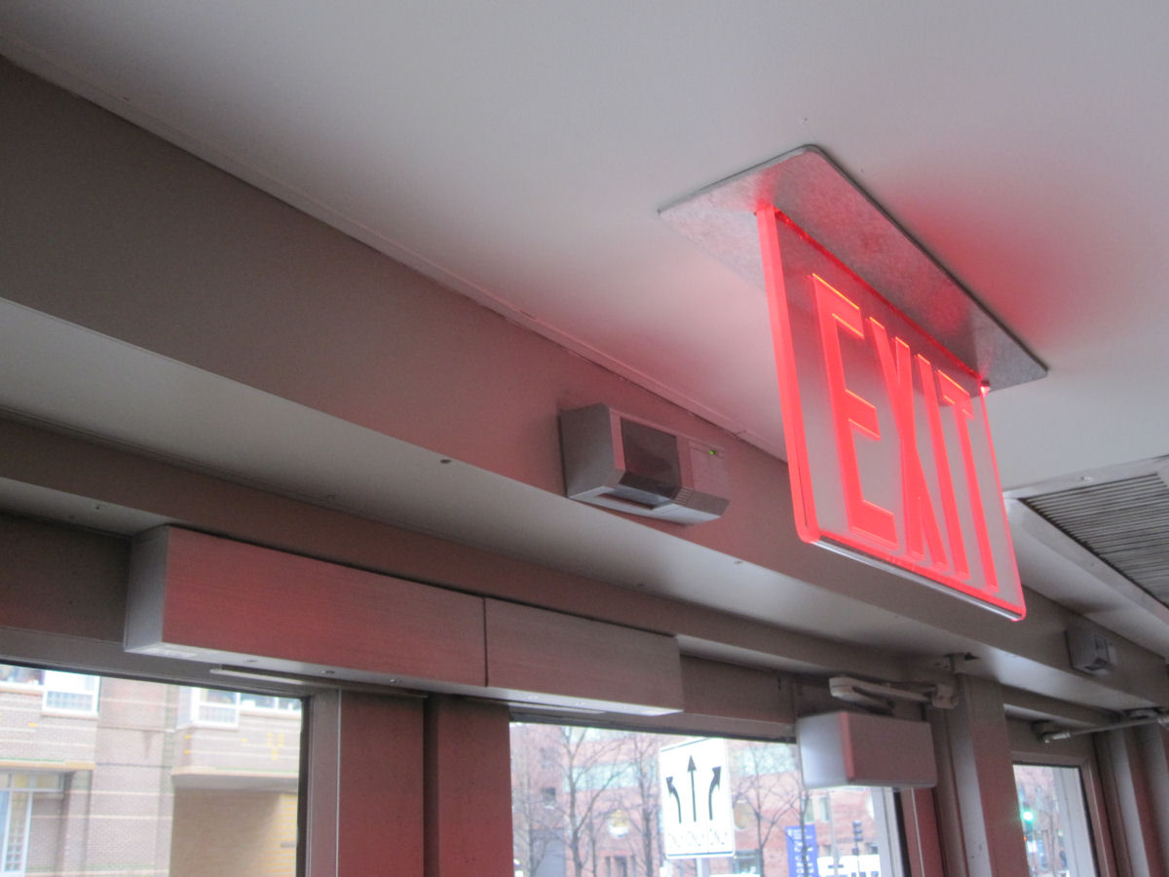

Slide 24
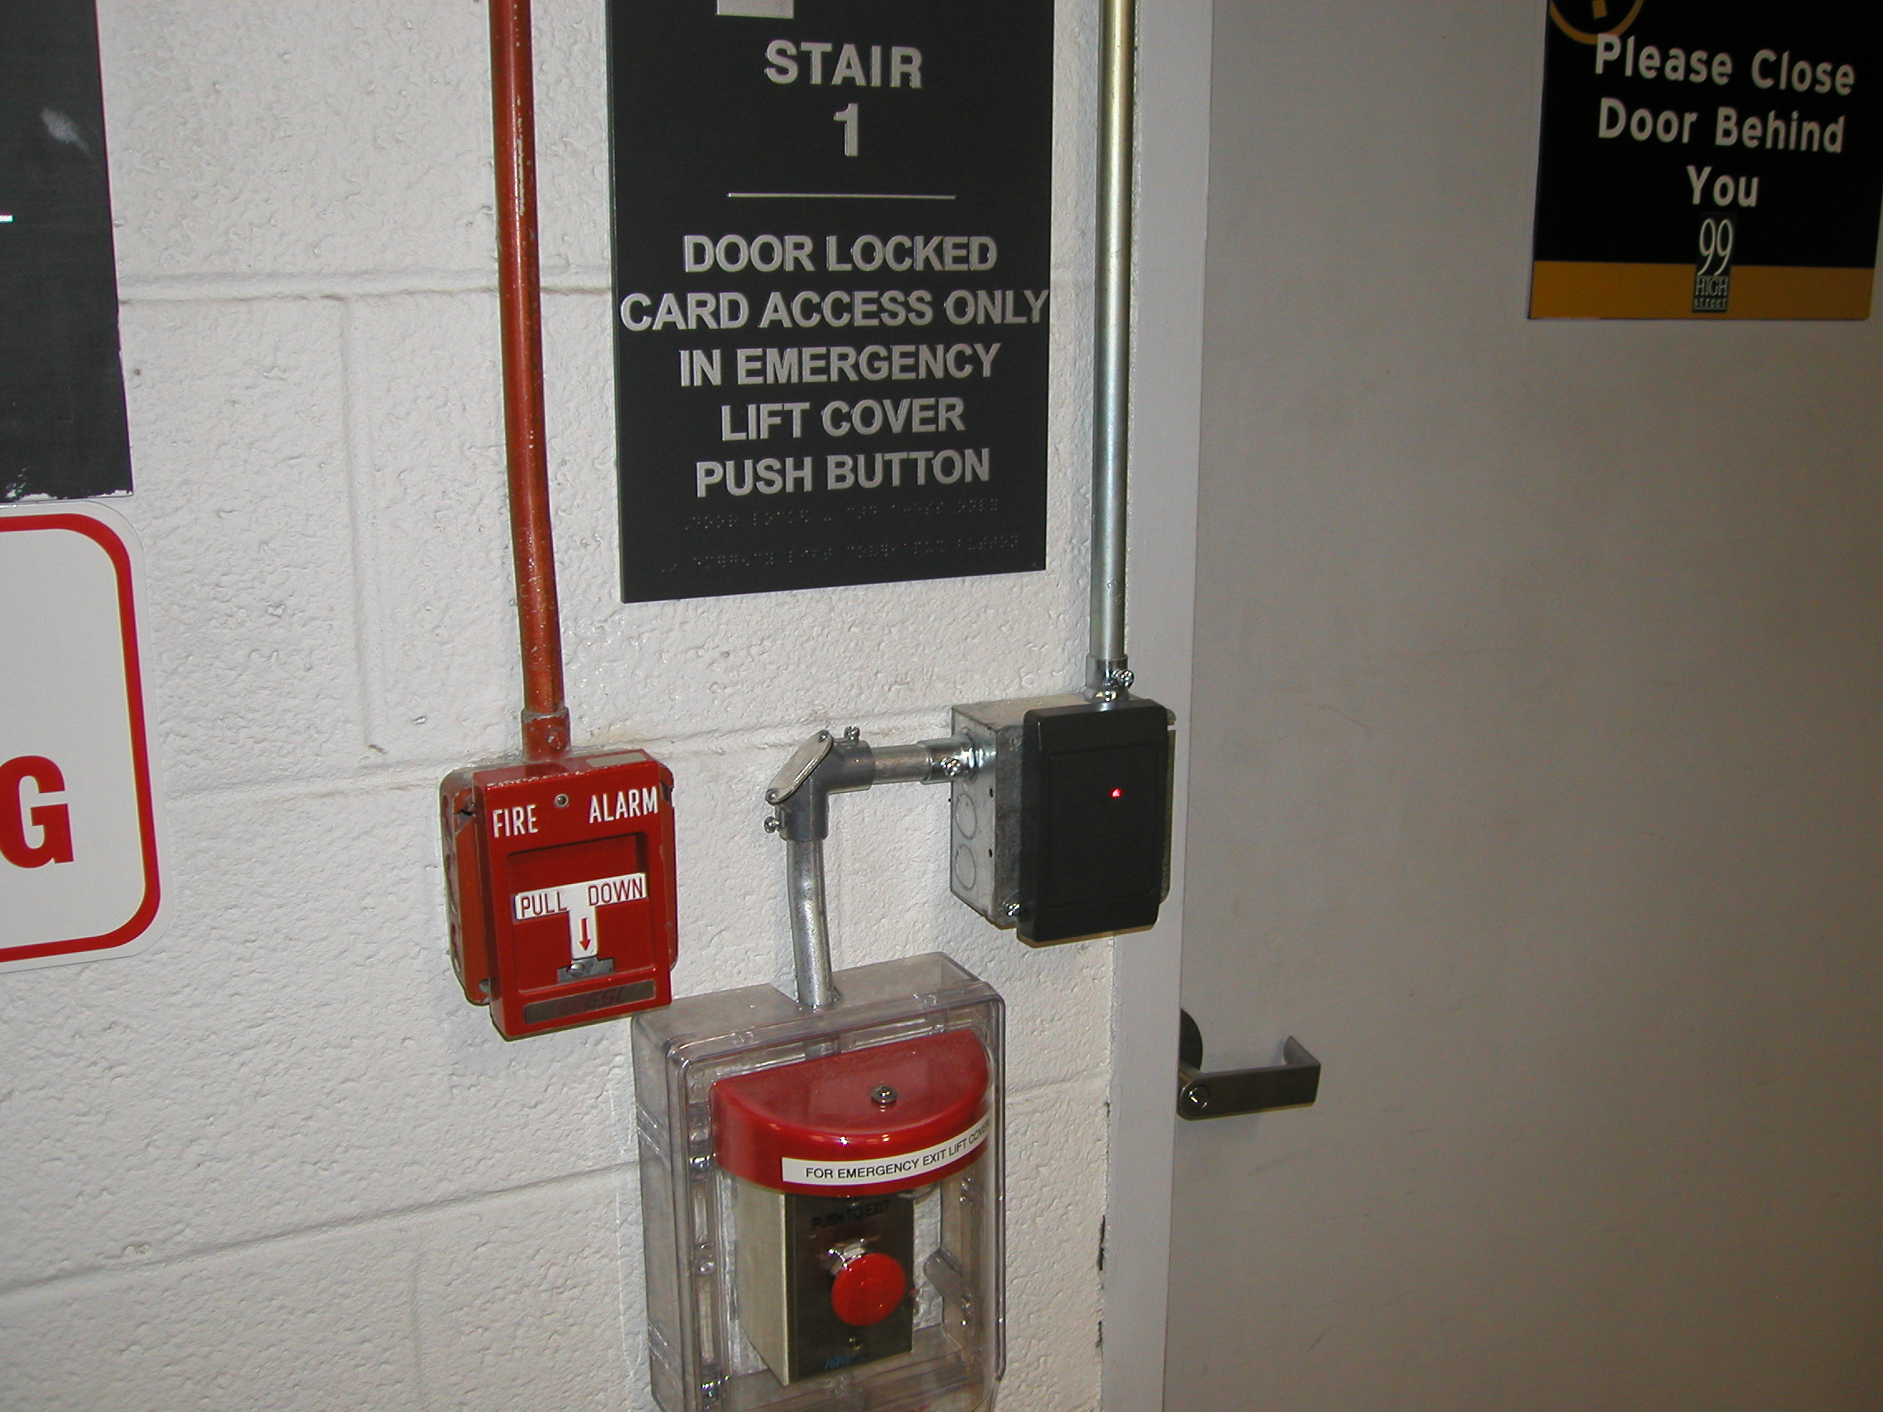

Slide 25
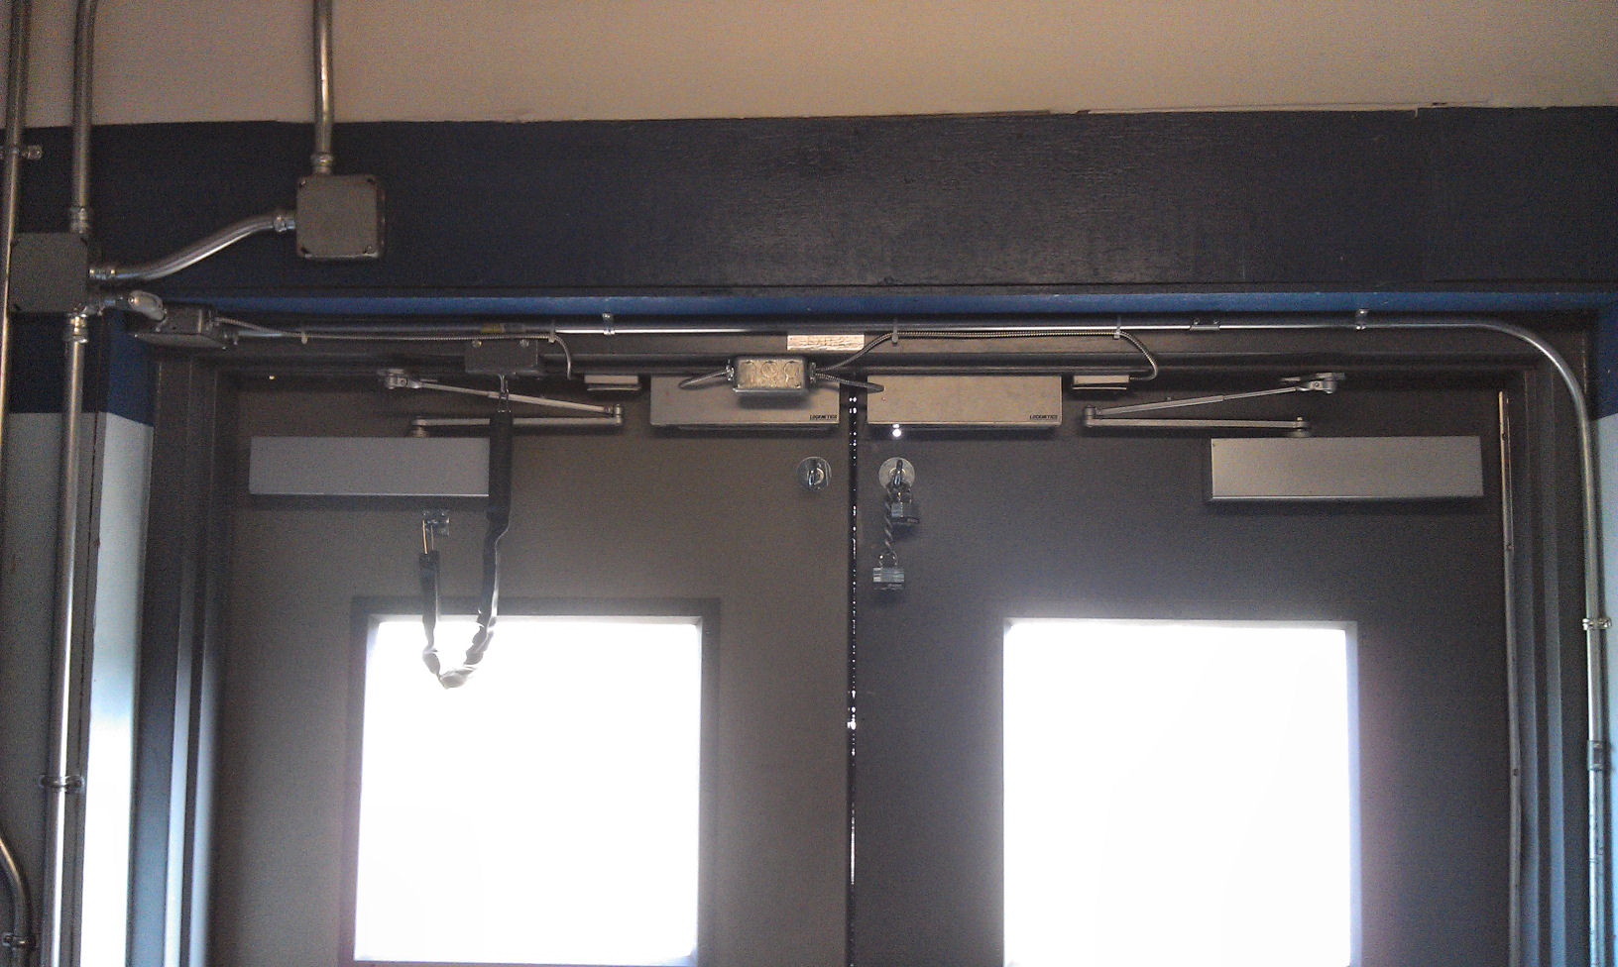

Slide 26
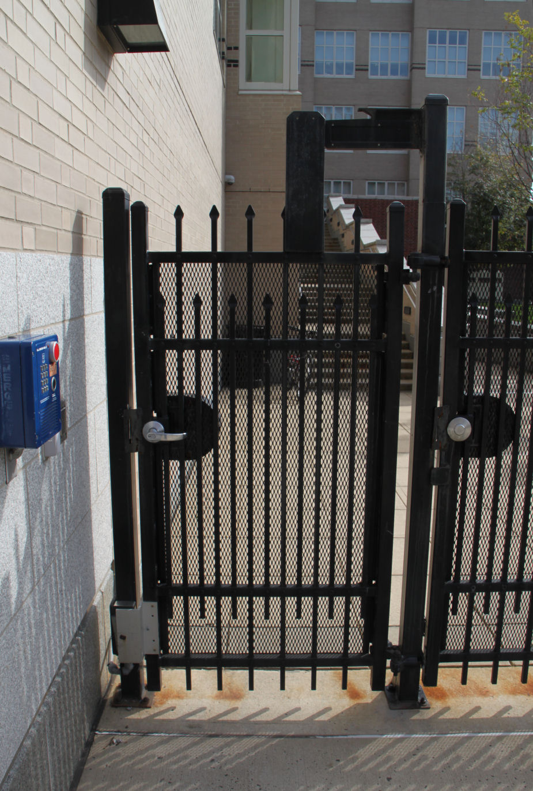
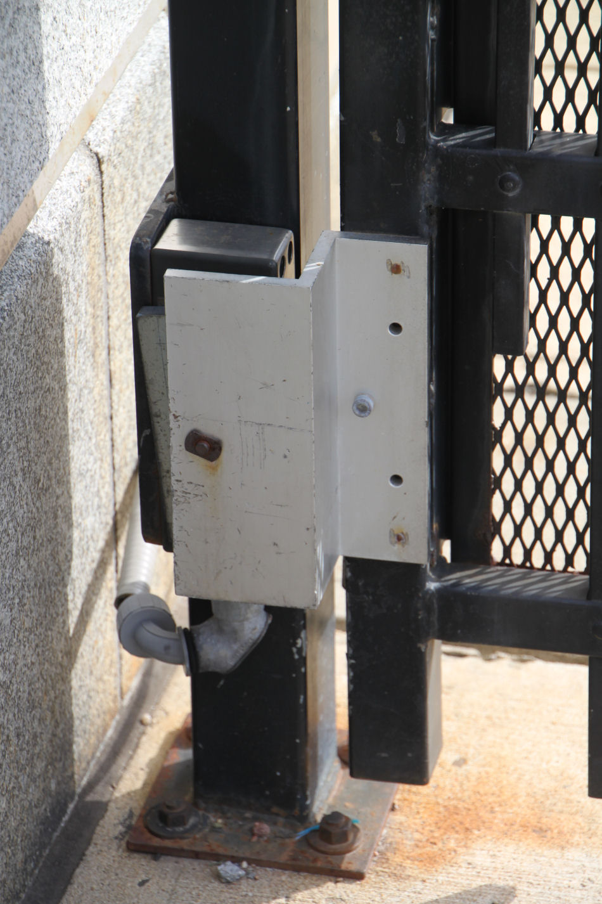
Mag-Locks can be an option for gates, but you may need a variance for the release devices.

Slide 27
TJ Bracket

Slide 28
With gates, you also need to think about conductors, closers, and access to hardware.

Slide 29
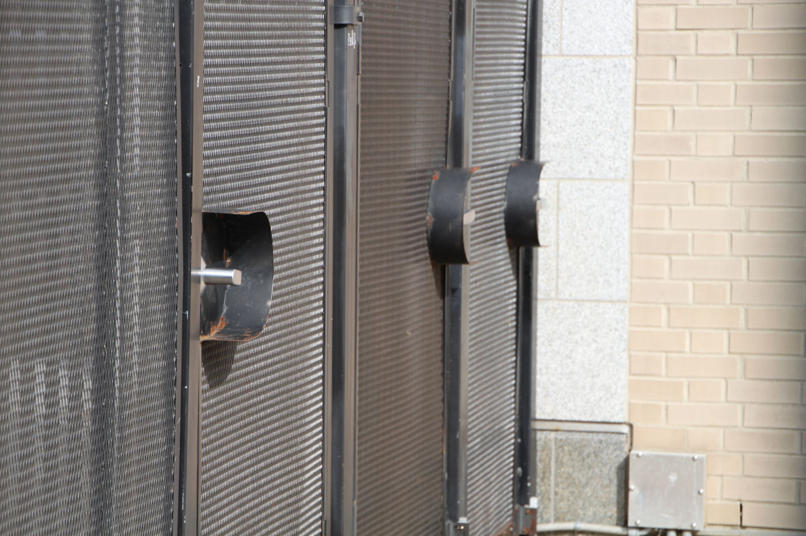

Slide 30
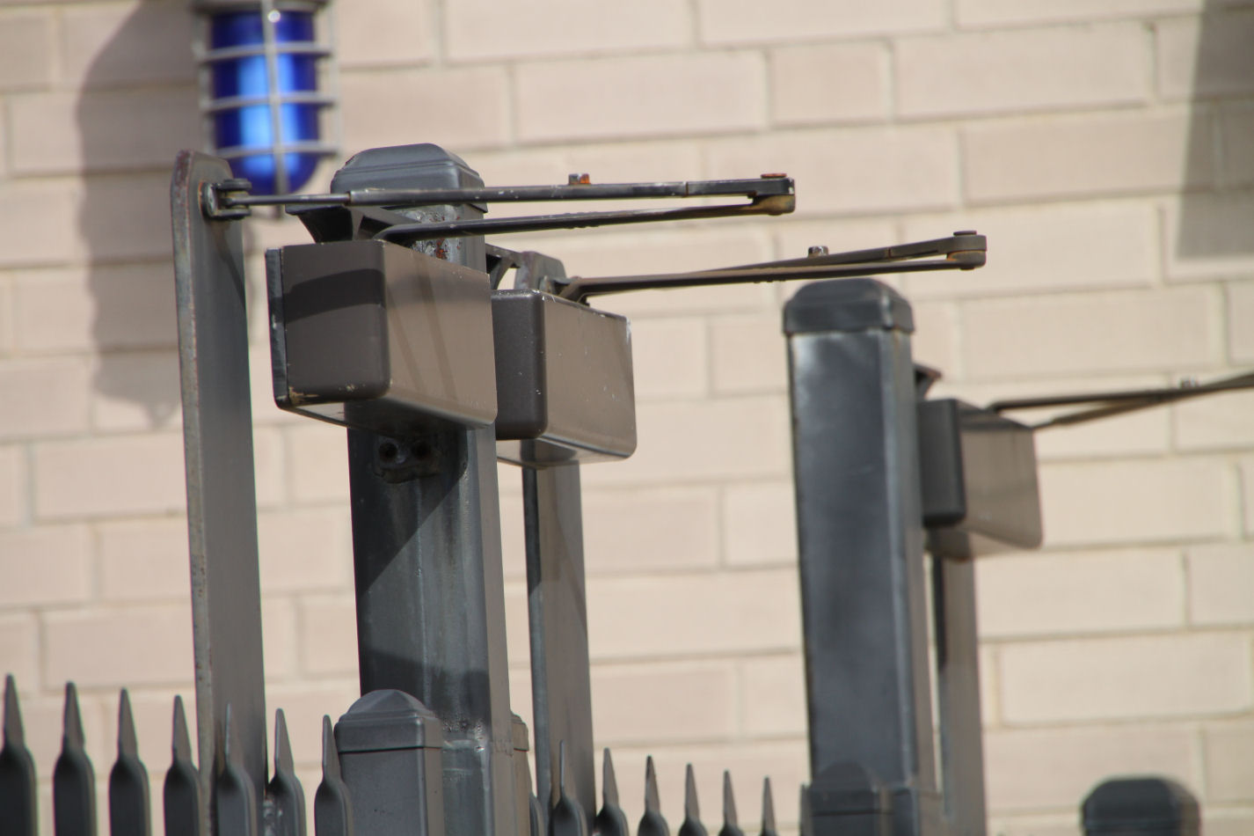

Slide 31
Is battery backup allowed?
Codes require mag-locks to unlock upon loss of power, but “loss of power” is not defined.
Is this loss of normal building power?
Can the lock be powered by the emergency generator along with the rest of the building?
NFPA 72 Interpretation - if the fire alarm system and mag-locks are on the same back-up power, this would meet the intent of the code.
Do not specify separate battery back-up in the power supply for the locks.

Slide 32
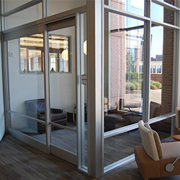
Door #103 No Sensor
The owner wants a mag-lock and card reader.
A motion sensor won’t work because it will be accidentally actuated by the room’s occupants.
Door has very narrow stiles.
Free egress is required.
What are our options?

Slide 33
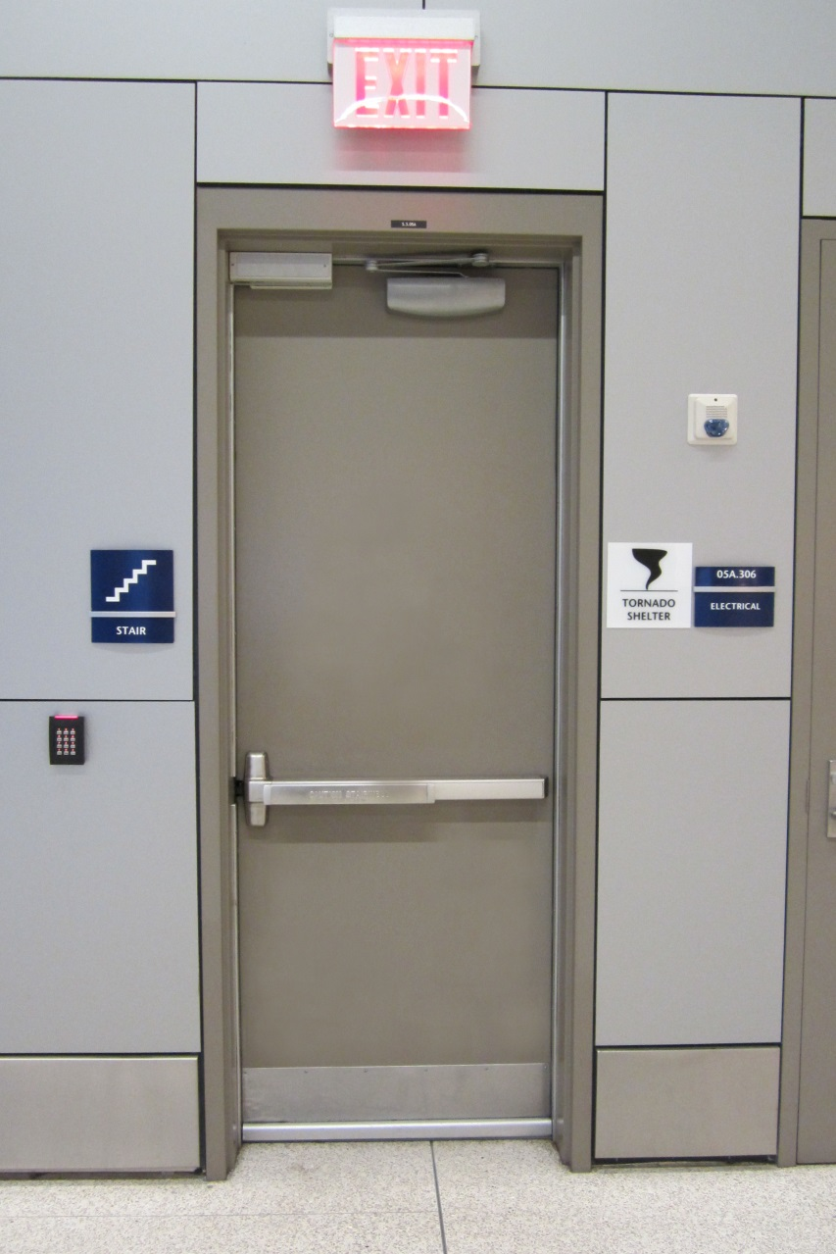
Mag-Lock with Door-Mounted Release (RX Switch)
2003 edition of NFPA 101: A bar with an RX switch in it could be used instead of a motion sensor
2006 edition of NFPA 101: Doors with electromagnetic locks and door-mounted release devices are considered “normal” doors, not access-controlled egress doors.

Slide 34
Mag-Lock with Door-Mounted Release (RX Switch)
2009 edition of NFPA 101: Electrically Controlled Egress Door Assemblies
2009 edition of IBC: Electromagnetically Locked Egress Doors
Release device affixed to door leaf
Obvious means of operation in direction of egress
Operable with one hand
Interrupts power supply and unlocks door
Loss of power unlocks door
Besides the motion sensor and push button, what has been removed from this list?

Slide 35
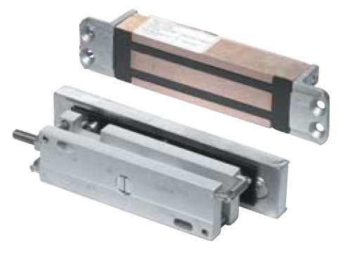
Direct-Hold Mag-Locks vs Shear Locks

Slide 36
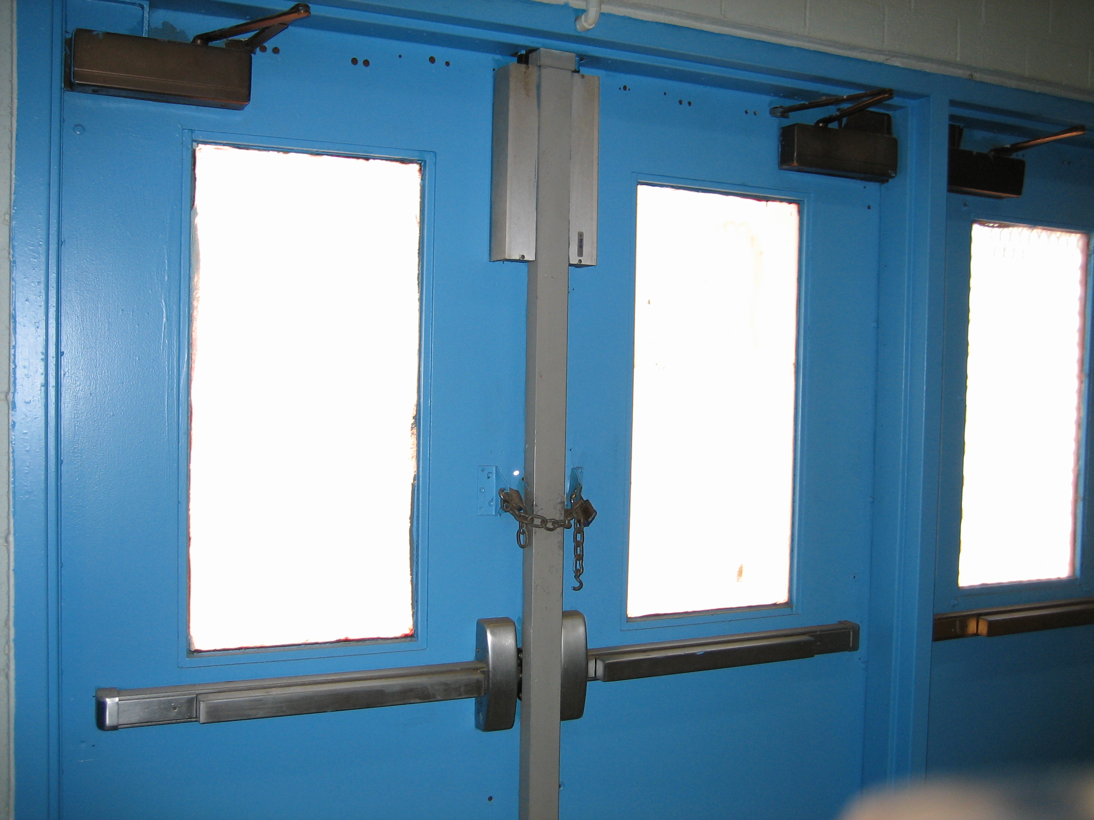

Slide 37
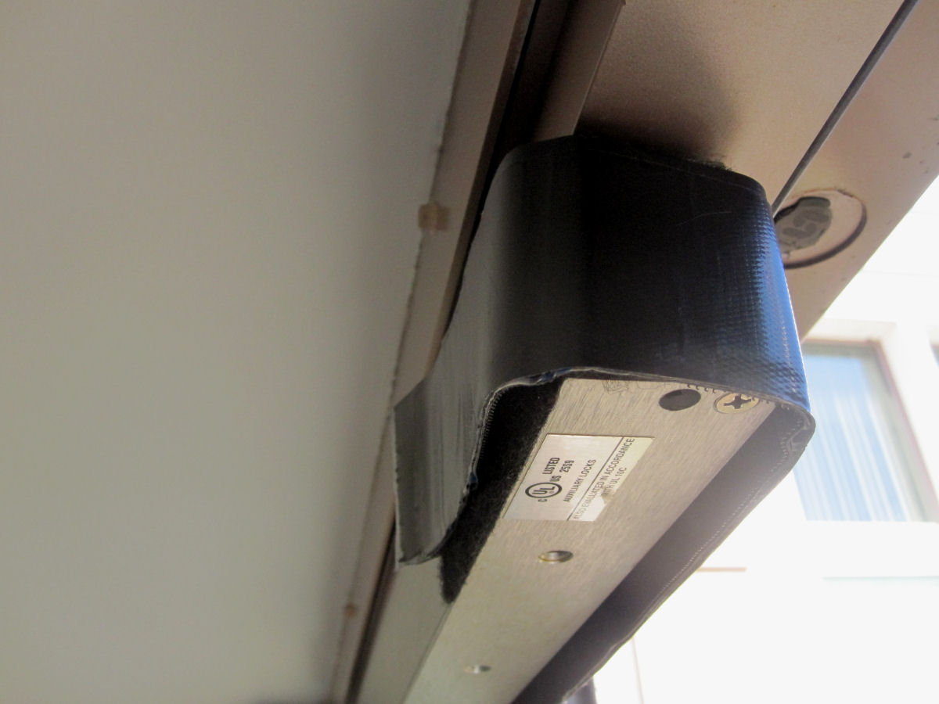

Slide 38
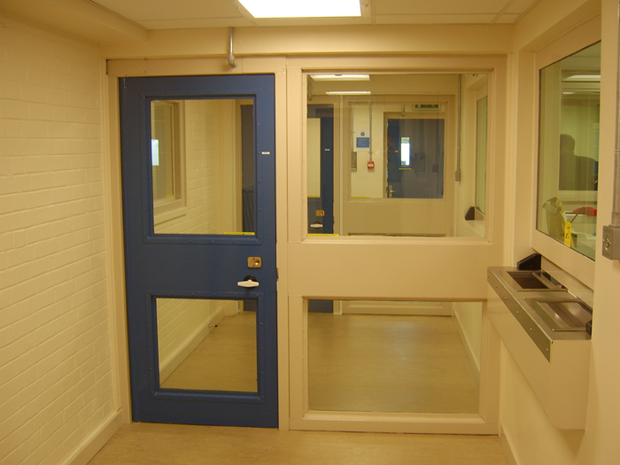
Interlocks (AKA man-traps), which often involve mag-locks, are not addressed in the IBC or NFPA 101.

Slide 40
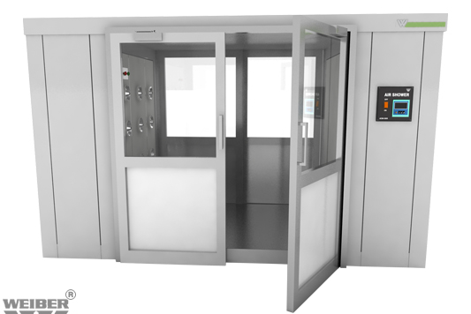
*

Slide 41
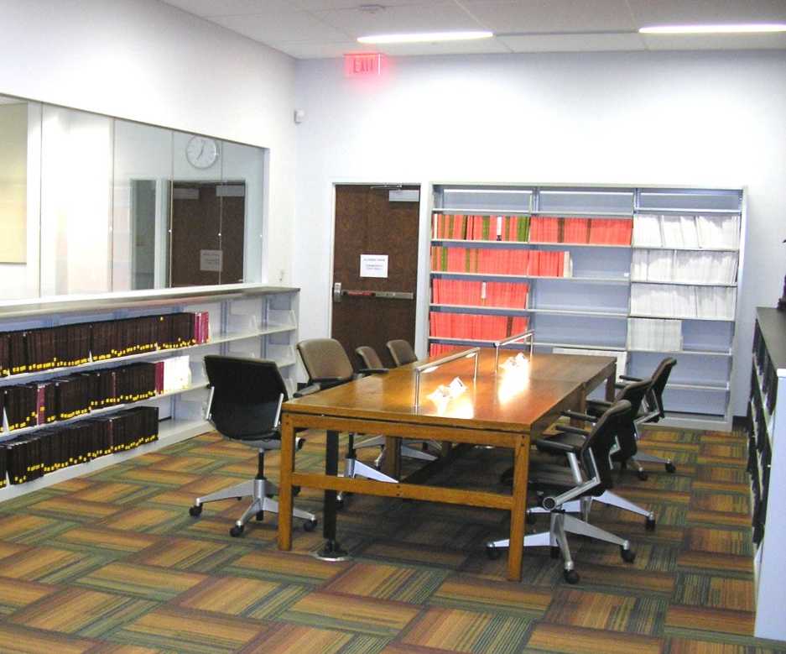
Door #104 Library Egress
Library emergency exit
Librarian wants to lock door and only allow egress if there is a fire alarm.
Code is NFPA 101-2009
What are our options?

Slide 42
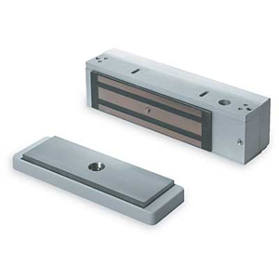
Delayed Egress Devices

Slide 43
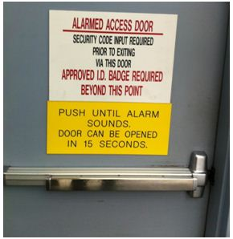
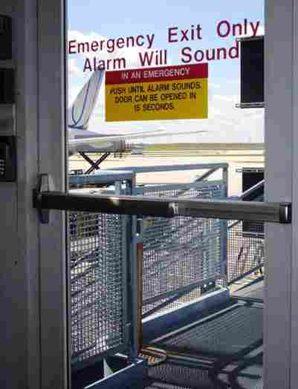
Delayed Egress
Designed to delay egress to prevent unauthorized use of the door.
Must allow egress for life safety.
Typically a delayed egress exit device or magnetic lock with delayed egress controller.

Slide 44
Delayed Egress Locks (NFPA 101)
Approved, listed, delayed egress locks
Must be allowed by occupancy chapter
Automatic sprinkler system or smoke/heat detection
Quantity of delays per egress path varies by occupancy
Immediate release by fire alarm, smoke detection system, or power failure
Capability of releasing from fire command center
15 lbs. applied for 3 second begins 15-second timer (30-second if approved by AHJ)
Audible local alarm
Manual rearm
Signage - “Push until alarm sounds. Door can be opened in 15 seconds.” (+ additional requirements)

Slide 46
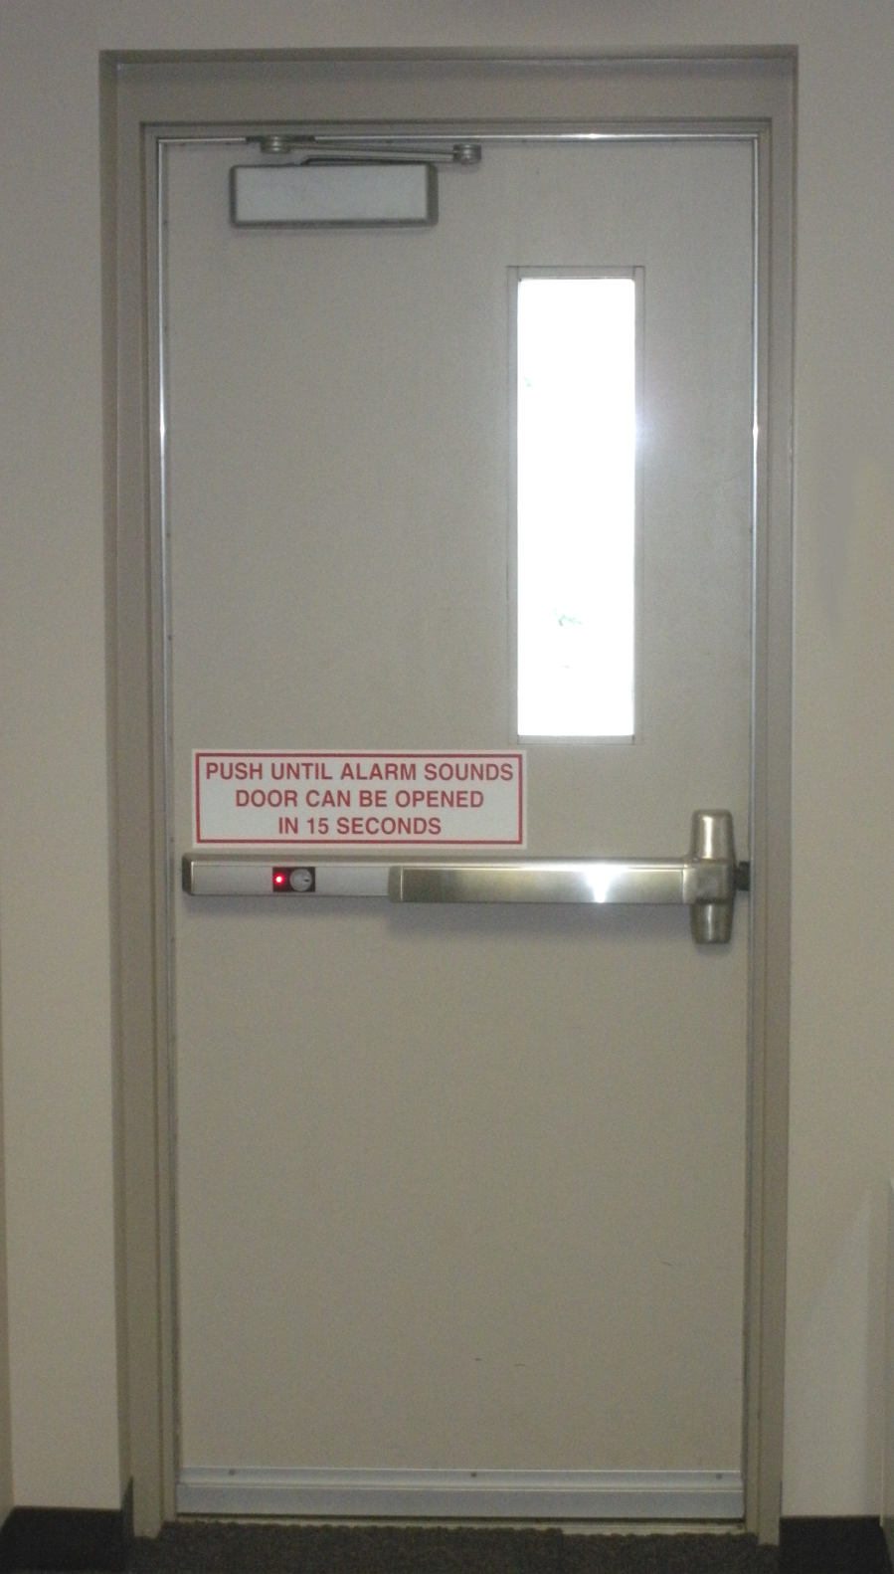

Slide 47
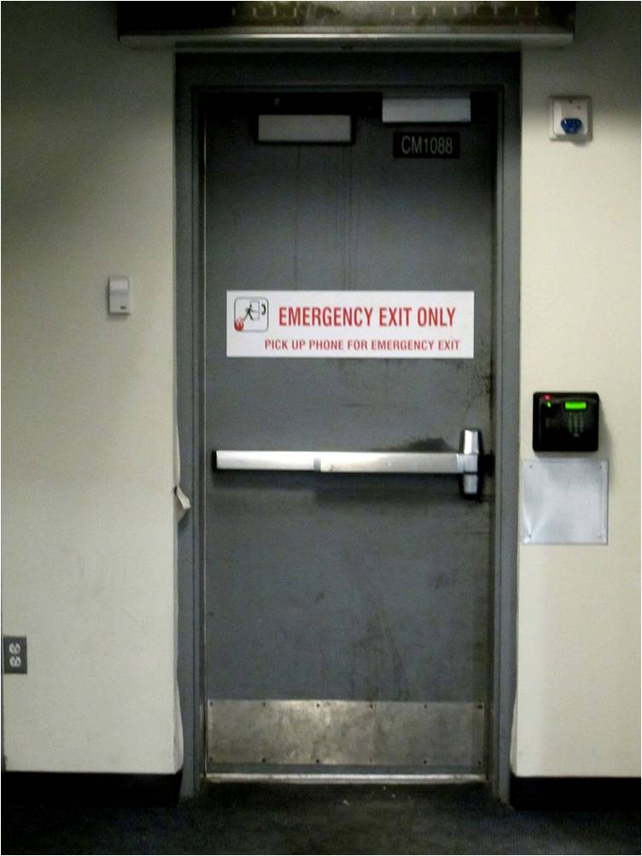
EMERGENCY EXIT ONLY
PICK UP PHONE FOR EMERGENCY EXIT

Slide 48
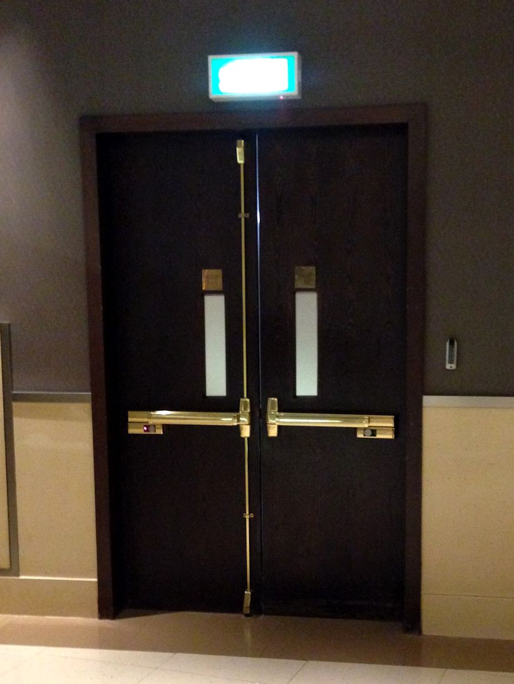

Slide 49
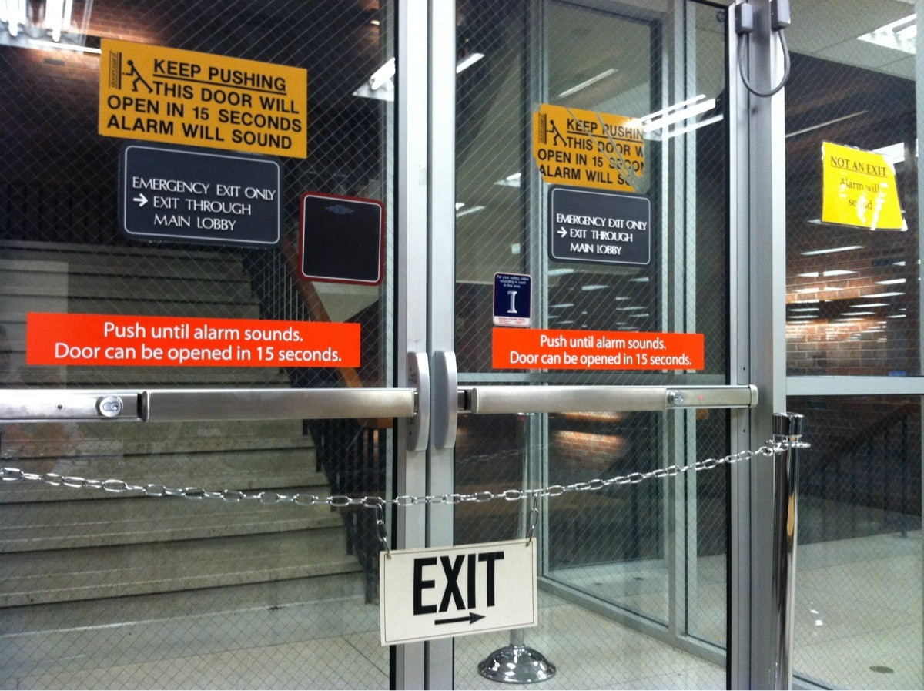

Slide 50
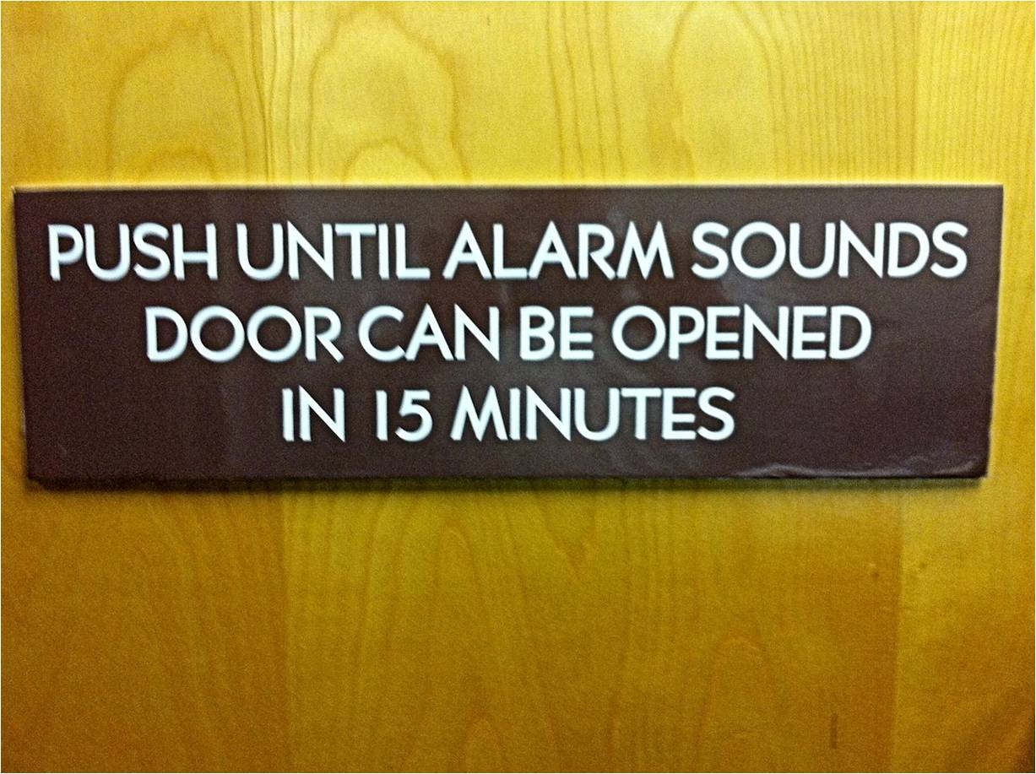

Slide 51
Door #104 Library Egress
Library emergency exit
Librarian wants to lock door and only allow egress during a fire alarm.
Code is NFPA 101-2009
What are our options?
What if the code was the 2009 IBC?

Slide 52
Delayed Egress (IBC)
Allowed in all occupancies except Assembly, Educational, and High Hazard
One delay before entering an exit
15 lbs. applied for 1 second begins 15-second timer (30-second if approved by AHJ)
BOCA option (automatic rearm) is not required for IBC compliance.

Slide 53
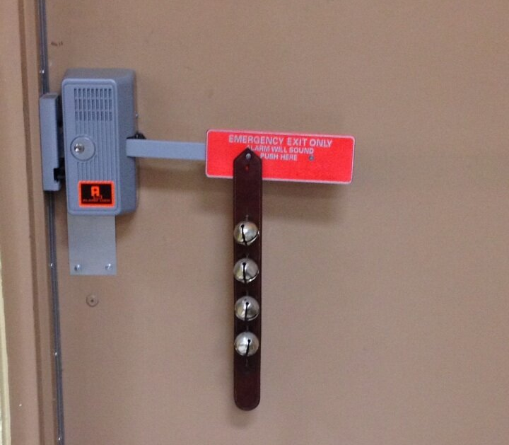
Sometimes an alarm is the most secure solution you can offer.

Slide 56
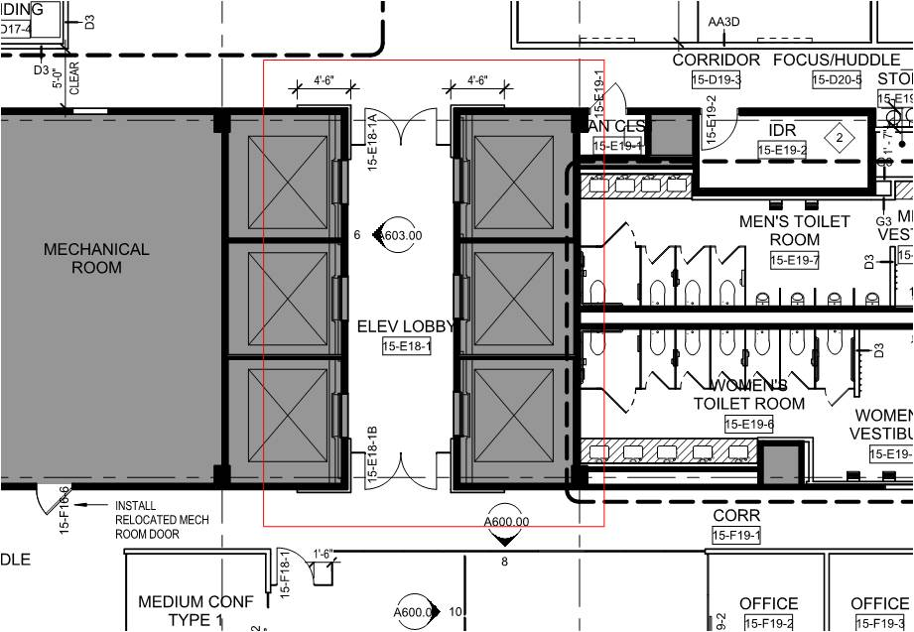
Door #105 Elevator Lobby
Means of egress from the elevator lobby is through the tenant space

Slide 58
Door #105 Elevator Lobby
Means of egress from the elevator lobby is through the tenant space
How can you provide security if the code is the 2009 IBC?
How can you provide security if the code is the 2009 edition of NFPA 101?

Slide 59
Elevator Lobby Egress
2009 IBC: 708.14.1: “Elevator lobbies shall have at least one means of egress complying with Chapter 10 and other provisions within this code.”
2009 NFPA 101: 7.2.1.6.3 Elevator Lobby Exit Access Door Assemblies Locking.
Fail safe lock – unlocks on fire alarm and power failure (battery backup not allowed)
Must be allowed by occupancy chapter
Switch listed per UL 294 Access Control System Units
Two-way communication system in elevator lobby
Some state codes also have modifications for elevator lobby doors.
*

Slide 60
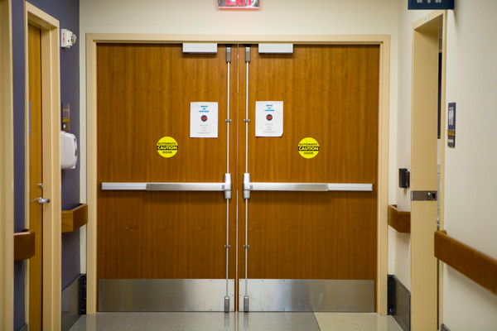
Door #106 Pediatric Ward
What options can you offer to allow the hospital to secure the doors on the egress side?

Slide 61
I-2 Special Egress Locks
Must have fire protection/detection system
Doors unlock upon activation of sprinkler/fire alarm and loss of power controlling lock
Capability of remote unlock
One special egress lock max. before entering an exit
Procedures must be part of emergency planning and preparedness
All clinical staff carry keys/code/credentials to operate locks
Emergency lighting at the door
Protective needs (maternity, pediatrics, emergency, dementia) vs. security measures (detention, forensics)
*

Slide 62
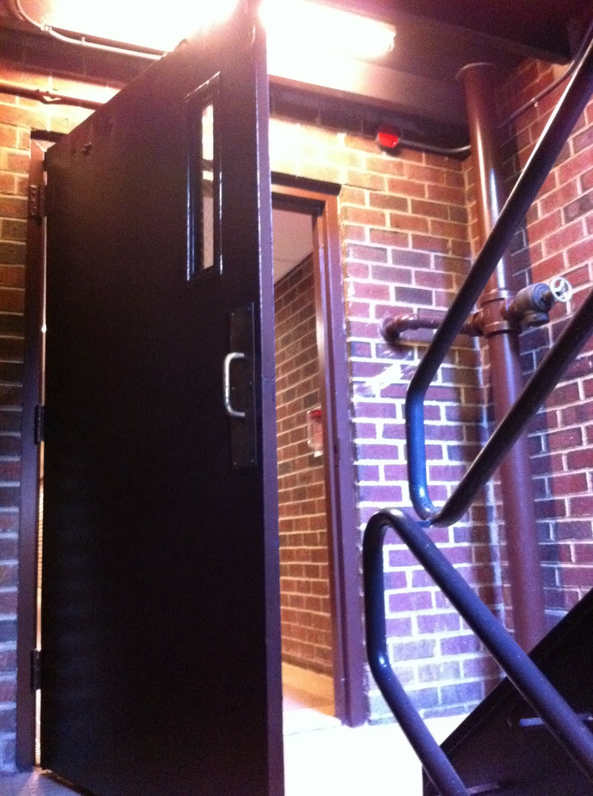
Door #107 Stair Door
Replacing existing stair doors
High-rise building
Multi-tenant
Card readers on stair side
Code is 2009 IBC
What’s the first problem with this door?

Slide 63
Door #107 Stair Door
Replacing existing stair doors
High-rise building
Multi-tenant
Card readers on stair side
Code is 2009 IBC
What are our options for locking the stair doors?

Slide 64
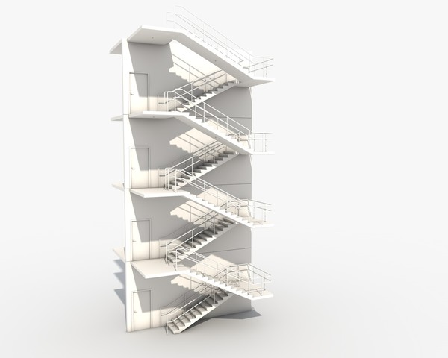

Slide 65
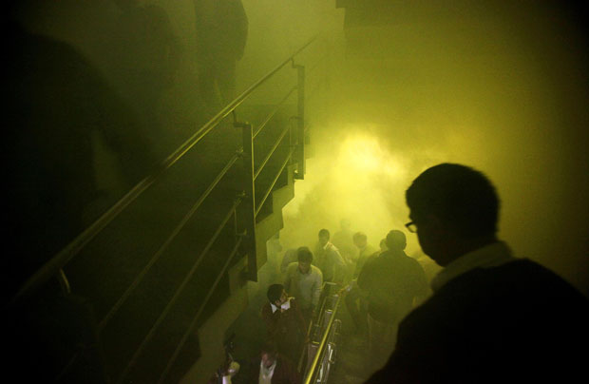

Slide 66
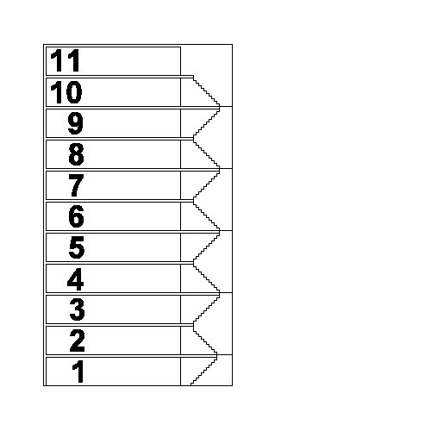
Stairwell Reentry
Stairwell doors are often locked to prevent entry to restricted floors.
During a fire, occupants must be able to move from the stairwell onto floors through doors that are normally locked.

Slide 67
Stairway Doors
Interior stairway means of egress doors openable from both sides without a key or special knowledge or effort
Discharge doors openable from egress side
High rise buildings (403.5.3)
Unlocked without unlatching by a signal from the fire command center
Stairway communication system required
Stairs serving 4 stories or less – recent changes

Slide 68
The 2003 edition of the IBC allowed stairs serving not more than four stories to have mechanical locksets on the stair side of doors other than the stair discharge.
Later editions require fail safe locks controlled remotely, even on stairs serving 4 stories or less.
OR

Slide 69
Free Access
Unlock on Fire Alarm

Slide 70
Free Access
Unlock on Fire Alarm

Slide 71
Electrified Locks

Slide 72
Fail Safe vs. Fail Secure
Fail Safe - When power fails, lock is unlocked.
Lock is still latched.
Fail Secure - When power fails, lock is locked.
Lever on secure side is locked.
Lever on egress side is not locked.
Which type of lock do we need for stairwell reentry?

Slide 73
Fail Safe vs. Fail Secure
Fail Safe - When power fails, lock is unlocked.
Lock is still latched.
Fail Secure - When power fails, lock is locked.
Lever on secure side is locked.
Lever on egress side is not locked.
Which type of lock do we need for stairwell reentry?
Why can’t you use an electric strike for these doors?

Slide 74
Door #104 Stair Door
Replacing existing stair doors
High-rise building
Multi-tenant
Card readers on stair side
Code is 2009 IBC
What if the code is NFPA 101 – 2009??

Slide 75
Selected Reentry
*
Allows mechanical locking of some doors
Selected reentry is not covered in the IBC

Slide 76
Selected Reentry
NFPA 101 - Door assemblies on stair enclosures shall be permitted to be equipped with hardware that prevents re-entry into the interior of the building, provided that the following criteria are met:

Slide 77
(1) There shall be not less than two levels where it is possible to leave the stair enclosure to access another exit.

Slide 78
(2) There shall be not more than four stories intervening between stories where it is possible to leave the stair enclosure to access another exit.

Slide 79
(3) Re-entry shall be possible on the top story or next-to-top story served by the stair enclosure, and such story shall allow access to another exit.

Slide 80
(4) Door assemblies allowing re-entry shall be identified as such on the stair side of the door leaf.
REENTRY
PERMITTED
ON THIS
FLOOR.

Slide 81
(5) Door assemblies not allowing re-entry shall be provided with a sign on the stair side indicating the location of the nearest door opening, in each direction of travel, that allows re-entry or exit.
REENTRY
FLOOR 5
EXIT
FLOOR 1

Slide 83
Session 4 – Electrified Hardware
Electric Latch Retraction
Access-Controlled Egress Doors
Electromagnetically Locked Egress Doors
Delayed Egress
Elevator Lobbies
I-2 Special Egress Locks
Stairwell Reentry

Slide 84
More information on codes for electrified hardware:
Doors with Access Control
Fail Safe vs. Fail Secure – When and Where?
Code Requirements for Electromagnetic Locks
Elevator Lobby Egress
Electromagnetically Locked Egress Doors
Stairwell Reentry – Myths and Facts
Delayed Egress Hardware – Code Comparison
Special Egress Locks in I-2 Occupancies
NFPA 72 on Access Control

Slide 85
PLEASE fill out the evaluation form (click here) to help me improve this course!

