Slide 1
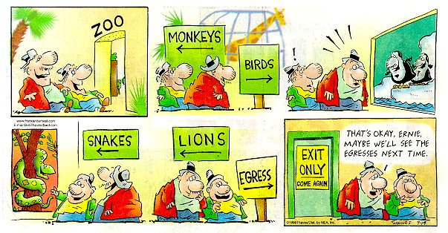
Decoded 3 – Egress and Life Safety
Audio: 866-430-4132, Code: 781-453-5306
Mute your phone (*6 to mute, #6 to unmute)
This webinar is being recorded.

Slide 2
Decoded 3 – Egress and Life Safety
Audio: 866-430-4132, Code: 781-453-5306
Mute your phone (*6 to mute, #6 to unmute)
This webinar is being recorded.
If you have approval to take the COR140 Exam, please sign up with Hanne Sevachko at DHI by this Thursday.
40 multiple-choice questions
90 minutes
open book
$375 (class is +/- $2000 including travel)

Slide 4
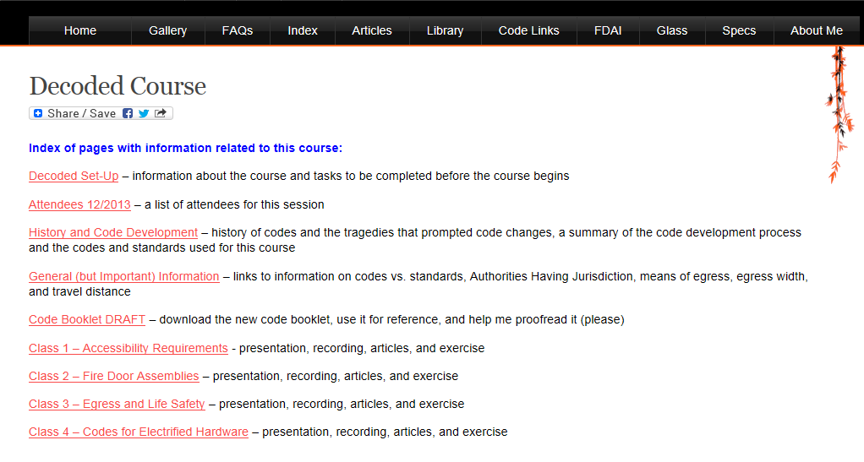

Slide 5
Session 3 – Life Safety
IBC – NFPA 101 – IFC
Occupancy Types – Use Groups
Occupied vs. Unoccupied
Opening Protectives
Means of Egress
travel distance, common path of travel, dead end corridors
clear width, projections, and door swing
opening force and auto operators
unlatching, bolts, hardware operation and height
panic hardware

Slide 6
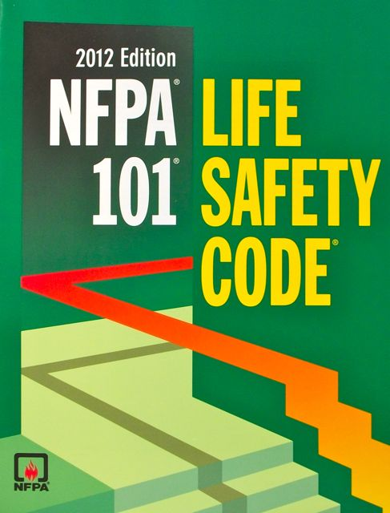
Building Code vs. Life Safety Code or Fire Code
A building code is typically used only during design/construction. After completion, the applicable fire code is enforced.

Slide 7
Question
What does “Approved” mean when it is used in the IBC or NFPA 101?
Type in the chat box.

Slide 8
Approved

Slide 9
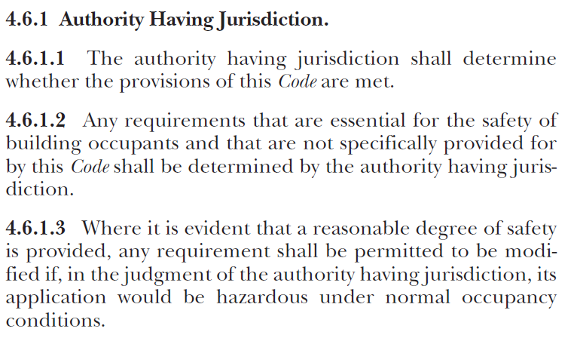
Authority Having Jurisdiction

Slide 10
Occupancy Classifications
(NFPA 101 – Chapter 6)
Use Groups
(IBC – Chapter 3)
Assembly
Educational
Day Care
Health Care
Ambulatory Health Care
Detention and Correctional
Residential
Residential Board and Care
Business
Mercantile
Industrial
Storage
Assembly
Business
Educational
Factory and Industrial
High Hazard
Institutional
Mercantile
Residential
Storage
Utility & Maintenance
Most are divided into sub-categories

Slide 11
Occupancy Classifications and Use Groups Some are a little tricky…
A college classroom building is a Business occupancy, but if a college classroom holds 50 or more, it is an Assembly occupancy.
NFPA 101’s Ambulatory Health Care occupancy is usually considered Group B (Business) for the IBC.
Child day care centers are considered Day Care occupancies per NFPA 101, but may be I (Institutional) or E (Educational) use groups per the IBC.
A training room within an office building is not considered an Assembly use group by the IBC unless it has an occupant load of 50 or more, or is over 750 sq. ft. in area.
NFPA 101’s Health Care, Board & Care, Detention & Correctional are all I (Institutional) use groups per the IBC.

Slide 12
Multiple Occupancies (NFPA 101)
6.1.14.2.1 Multiple Occupancy. A building or structure in which two or more classes of occupancy exist.
6.1.14.2.2 Mixed Occupancy. A multiple occupancy where the occupancies are intermingled. (follow most stringent requirements throughout)
6.1.14.2.3 Separated Occupancy. A multiple occupancy where the occupancies are separated by fire resistance–rated assemblies. (follow separate requirements for each area)

Slide 13
Hazard of Contents (NFPA 101)
6.2.2.2* Low Hazard Contents. Low hazard contents shall be classified as those of such low combustibility that no self propagating fire therein can occur.
6.2.2.3* Ordinary Hazard Contents. Ordinary hazard contents shall be classified as those that are likely to burn with moderate rapidity or to give off a considerable volume of smoke. (most buildings are ordinary hazard)
6.2.2.4* High Hazard Contents. High hazard contents shall be classified as those that are likely to burn with extreme rapidity or from which explosions are likely.

Slide 14
Question
According to NFPA 101, when is a building considered “occupied”?
Type in the chat box.

Slide 15
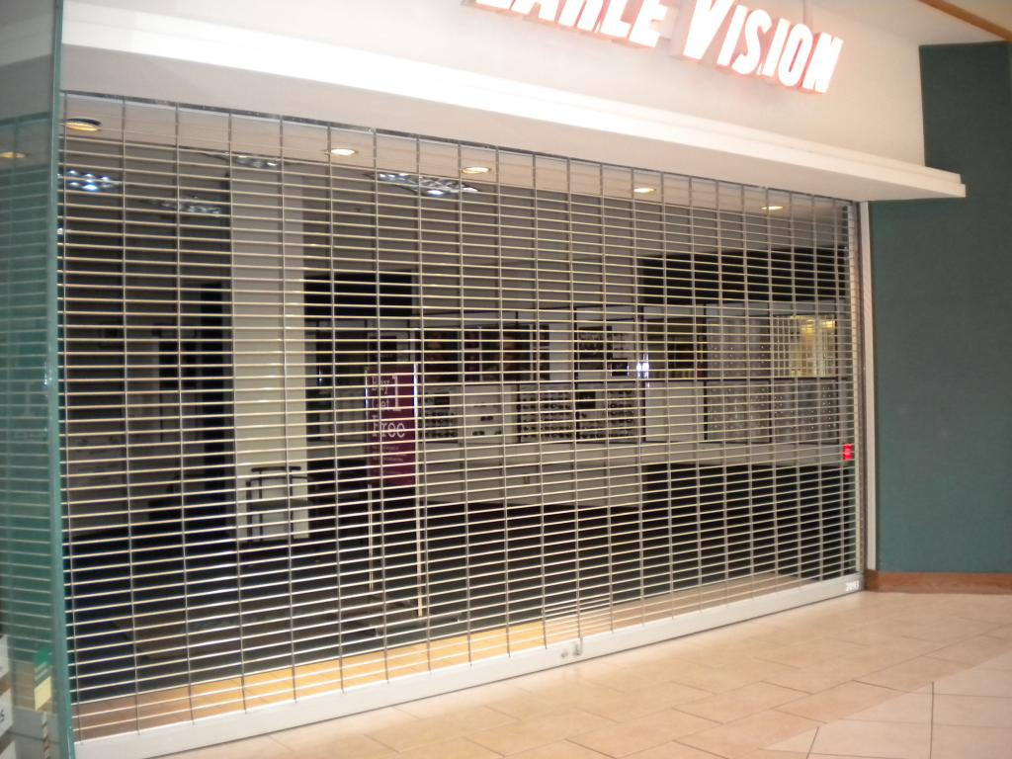
Occupied vs. Unoccupied (NFPA 101)
NFPA 101 and IFC – some requirements differ for times when the building is open or occupied by more than 10 people.
IBC – no difference in requirements for occupied vs. unoccupied

Slide 16
Chapter 7 Means of Egress
Chapter 8 Features of Fire Protection
Chapters 12-42 Occupancy Chapters
Chapter 7 Fire and Smoke Protection Features
Chapter 10 Means of Egress

Slide 17
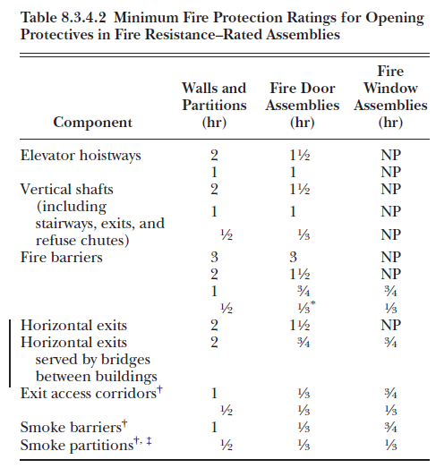
Opening Protectives (NFPA 101)

Slide 18
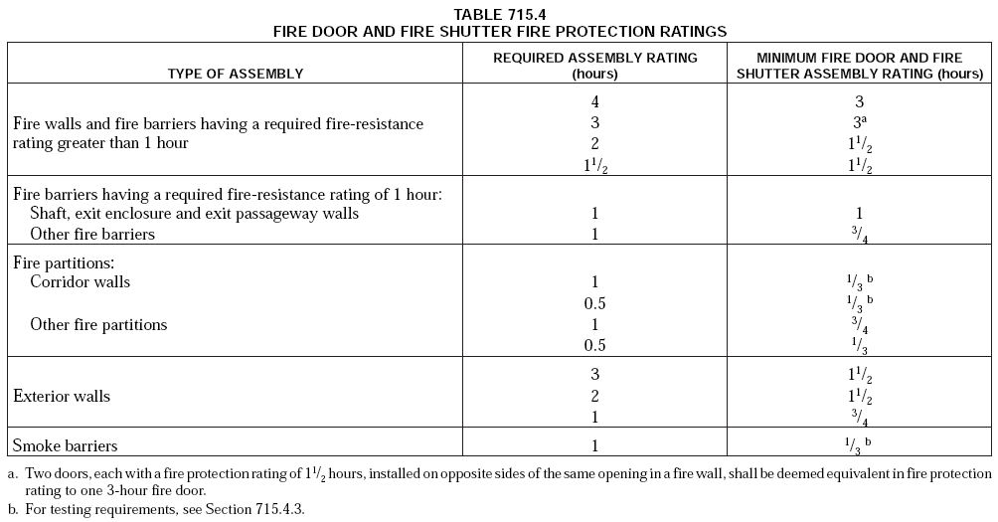
Opening Protectives – (IBC)

Slide 19
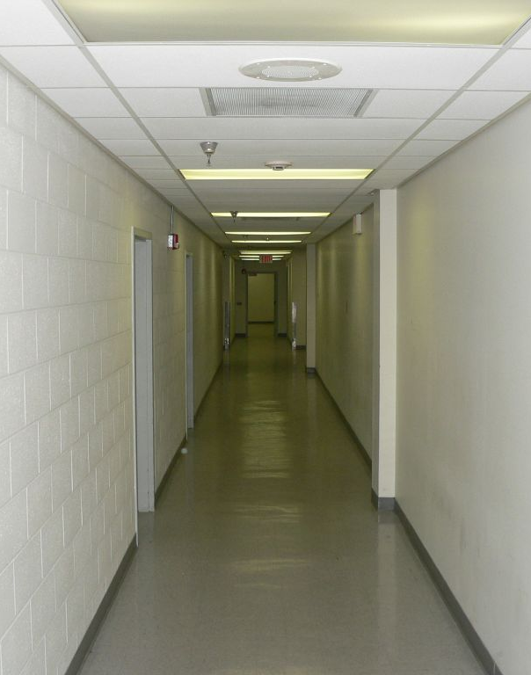
Means of Egress
A continuous and unobstructed way of travel from any point in a building or structure to a public way
Not every door is an egress door.
Not every egress door has an exit sign.

Slide 20
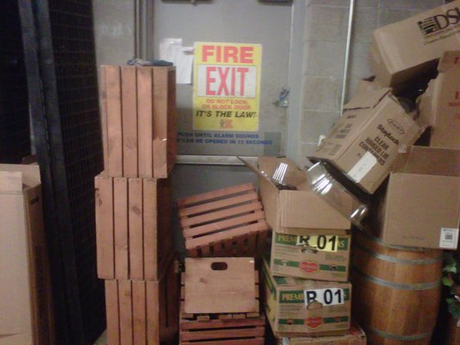

Slide 21
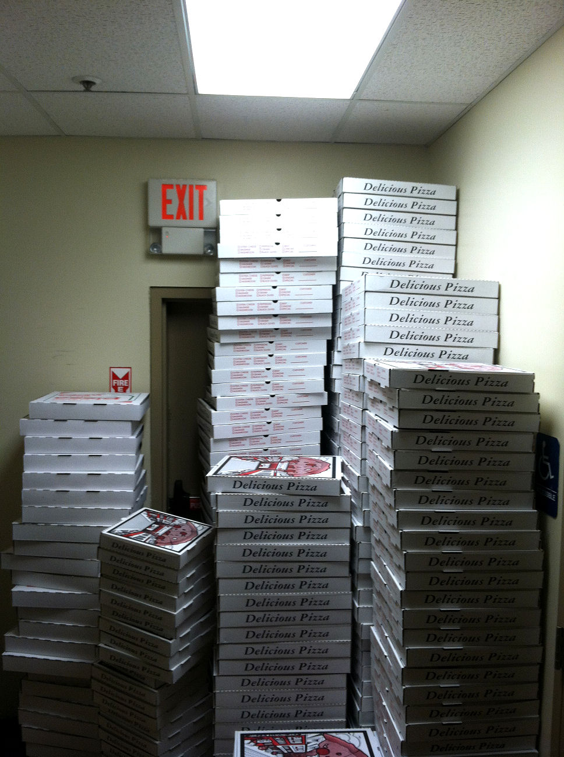

Slide 22
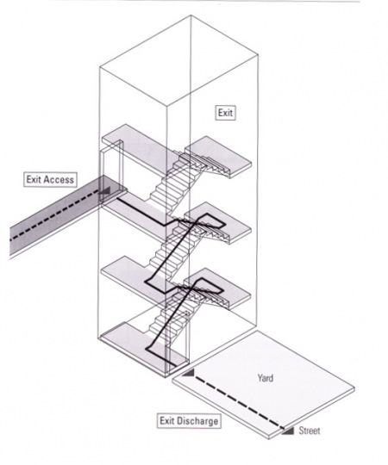
Means of Egress
Exit Access – leads from occupied portion to an exit
Exit – separated by fire-resistance-rated construction and opening protectives to provide a protected path of egress travel
Exit Discharge – between termination of an exit and a public way
Exit
Exit
Access
Exit Discharge

Slide 23
Exit Passageway

Slide 24
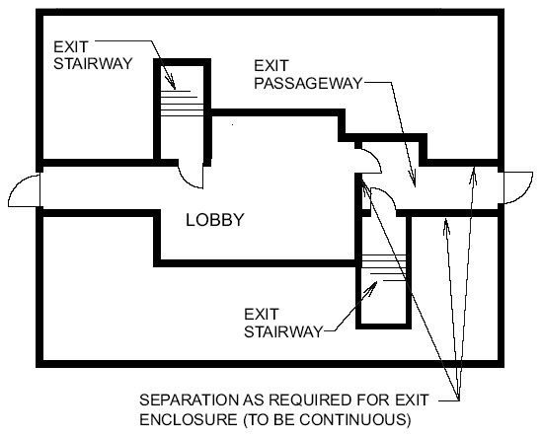
Exit Passageway

Slide 25
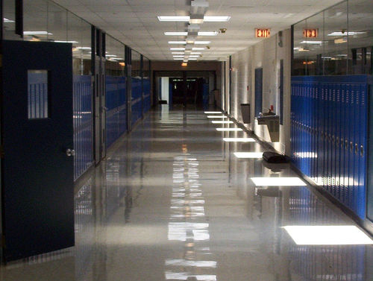
What is this?
P25

Slide 26
This is not an exit passageway. It is an exit access.

Slide 27
Means of Egress
Exit Access – leads from occupied portion to an exit
Exit – separated by fire-resistance-rated construction and opening protectives to provide a protected path of egress travel
Exit Discharge – between termination of an exit and a public way
Exit
Exit
Access
Exit Discharge

Slide 28
Exit / Exit Enclosure

Slide 29
Horizontal Exit
P29

Slide 30
Horizontal Exit

Slide 31
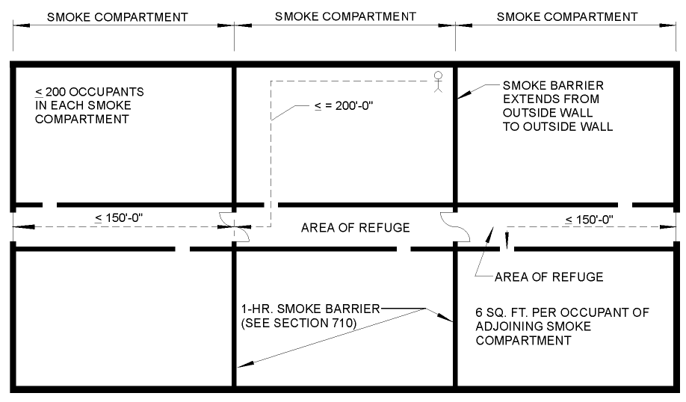
Horizontal Exit

Slide 32
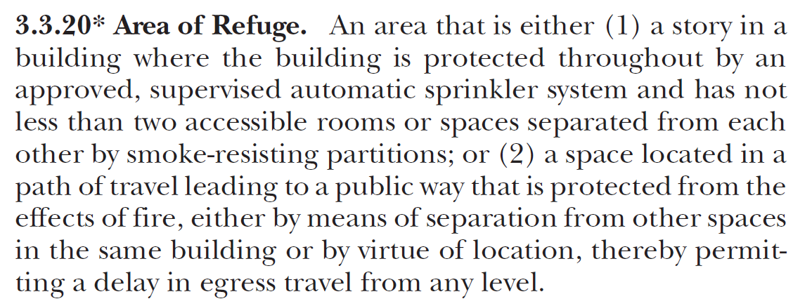
Area of Refuge
NFPA 101
IBC

Slide 33
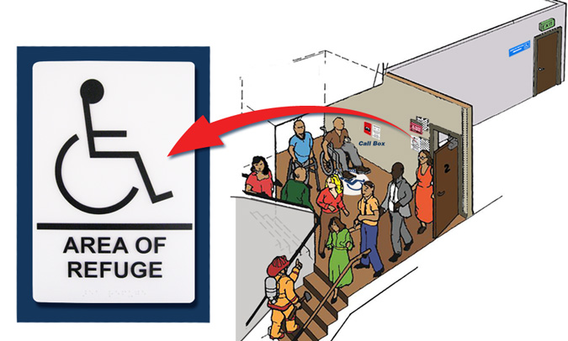
Area of Refuge

Slide 34
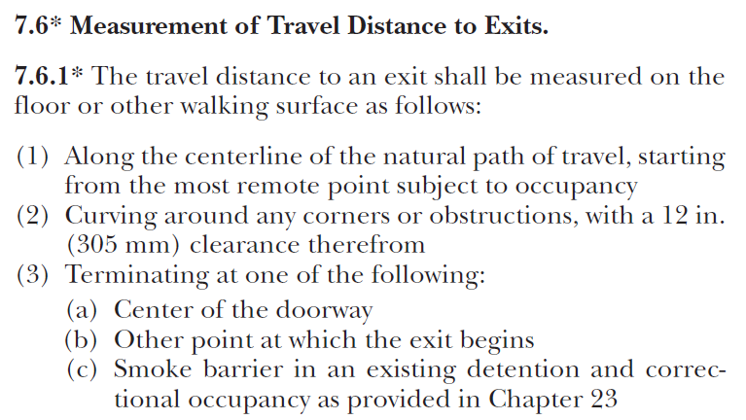
Travel Distance
Travel distance may end at the beginning of an exit, at an exit discharge, or at a horizontal exit.

Slide 35
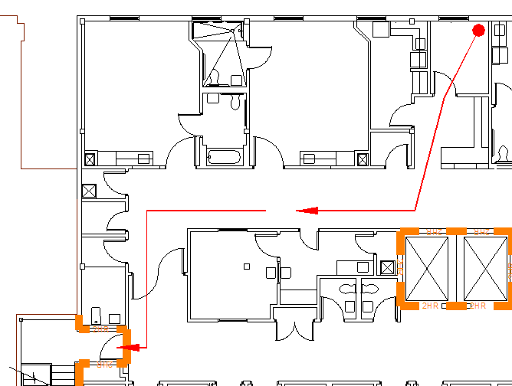
Travel Distance

Slide 36
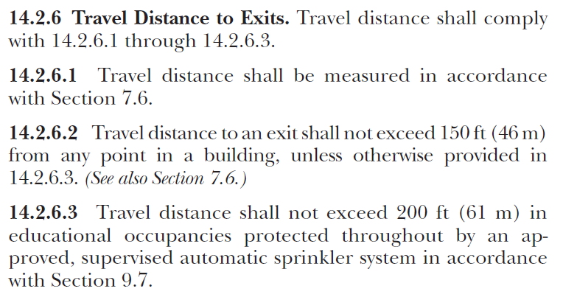
Example from New Educational Chapter

Slide 37
Question
What is the common path of travel?
Type in the chat box.

Slide 38
Common Path of Travel

Slide 39
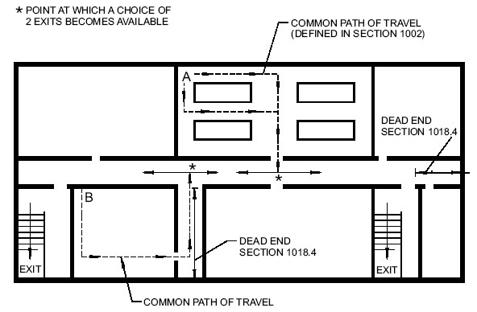
Common Path of Travel

Slide 40
Common Path of Travel Example from Existing Educational Chapter

Slide 41
Dead End Corridor
Ex:

Slide 42
Dead End Corridors
Ex:

Slide 43
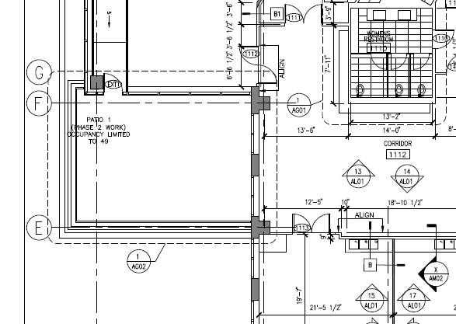
Courtyards, Terraces, and Roofs

Slide 44
Courtyards, Terraces, and Roofs

Slide 45
Readily Distinguishable
Means of egress doors must be visible.
No mirrors
No drapes
No decorations
No invisible doors!

Slide 46
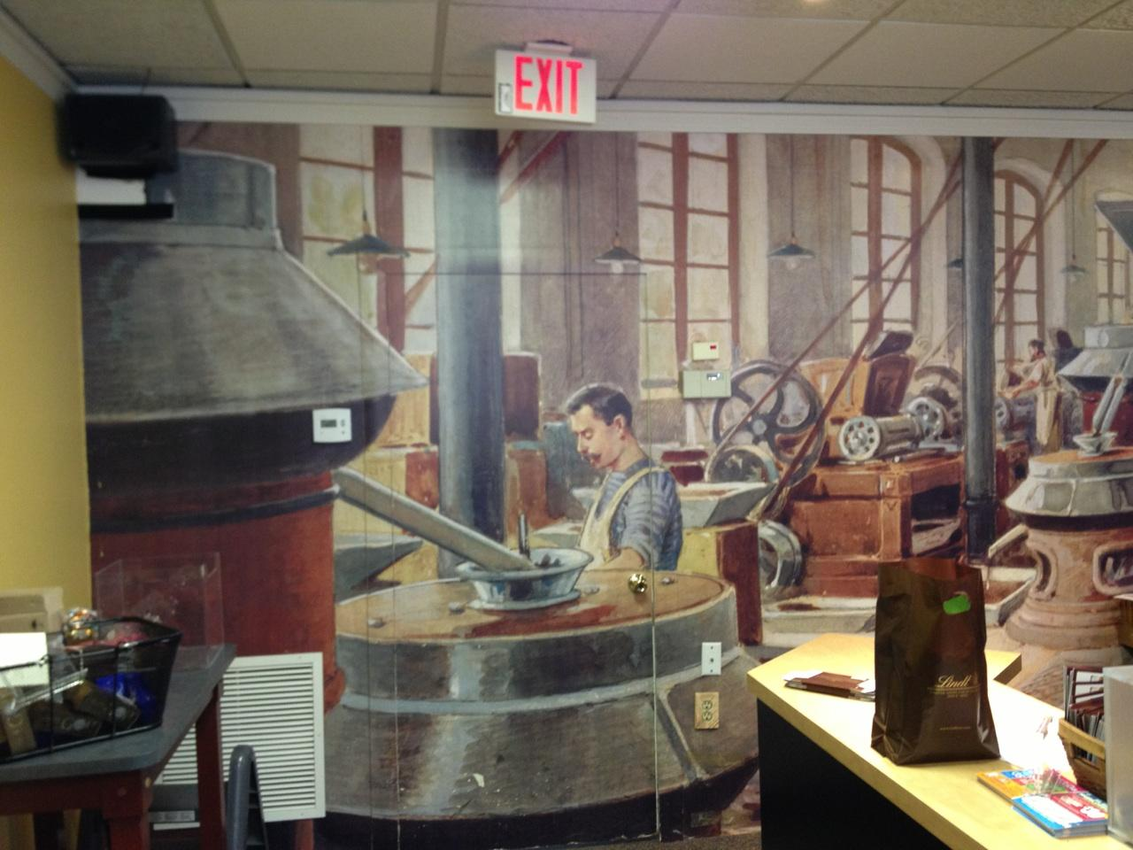

Slide 47
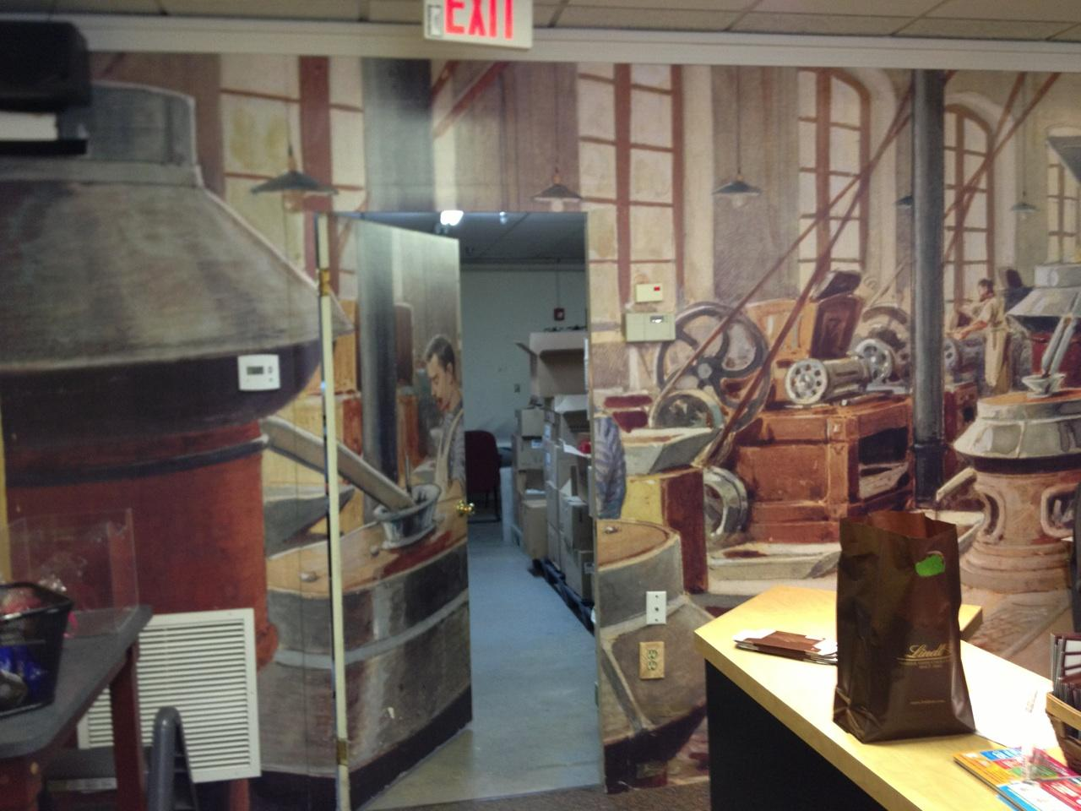

Slide 48
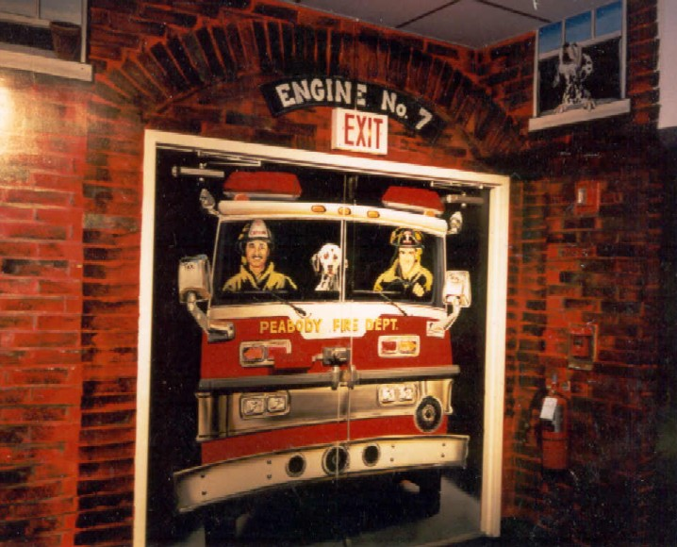

Slide 50
Luminous Egress Path Markings

Slide 51
Luminous Egress Path Markings
Not currently required by NFPA 101 occupancy chapters
Required by IBC in high-rise buildings in Group A – Assembly, B – Business, E – Educational, I – Institutional, M – Mercantile, and R-1 – Residential
Typically required on exit discharge doors – not on doors leading to the exit.
1” stripe around frame
Marking on or behind hardware
“Exit” in bottom 18” of door
Additional marking on stairs, walls, etc.

Slide 52
Size of Doors
32” clear width minimum
Measured with door open to 90 degrees
Between the face of the door and the stop
At least one leaf of a pair must comply
48” wide nominal max. (IBC/IFC only – not NFPA 101)
80” high nominal min.
78” to the closer arm

Slide 53
Question
The clear opening width of a newly-installed door measures 31”. What is a possible solution?
Type in the chat box.

Slide 54
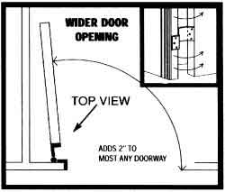
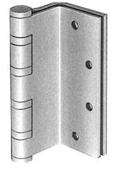
Swing Clear Hinges
May be used to gain more clearance on existing openings.

Slide 55
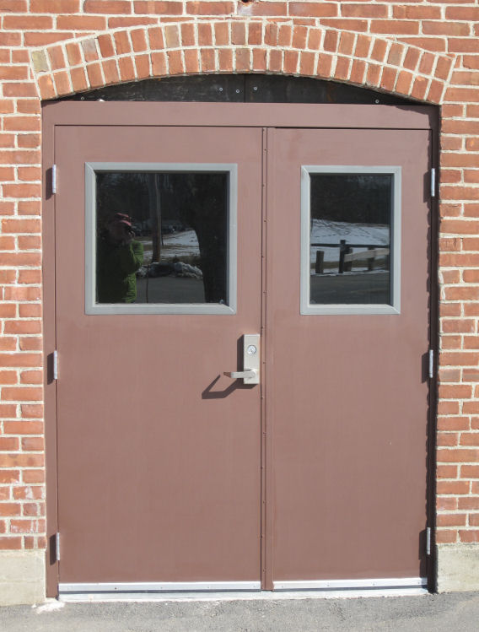

Slide 56
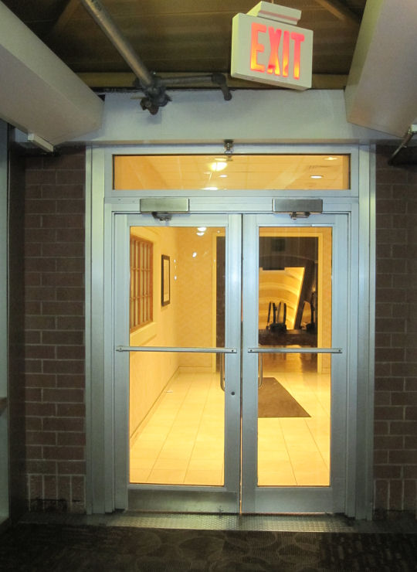

Slide 57
Projections Into Clear Width (IBC)
No projections into the required clear opening width lower than 34” above the floor.
Projections into the required clear opening width between 34” and 80” above the floor shall not exceed 4”.
4” Max.
No Proj.

Slide 58
Projections Into Clear Width (NFPA 101)
NFPA 101 limits the 4” projections to 34”-48” above the floor, hinge side only, only to address panic hardware.
4” Max.
No Proj.

Slide 59
32” clear min.
May not project more than 4” into the REQUIRED minimum clear width of 32”.

Slide 60
4’ wide door
32” clear
minimum
May not project more than 4” into the REQUIRED minimum clear width of 32”.

Slide 61
Question
When is a door required to swing in the direction of egress?
Type in the chat box.

Slide 62
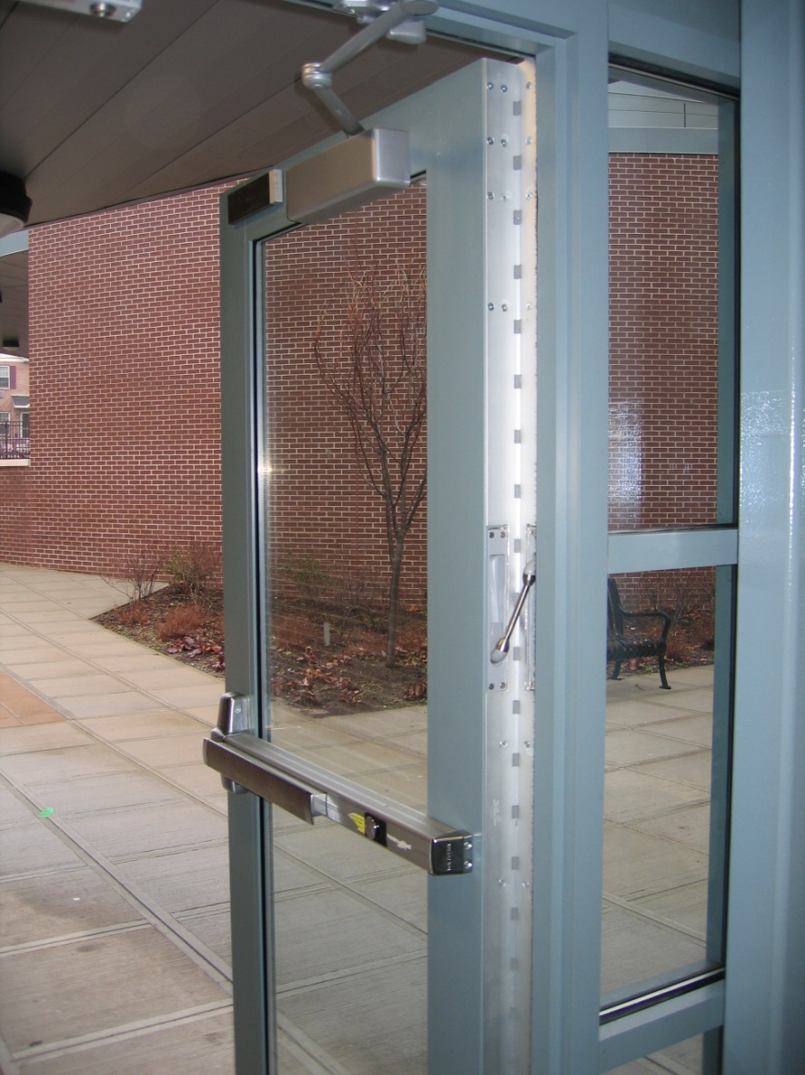
Door Swing
Egress doors shall be side-hinged swinging
Exceptions – consult code
Swing in the direction of egress:
When serving an occupant load of 50 or more
Group H occupancy

Slide 63
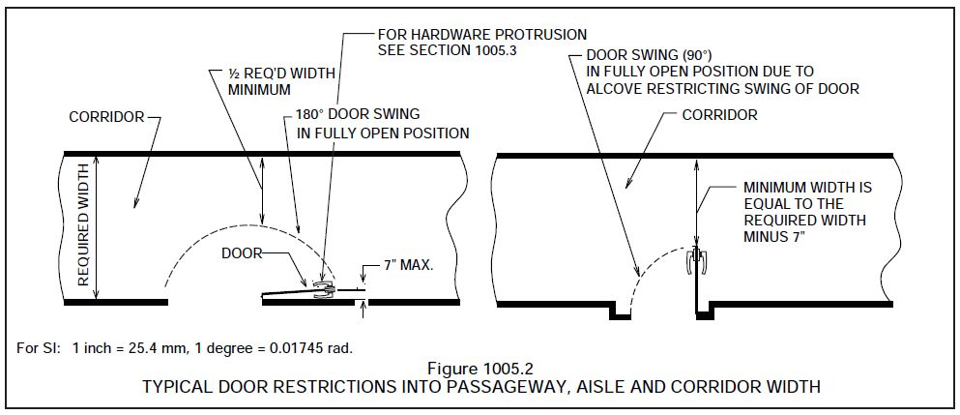
Encroachment
Must encroach no more than ½ of the required width at any point in door swing
7” maximum encroachment on required minimum width when fully open (be careful of cush closers and o.h. stops)

Slide 64
Encroachment
Must encroach no more than ½ of the required width at any point in door swing
7” maximum encroachment on required minimum width when fully open (be careful of cush closers and o.h. stops)

Slide 65
Door Opening Force
P65
Interior swinging egress doors (non-fire-rated) – 5 lbs
Other swinging doors + sliding and folding…

Slide 66
Door Opening Force
P66
Interior swinging egress doors (non-fire-rated) – 5 lbs
Other swinging doors + sliding and folding
15 pounds to release latch
30 pounds to set the door in motion
15 pounds to swing door to fully-open position

Slide 67
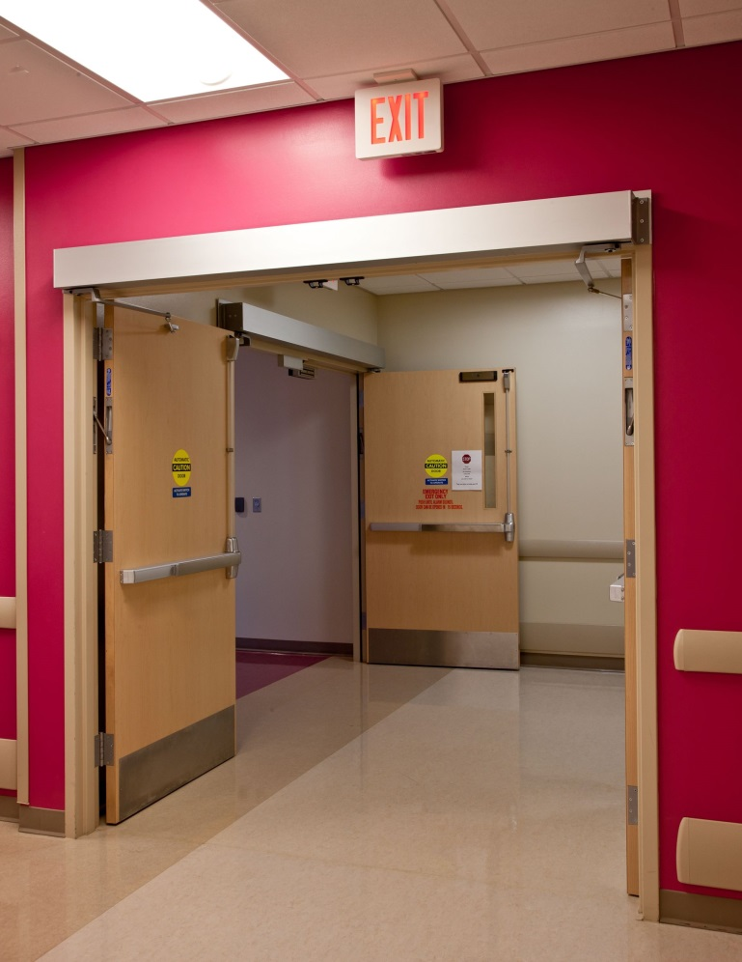
Power-Operated Doors
P67

Slide 68
Power-Operated Doors
In the event of a power failure:
15 pounds to release latch
50 pounds to set door in motion
30 pounds to open to fully-open position
Full-Power Operated - A156.10
Power-Assist and Low Energy - A156.19

Slide 69
Question
What are some of the rules for operating hardware on an egress door?
Type in the chat box.

Slide 70
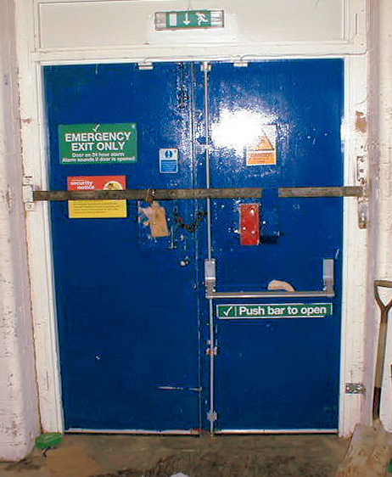
Door Operations
Readily openable
No key or special knowledge or effort

Slide 71
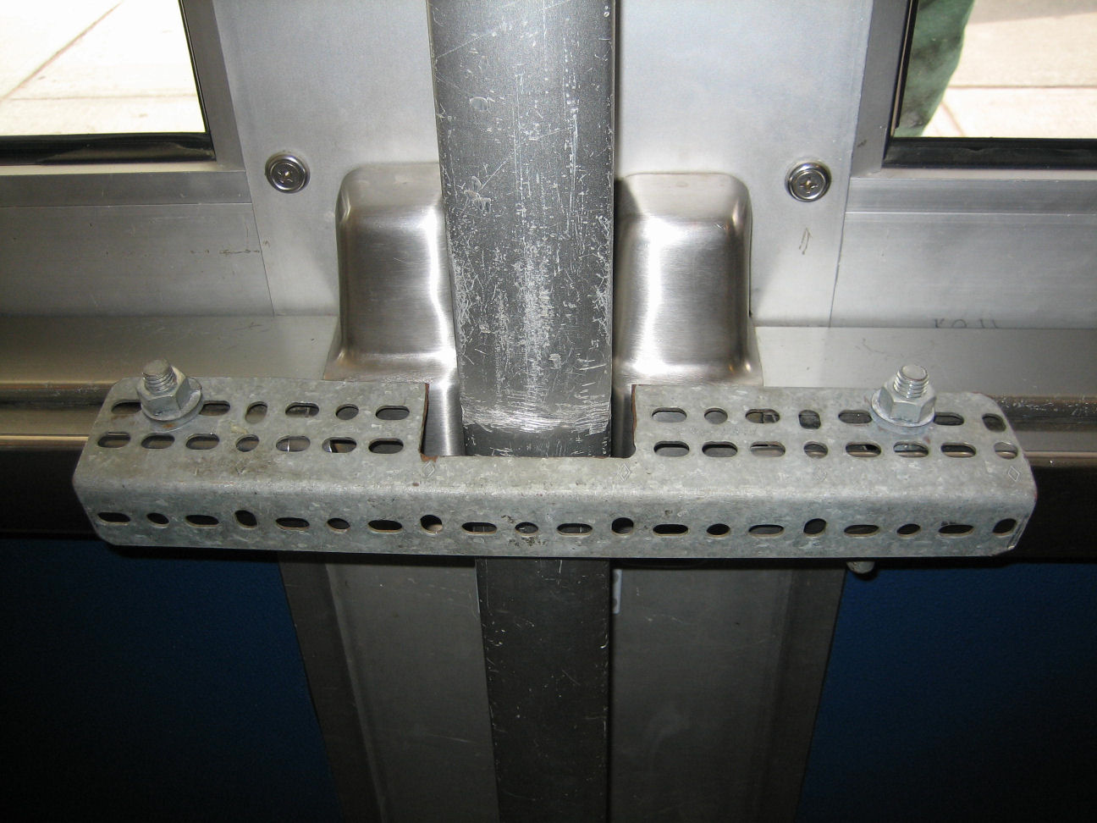

Slide 72
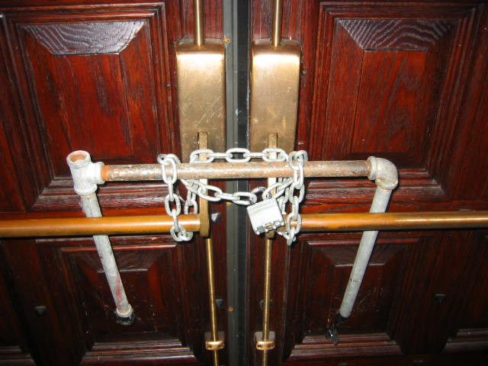

Slide 73
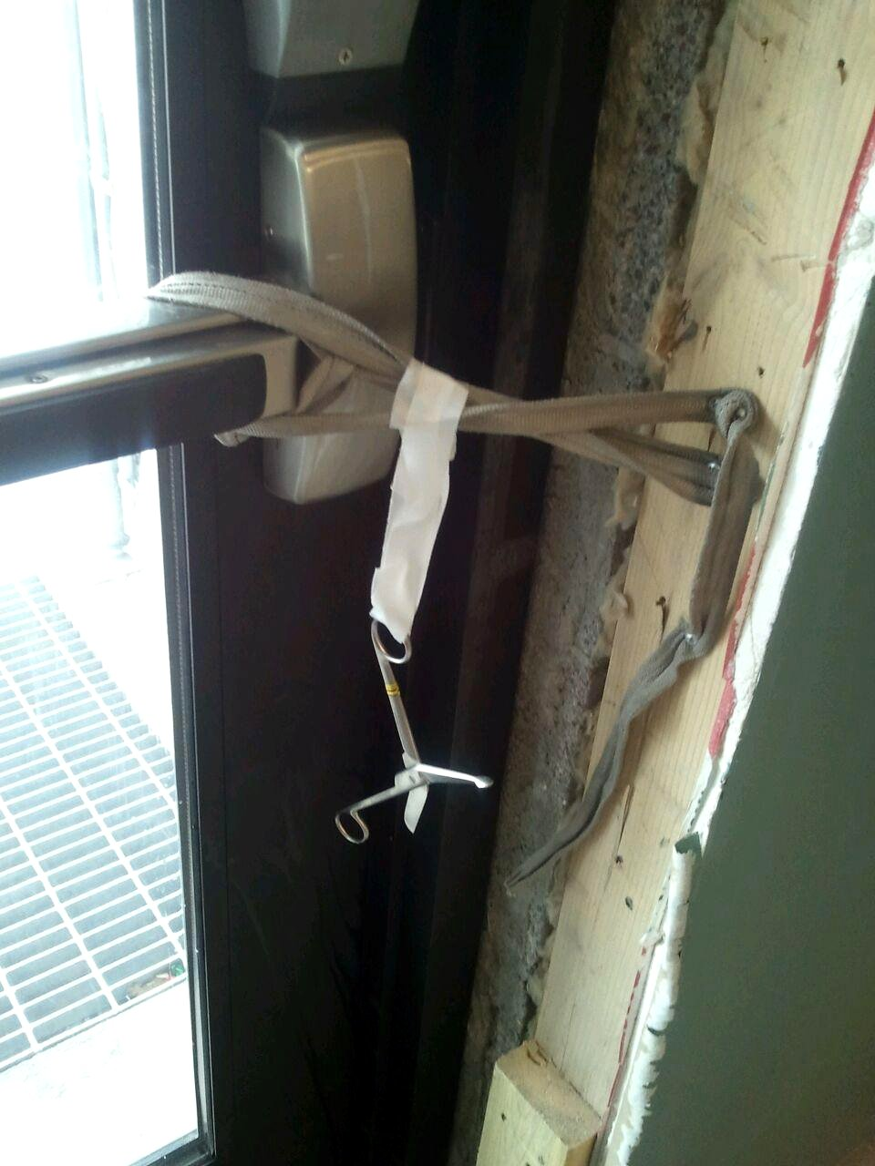

Slide 74
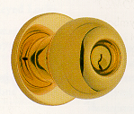
Hardware
Easy to grasp
Operable with one hand
No tight grasping
No tight pinching
No twisting of the wrist
YES!
NO!

Slide 75
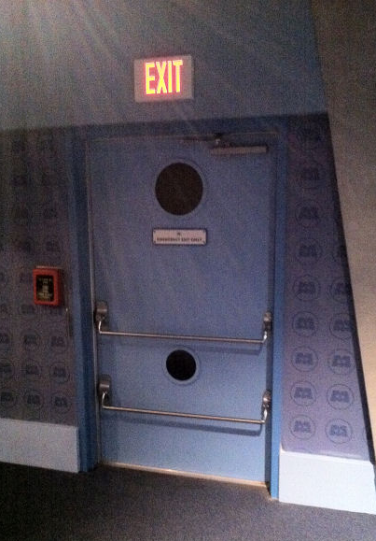
Hardware Height
Operating Devices
34” minimum AFF
48” maximum AFF
Locks used only for security purposes – any height

Slide 76
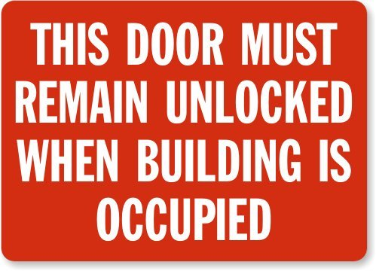
Locks & Latches
Permitted to prevent operation of doors where any of the following exists:
Places of detention or restraint
Use Group A with an occupant load of 300 or less, Groups B, F, M, and S, and in churches
Main exterior door
Key-operated locking from egress side
Locking device readily distinguishable as locked
Signage on or adjacent to door
Revocable by the building official for cause

Slide 77
Locks & Latches (continued)
Permitted to prevent operation of doors where any of the following exists:
Individual dwelling or sleeping units of Group R occupancies with an occupant load of 10 or less, one additional… (may vary by local code)
Nightlatch
Deadbolt
Security chain
No key or tool needed on egress side

Slide 78
Bolt Locks (IBC)
Manual flush bolts or surface bolts not permitted
Exceptions:
Doors not required for egress in dwelling units.
Storage or equipment rooms.
Group B, F, or S occupancy with an occupant load of less than 50.
Group B, F, or S occupancy where inactive leaf is not needed to meet egress width requirements and building is fully sprinklered.
Pairs at hospital patient rooms may have constant latching bolts.
No dummy hardware on inactive leaf.

Slide 79
Unlatching
Unlatching any leaf shall not require more than 1 operation
Exception:
Places of detention or restraint
Storage or equipment rooms
Automatic flush bolts
Individual dwelling units and guestrooms of Group R occupancies

Slide 80
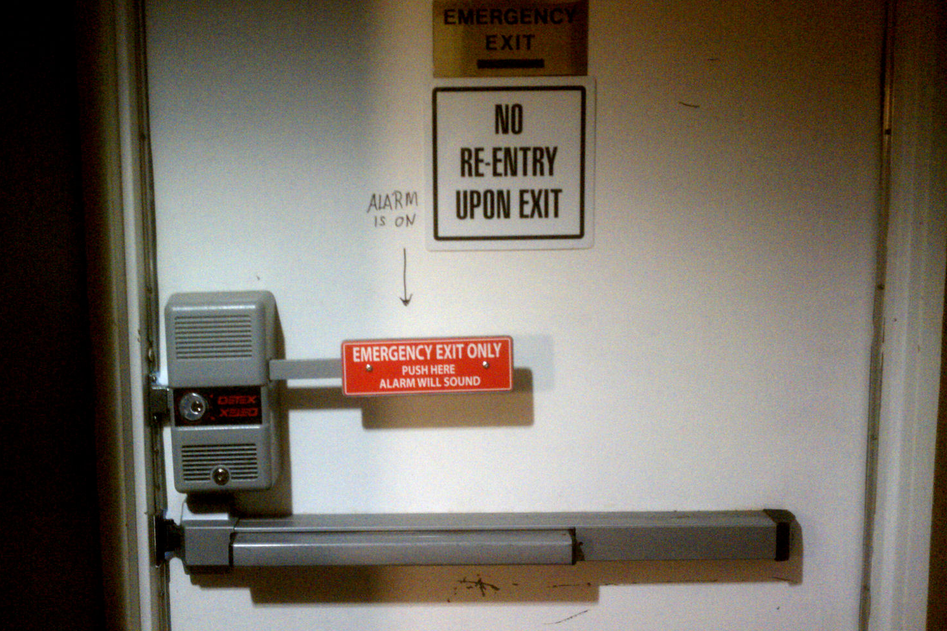

Slide 81
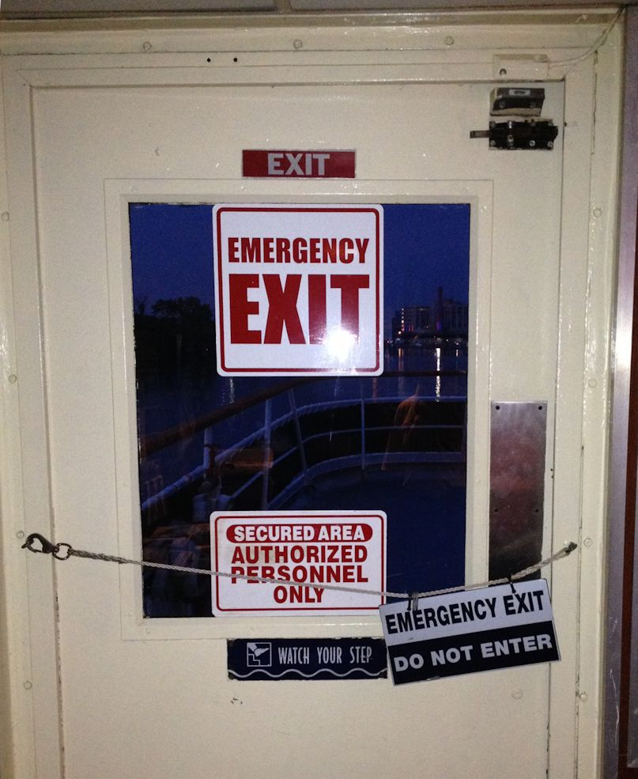

Slide 82
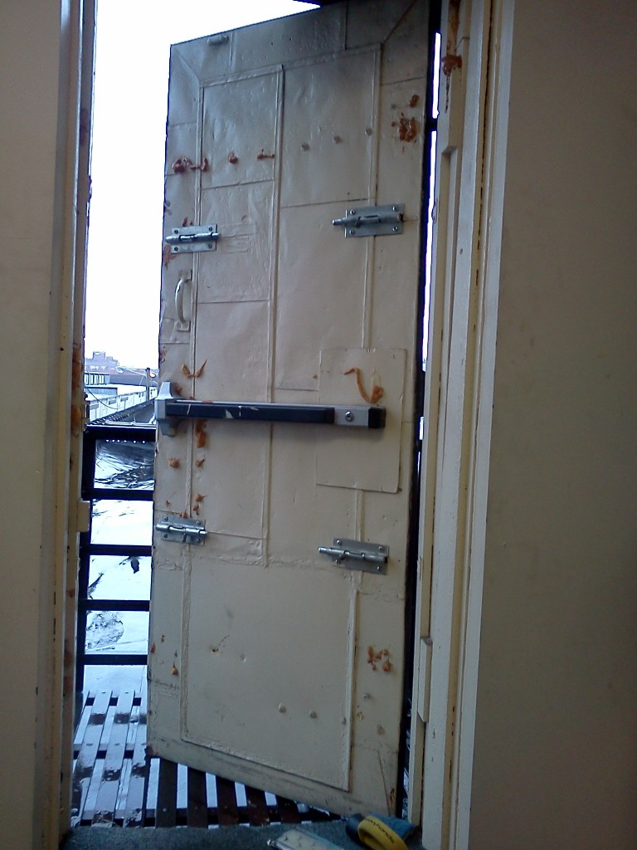
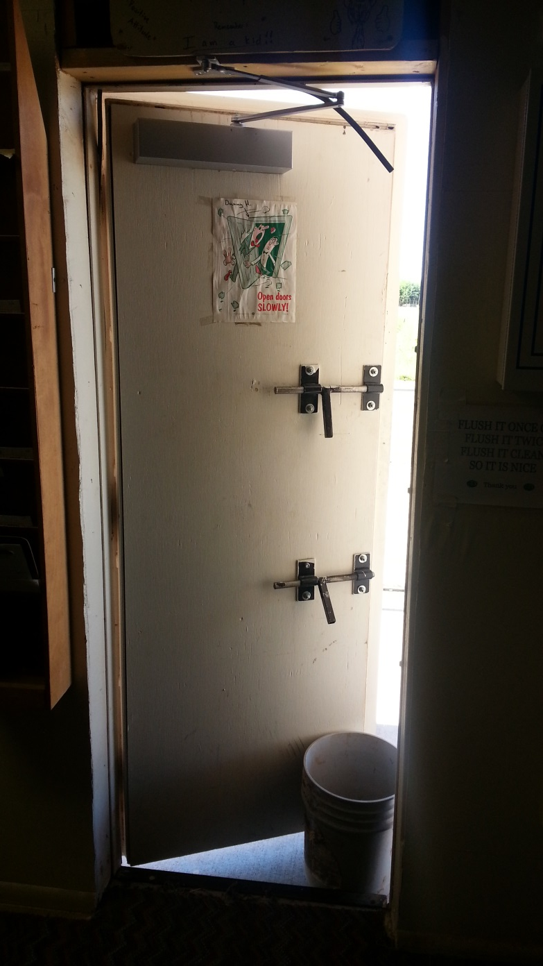

Slide 83
Panic and Fire Exit Hardware
touchpad style
crossbar style

Slide 84
Question
According to NFPA 101-2009, where is panic hardware required?
Type in the chat box.

Slide 85
Panic and Fire Exit Hardware
IBC 2006, 2009, 2012
Educational and Assembly Occupancies with an occupant load of 50 or more
All High Hazard Occupancies
IBC 2000, 2003
Educational and Assembly Occupancies with an occupant load of 100 or more
Some High Hazard Occupancies
NFPA 101 (all)
Educational, Assembly, and Day Care Occupancies with an occupant load of 100 or more
Some High Hazard Occupancies

Slide 86
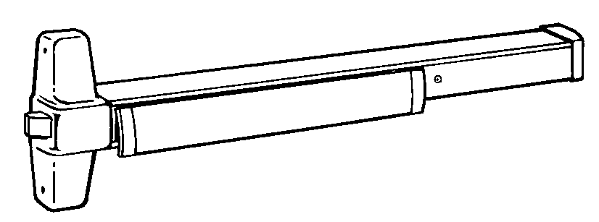
Panic and Fire Exit Hardware
Requirement for panic hardware applies to means of egress doors in these occupancy types which latch or lock.

Slide 87
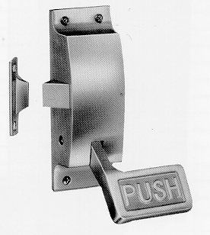
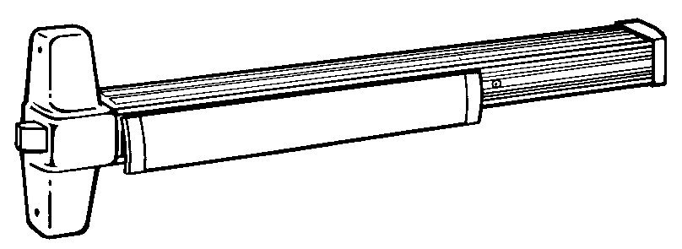
Panic and Fire Exit Hardware
Where panic hardware is required, actuating portion of device (touch-pad or cross-bar) must be at least half the width of the door.

Slide 88
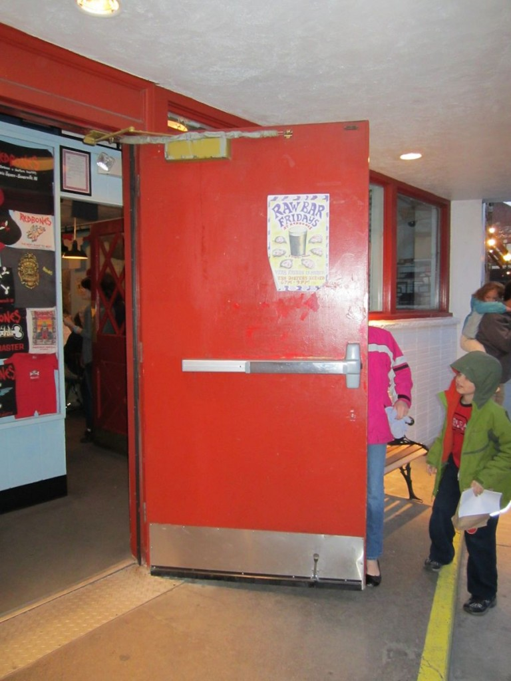

Slide 89
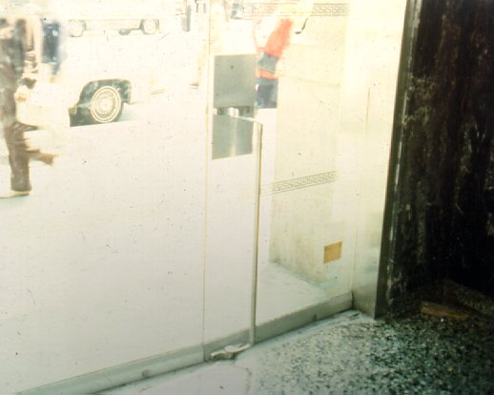

Slide 90
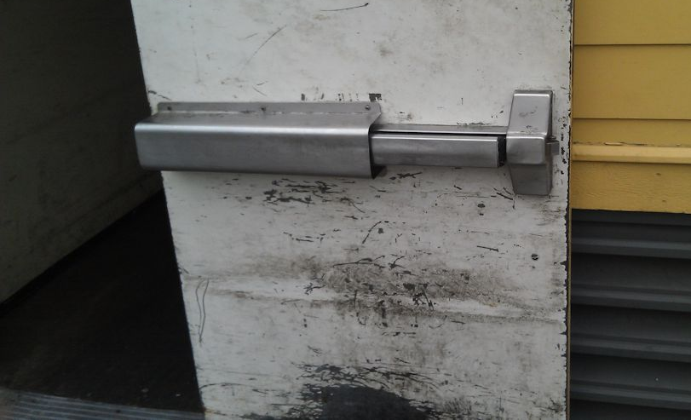
Is this acceptable? Type in the chat box.

Slide 91
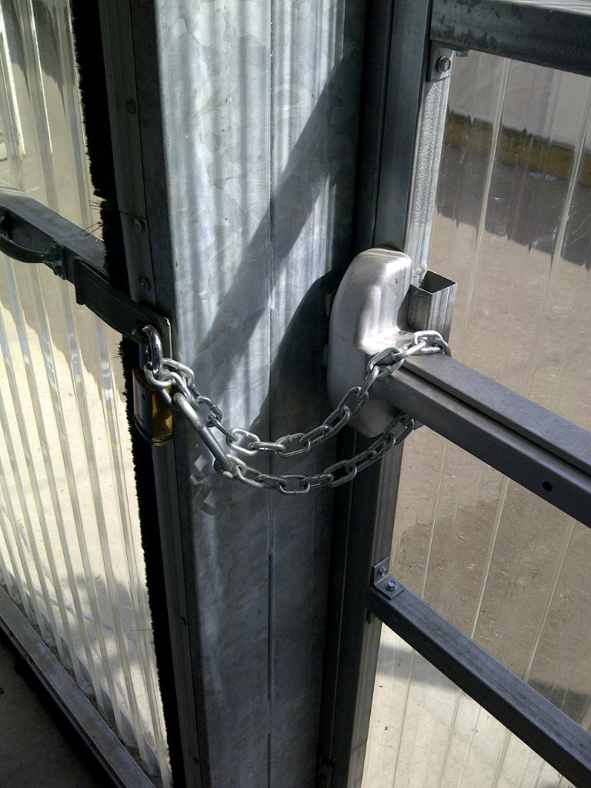
Panic and Fire Exit Hardware
15 pounds of force maximum to actuate
One motion to exit - no other locking/latching hardware

Slide 92
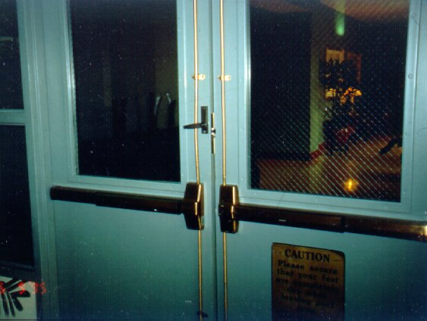

Slide 95
Panic and Fire Exit Hardware
P95

Slide 96
Panic and Fire Exit Hardware
Panic hardware used on balanced doors must be touchpad style (not crossbar) and touchpad must not extend more than half the width of the door.

Slide 97
Panic and Fire Exit Hardware
Panic hardware used on balanced doors must be touchpad style (not crossbar) and touchpad must not extend more than half the width of the door.

Slide 98
NFPA 70 National Electric Code
Rooms housing large equipment - 600 Volts, nominal or less, 1200 amperes or more (2014 NEC: 800 amps)
Rooms housing conductors and equipment used on circuits of over 600 Volts, nominal.
Transformer Vaults
Where the entrance has a personnel door(s), the door(s) shall open in the direction of egress and be equipped with panic bars, pressure plates, or other devices that are normally latched but open under simple pressure. (2014: “listed panic hardware”)

Slide 99
Glass and Glazing
Glass in fire doors was once exempt from impact-resistant requirements.
Glass in fire doors is no longer exempt per the IBC.
Traditional wired glass is extremely hazardous.
There is A LOT more information about glass on iDigHardware (click the Glass tab)

Slide 100
Session 3 – Life Safety
IBC – NFPA 101 – IFC
Occupancy Types – Use Groups
Occupied vs. Unoccupied
Opening Protectives
Means of Egress
travel distance, common path of travel, dead end corridors
clear width, projections, and door swing
opening force and auto operators
unlatching, bolts, hardware operation and height
panic hardware

Slide 101
Homework
Find at least one non-compliant egress door.
Photograph the issue and find the applicable paragraph in the 2009 IBC and 2009 NFPA 101 (ie. the paragraph that requires one motion to unlatch, or panic hardware, etc.).
Email photos and documentation to lori.greene@allegion.com.

Slide 102
P102

