Slide 1
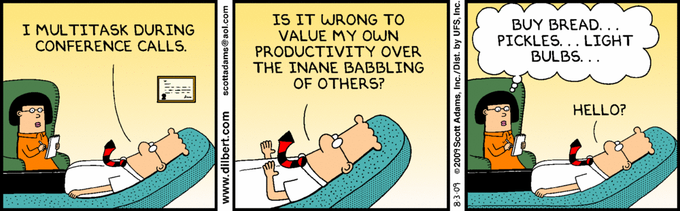
Decoded 1 – Intro & Accessibility Requirements
Audio: 866-430-4132, Code: 781-453-5306
Mute your phone (*6 to mute, #6 to unmute).
This webinar is being recorded.
Remember, you promised to pay attention.

Slide 2
Decoded 1 – Intro & Accessibility Requirements

Slide 3

Lori Greene, AHC/CDC, CCPR, FDAI
  Manager, Codes & Resources
  25+ years in the industry
  19 years with Allegion / IRST / rep
  Previous Positions
    Spec Team Lead – New England
    Specwriter
    Customer Service / Tech Support for manufacturer’s rep

Slide 4
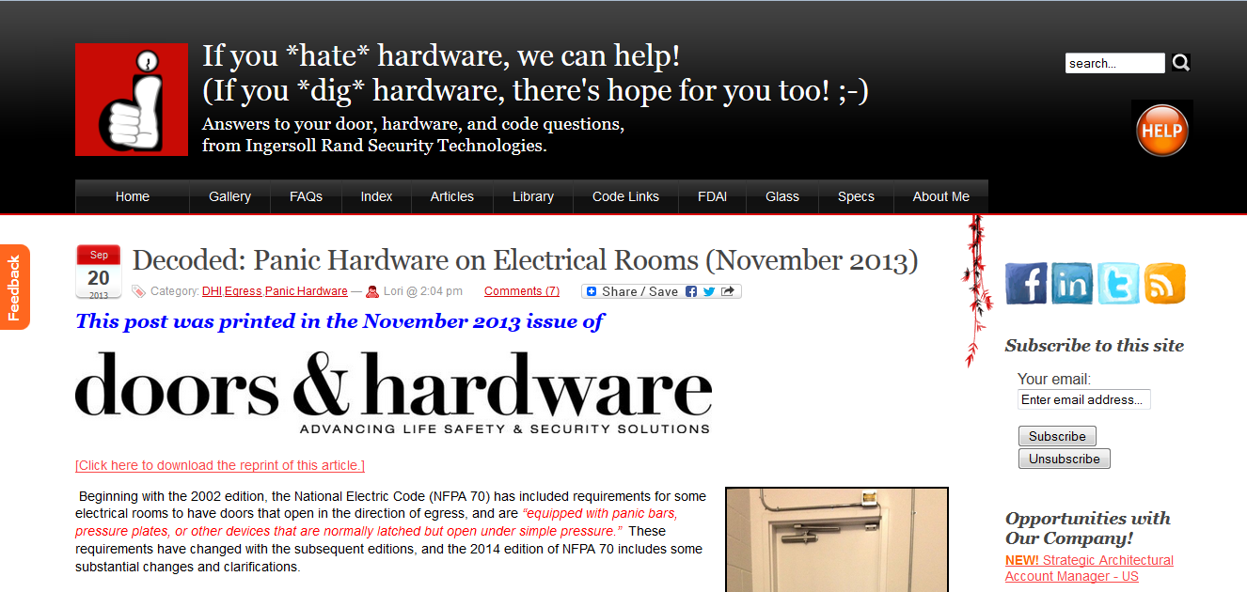
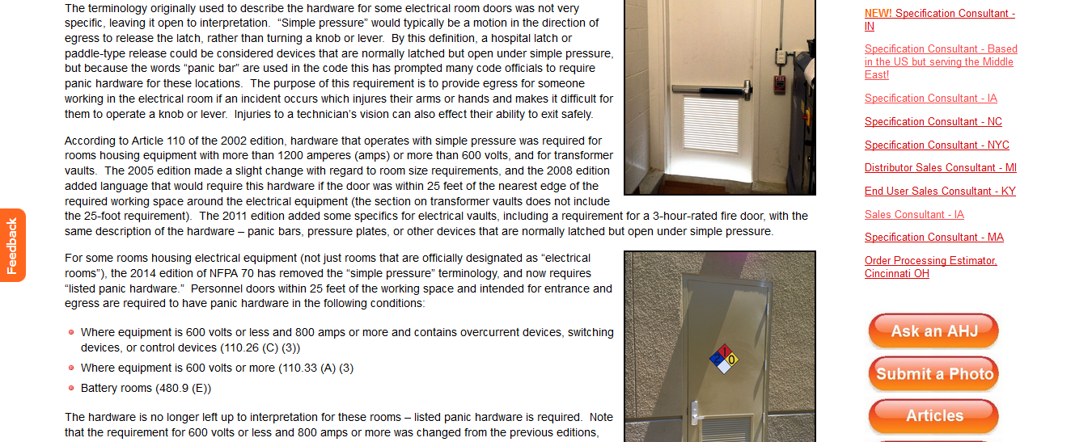
iDigHardware / iHateHardware.com
P4

Slide 5
Session 1 – Intro & Accessibility
Brief overview of some codes and standards which impact the door and hardware industry.
Who is the AHJ?
Resources for code information.
How codes affect our business.
Code development process and tragic fires that have shaped current codes.
Accessibility Requirements

Slide 6


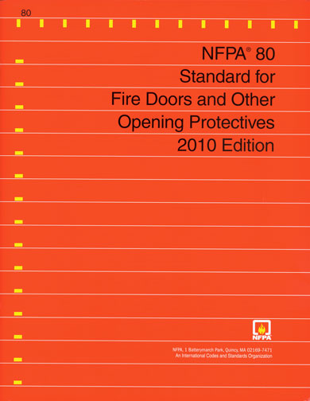
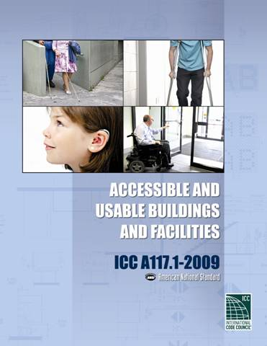
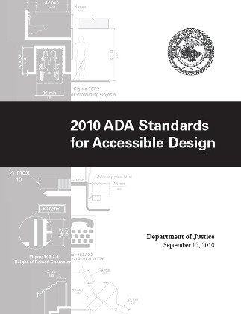
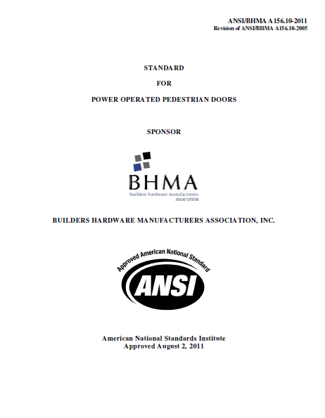
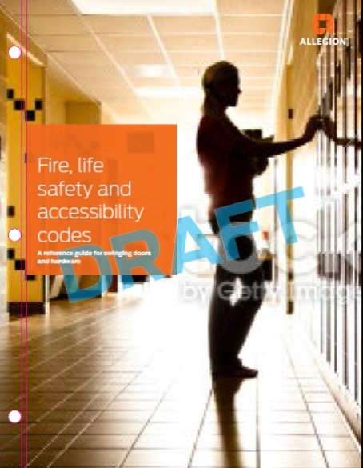
Which code / standard?

Slide 7
Which code / standard?
Know which code applies to the project’s jurisdiction.
COR140 exam will reference:
    2009 IBC
    2009 NFPA 101
    2009 A117.1
    2007 NFPA 80
Download the correct editions from Techstreet.
Mark them up so you can find the right section quickly and easily.
Allegion code booklet contains references for all editions.

Slide 8


Commentary / Handbook

Slide 9
Some state codes differ from the national codes discussed here.
Get familiar with your state code requirements!
P9

Slide 10
How codes affect our business…
The use of many products is code-driven:
    Panic hardware / fire exit hardware
    Fire doors, closers, positive latching
    Delayed egress locks
Codes affect the selection of almost every hardware item:
    Hinges, latches, closers, protection plates, gasketing
    Electrified hardware
    Fire doors

Slide 11

Authority Having Jurisdiction (AHJ)
Building Inspector
Fire Marshal
Insurance Inspector
Joint Commission (hospitals)
Health Inspector
Electrical Inspector
Others

Slide 12
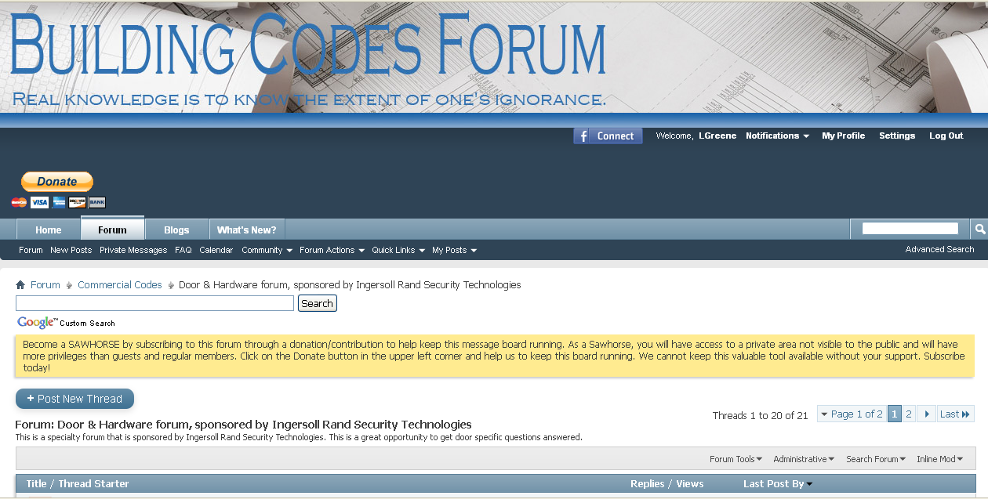
Building Codes Forum
Thousands of members, many AHJs
We have our own forum – Door & Hardware Forum

Slide 13
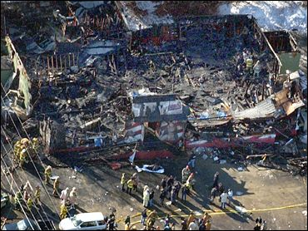
Code change is often prompted by tragedy
Iroquois Theater Fire (1903)
    603 killed
Triangle Shirtwaist Factory (1911)
    146 killed
Cocoanut Grove (1942)
    492 killed
Station Nightclub (2003)
    100 killed
Many other fires

Slide 14
Why do we have codes?
Without enforceable codes we would have more tragedies like these.
People who did not comply with the requirements would not be held accountable.
We learn from the past and make code changes to avoid these problems in the future.

Slide 15
Code Development Process
Prior to 2000, there were 3 model codes in the US – now called the Legacy Codes
    BOCA National Building Code
    UBC Uniform Building Code (aka ICBO)
    SBCCI Standard Building Code
Organizations worked together to create the 2000 International Building Code.
NFPA also publishes a building code – NFPA 5000.

Slide 16
Code Development Process
Codes and standards are typically revised every 3 years.
Anyone can submit a code change proposal.
Proposals are approved, disapproved, or modified at the code hearings.
The public may comment on the changes.
I participate through the BHMA Codes & Government Affairs Committee

Slide 17
Accessibility
A117.1 vs. ADA vs. Others
Clear Width
Maneuvering Clearance
Hardware & Thresholds
Closing Speed & Opening Force
Flush Bottom Rail
Vision Lite Location

Slide 18
Accessibility Standards
P18
A117.1 – Accessible and Usable Buildings and Facilities
ADA – Americans with Disabilities Act Standards for Accessible Design
UFAS – Uniform Federal Accessibility Standards
Fair Housing Act
State Standards
Others

Slide 19
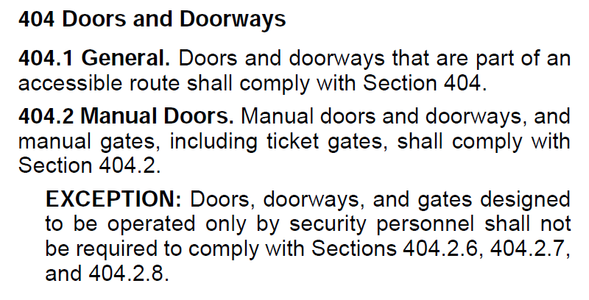

Slide 20
Clear Opening Width
P20

Slide 21
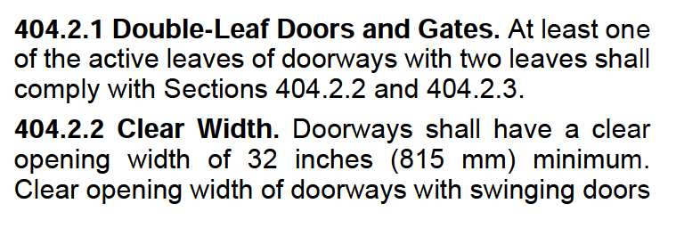
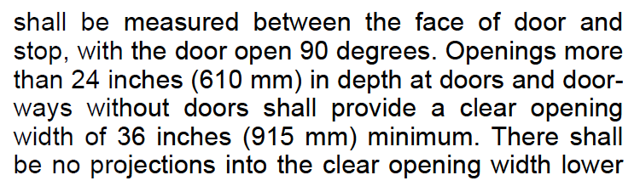
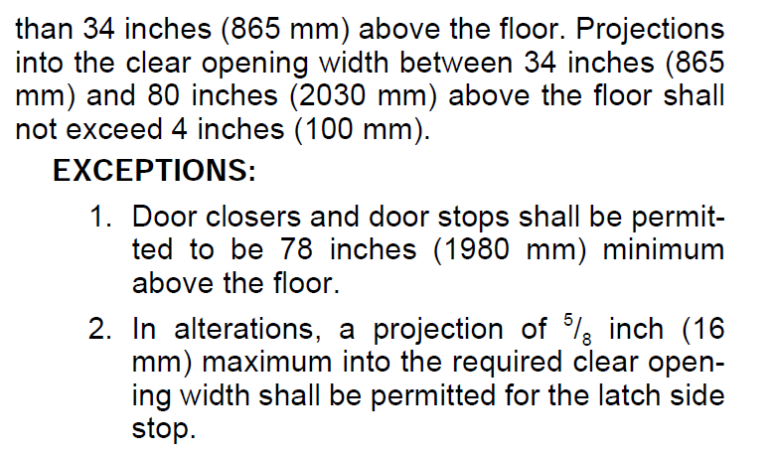

Slide 22
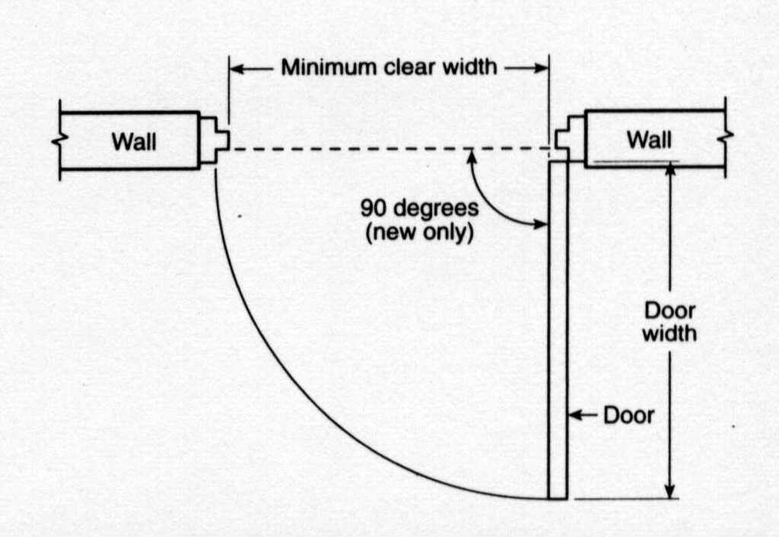
Swing clear
hinges can help
increase the clear
opening width.

Slide 23
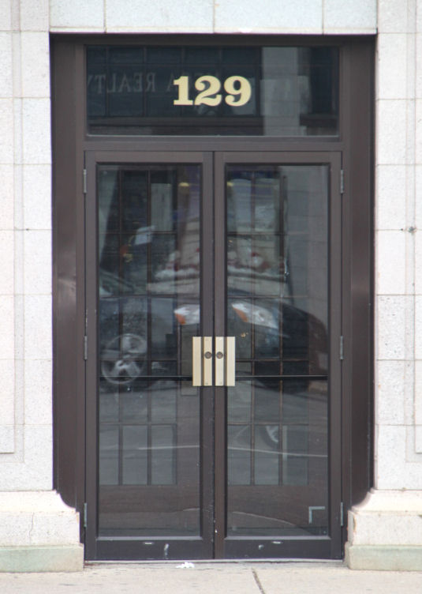
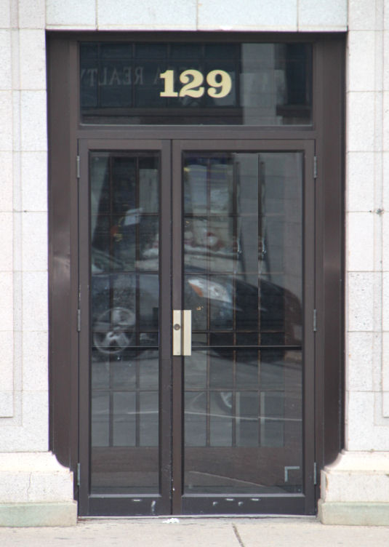
5’ equal pairs are
not compliant
At least one leaf must provide 32” clear measured from face of door open at 90 degrees to edge of inactive leaf.

Slide 24
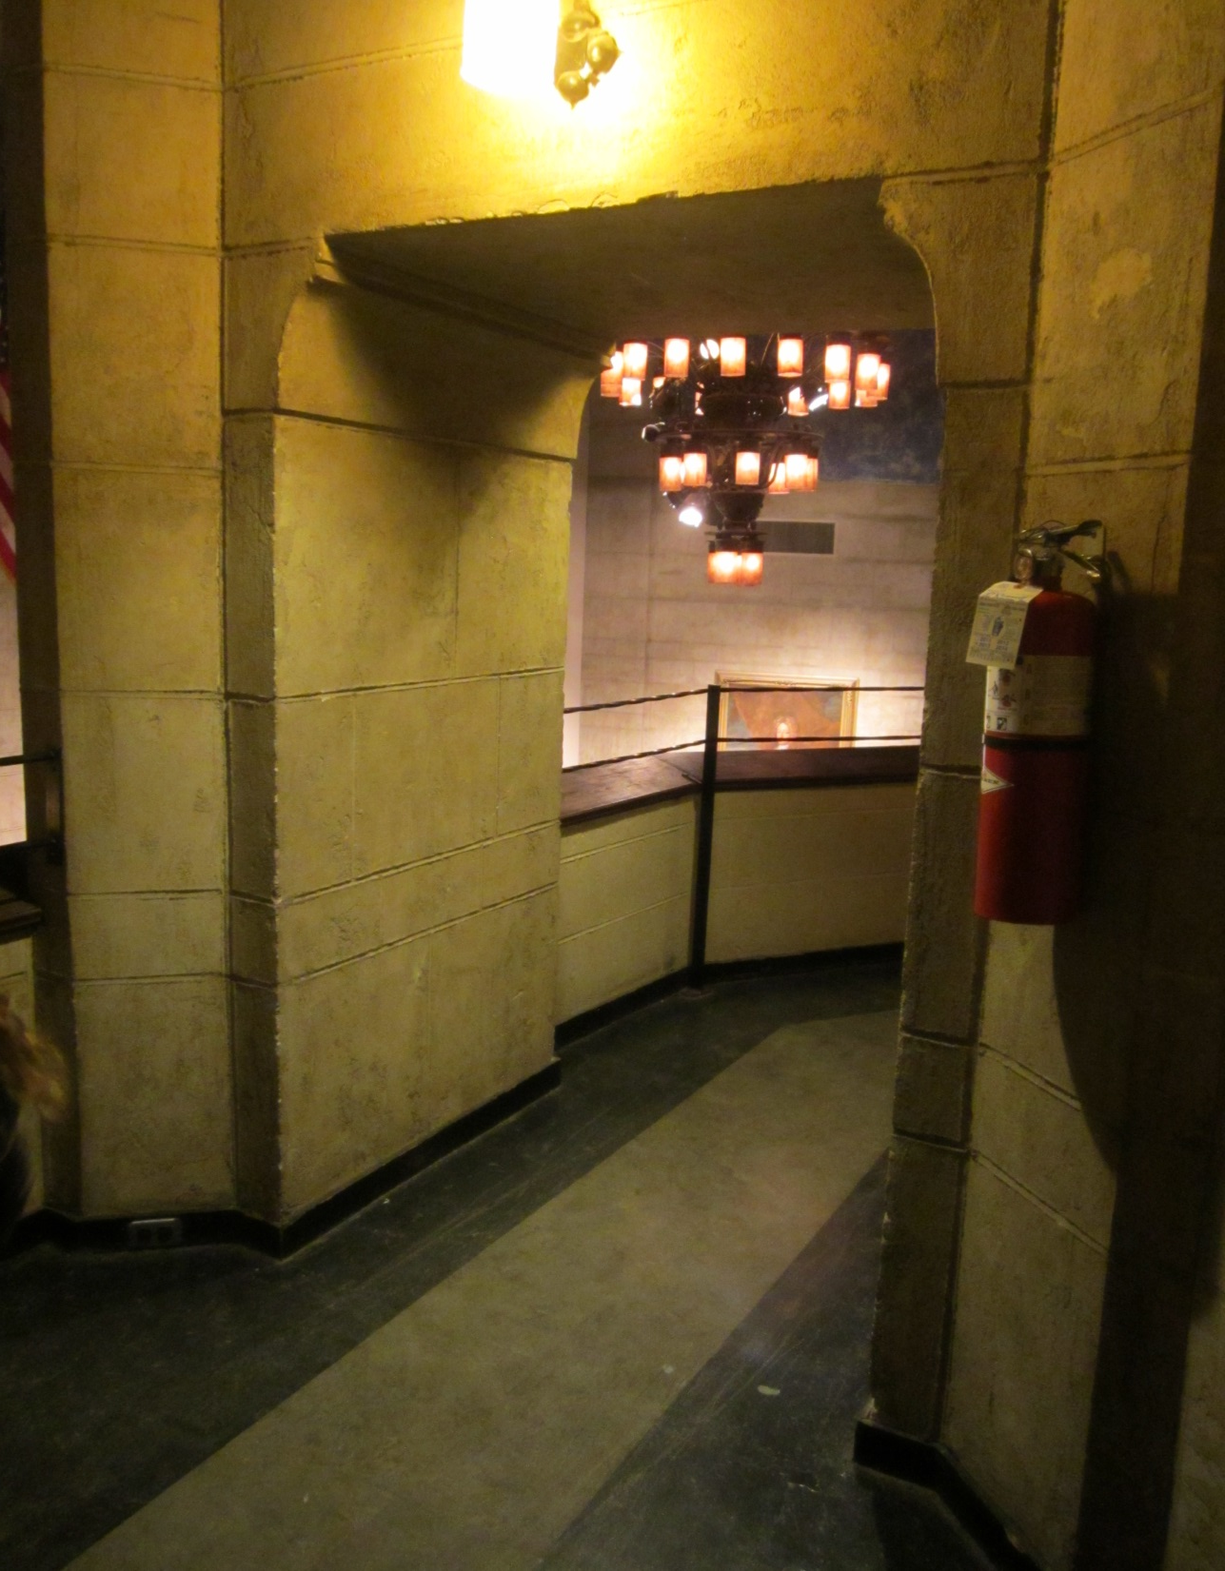
>24” deep
36” minimum

Slide 25

Projections Into Clear Width
No projections into the required clear opening width lower than 34” above the floor.
Projections into the required clear opening width between 34” and 80” above the floor shall not exceed 4”.
4”Max.
No Proj.

Slide 26
32” clear min.
May not project more than 4” into the REQUIRED minimum clear width of 32”.

Slide 27
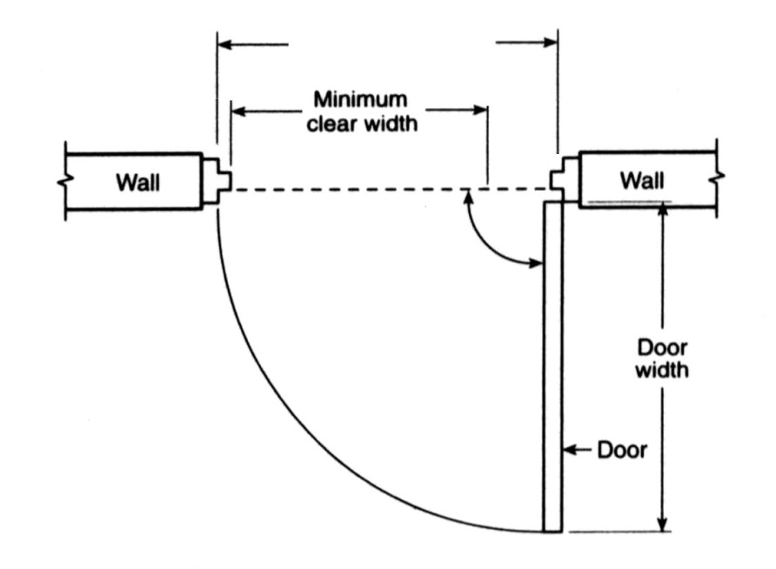
4’ wide door
32” clear
minimum
May not project more than 4” into the REQUIRED minimum clear width of 32”.

Slide 30
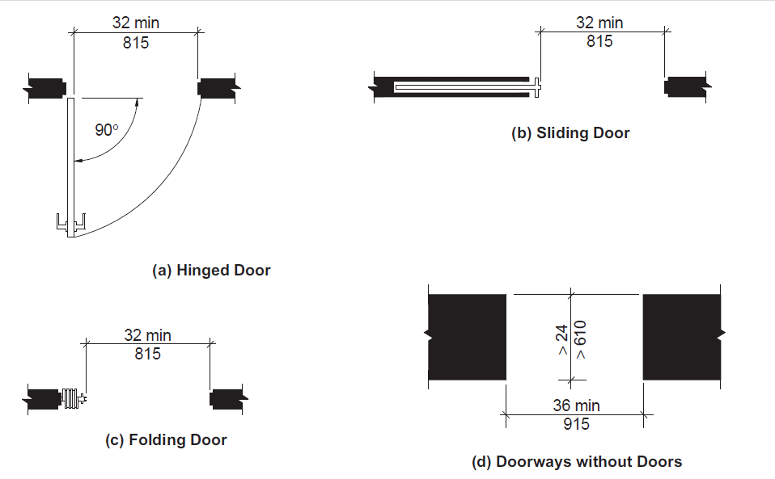

Slide 31
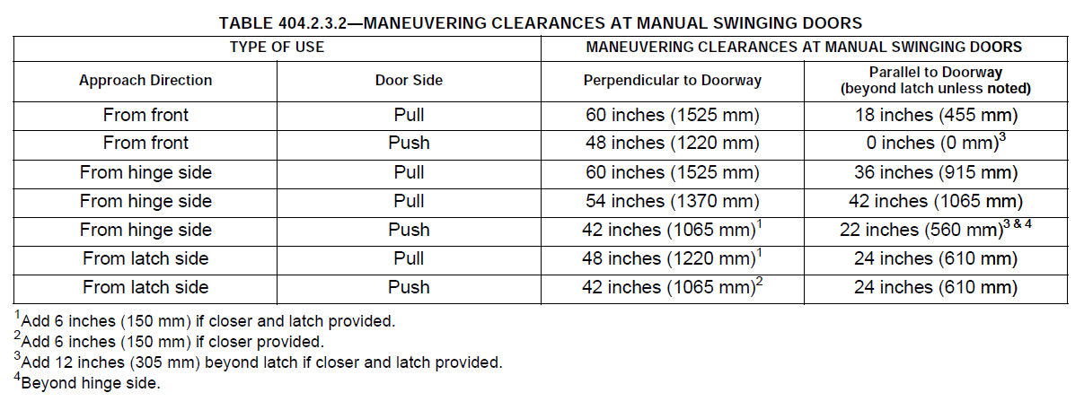
Maneuvering Clearance

Slide 32
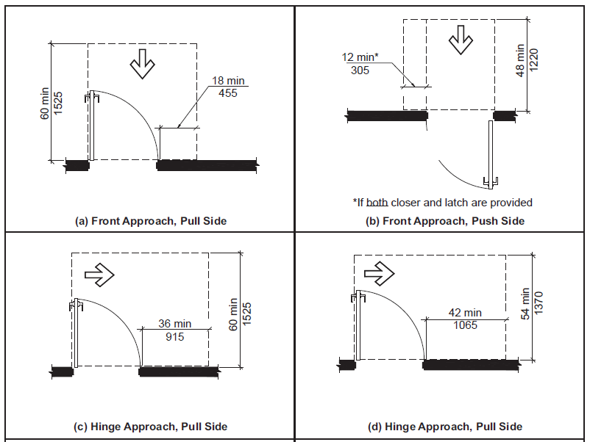

Slide 33
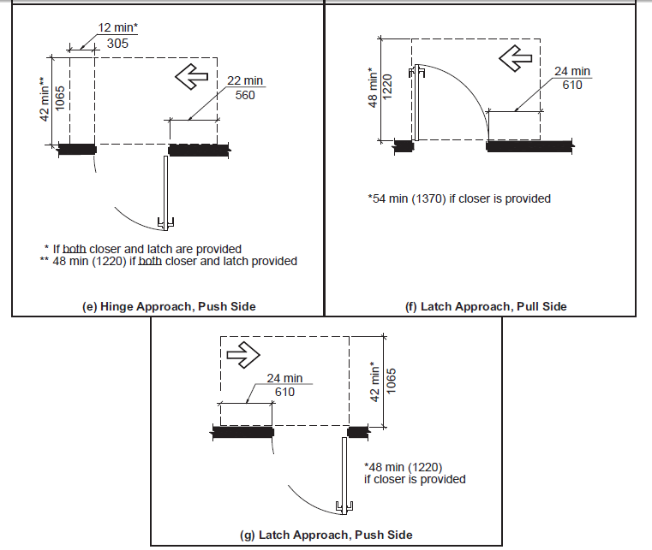

Slide 34
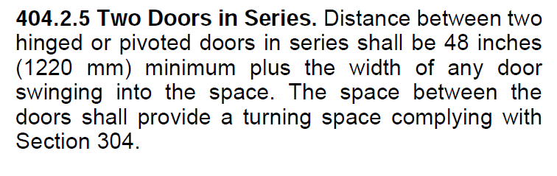
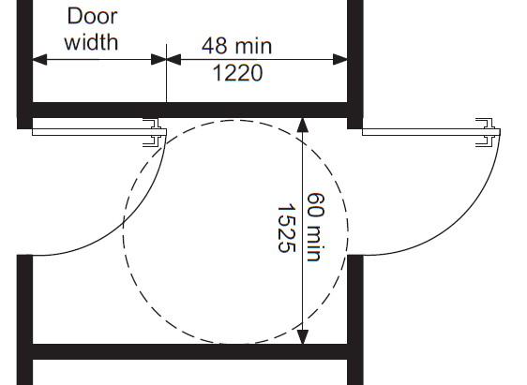

Slide 35
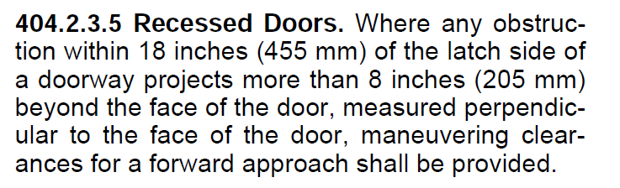
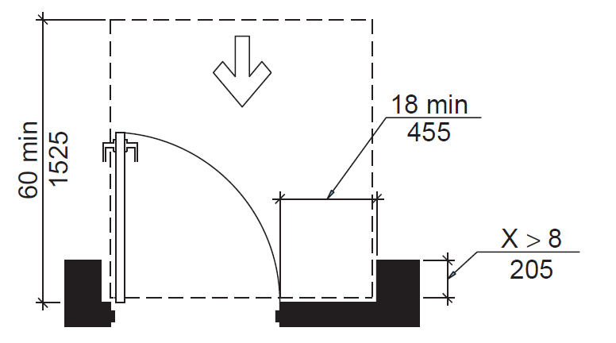

Slide 36
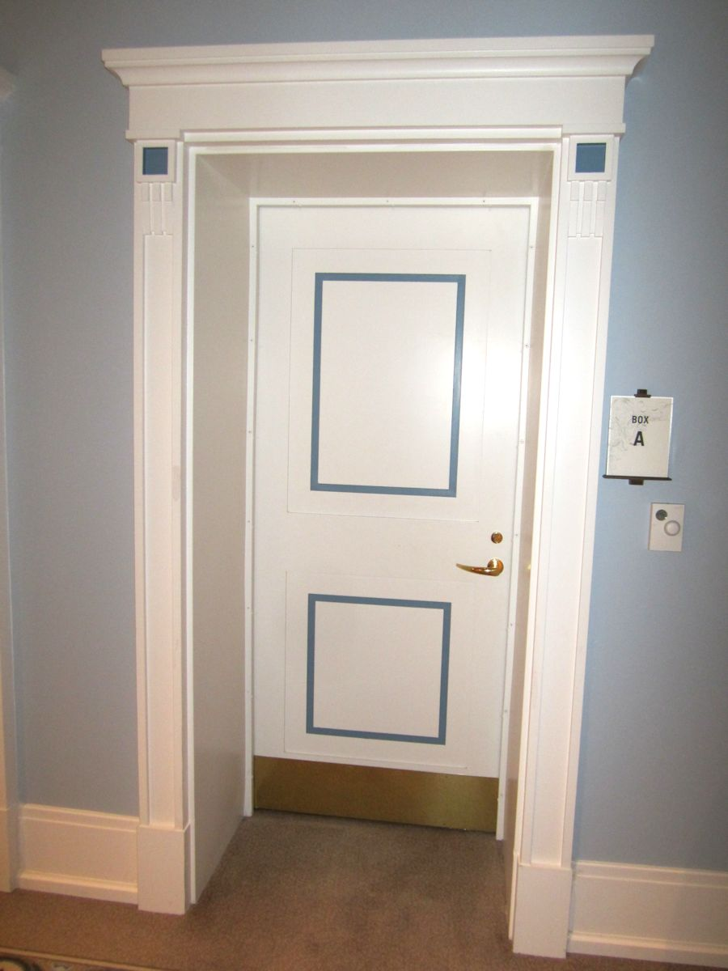
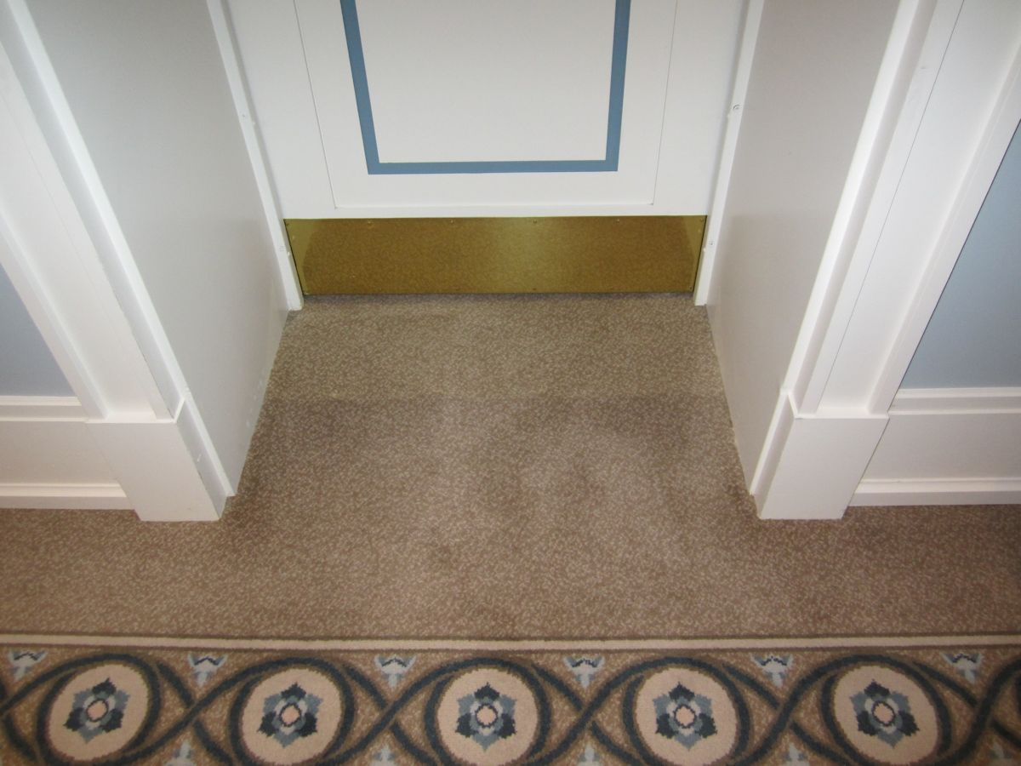

Slide 38
Thresholds
P38

Slide 39
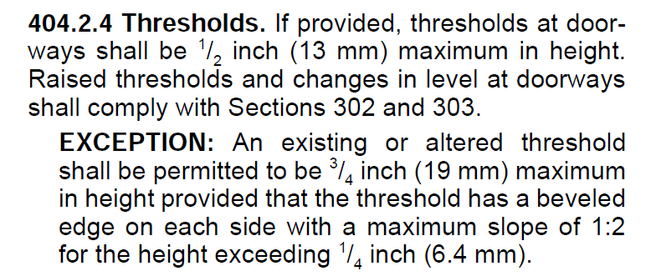
Threshold
Ramp

Slide 40
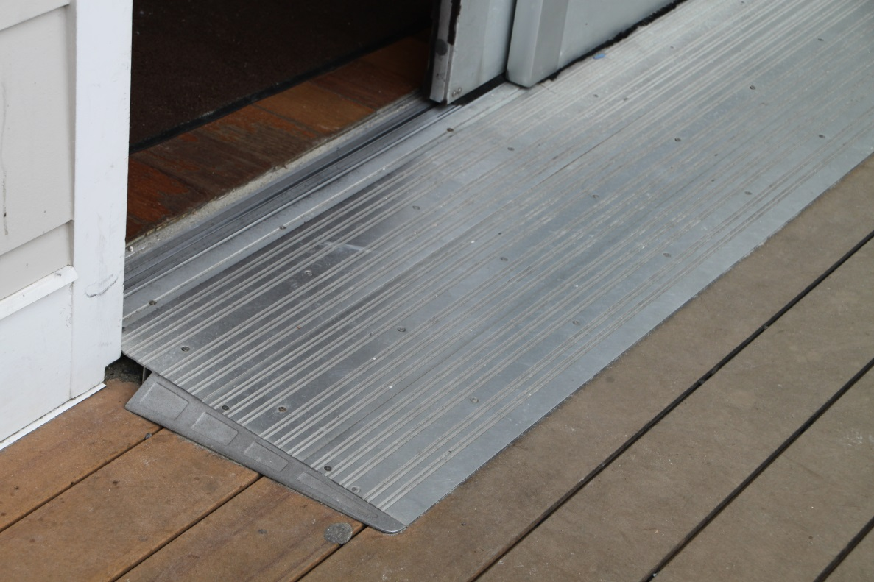
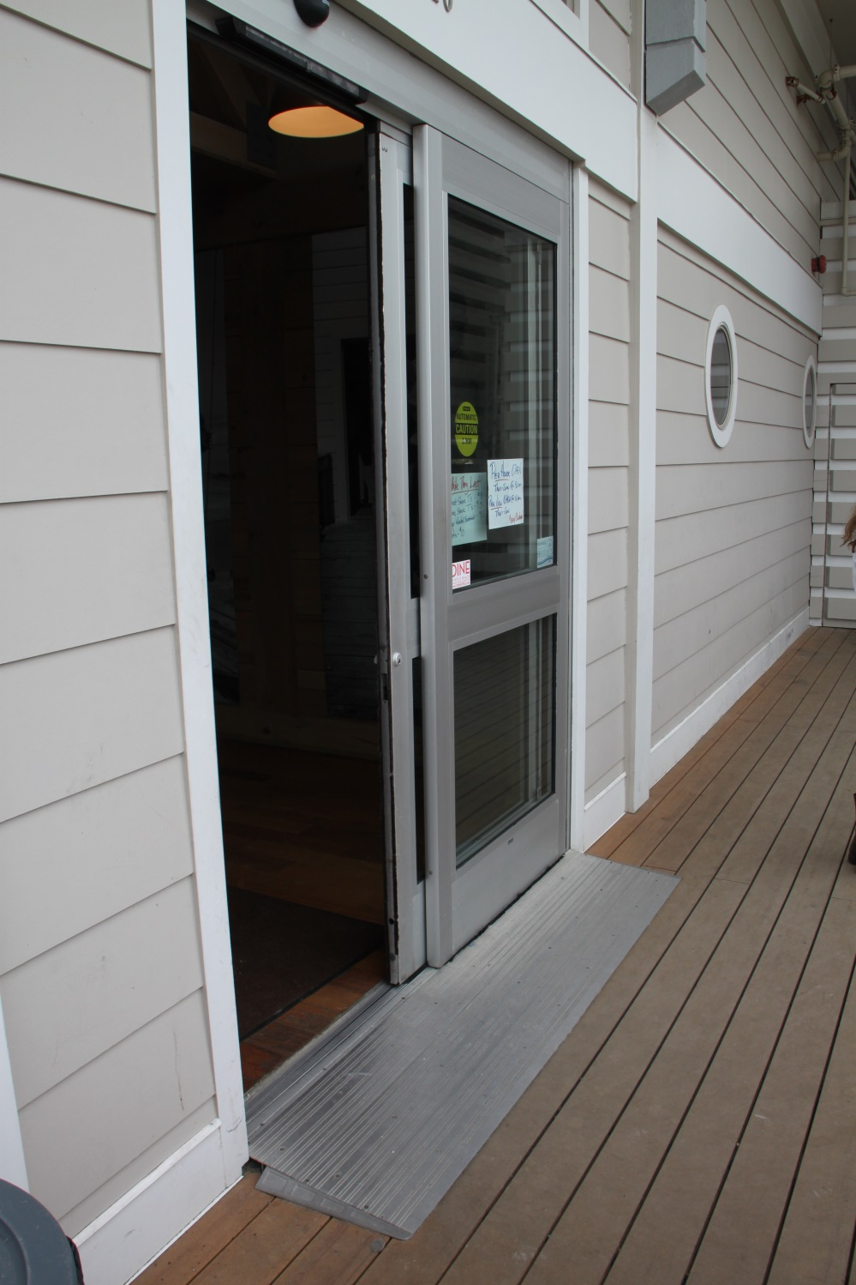

Slide 41
Door Hardware
P41

Slide 42
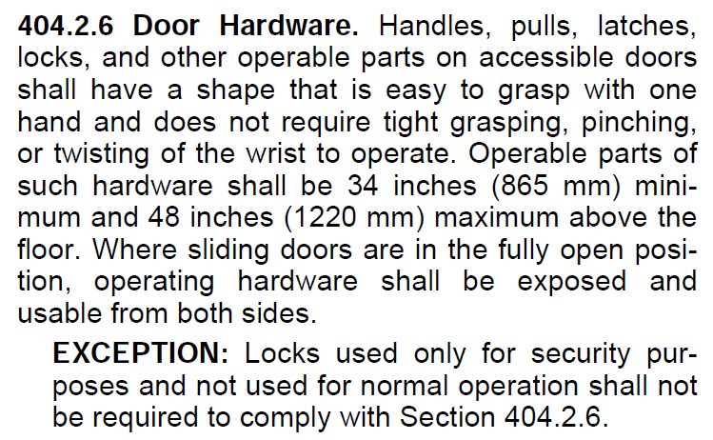

Slide 43
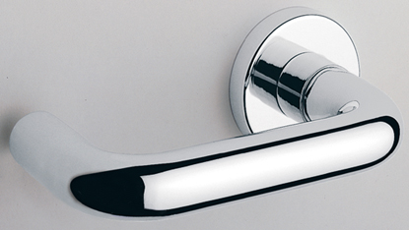
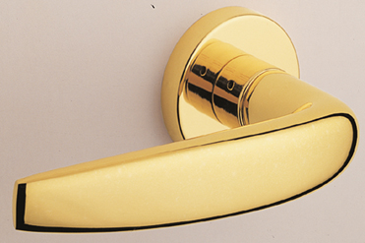
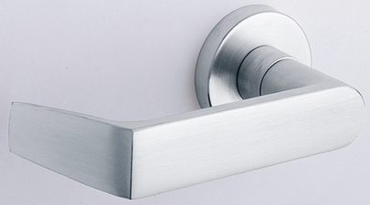
Lever Handles
In California, the lever has to return to within ½” of the face of the door.

Slide 44
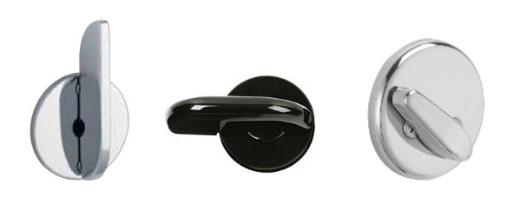
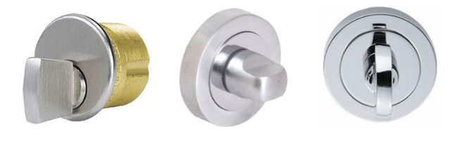
Thumbturns
Size is not specified by the standards.
No grasping, tight pinching, or twisting the wrist.
Accessibility standards are not specific.
GOOD
???

Slide 45
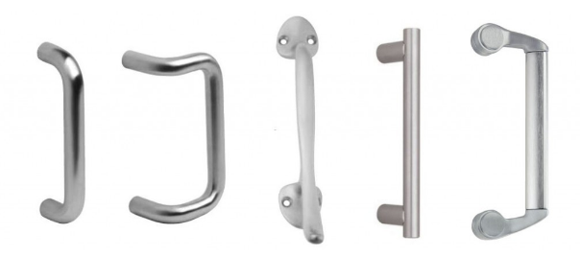
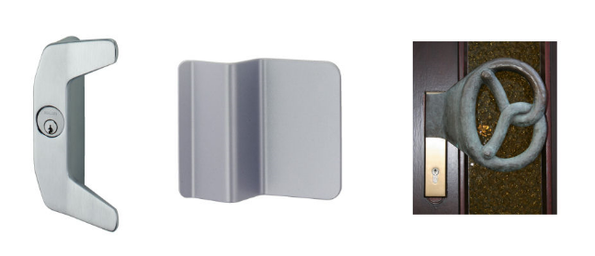
Pulls
Projection of pull is not specified by ADA or A117.1.
Pull should be open so hand can slide through.
Accessibility standards are not specific.
GOOD
???

Slide 46
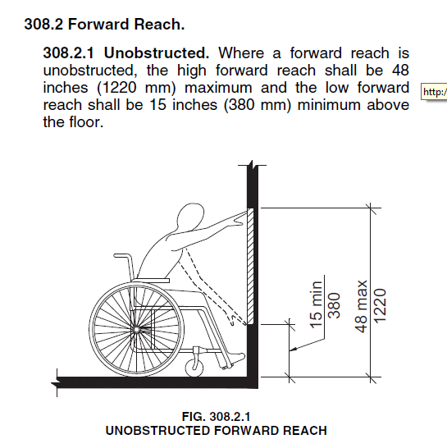
Hardware must be mounted between 34” and 48” AFF.

Slide 47
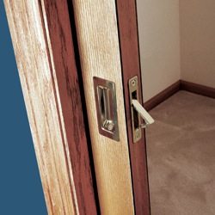
Sliding Doors
When fully open, operating hardware exposed and usable from both sides
Surface-mounted pulls are required, and the door does not retract fully into the pocket.
Affects clear opening width.
NOT Accessible

Slide 49
Closing Speed
P49

Slide 50
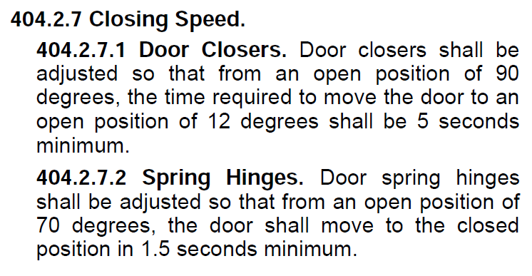

Slide 51
Opening Force
P51

Slide 52
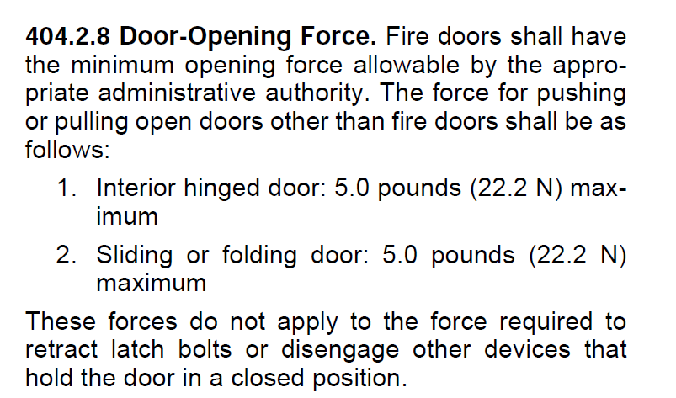

Slide 53
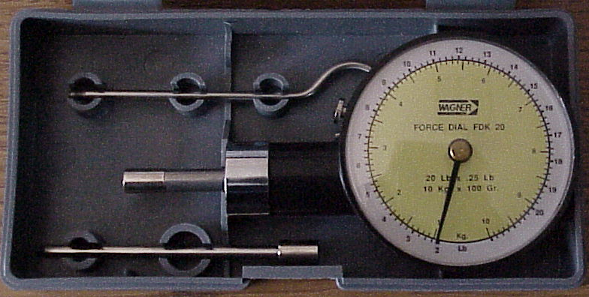
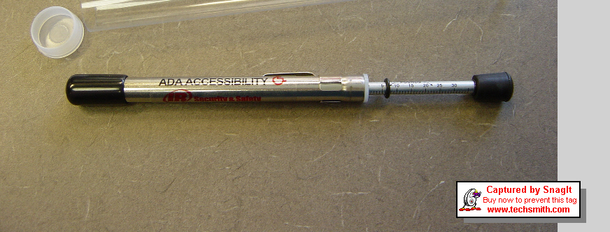

Slide 54
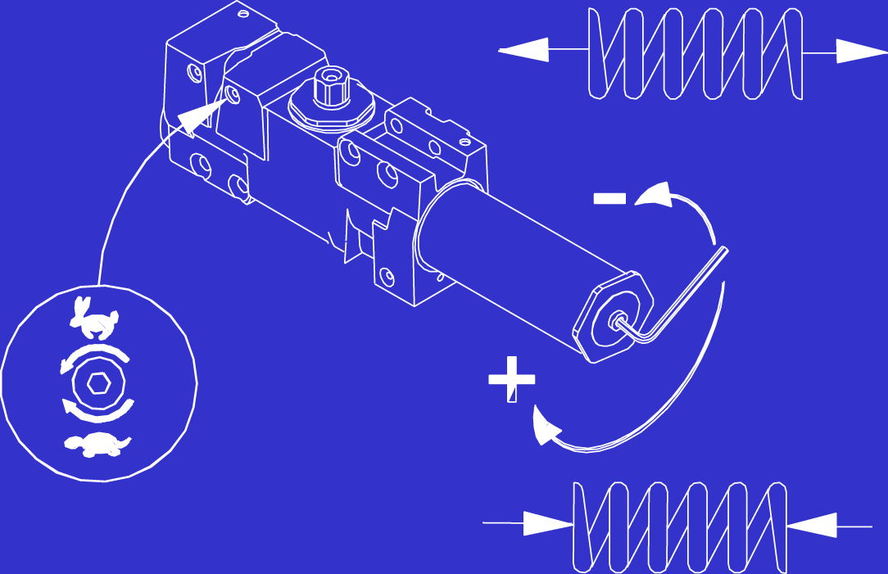
Adjustments of a Door Closer
Closing Speed
Closing Force

Slide 55
Door Surface
P55

Slide 56
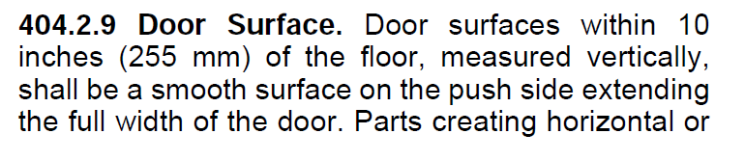
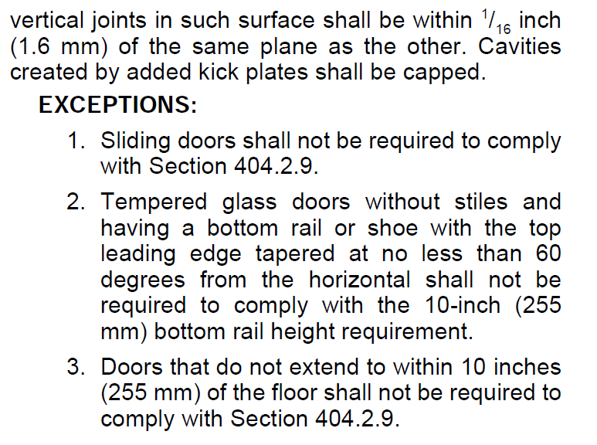

Slide 57
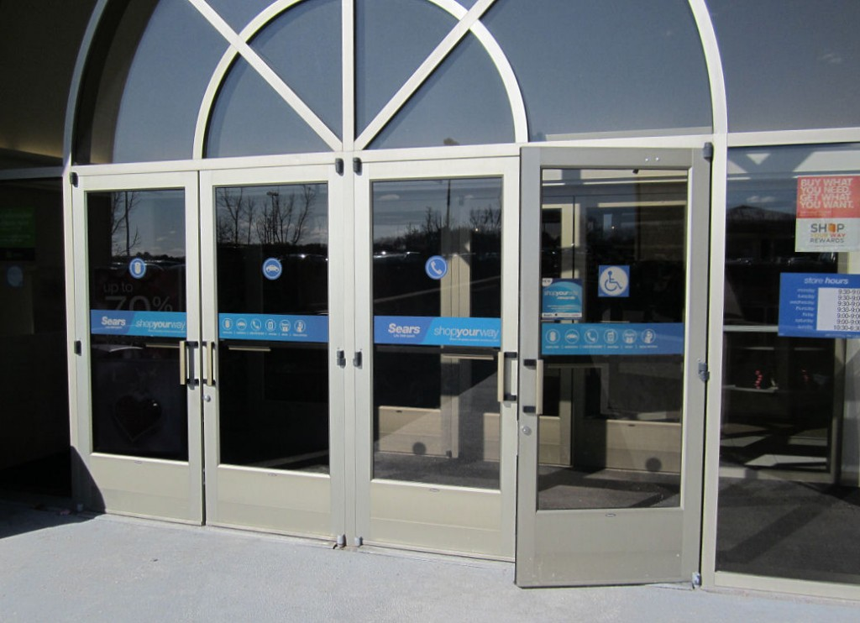


Slide 58


Slide 60
Vision Lites
P60

Slide 61


Slide 62



Slide 63


Slide 64



Slide 65

Power-Operated Doors
Full-Power Operated automatic doors – comply with ANSI/BHMA A156.10

Slide 66

Power-Operated Doors
Power-Assist and Low Energy – comply with ANSI/BHMA A156.19

Slide 67

Requirements of A156.19 for low energy operators
Initiated by a “knowing act”
    Wall- or jamb-mounted push button
    Touchless switches
    Opening the door
    Access control - keypad, card reader, keyswitch
  Low energy operators not initiated by a knowing act must follow the requirements of A156.10.

Slide 68
Requirements of A156.19
Knowing Act Switches
    1’ to 5’ from door preferred, 12’ maximum
    Accessible from swing side with door open
    User not in path of moving door
    User in full sight of door when activating switch
    34” to 48” a.f.f.

Slide 69
Requirements of A156.19
Open/close slowly
Stay open for 5 seconds
Closing Force – 15 pounds maximum
Opening Force
    15 pounds to release latch
    30 pounds to set door in motion
    15 pounds to fully open
Signage

Slide 70
Tactile Warning - UFAS
4.29.3* TACTILE WARNINGS ON DOORS TO HAZARDOUS AREAS. Doors that lead to areas that might prove dangerous to a blind person (for example, doors to loading platforms, boiler rooms, stages, and the like) shall be made identifiable to the touch by a textured surface on the door handle, knob, pull or other operating hardware. This textured surface may be made by knurling or roughing or by a material applied to the contact surface. Such textured surfaces shall not be provided for emergency exit doors or any doors other than those to hazardous areas.
This requirement does not appear in the ADA or A117.1.

Slide 71
2010 ADAAG – Automatic Doors (not in A117.1)
404.3.1 Clear Width. Doorways shall provide a clear opening of 32 inches (815 mm) minimum in power-on and power-off mode. The minimum clear width for automatic door systems in a doorway shall be based on the clear opening provided by all leaves in the open position.
404.3.2 Maneuvering Clearance. Clearances at power-assisted doors and gates shall comply with 404.2.4. Clearances at automatic doors and gates without standby power and serving an accessible means of egress shall comply with 404.2.4.
EXCEPTION: Where automatic doors and gates remain open in the power-off condition, compliance with 404.2.4 shall not be required.

Slide 72



Slide 73
2010 ADAAG - Operation
404.2.7 Door and Gate Hardware. Handles, pulls, latches, locks, and other operable parts on doors and gates shall comply with 309.4. Operable parts of such hardware shall be 34 inches (865 mm) minimum and 48 inches (1220 mm) maximum above the finish floor or ground. Where sliding doors are in the fully open position, operating hardware shall be exposed and usable from both sides.

Slide 74
2010 ADAAG - Operation
309.4 Operation. Operable parts shall be operable with one hand and shall not require tight grasping, pinching, or twisting of the wrist. The force required to activate operable parts shall be 5 pounds (22.2 N) maximum.
EXCEPTION: Gas pump nozzles shall not be required to provide operable parts that have an activating force of 5 pounds (22.2 N) maximum.

Slide 75



Slide 76
Session 1 – Intro & Accessibility
Brief overview of some codes and standards which impact the door and hardware industry.
Who is the AHJ?
Resources for code information.
How codes affect our business.
Code development process and tragic fires that have shaped current codes.
Accessibility Requirements

Slide 77
Session 1 – Intro & Accessibility
A117.1 vs. ADA vs. UFAS
Clear Width
Maneuvering Clearance
Hardware & Thresholds
Closing Speed & Opening Force
Flush Bottom Rail
Vision Lite Location

Slide 78
There are articles about all of these topics on iDigHardware.com.

Slide 79

P79

